Slide 1
Bayesian models of atypical sensory perception in autism
Queensland Brain Institute
Randeniya, R.¹, Vilares I.²,Tanksale R.¹, Mattingley J.B. ¹, Garrido M.I.³
1. The University of Queensland 2. The University of Minnesota 3.The University of Melbourne
contact : r.randeniya@uq.edu.au

Slide 2
Background
Atypical sensory perception such as sensory sensitivities, weak central coherence and intolerance of uncertainty is estimated to occur in as many as 90% of autistic individuals ¹.
Several Bayesian theories have been proposed to explain atypical sensory processing in autism but remains unresolved as to whether such disruptions are caused at the sensory level (likelihood) or in forming a weak model of the sensory environment (priors).
Posterior
Prior
Sensory observation/
Likelihood

Slide 3
Current Bayesian models of perception in Autism
Typical Learning:
Posterior
Prior
Sensory observation / Likelihood
Hypo-priors model (Pelicano & Burr, 2012)²:
Forming a weak model of the world (high variance in the prior) can increase reliance on new sensory observations
Precise likelihood model (Brock, 2012)³:
Less noise in new sensory observations (less variance) can increase reliance on new sensory observations
HIPPEA model (Van de Cruys et al. 2013)⁴:
The weighting of the difference between prior expectations and new information (i.e. prediction errors) is disrupted. Called high, inflexible precision of prediction errors (HIPPEA).

Slide 4
Research Questions
1. Do individuals with a diagnosis of autism spectrum disorder (ASD) rely more on new information (i.e. likelihood) vs their model of the world (i.e. priors) compared to neurotypical (NT) individuals?
2. Does the ASD group show differences in their prior and likelihood representations compared to the NT group?

Slide 5
Methods

Slide 6
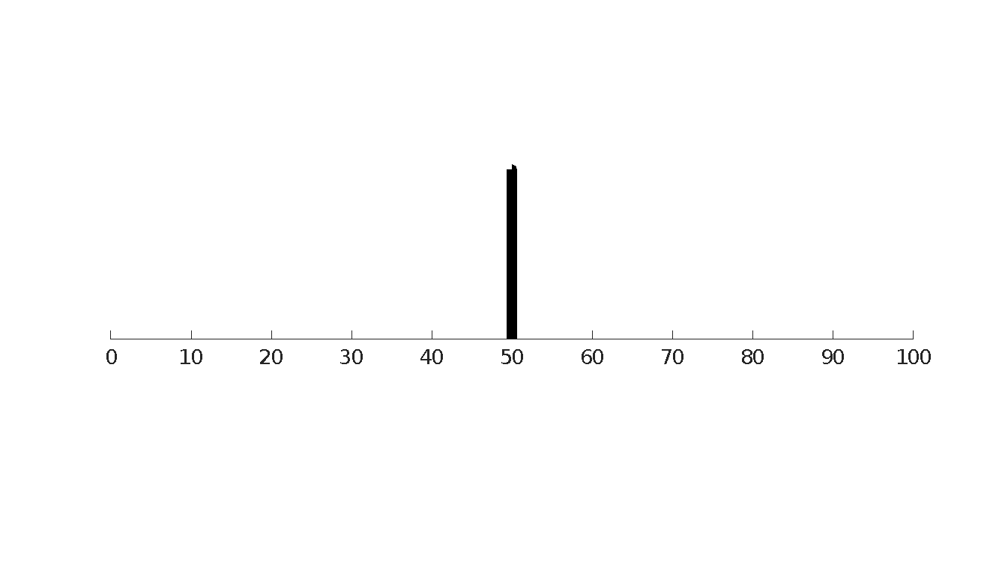
Behavioural Paradigm : Coin Task (Vilares et al. 2012)⁵
Participants were instructed that someone was throwing a coin to the centre of a pond (i.e. middle of the computer screen). They would see splashes the coin made each time and their job was to guess where the coin fell in. A single trial was as below:
1 -
1. Trial Start: Five blue dots (splashes / likelihood) shown
2 -
2. Participant moves the blue bar (net) to where they think the coin fell in
\\
3 -
3. Participants moves black bar to indicate their confidence
\\
4 -
4. True position of coin is shown
1500ms
1 -
1. New Trial

Slide 7
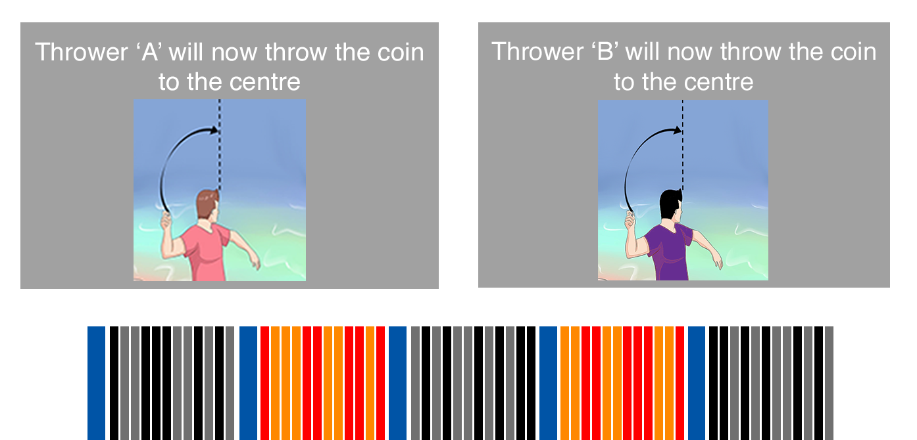
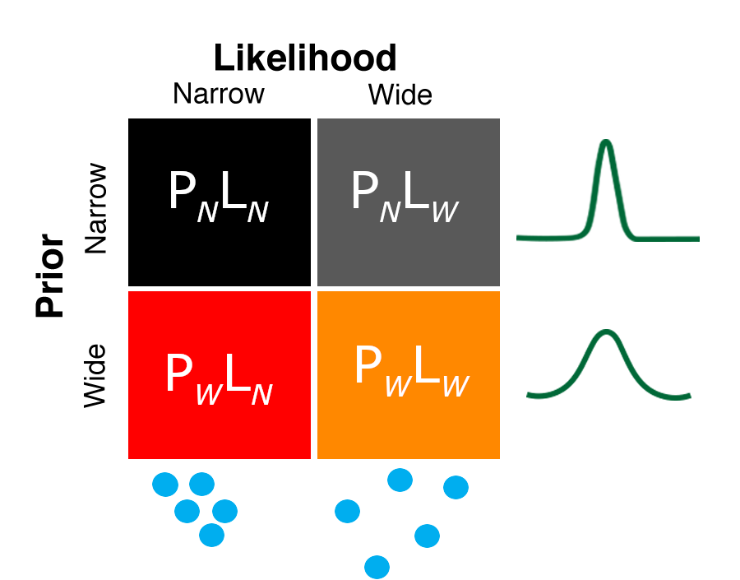
Coin Task: Trial Types
Participants were also told there would be two people throwing the coin and one thrower may be better than the other at throwing to the middle. (Figure 1)
Thus, there were four types of trials arising from a narrow or wide uncertainty of the Prior (i.e. thrower A or B) and a narrow or wide uncertainty of the likelihood (i.e. splashes) (Figure 2)
x12
~2 mins
per block
Figure 2 : Four types of trials
Narrow Prior
Block
Wide Prior
Block
Figure 1: Trials setup with 12 alternating blocks of each type of Prior

Slide 8
Procedure
Recruitment
NT = 48 and ASD = 32
Participants completed demographic, autism trait⁶, sensory sensitivities⁷, anxiety⁸ and depression⁹ questionnaires (~30mins)
Practice Task (~10mins)
Main experimental session (~1 hr.)
Participants completed the Coin-Task described in previous slides
Participants completed the task while undergoing a magnetic resonance imaging (MRI) scan or outside of the scanner at a computer
‘No Prior’ Task (~15mins)
Participants estimated the middle of the five blue dots (i.e. splashes), the variance of these estimates was obtained as the likelihood variance
Participants completed this task outside of the MRI.

Slide 9
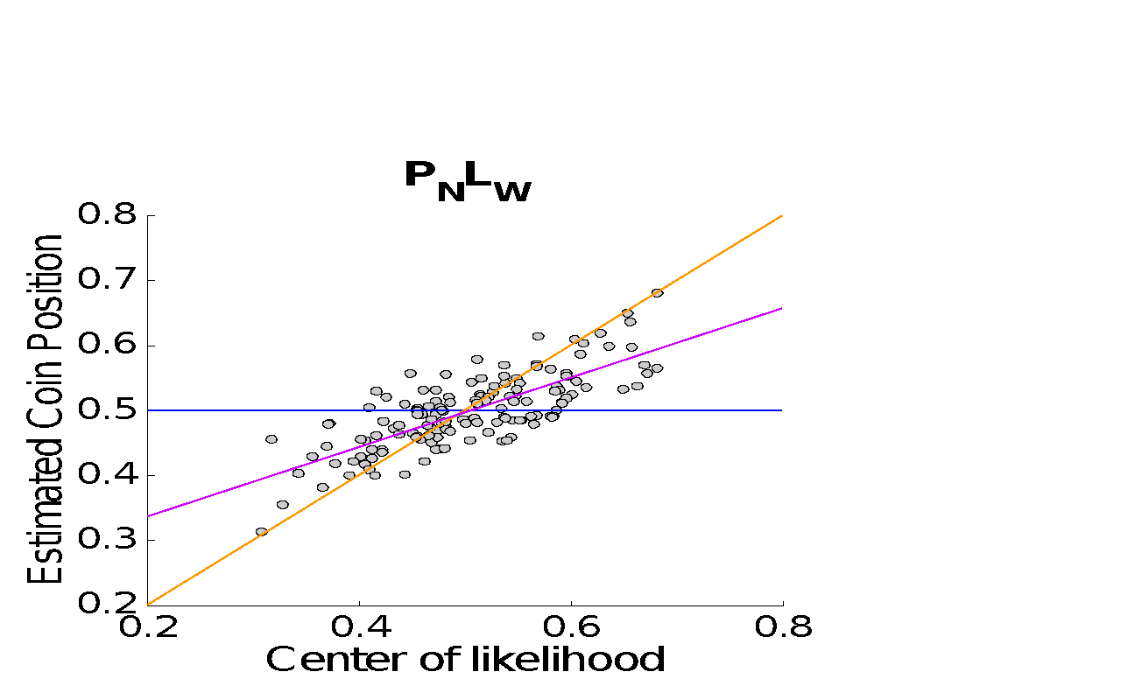
Calculating participant’s Likelihood Reliance and Prior Variance
(For more details on modelling Likelihood Reliance & Prior Variance see : Körding et al. 2004 / Vilares et al. 2012)
For each condition we can regress the participant’s estimates of the position of the coin on the true centre of the likelihood for each trial :
If slope = 1
Regression line, slope = 0.69
If slope = 0
The slope of the regression can be used as a measure of ‘Likelihood Reliance’:
If the slope → 1, participants rely highly on the likelihood
slope → 0, participants rely highly on the prior information
Using the slope of the regression, and an estimate of participants likelihood variance (σ²_{L}) from the ‘No Prior’ task we can calculate participants subjective prior variance (σ²_{P} ), as follows:
σ²_{P} = σ²_{L}* slope / (1- slope)

Slide 10
Results

Slide 11
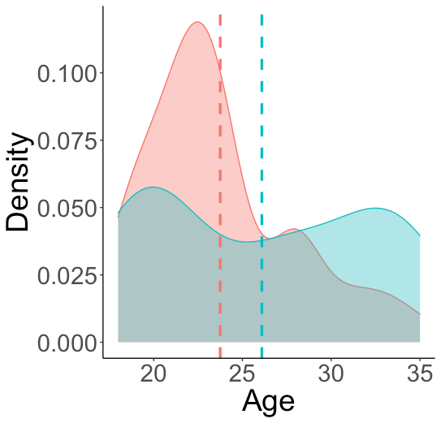
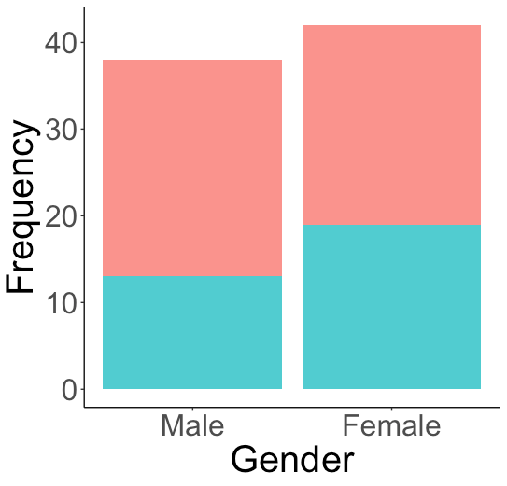
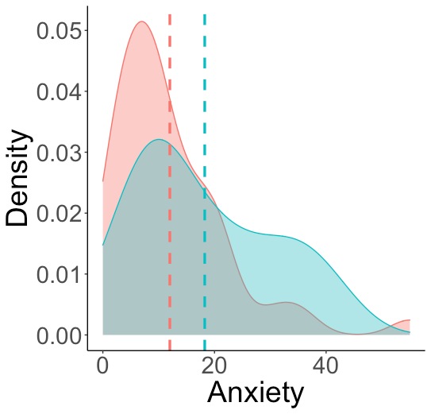
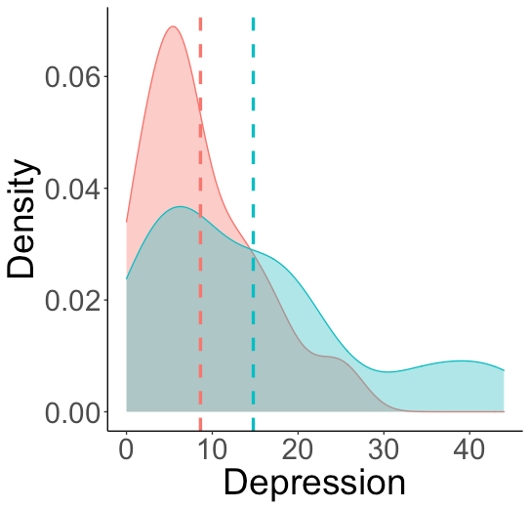
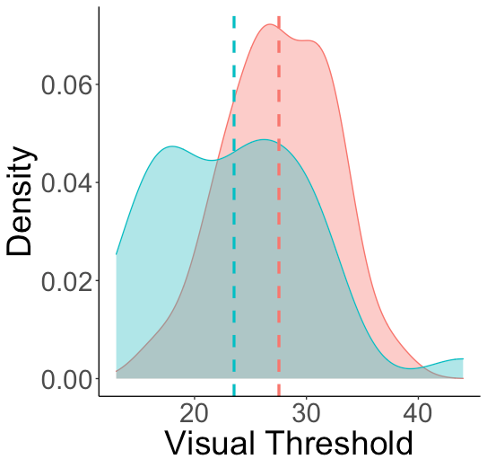
Demographic profile of participants
ASD = 32
NT = 48
Dashed lines indicate group means
Hypersensitivities increase
ASD group showed significantly more anxiety (t = -2.417, p = 0.018) and depression (t = -2.848, p = 0.018) and were older (t = -2.030, p = 0.046) than the NT group, thus these were included as covariates in further analyses

Slide 12
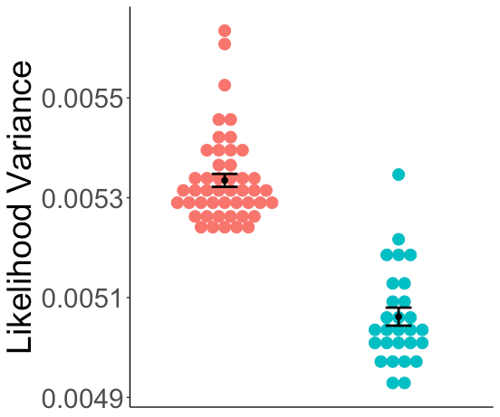
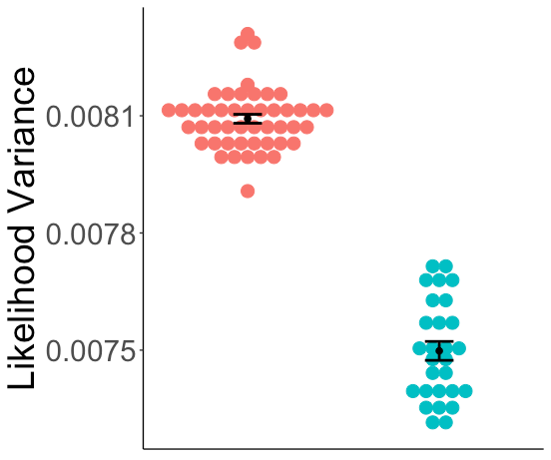
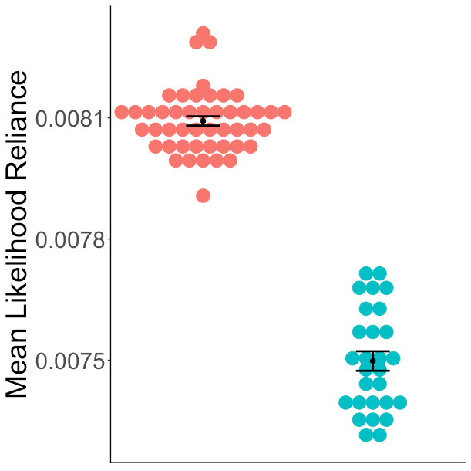
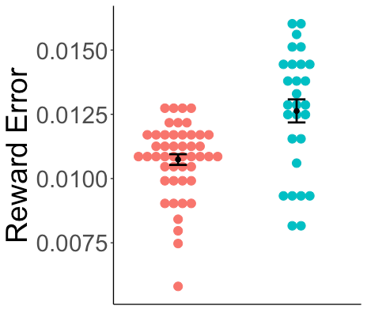
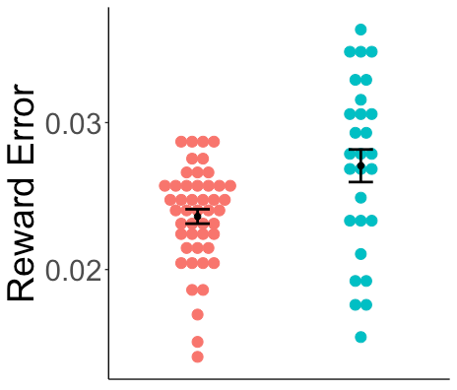
Narrower likelihood variance for ASD in the ‘No-Prior’ Task
The ASD group showed narrow likelihood variance compared to the NT group
Narrow
Wide
ASD
NT
F = 13.214,
p = <0.001**
F = 5.782
p = 0.019*
The ASD group showed less accuracy (more errors) in the estimated likelihood
Narrow
Wide
F = 6.301
p = 0.014*
F = 5.118
p = 0.027*
Mean +/- 95% CI shown
Note: Values displayed are predicted values from multivariate models accounting for age, anxiety, depression and average time spent on each trial

Slide 13
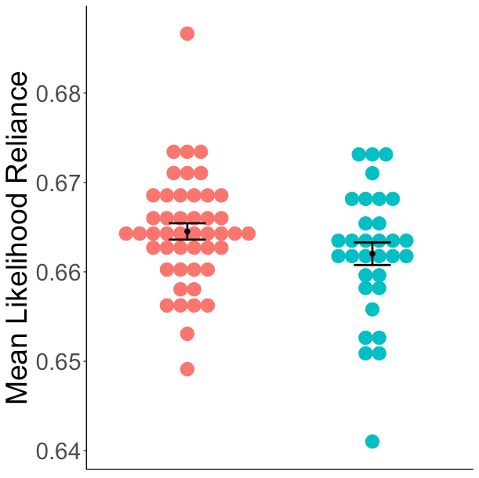
No group differences in likelihood reliance
F = 0.016
p =0.900
ASD
NT
We also found no differences in the accuracy between groups on the main task
⧧Model accounts for age, anxiety, depression

Slide 14
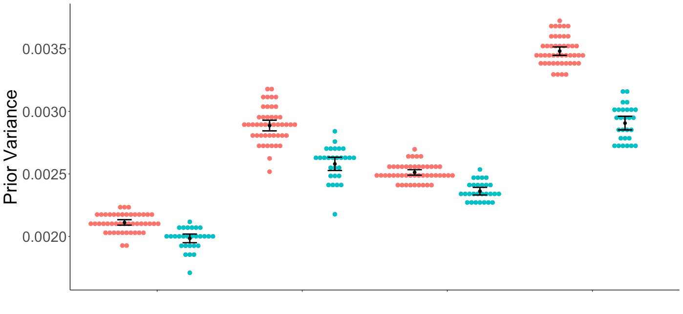
Narrower subjective priors in ASD when the prior is wide
Only for conditions with a high prior uncertainty (P_{W}), the ASD group showed significantly narrow subjective prior variance compared to the NT group.
ASD
NT
F = 11.844
p = 0.001**
Mean +/- 95% CI shown
F = 2.090
p = 0.153
F = 4.990,
p = 0.029*
F = 0.575
p = 0.451
P_{N}L_{N}
P_{N}L_{W}
P_{W}L_{N}
P_{W}L_{W}
⧧Models account for age, anxiety, depression

Slide 15
Conclusions
Unexpectedly, the task did not find any differences between ASD and NT groups on likelihood reliance.
The ASD group showed narrow variance of their likelihood estimates compared to the NT group as described by the ‘Precise Likelihood Model’³.
Contrary to the above model however the ASD group did not show increased reliance on the likelihood but also showed narrow priors related to this task.
This may be instead explained by the high, inflexible precision of prediction errors (HIPPEA) model⁴ as below:
narrow priors
narrow likelihood

