Slide 1
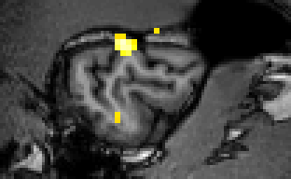
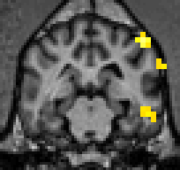
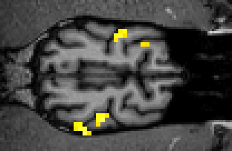
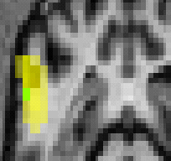
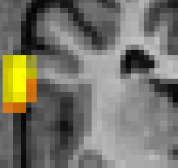
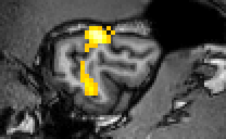
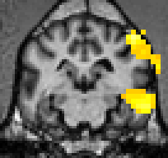
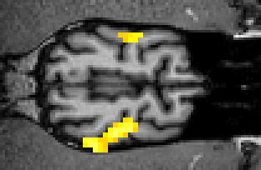
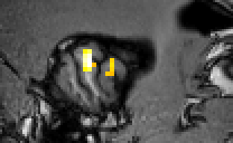
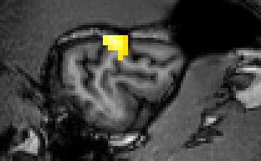
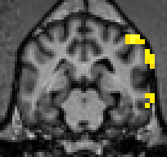
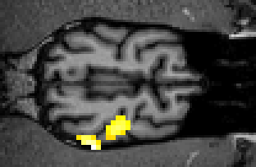
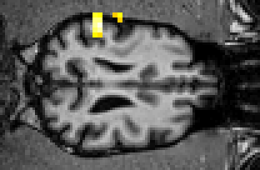
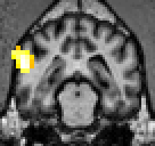
Language discrimination in dogs – an fMRI study on the effects of immersion in a new language
Marianna Boros¹, Laura Verónica Cuaya¹, Andrea Deme²,
Raúl Hernández-Perez¹, Attila Andics¹
¹ MTA-ELTE ‘Lendület’ Neuroethology of Communication Research Group,
² MTA-ELTE ‘Lendület’ Lingual Articulation Research Group
marianna.cs.boros@gmail.com
Introduction
Human infants are learning one word per waking hour at the peak period of language acquisition¹. Doing that effortlessly is enabling them to get from babbling at 6 months of age to full sentences by the age of 3 years². They are tuned to spoken language from birth and use computational strategies to detect the statistical and prosodic patterns in language input³.
In contrast there is a limit to language capacity in non-human species in terms of vocabulary, achieving symbolic communication ability and reciprocal receptive behaviors⁴.
However similarly to infants there is evidence for:
language discrimination by cotton-up tamarins⁵ and rats⁶;
sensitivity to transitional probabilities in cotton-up tamarins⁷ and rats⁸.
Dogs live in the same language environment as humans, they attend to spoken words and process them similarly to humans^{9,10}. Consequetly the aim of the present study is to investigate if a neural attunement to the surrounding language can be observed in dogs, similarly to humans.
Method
Subjects N = 2 Mexican dogs recently moved to Hungary
Design Longitudinal fMRI study on language immersion:
Scanning every 1,5 moths (first scanning within the first month of their arrival)
Segmental experiment: pseudowords (not presented here)
Suprasegmental experiment: excerpt from the Little Prince
Stimuli 3 languages with different phonetic structures and intonations:
‘Native language’ – Mexican Spanish
Immersion language – Hungarian
No contact language – Polish
Aquisition details Sparse sampling, 8 channel coil
Results
T1
T3 - T1
Spanish
Spanish
Hungarian
Hungarian
Polish
Polish
Conclusions
Rigth hemispheric activation for human language (see Andics et al, 2016)
More extended activations for the novel but not for the unknown language – learning?
Traces of neural specialization for the familiarity effect
References
Acknowledgements
Berwick et al., 2012
Kuhl, 2003
Saffran et al., 1996
Savage-Rumbaugh, Rumbaugh and Boysen, 1980
Ramus et al, 2001
Toro et al. 2005
Hauser et al., 2001
Toro et al. 2003
Andics et al 2014
Andics et al., 2016
Funded by the Hungarian National Academy of Science
Lendület grant no LP2017 - 13/2017
awarded to Attila Andics

