Slide 1
Strengthening Authentication to Adapt to Changing Circumstances®
Presented By Stephanie Urquhart
Internal Sales Assistant, PistolStar Inc.

Slide 2
What is PortalGuard?
PortalGuard is an authentication and security solution that allows end-users to securely authenticate and manage their portal login credentials directly from a Web browser, while providing administrators with functionality to meet or exceed their security objectives.
PortalGuard supports multiple platforms and portals including Websphere/Websphere Portal, SharePoint/IIS, and Lotus Domino.

Slide 3
Why Use PortalGuard?
PortalGuard is the solution for confronting your security challenges:
Achieve Stronger Authentication
Reduce Risk – Security and Financial
Enhance Compliance with Security and Industry Standards
Deliver Effective Password Policies
Does this describe your environment?
Growing number of Web and enterprise applications raising the number of password stores and sets of password policies you need to manage.
Keeping up with the speed of business entails providing globally and remotely-based employees, customers, partners and vendors with streamlined access to corporate intranets and extranets.

Slide 4
Many Configurable Password and Authentication Features…
Self-service Active Directory Password Reset and Recovery– Highly configurable and secure challenge question and answer functionality
Single password using Microsoft Active Directory – Have fewer passwords to remember and manage
One-time password (OTP) – Offers a strong two-factor approach to authentication
Verbal authentication to the help desk – By providing highly configurable challenge question and answer functionality
Prevent multiple users from logging in with the same credentials
Define strike-out limits by person, group or hierarchy – Alerts are emailed when strike-out limits are exceeded
And many more…

Slide 5
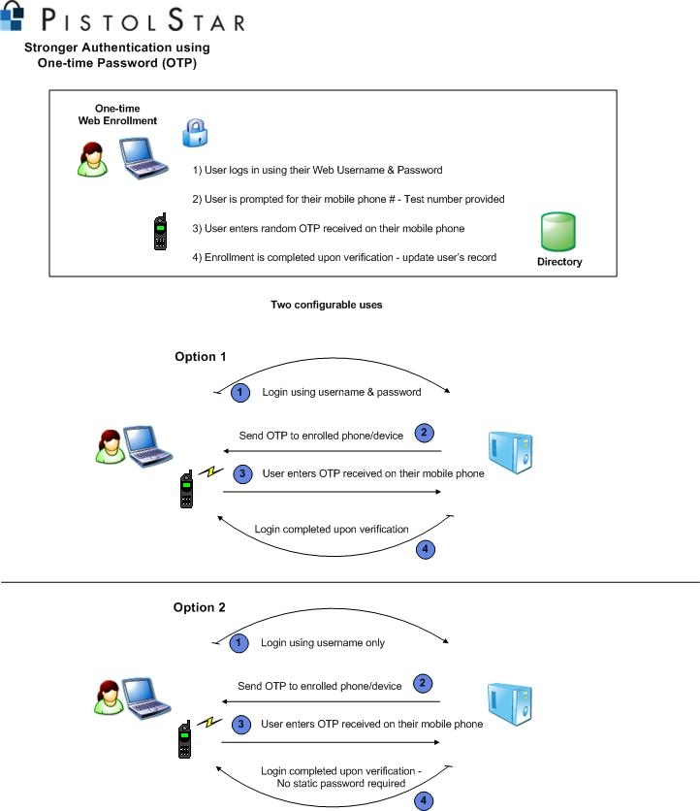
A Technical Look At… One-time Password (OTP) Functionality

Slide 6
An Overview Of…
Benefits for Multiple User Groups:
For End-Users – Maintaining Productivity
For Administrators – Avoiding Increased Help Desk Calls
For Management – Stopping Hackers in Their Tracks
Advantages for Numerous Industries:
Financial
Government
Healthcare
Manufacturing
Education
Non-profit
Insurance
And many more…

Slide 7
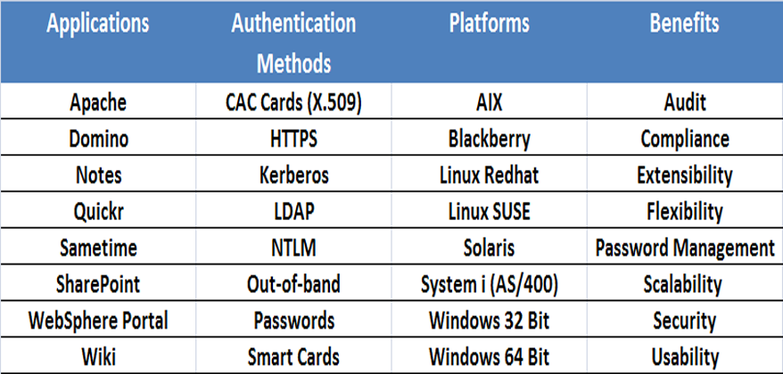
Extensible Authentication Framework
ALL PistolStar Authentication Solutions Are:
Enterprise Ready
Proven Products
Come from a vendor who has been in the business of authentication over 10 years
Available with unprecedented support directly from the developers
Tailored Authentication
For an environment and/or situation, which requires specific authentication functionality, our team would make the necessary adaptations to meet or exceed security objectives, and provide you with a fully supported solution.
Matrix for Authentication Technologies

Slide 8
More Than 475 Customers Worldwide…
About PistolStar, Inc.
Founded in 1999 as a consulting company
Authority in Tailored Authentication solutions
Reactive to customer driven requirements
Experience across numerous platforms and applications including SharePoint/IIS, WebSphere, and Domino.
The PistolStar Advantage
Tailored Authentication: we deliver a product that will fit precisely with your environment
Excellent Customer Service: receive support directly from the developers
Easy Deployments: let us take you by the hand

