Slide 1
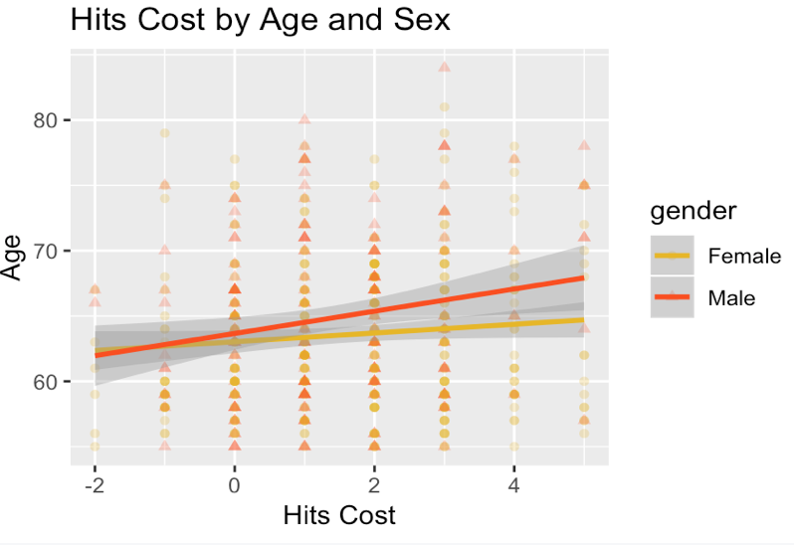
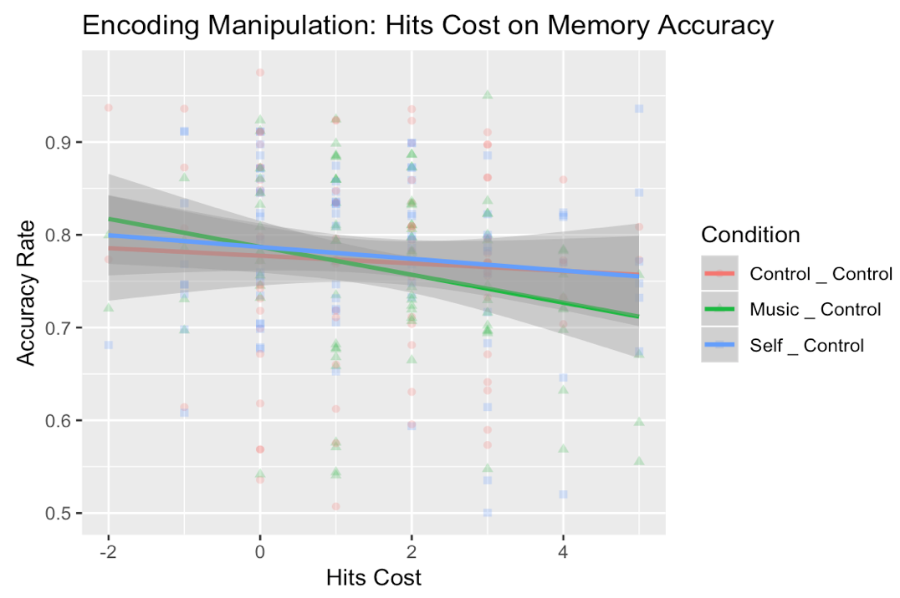
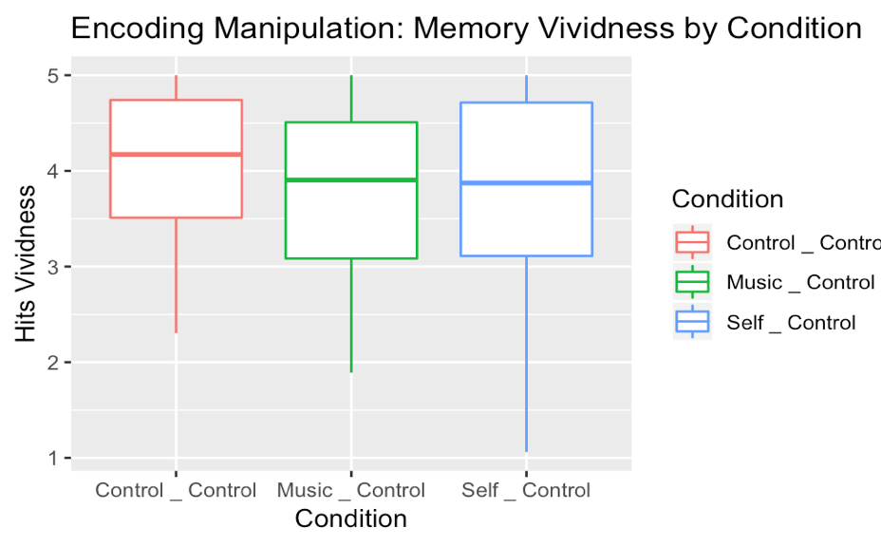
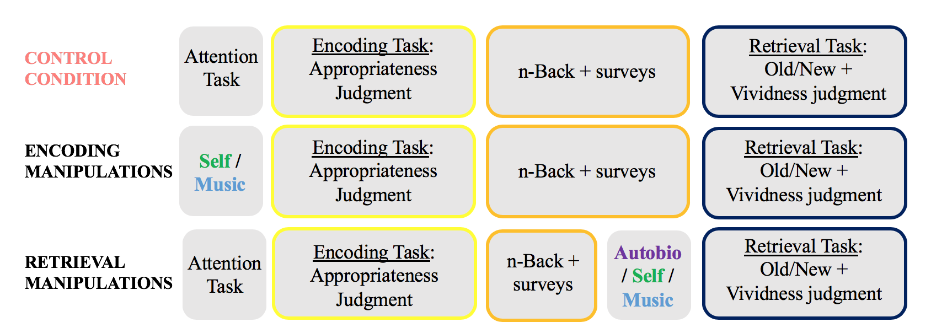
Utilizing socioemotional processing to alter older adults’ memory:
Implications for individual differences in cognition
Rachel Van Boxtel, Jaclyn H. Ford¹, & Elizabeth A. Kensinger¹
¹Department of Psychology and Neuroscience, Boston College
INTRODUCTION
Healthy aging is associated with a characteristic decline in working memory and ability to learn new information, possibly due to age-related degradation of the prefrontal cortex¹
Younger adults engage the lateral PFC when engaging in successful recall, this may become less efficacious with age²
These regions might be able to be bypassed by engaging the medial PFC³
The medial PFC is associated with memories in both socioemotional relevance and music^{4,5}
Therefore, it may be able to be primed utilizing socioemotional tasks prior to encoding or retrieval
n-Back is a cognitive test used to assess individual working memory ability
Do individual cognitive differences influence the extent to which manipulations prior to encoding or retrieval affect performance on a memory task?
RESULTS
n-Back: Correlations with Demographic Variables
Performance on n-back associated with
age (p=0.003)
Significant correlation between age and n-back hits cost (r=0.119, p=0.006).
sex (p=0.022)
A smaller mean for Hits Cost for males compared to females
Performance on n-back was not correlated with education level
ENCODING MANIPULATIONS: Memory Performance & Individual Cognitive Differences
Accuracy Rate:
Main effect of n-back performance measures
Hits Cost (df = 1, F = 5.46, p = 0.02)
Response Time Cost (df = 1, F = 8.96, p = 0.003)
No main effect of condition
No interactions between memory task accuracy rate and individual differences in working memory ability (n-back costs)
Hits vividness:
Main effect of condition, but in unexpected direction
means = 4.05 (control), 3.76 (music), 3.79 (self-reference)
No interactions with vividness ratings on hits and individual working memory ability
?
>
Older adult brains primed to utilize the mPFC
Older adults relying on degraded lPFC
sex
Key:
correct
incorrect
0-back
TARGET LETTER:
K
K
V
P
R
K
n-Back Costs⁶: difference in performance between 0-back and 2-back
2-back
K
V
K
R
O
P
L
P
E
M
X
METHODS
Participants: 522 (M_{age}=64.02, SD=5.95, 55-94 years; 336 female) recruited via Amazon Mechanical Turk
Task Procedure:
Participants shown 80 title-image pairs of neutral valence and asked to rate appropriateness of titles; they were later asked to retrieve these titles
Randomly assigned to an encoding or retrieval manipulation
Analysis:
n-Back:
Response Time Cost – 2-back minus 0-back response times
Hits Cost – 0-back minus 2-back hits
How is n-back costs related to demographics (age, biological sex, education)?
ANCOVA:
Effect of manipulation condition on participant’s memory accuracy and vividness
Interactions of n-back costs with condition on memory performance
CONCLUSIONS
n-Back performance has reliable demographic differences, with decreased performance with increasing age, along with sex differences.
Effect of Condition only plays a role in the vividness of memory, and with mixed results for the effects of manipulations compared to controls
Timing of Manipulations mattered in the significance of effects
Encoding Manipulations showed many more main effects effects of the following categories:
n-back costs (both Hits Cost and Response Time Cost) on Memory Accuracy Rate
Effect of condition on Memory Hits Vividness
No significant effects of condition were seen in the Retrieval Manipulation conditions
Response Time Cost on Memory Accuracy driven by opposite directionality between 2-back and 0-back response times
Future work will utilize in-person behavioral and fMRI testing to examine these learning strategies in older adults
Are older adults able to access an online study less representative of memory performance of the general older adult population?
What structural or mechanistic individual differences characterize these individuals’ memory?
REFERENCES
1. Raz, N., Gunning, F.M., Head, D., Dupuis, J.H., McQuain, J., Briggs, S.D. (1997). Selective aging of the human cerebral cortex observed in vivo: differential vulnerability of the prefrontal gray matter. Cerebr. Cortex, 7 (3) (1997), pp. 268-282 2. Grady, C.L. (2008) Cognitive neuroscience of aging. Ann NY Acad Sci, 1124 (1)), pp. 127-144 3. MacPherson, S.E., Phillips, L.H., Della Sala S. (2002). Age, executive function, and social decision making: a dorsolateral prefrontal theory of cognitive aging. Psychol Aging, 17(4): 598-609. 4. Gutchess, A., & Kensinger, E. A. (2018). Shared Mechanisms May Support Mnemonic Benefits from Self-Referencing and Emotion. Trends in cognitive sciences, 22(8), 712–724. doi:10.1016/j.tics.2018.05.001 5. Janata, P. (2009). The neural architecture of music-evoked autobiographical memories. Cerebral Cortex, 19, 2579-2594. 6. Bopp, K.L., & Verhaegen, P. (2020). Aging and n-Back Performance: A Meta-Analysis. J Gerontol B Psychol Sci Soc Sci, 2020, Vol. 75, No. 2, 229–240.
ACKNOWLEDGMENTS
The authors would like to thank Ryan Daley and Erin Welch for their help collecting and analyzing data for this project. This work was supported by funding from NSF SOL1823795.
Notes:
Would you like a walk through?
Would you like a short version or an elaborated version? 1 minute vs 3 minutes
What piqued your interest in this?
This could indicate that there are actual effects between how the manipulations
Do the encoding manipulations effect n-back performances, the mean hit cost and mean response time cost… then look at if those three sets of mean are the same or if the means are actually different!!!! ANOVA (put in the means of hits !!!!)
Future work: younger adults performing better than the older adults on the n-back

