Slide 1
Notes:
Thank you for taking time out of your busy day to join us.
We are going to discuss implementing OEM, how we setup different templates to create meaningful actionable alerts, and how we have developed the Alert optimizer tool to help us maintain and manage OEM alert volumes.
First I will talk about implementing OEM out of the box.
Next, John Kaufling will walk you through OEM Templates, Thresholds, Metrics and Policies
And Chet Szatkowski will wrap everything up by taking us through how to maintain OEM with our Alert optimizer tool and walking you through a customer example where we use the Alert optimizer to each and every week to improve the information coming out of OEM as well as control the alert volumes

Slide 2
Topics
Implementing OEM out of the box
OEM Monitoring Templates
OEM Thresholds, Metrics, and Policies
Maintaining OEM with Datavail’s Alert Optimizer
Case Study
Notes:
Thank you for taking time out of your busy day to join us.
We are going to discuss implementing OEM, how we setup different templates to create meaningful actionable alerts, and how we have developed the Alert optimizer tool to help us maintain and manage OEM alert volumes.
First I will talk about implementing OEM out of the box.
Next, John Kaufling will walk you through OEM Templates, Thresholds, Metrics and Policies
And Chet Szatkowski will wrap everything up by taking us through how to maintain OEM with our Alert optimizer tool and walking you through a customer example where we use the Alert optimizer to each and every week to improve the information coming out of OEM as well as control the alert volumes

Slide 3
Implementing Oracle Enterprise Manager

Slide 4
Why OEM?
No additional licensing cost unless you use the tuning pack, diagnostic packs, or EBS plugin.
Detects negative impact situations on system performance and allows them to be corrected before the impact is felt.
Monitor from the lowest level host server key- performance-metrics, to the Oracle middle-tier components such as Web Application Servers and Oracle Workflow processes, through the system response time of an Oracle web page can be configured for monitoring in real time.
Notes:
Why do we use OEM to monitor oracle databases, database servers, application servers, storage, etc.
It is an oracle developed product. What better tool to monitor an oracle database than a tool developed by oracle.
OEM allows you to manage Oracle‘s complete software and hardware stack, from applications-to-disk.
IT organizations are coping with more and more complexity than ever before. We are facing issues Issues ranging from growing data volumes, to composite applications, to virtualization and how best utilize the Cloud. Managing all these systems and services 24x7 is a giant challenge and constant battle for IT.
Oracle Enterprise Manager provides an integrated console that gives IT departments business visibility and comprehensive IT management across the stack. In short, it integrates IT management with business applications and systems. This integration enables IT to gain unobstructed views of business transactions and the business-user experience. As a result, IT professionals can focus their efforts where they will have the greatest positive impact on the business.
Allows for the detection of situations which might have a negative impact on overall system performance and allows these situations to be corrected before the impact causes the user community to be exposed to the system performance event.

Slide 5
Configuring and Deploying OEM Grid
The OEM Management Agents are installed on the target hosts.
The Oracle Management Server can then automatically detect and configure the Management Agents and discover the various targets (the host itself, databases, OC4Js, Web servers etc.,) running on any particular host on which the agent itself is running.
Using these configured agents, the Management Server is configured via its Administrative Web interface to collect various metrics from hosts, Web Servers, and, using optional Oracle EBS plug-ins, key parameters of the EBS architecture itself.
For all configured agents metrics, key performance metric thresholds can be set so that an “alert” is generated when the current value of the monitored metric.
Notes:
The OEM Management Agents are installed on the target hosts.
The Oracle Management Server can then automatically detect and configure the Management Agents and discover the various targets (the host itself, databases, OC4Js, Web servers etc.,) running on any particular host on which the agent itself is running.
Using these configured agents, the Management Server is configured via its Administrative Web interface to collect various metrics from hosts, Web Servers, and, using optional Oracle EBS plug-ins, key parameters of the EBS architecture itself.
For all configured agents metrics, key performance metric thresholds can be set so that an “alert” is generated when the current value of the monitored metric.

Slide 6
Configuring and Deploying OEM
OEM Grid provides detailed information on the current status of all configured targets . The status of the configured “alerts” for various targets and target-types are also cleanly summarized in a “dashboard” so that any issues present can be easily detected, analyzed, and addressed in a forward-looking manner.
Groups of targets can be associated with each others as “Systems” to collectively show the health of an overall environment as well as its lower-level components/targets.
Notes:
OEM Grid provides detailed information on the current status of all configured targets. The status of the configured “alerts” for various targets and target-types are also cleanly summarized in a “dashboard” so that any issues present can be easily detected, analyzed, and addressed in a forward-looking manner.
Groups of targets can be associated with each others as “Systems” to collectively show the health of an overall environment as well as its lower-level components/targets.

Slide 7
Configuring and Deploying OEM
Notes:
As you can see in this dashboard view, you are quickly able to see a red light green status of the targets along with the number of alerts that have been generated.

Slide 8
OEM Notifications and Alerts
OEM Grid can be configured to have alerts trigger specific actions; including a “Corrective Action” , notifications via email / SMS, the creation of a service organization’s “Ticketing System” ticket, or any other similar action.
“Corrective Actions” for an alert can be user defined and allow for an automatic response to a specific alert. For example -- an automatic re-compilation of database objects which have become “invalid” etc.
Notes:
As many of you know, just turning on OEM out of the box can very quickly overwhelm you if with alerts notifications especially if you have hundreds or thousands of targets in your environment

Slide 9
OEM Notifications and Alerts
Using these notifications allows for a seamless end-to-end tracking system to be deployed which documents the lifecycle of any performance event for historical analysis of the response time to an event, the details analysis performed, and the remedies which were ultimately actioned by the Datavail DBA teams.
OEM keeps a history of the generated alerts so that, if properly queried from the repository using Datavail’s Alert Optimizer, the alerts can be reviewed on a regular basis allowing trends in the recurrence of specific alerts, or groups of alerts, from specific targets or systems to be visually detected and ultimately corrected from recurring in large volumes.
Notes:
Using these notifications in conjunction with a ticketing system allows for a seamless end-to-end tracking of any performance event for historical analysis of the response time to an event, the detailed analysis performed, and the remedies which were ultimately actioned by the DBA teams.
Many times OEM is not implemented in conjunction with a ticketing system to track all alerts that a DBA or DBA team are addressing.
One of the benefits of our Alert Optimizer tool is the ability to visual show how many alerts or notifications are coming from OEM.
If OEM notifications are only going to a DBAs mailbox or to a mailbox monitored by a DBA team no one else will has visibilty to the alert volumetrics being generated by OEM.
The history within the OEM repository is what allowed us to develop the Alert Optimizer for our customers. The alert history allows us to trend alerts over many different timelines and allows us to pinpoint where the “noise” is coming from in relation to targets, metrics, and policies

Slide 10
Oracle Enterprise Templates

Slide 11
OEM Templates
Many OEM implementations use the Oracle provided templates with very little customization.
Datavail has found it is better to create customized templates suited to your business needs.
Production and non-production
Production, test, qa, staging, dev
Data Warehouse, OLTP
Application A, Application B, Application C
Allows you to customize thresholds and metrics for an environment or application.
Not all systems are created equally and should not be monitored the same.
Space thresholds that trigger at 90% for an OLTP system are usually not adequate for a data warehouse database.
At 90% used on a data warehouse, there could still be several terabytes of free space.
Notes:
Many times OEM grid is implemented out of the box with very little customization to the templates. This can quickly lead to the “boy that cried wolf” situation because of the copious generation of non actionable alerts.
Many DBAs may ask, what is the advantage of creating templates?
Monitoring templates simplify the task of standardizing monitoring settings across your enterprise by allowing you to specify the monitoring settings once and apply them to your monitored targets.
This makes it easy for you to apply specific monitoring settings to specific classes of targets throughout your enterprise.
For example, you can define one monitoring template for test databases and another monitoring template for production databases.
Taking the time to create the separate templates allows us to have to customize thresholds and metrics for an environment or application
As you know, not all systems are created equally and should not be monitored the same.

Slide 12
OEM Templates
What are the critical database components to have in your templates?
Alert.log errrors
Database up/down
ASM database up/down
Listener up/down
Server up/down
Cluster component status
ASM space
Filesystem space
Tablespace space
Archive log dest space
Recovery file dest space
Notes:
Out of the box OEM templates may have thresholds, metrics, or polices that be set at levels the are too narrow or too wide.
Customizing OEM templates across our customer base has given us unique in-site in what we should include in our templates. So much of the time we disable many metrics and policies to get us down to monitoring the basics that are critical to supporting an oracle database.
The basics we encourage our customers to use are shown here.
As mentioned earlier, some metric thresholds come predefined out-of-box.
While these values are acceptable for most monitoring conditions, your environment may require that you customize threshold values to more accurately reflect the operational norms of your environment.
Setting accurate threshold values, however, may be more challenging for certain categories of metrics such as performance metrics.
Monitoring session wait events and response time events can generate hundreds to thousands of non actionable alerts.
For example, what are appropriate warning and critical thresholds for the Response Time Per Transaction database metric?
For such metrics, it might make more sense to be alerted when the monitored values for the performance metric deviates from normal behavior.
Enterprise Manager provides features to enable you to capture normal performance behavior for a target and determine thresholds that are deviations from that performance norm.
As Chet will show you in a few minutes, you really need a tool like Datavail’s Alert Optimizer to identify where the alerts are coming from.

Slide 13
Getting More from OEM
Using Oracle’s Enterprise Manager Grid Control in combination with PL/SQL scripts which were custom developed by Datavail for Oracle’s E-Business Suite, an EBS environment can also be monitored in real-time for significant performance-impacting events.
The Complete EBS architecture, from the lowest level host server key- performance-metrics like CPU and memory consumption, to the EBS middle-tier components such as Web Application Servers and Oracle Workflow processes, all the way up to the system response time of an EBS module’s web page can be configured for monitoring in real time.
Notes:
User-defined metrics allow you to extend the reach of Enterprise Manager's monitoring to conditions specific to particular environments via custom scripts or SQL queries and function calls. Once a user-defined metric is defined, it will be monitored, aggregated in the repository, and can trigger alerts like any other metric in Enterprise Manager. There are two types of user-defined metrics: Operating System and SQL.
Operating System (OS) User-Defined Metrics: Accessed from Host target home pages, these user-defined metrics allow you to implement custom monitoring functions via OS scripts.
SQL User-Defined Metrics: Accessed from the Database target home pages, these user-defined metrics allow you to implement custom database monitoring using SQL queries or function calls.
Now

Slide 15
Maintaining OEM
OEM is ready for prime time…. but how do you keep it tuned and working efficiently?
OEM is not a turn it on and forget it monitoring tool.
Analyzing patterns, within hundreds of alerts per day, becomes difficult without some sort of data grouping, filtering, and sorting which is currently unavailable in Oracle’s OEM Grid Control software. This is why we developed the Alert Optimizer to “reduce the noise”.
Notes:
Our experience gained as a result of our partnership with several large OEM Grid installations, some of which include thousands of individual target objects being monitored, Datavail has developed unique tools to analyze the volume and distribution of configured alerts generated by OEM.

Slide 16
Maintaining OEM
The Alert Optimizer allows the clustering of alert history to be arranged chronologically, by system, by target, and by metric-type, amongst many other parameters returned from the repository for each individual alert.
Organizing the alerts by the categories below quickly allows us to see what is happening with alert volumes.
By Day
By Week
By Target Name
By Metric Name
Hourly Alert Volume
Notes:
By querying the OEM Grid repository directly for alert histories and properly formatting the returned data set, this information can be logically grouped and visually analyzed for alerting patterns.

Slide 17
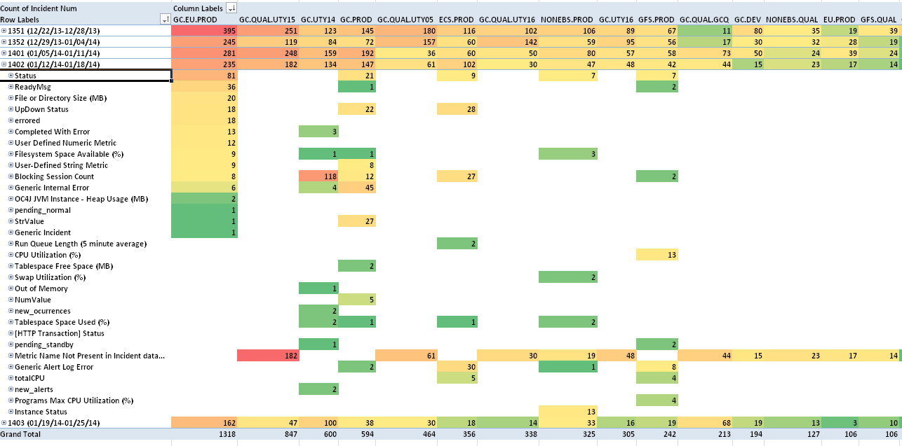
Maintaining OEM with Alert Optimizer
Filter, sort, group and graph to analyze alerting trends.
Analyze, export, manipulate, chart OEM Grid dataset in MS Excel, completely independent of the OEM Grid repository itself.
Notes:
The Datavail OEM Alert Optimizer allows for any level of drill-down, filtering, sorting, grouping, and graphing to further analyze alerting trends for significant performance events across entire systems and over any time period.
As the core OEM Grid dataset is now embedded in MS Excel itself, this data can be statistically analyzed, exported, manipulated, trended and charted etc. completely independent of the OEM Grid repository itself.

Slide 18
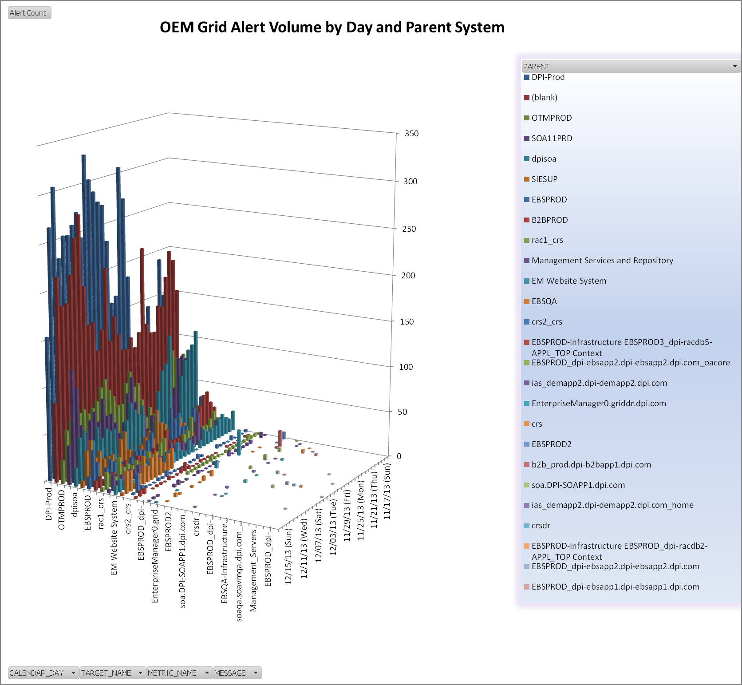
Maintaining OEM with Alert Optimizer
Aggregate the alert volume data overtime, group by the parent system object from which the alert target is associated to yield visually obvious alert volume patterns.
Focus or reduce the worst offenders, by adjusting the metric alert thresholds.
Notes:
By aggregating the alert volume data over time, and grouping by the parent system object from which the alert target is associated yields visually obvious alert volume patterns.
This ultimately allows DBA teams to quickly focus on reducing the worst offenders, by adjusting the metric alert thresholds to values which more appropriately match the targets operational baseline (alerting by exception only), eliminating useless alerts for a particular metric, or by eliminate a target from monitoring/alerting altogether.
This ultimately allows DBA teams to quickly focus on reducing the worst offenders,

Slide 19
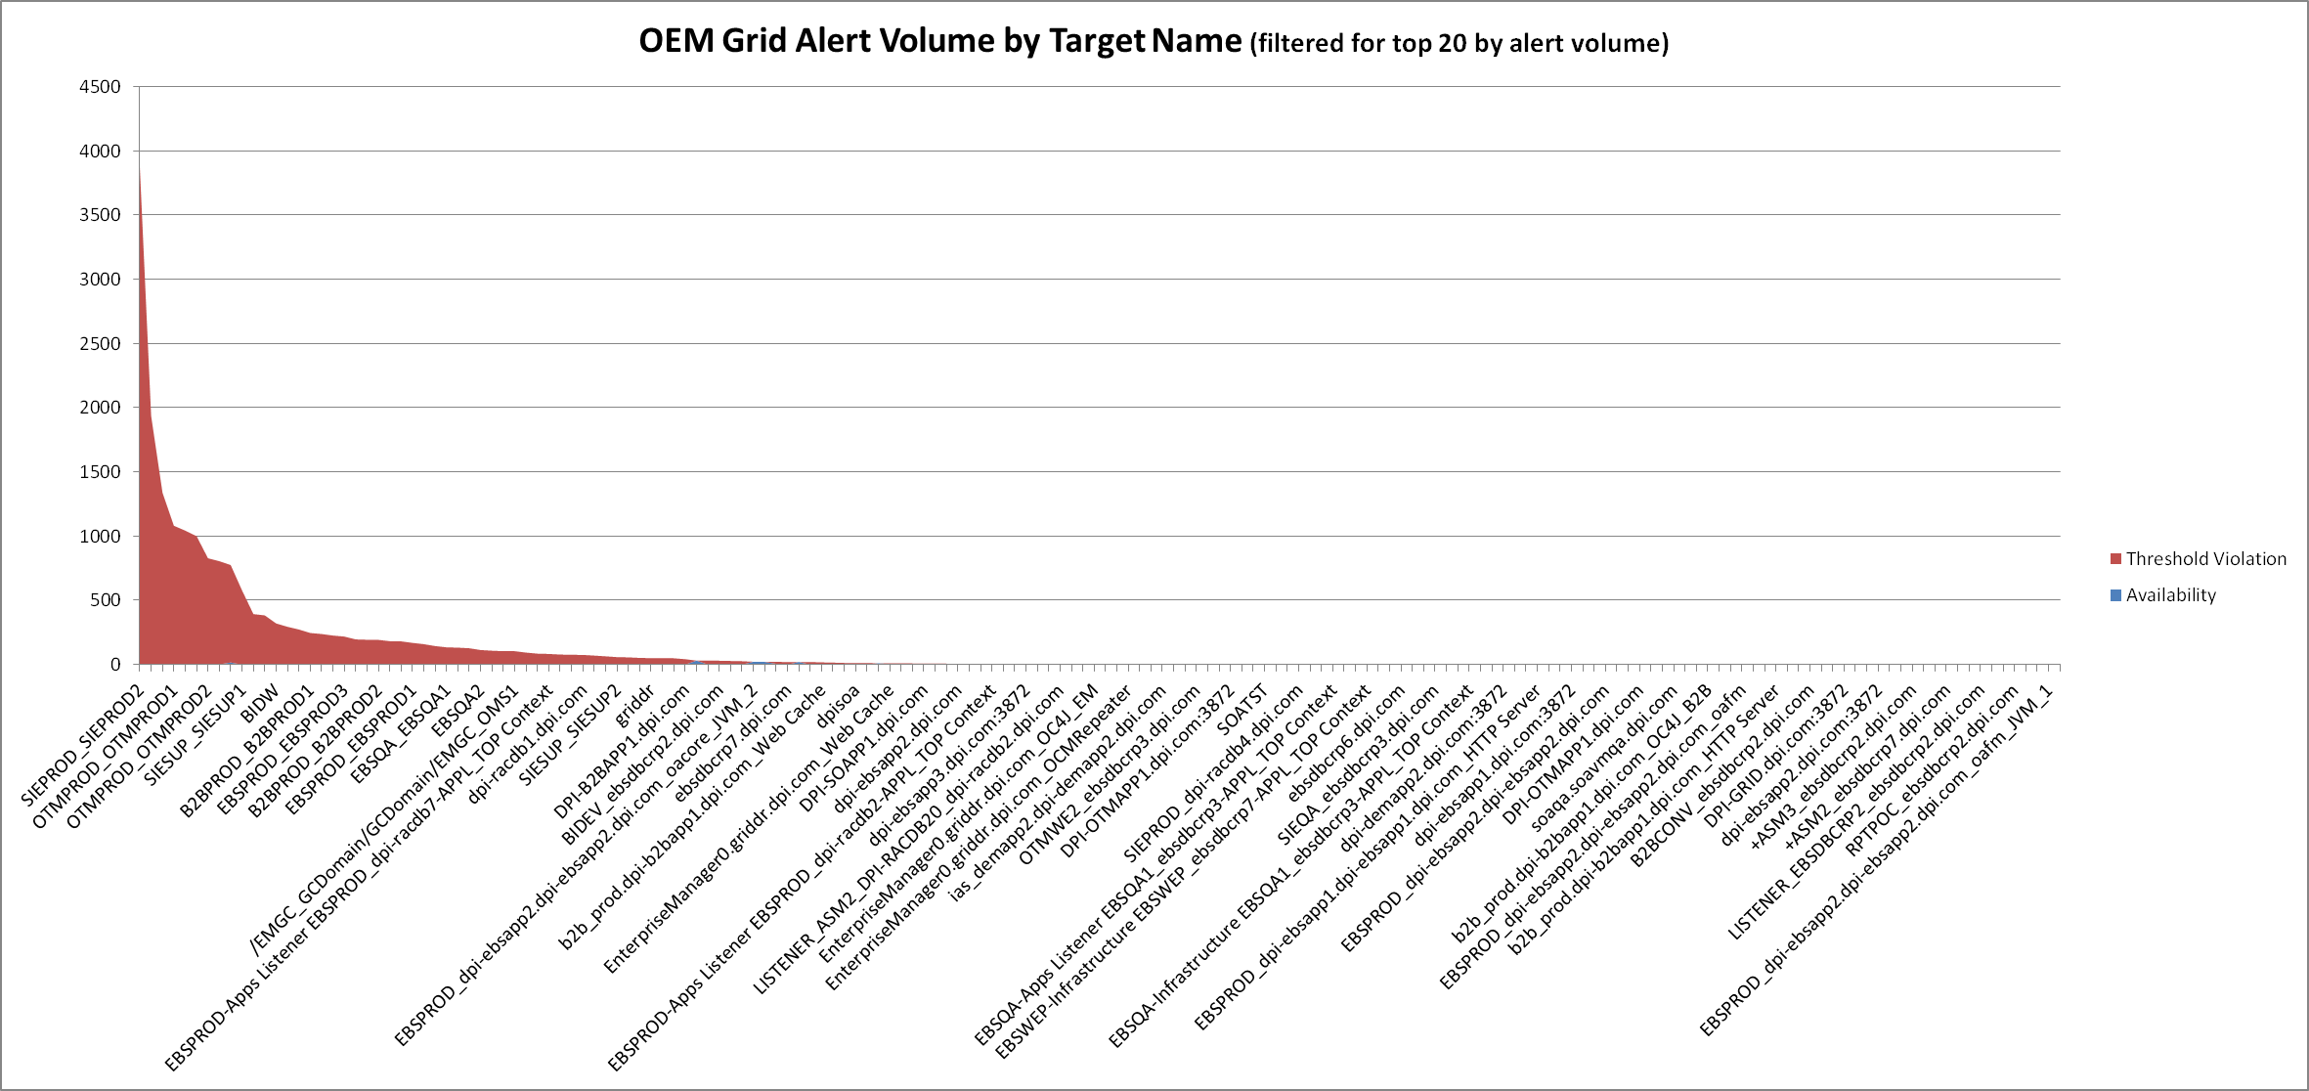
Maintaining OEM with Alert Optimizer
Aggregation by “Target Name” allows for the immediate visualization.
By reducing the largest volume offenders, better reduce the alert’s root causes to through system tuning, metric threshold modification, or specific alert elimination.

Slide 20
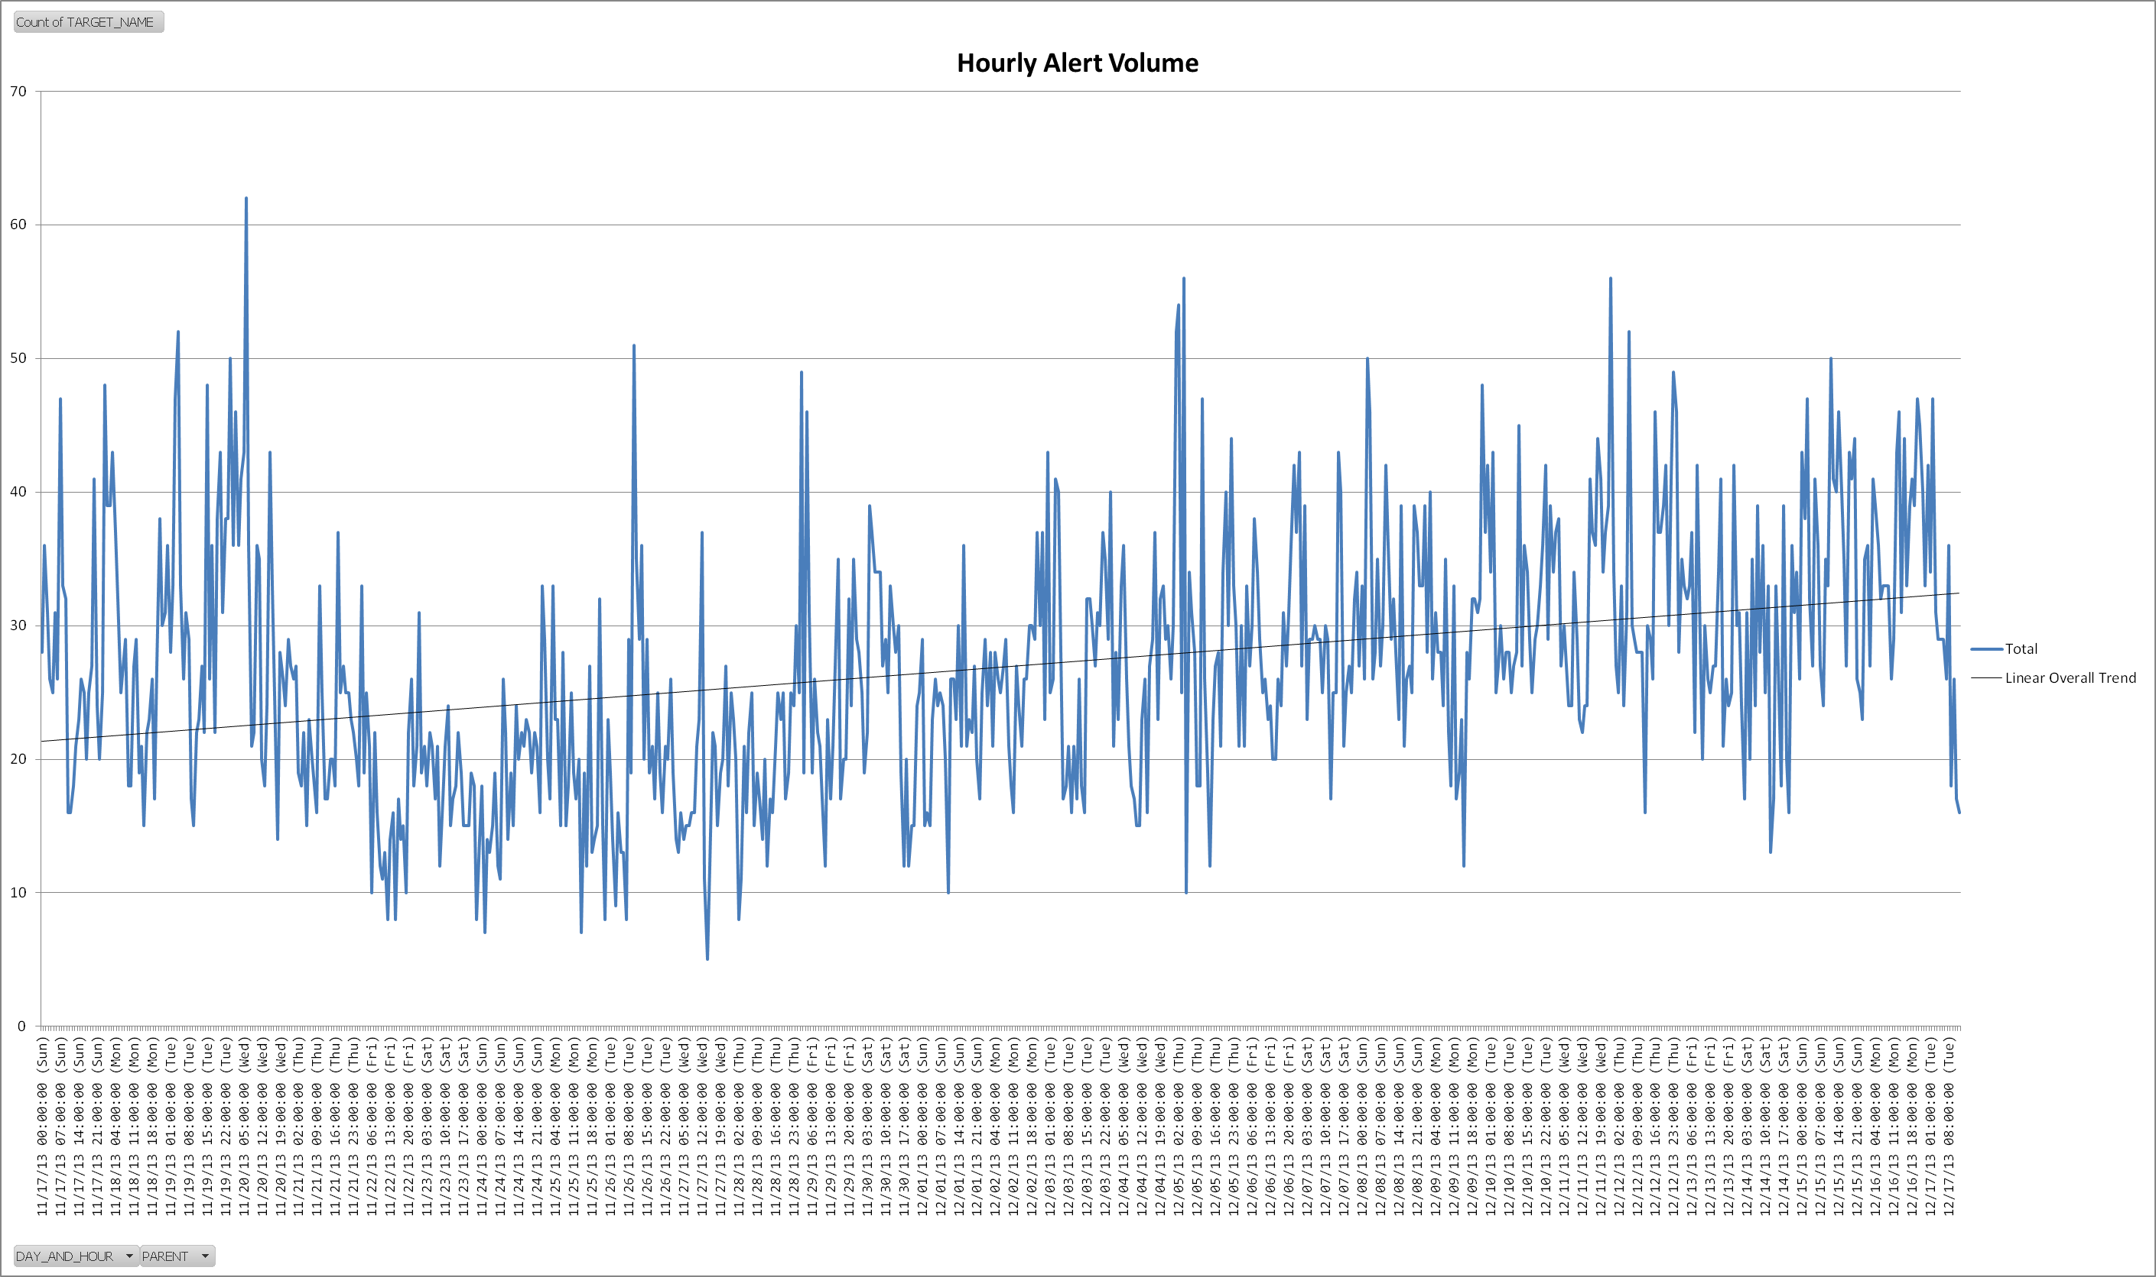
Maintaining OEM with Alert Optimizer
View the immediate load placed upon those who are monitoring and addressing these alerts.
Notes:
Aggregation purely by alert volume vs. time shows the immediate load placed upon those who are monitoring and addressing these alerts. As shown below, trends in easily-filterable overall periods of alert volume can be assessed. Ideally alert volume trends would head in an either even, or negative direction indicating a stable, or increasingly well performing target environment.

Slide 21
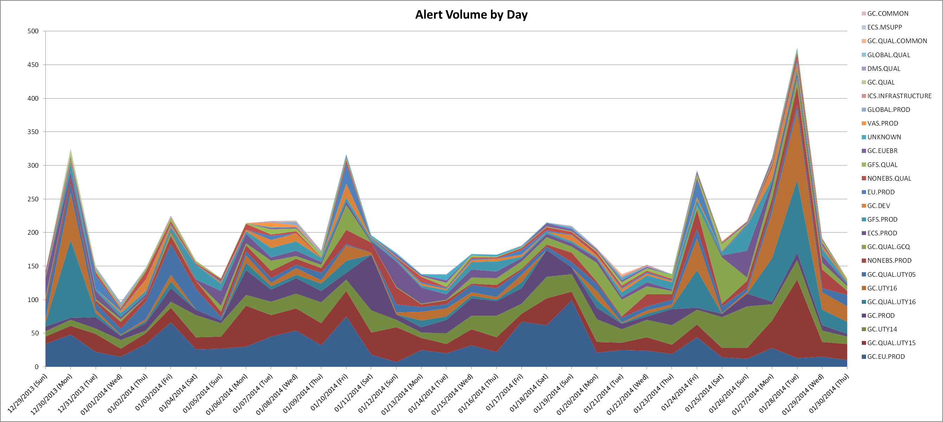
Maintaining OEM with Alert Optimizer
Review OEM Grid alert trends weekly to address the most critical and/or highest volume alerts from the previous week.
Proper resolution of their root cause allows the Applications DBA support team to focus on forward-looking environment tuning issues and database performance.
Notes:
Diligent attention to alert patterns and proper resolution of their root cause allows the Applications DBA support team to focus on forward-looking environment tuning issues and database performance.
Proper resolution of their root cause allows the Applications DBA support team to focus on forward-looking environment tuning issues and database performance, or reassign the DV DBA resources to deploying code changes or executing other requests from the client’s internal teams.
After regular weekly meetings for 6 months, total alert volume has been reduced by more than 50%.

Slide 22
Maintaining OEM (Monitoring Templates)
Review Oracle delivered OEM Grid baseline templates to ensure that the template settings match your target environment baseline.
Baseline the environment so as to match each “dial” in the template of individual metric threshold to the target on which it is deployed.
The most common finely-tuned metrics are host-level CPU usage, database instance wait session classes, blocking session timing logic, application response time beacons (available in the Oracle EBS AMP add-in.)
Notes:
Datavail reviews Oracle delivered OEM Grid baseline templates to ensure that the template settings match the customer’s target environment baseline. If the seeded templates for a particular object, or object type are too “narrow”, excessive alerts will result when pushed to the target, if too “wide”, WARNING and CRITICAL alerts will not be generated in time to rectify the situation before the end users are ultimately impacted by the potentially avoidable root cause.
Base-lining an environment is critical to matching each “dial” in the template of individual metric threshold to the target on which it is deployed. Developing a standard template for a target which can be pushed to new targets and then dialed-in saves time for newly deployed targets and prevents unnecessary and useless alerts and their associated incidents.
The most commonly finely tuned metrics are host-level CPU usage, database instance wait session classes, blocking session timing logic, application response time beacons (available in the Oracle EBS AMP add-in.)

Slide 23
Case Study

Slide 24
Customer Overview
$20 Billion in revenue; Fortune 150 company; 16,500 employees worldwide
Datavail supports this EBS environment, which is one of the world’s largest Oracle EBS roll-outs & customization projects
Environmental Specifics
8 – 10k incidents per mo., 90% automatically created from OEM Grid.
10 target environments with differing outage windows, 4 PROD, 6 Quality (PreProd)
24x7 execution, roughly evenly distributed between all shifts
Continuous optimization of Grid control alerting with client via Datavail’s Alert Optimizer tool

Slide 25
Live Demonstration

Slide 26
Questions
For more information on Datavail or the Alert Optimizer please email info@datavail.com or visit www.datavail.com/alertoptimizer.

