Slide 1
Uniform Guidance Implementation Overview 2015 VIRTUAL PROJECT DIRECTORS’ CONFERENCE
HOLD FOR
VIDEO
WINDOW

Slide 2
Agenda
HOLD FOR
VIDEO
WINDOW
Goals of the Uniform Guidance
Department adoption and preparation for implementing the guidance
Timeline – when changes impact your grant
Guided tour of the Uniform Guidance and key changes to it
Resources for technical assistance and training

Slide 3
Taking Effect
HOLD FOR
VIDEO
WINDOW
Uniform Guidance (2 CFR Part 200) applies to:
New and Continuation grants made on or after
December 26, 2014
Audit and indirect cost changes take effect when your next fiscal year after December 26, 2014, starts
Funds carried over into a new fiscal year starting on or after December 26, 2014
Funds carried over into a continuation grant on or after December 26, 2014

Slide 4
2 CFR Part 200 Table of Contents
HOLD FOR
VIDEO
WINDOW
Subpart A – Acronyms and Definitions
Subpart B – General Provisions
Subpart C – Pre-Award Requirements
Subpart D – Post-Award Requirements
Subpart E – Cost Principles
Subpart F – Audit Requirements
Appendices III-V and VII – Indirect Cost/Cost Allocation Plans

Slide 5
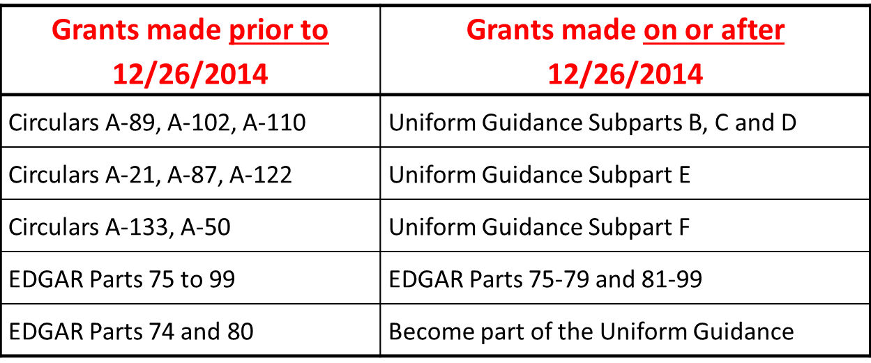
Understanding 2 CFR Part 200
HOLD FOR
VIDEO
WINDOW

Slide 6
Grant Award Notification (GAN)
HOLD FOR
VIDEO
WINDOW
Legal document that outlines the relationship between the Department and the grantee that includes the: ED program contact; the timeframe length of the project period; the award amount for the current budget period; key personnel; indirect cost rate for this award; the regulations governing the award and other terms and conditions
Read the “fine print”

Slide 7
Key Changes: Post-Award
HOLD FOR
VIDEO
WINDOW
Increased flexibilities and responsibilities for you, our grantees:
Greater emphasis on internal controls to ensure compliance and fiscal responsibility
Enhanced oversight requirements of sub-recipients and contracts which include risk assessment and use of monitoring tools
Greater focus on performance expectations and results

Slide 8
Cost Principles: Notable Changes
HOLD FOR
VIDEO
WINDOW
2 CFR 200.407 lists 22 prior approval requirements. However, some pre-approvals were missed, so check specific cost principles before assuming that they don’t require prior approval.
Clarifications:
Certifications are required for fiscal reports, payment requests, and indirect cost proposals
Direct charging of materials and supplies
Computer equipment <$5,000 specifically treated as supply

Slide 9
Risk Based Monitoring
HOLD FOR
VIDEO
WINDOW
Increased responsibilities for pass-through entities:
2 CFR 200.331 (b) Pass-through entities must evaluate each sub-recipient’s risk of noncompliance with Federal statutes, regulations, and the terms and conditions of the subaward for the purpose of determining the appropriate monitoring actions.
Risk Assessment does not have to be completed before sub-awards are made, but recipients can decide to make assessments before making the sub-awards.

Slide 10
Risk Based Monitoring
HOLD FOR
VIDEO
WINDOW
Under 2 CFR 200.331 (d) and (e) Pass-through entity monitoring must include:
Review of financial and performance reports
Issue management decisions for audit findings on subrecipients
Ensure that the subrecipients take timely, appropriate action to cure deficiencies by way of:
Provide training and technical assistance
Perform an on-site review of entity’s program operations
Arrange for agreed-upon-procedures for Audit services

Slide 11
Key Changes: Audits
HOLD FOR
VIDEO
WINDOW
Threshold for a required Single Audit has increased to $750,000
Questioned costs <$25,000 are no longer required to be reported
Fewer audits and findings have monitoring implications
Audits must be submitted electronically to the Federal Audit Clearinghouse and made available to all funding agencies
States will continue to resolve sub-recipient audits

Slide 12
Key Changes: Indirect Costs
HOLD FOR
VIDEO
WINDOW
Flexibility for new Grantees: de minimis rate of 10% MTDC
SEAs and LEAs not eligible (EDGAR Part 76.561)
De minimus rate not to be confused with Department’s temporary rate of 10%
New grantees that have never had rate have option to negotiate ICR and use temporary rate OR to use de minimis rate BUT
Grants subject to “supplement not supplant” must use restricted rate
Training grants must use 8% MTDC rate under §75.562

Slide 13
Key Changes: Indirect Costs
HOLD FOR
VIDEO
WINDOW
New flexibility: Grantees with a negotiated rate may apply for an extension of up to 4 years.
Reduces the requirement to renegotiate annually
Requests for extensions must be submitted 4 months after the end of the grantee’s fiscal year (60 days earlier than due date for indirect cost proposals)
See GAN for your rate
Program statute may cap the indirect cost rate

Slide 14
Resources
HOLD FOR
VIDEO
WINDOW
Your Department program officer
The Department’s one-stop shop for information: http://www2.ed.gov/policy/fund/guid/uniform-guidance/index.html
Includes links to COFAR and OMB
Includes links to EDGAR, including former Parts 74 and 80
Email questions to: uniformgrantguidanceimplementation@ed.gov

