Slide 1

ADMASTER-STAMP!894359-1021
Voya Employee Benefits
UBA Virtual Conference
May 4-5, 2020

Slide 2
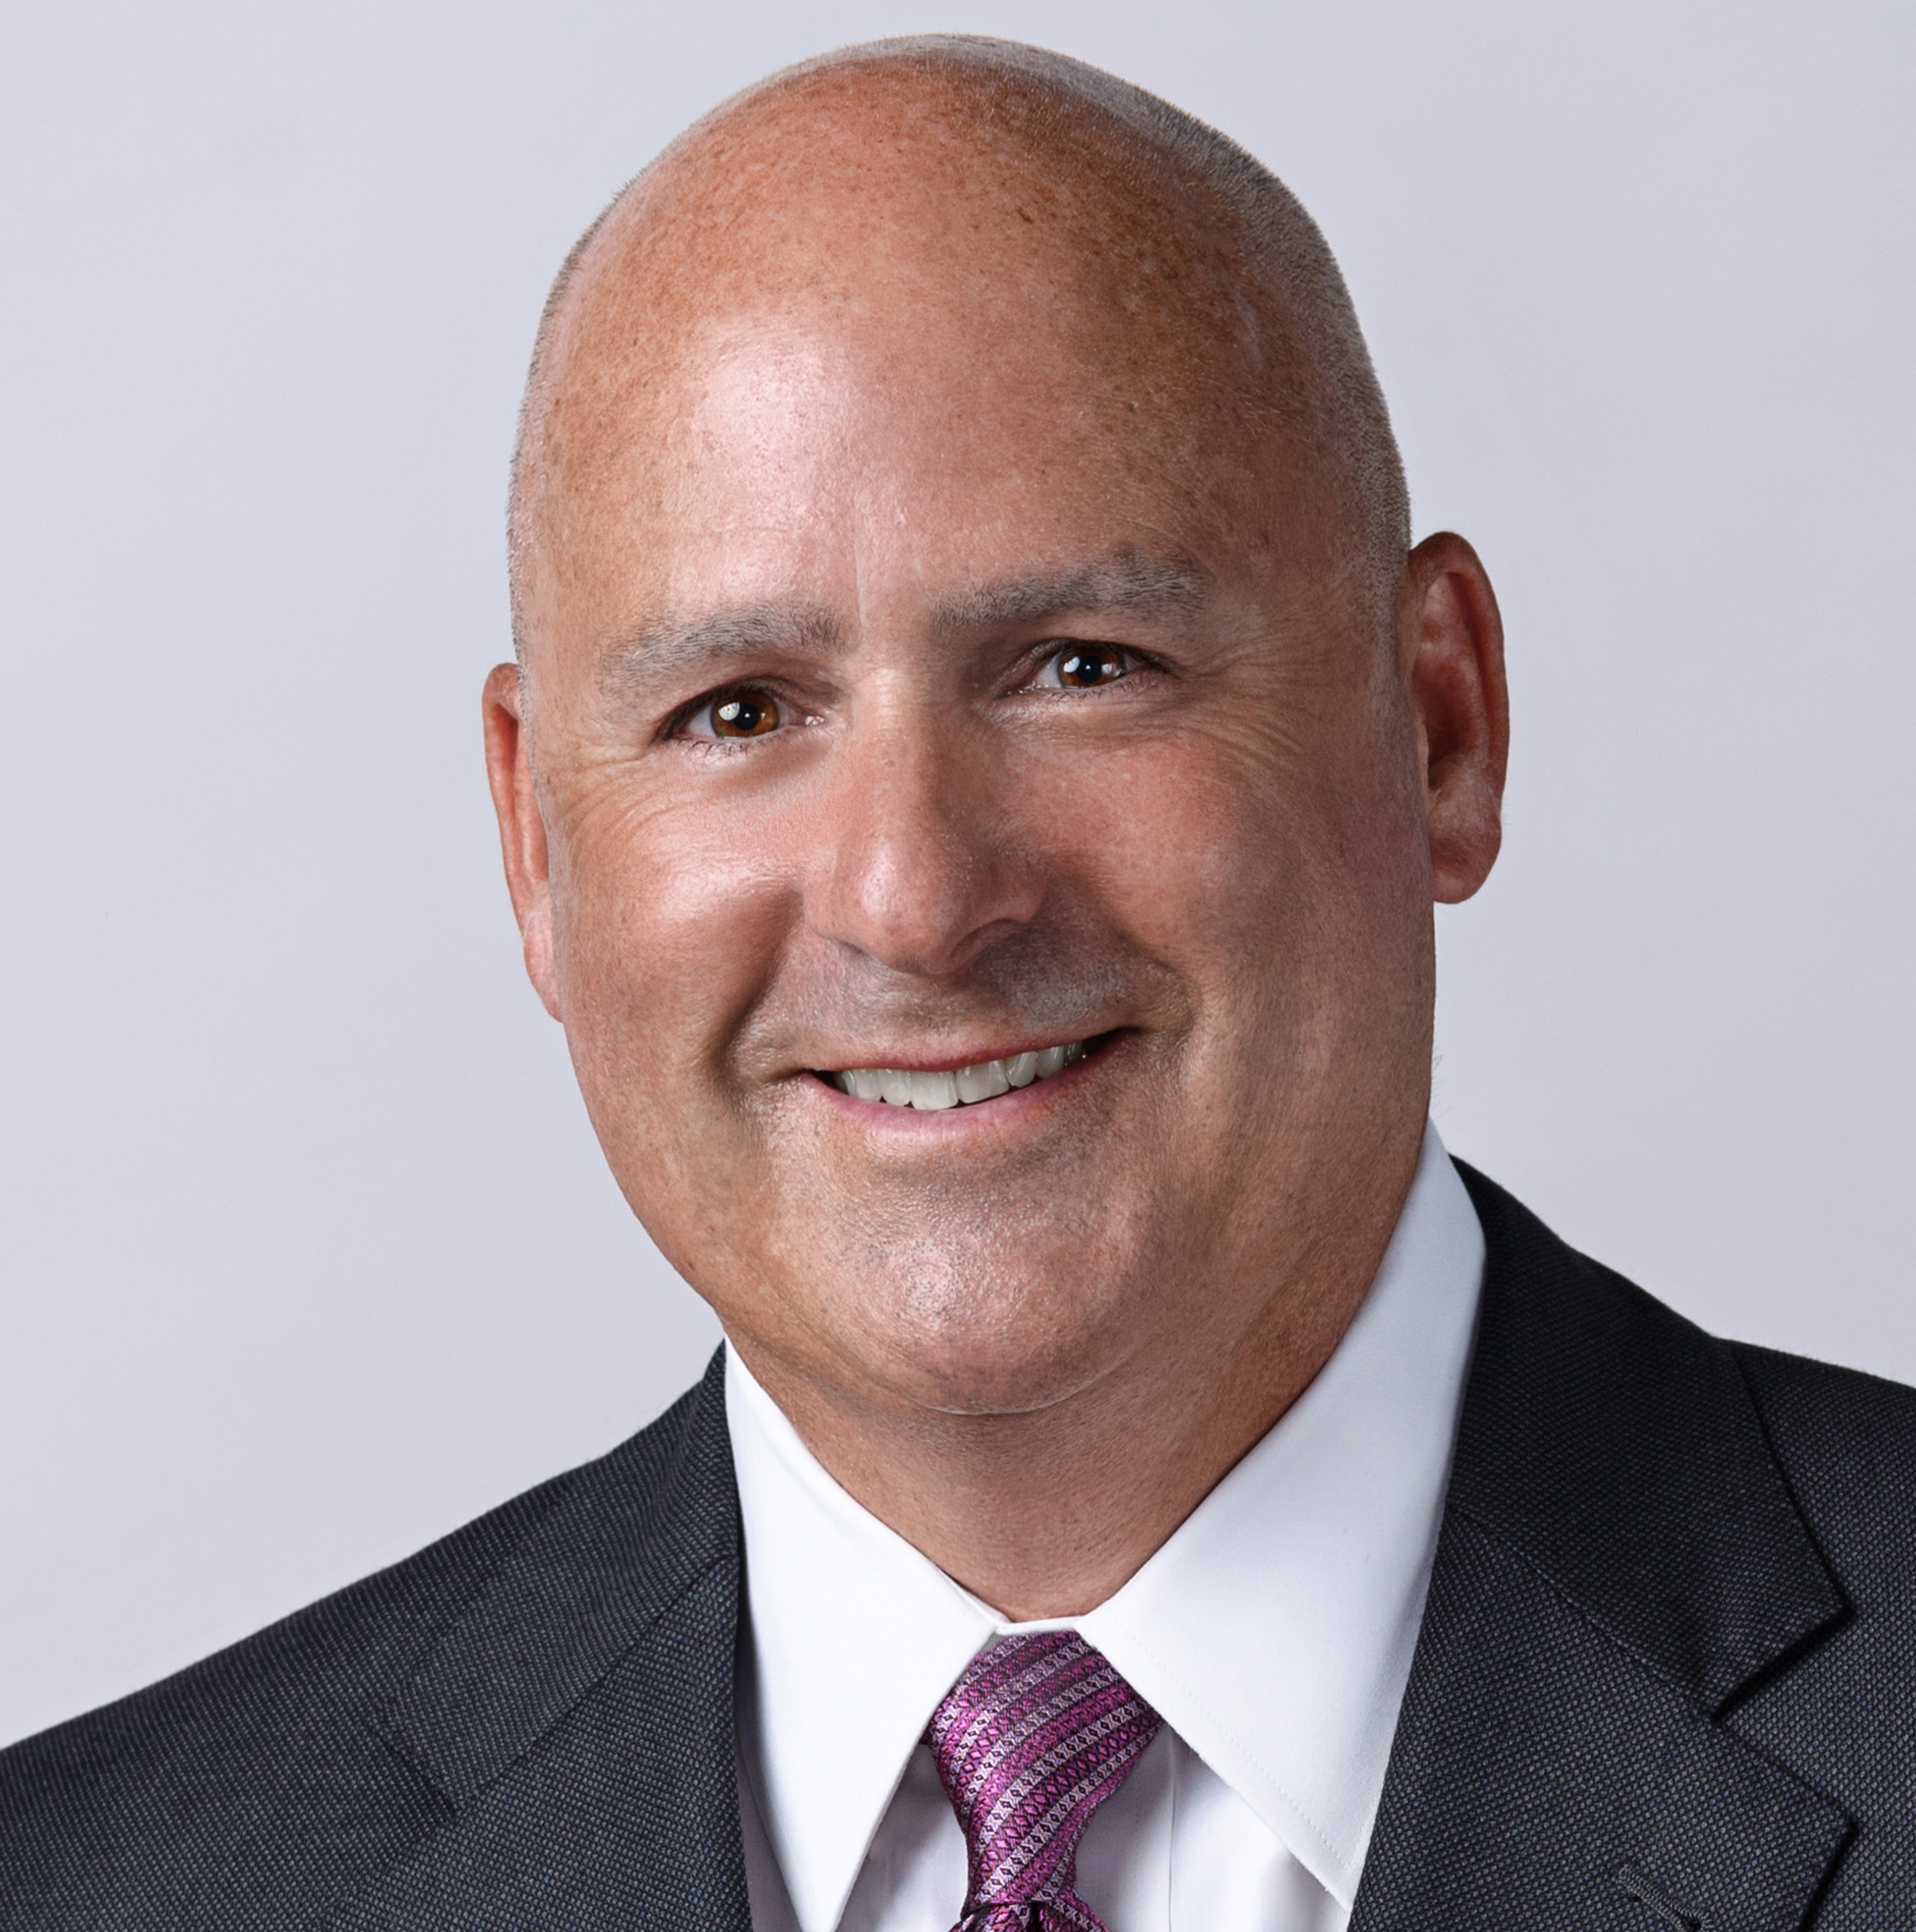
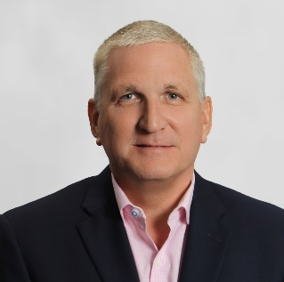
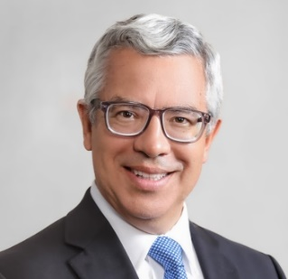
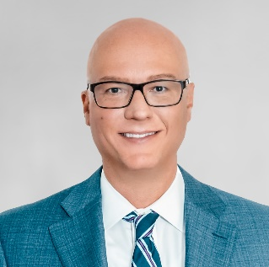

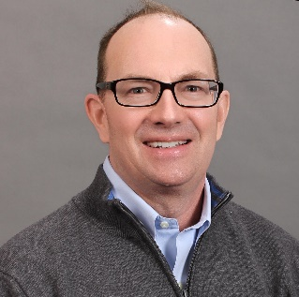
ADMASTER-STAMP!894359-1021
Meet your Voya Employee Benefits team
Bill Barrera
VP, Stop Loss Distribution & Strategic Relationships
508.641.6902
William.Barrera@voya.com
Bob Collins
Sales Rep
Robert.Collins@voya.com
Steve Barry
Director, Strategic Relationships & Global Solutions
312.422.8569
Stephen.Barry@voya.com
Brett Ford
Sales Rep
617.755.1079
Brett.Ford@voya.com
Kelsey Beckman
Strategic Relationship Analyst
612.342.7104
Kelsey.Beckman@voya.com
Jim Garrity
Sales Rep
James.Garrity@voya.com

Slide 3
Voya’s complementary business mix
ADMASTER-STAMP!894359-1021
6,000
employees
13.8 million
customers
$7.5 billion
2019 revenues
$603 billion
total AUM and AUA*
$8.2 billion
market cap
(as of December 31, 2019)
Percentage of adjusted operating earnings before income taxes by segment – year ended December 31, 2019**.
18%
20%
62%
*Excludes Corporate. Excludes deferred acquisition costs and value of business acquired and other intangibles unlocking.
    *Voya Financial Fact Sheet, 2019 Quarter 4
Notes:
Speaker notes: Voya Financial, Inc. (NYSE: VOYA) helps Americans plan, invest and protect their savings – to get ready to retire better. With a clear mission to make a secure financial future possible – one person, one family and one institution at a time – Voya’s vision is to be America’s Retirement Company®.
Provide retirement plans to more than two dozen Fortune 500 companies
2018 DALBAR recognition for digital retirement-planning excellence

Slide 4

Robust product portfolio
ADMASTER-STAMP!894359-1021
Group Life Insurance
Basic and Supplemental Life
Accident Death & Dismemberment (AD&D)
Disability Income Insurance & Voya Absence Resources
STD
LTD
FMLA
Both fully-insured and self-funded STD available
Critical Illness/
Specified Disease
Hospital Indemnity
Accident
Whole Life
STD
Supplemental Health Insurance Portfolio
Specific & aggregate coverage
Deductibles as low as $50,000
Voya Absence Resources services are provided by FMLASource®, Inc. AbsenceResources is a registered trademark of ComPsych Corporation
Stop Loss Insurance
Notes:
Speaker notes: This static slide provides a high-level overview of our products.

Slide 5
UBA inforce (as of March 31, 2020)
$52.6M Total
Year-over-year inforce growth
2017 | 2018 | 2019 | 2020
13.5% | 20.8% | 15.1% | 1.3%
$7.8M
Supplemental Benefits
$13M Life
ReliaStar Life Insurance Company, a member of the Voya® family of companies

Slide 6
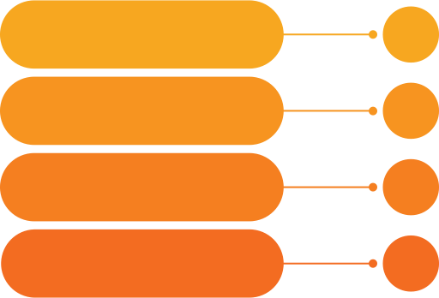

Where we specialize
Minimum Case Size =
200 Lives
Self Administered Billing
Competitive products and pricing
Strategic Partnerships with BenAdmin Platforms

Slide 7

The Voya Supplemental Benefits Difference
The Voya Supplemental Benefits Difference
Advantages:
  Wellness claims paid within 24 hours
  Enhanced Cancer coverage
  Perpetual Guarantee issue
  Residentially Built on Several Ben Admin Systems for self-enrollment
  Streamlined administration and billing
  Claims Integration
  Simplified claims submission process
  Customized Employee experience

Slide 8













Voya’s Enrollment Technology Strategy
Flexible plan designs Multiple rating methodologies Self-service enrollment Real-time EOI for Life Self billing/Self Admin GI for Supplemental products – Always!
Creating products and services for technology platform
Preferred partnerships
Consultant based strategy

Slide 9

Life & Disability
Disability Claims Process
Reach out directly to providers to obtain necessary documentation Take the burden of proof from the claimant and make it our own Call the claimant to explain approval or denial prior to any written communication
Waiver of Premium
No need to complete separate waiver application True integration with LTD; approval if totally or partially disabled
Online Administration
Numerous EOI processing platforms Claim Status reports EDI termination feeds for Port/Conversion
Enhanced AD&D Benefits & Flexible Contract
Added 15 more conditions Example- brain damage, HIV, therapeutic counseling, etc.

Slide 10

Stop Loss
Our Stop Loss Insurance features include:
Individual excess risk:
Laser free renewal
Renewal rate cap
Plan mirroring coordination
Individual gapless renewal
Aggregating individual deductible
Individual advanced funding
Individual terminal liability
Aggregate excess risk
Aggregate terminal liability
Got claims? We’ve got you covered.
We are a direct writer, which streamlines the claims process so employers get reimbursed faster.
Our average turnaround time for claims is less than 10 days for complete submissions

Slide 11
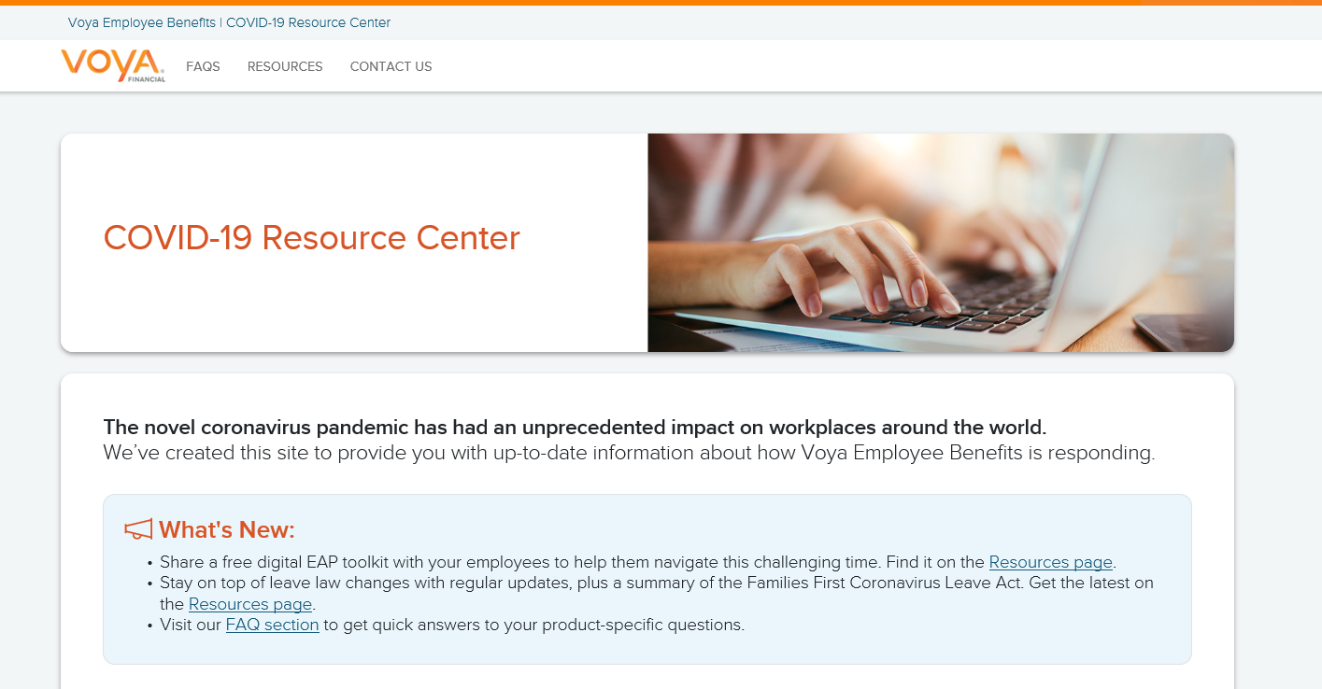
COVID-19 Microsite
[COVID-19 Resource Center]

Slide 12

How Voluntary can help during a pandemic
Wellness Benefit – Supplemental Health coverages may also include a Wellness Benefit, which pays an annual benefit if an insured undergoes a covered health screening test. A COVID-19 screening test would be considered a covered health screening under this benefit, regardless of the result of such test.
Furlough Employees – If an employee experiences a furlough (temporary layoff)/leave of absence or temporary reduction in hours due to circumstances related to COVID-19, Voya will administratively extend a period of continuation.
90 days or
the end of the period when an employee
  is unable to work,
  is working reduced hours, or
  is not working from their usual work location

