Slide 1
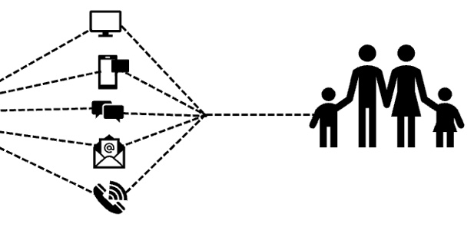
How does your staff deliver year-round communication to your workforce?
They Don’t… Our Platform Does!
Historically, benefit communication occurs only around open enrollment. Why? Because, communicating year-round takes time and resources most benefit advisors and their clients don’t have.
Our platform eliminates these challenges and delivers communication directly to your employees and their dependents.
Initial Conversation and Discovery
Create Better Consumers &
Increase Benefit Value Perception
Communication Blueprint Workshop
Implement Communication Blueprint
Motivate & Reward
Educate & Empower
Year-round, strategic and purposeful benefit communication increases awareness of plan options and tools, promotes proper utilization, and enhances the real value of your benefits programs.
Schedule your Communication Blueprint workshop today!
Get In Touch:
Chip Abernathy e: chip@yourtouchpoints.com
p: 281-300-3668

