Slide 1
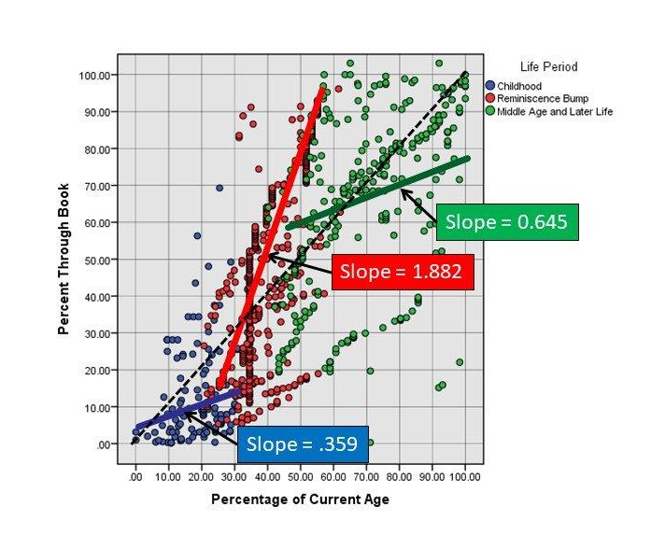
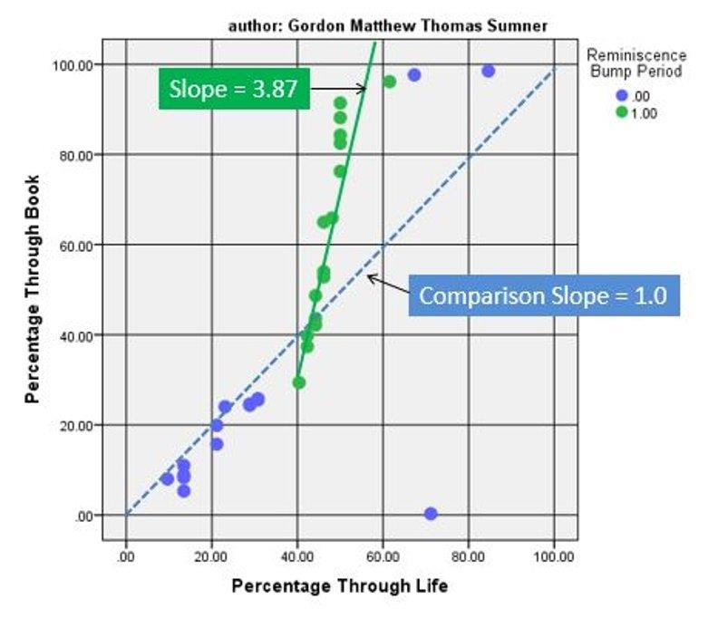
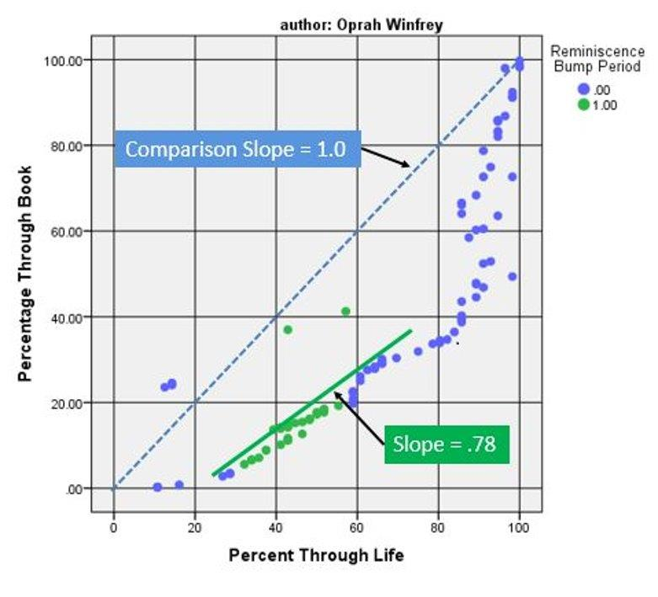
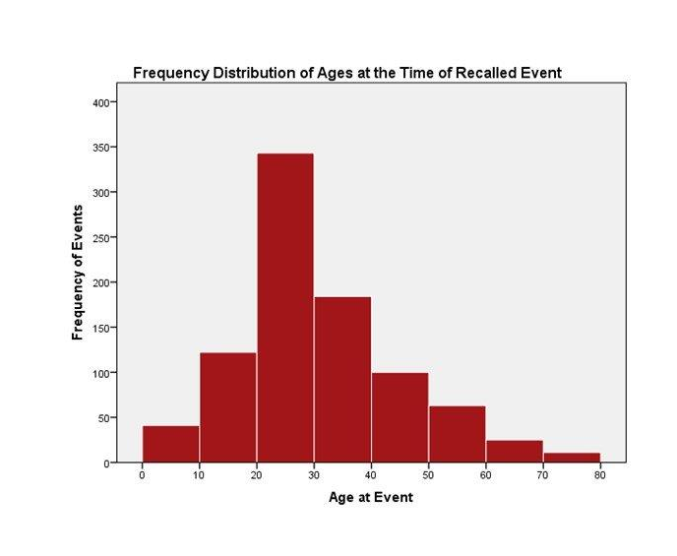
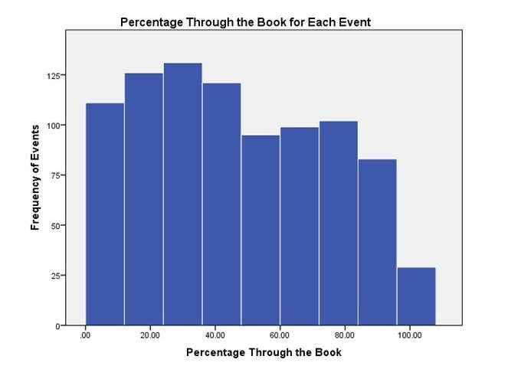

The Reminiscence Bump Effect in Published Autobiographies
Thomas W. Pierce, Hannah Benz, Grace Flood
Department of Psychology, Radford University
Abstract
  As inclusion criteria, each author had to be at least 50 years of age at the time the book was published, and the autobiography had to describe events taking place throughout the author’s life, not just events from one or more selected periods of their life.
Regression analyses revealed that the percentage of age at the time of life events was a significant predictor of the percentage of the way through the book at which each event appeared (Figure 5). The mean slope of the line representing events during the reminiscence period (b = 1.88, SD = 1.11) was significantly greater than 1.0, t(11) = 2.51, p = .034.
This suggests that even in published autobiographies the reminiscence bump is present.
In autobiographical memory research, the reminiscence bump effect refers to the tendency for older adults to recall more life events from their teens, twenties, and early thirties than from other decades of life (e.g., Rubin, 1986). The purpose of this study was to determine if a reminiscence bump is observed in narrative accounts of life events presented in published autobiographies. In the current study, we identified the major life events described in 12 autobiographies. For each life event, we recorded the age of the author at the time of the event, the page on which the description of each event began, and whether the event was perceived by the author as positive or negative. 889 events were identified across the 12 autobiographies. Grouping events by decade of life, the following frequencies were observed: 41 events from 0-10 years; 122 events from 11-20 years; 343 events from 21-30 years; 184 events from 31-40 years; 100 events from 41-50 years; 63 events from 51-60 years; 25 events from 61-70 years; 11 events from 71-80 years. The frequency distribution for the ages of life events obtained from autobiographies is consistent with the frequency distributions obtained from laboratory studies of the reminiscence bump. When frequency distributions for Age at Event were examined separately for each author, a reminiscence bump was clearly evident in the distributions of life events described by eight of the 12 authors.
Results
  Samples of two autobiographies reporting the events that were observed are displayed below. There was considerable variability among the authors. In most books, authors devoted a disproportionately large amount of space to events from the reminiscence bump period (Figure 1). In other books, authors wrote less about events from the reminiscence bump period (Figure 2).
Introduction
In autobiographical memory research, the reminiscence bump refers to the tendency of older adults, when asked to recall life events, to report more events from their teens, twenties, and early thirties than any other decade of life (e.g. Rubin, 1995).
Research investigating the reminiscence bump often employs self-report methods to prompt participants to recall as many events from their lives as they can (Pierce & Elliott, 2019).
The purpose of this study was to determine if a reminiscence bump is observed in narrative accounts of life events, specifically in autobiographies
It was hypothesized that authors of the autobiographies would indeed report more events during their late teens, twenties, and early thirties than any other period of life.
Figure 5
Figure 1
Figure 2
Discussion
899 events were identified across the 12 autobiographies. When grouping the events by decade of life, a greater proportion of life events were reported from the reminiscence bump period (18-32 years of age) than other periods of life
Events from the 15-year reminiscence bump period described in the author’s autobiographies took up an average of 45% of the pages in their books. In comparison, the reminiscence bump represents an average of 24% of the length of the authors’ lives at the time they published their autobiography.
Frequency distributions were generated displaying the distribution of chronological ages at the time of each life event (Figure 3) and the percentage of the way through the book each life event was recorded (Figure 4).
The most common pattern recorded in autobiographies examined in this study was that a greater percentage of life events from late adolescence and early adulthood was present than from any other period of life, including a recency effect.
Events from the reminiscence bump period in most autobiographies examined take up a disproportionately larger percentage of the text.
These data provide further replication of the existence of a reminiscence bump in which life events from late teens, twenties, and early thirties are more likely to be recalled than events from any other period of life.
Method
References
Life events were collected from the published autobiographies of 12 authors. The mean age of the three female and nine male authors at the time of publication was 63.75 (SD = 11.89). Each autobiography was evaluated in the following ways:
  Throughout each autobiography, every page that the author spoke about an event at a specific age the page number, age, and perception of the event (positive, negative, neutral) was recorded.
  For each autobiography, we looked at the proportion of events during the reminiscence period (i.e. 18-32 years of age) in comparison to the rest of their lives.
Pierce, T. W., & Elliott, A. N. (2019). Recent progress in reminiscence research. In F. Gibson (Ed.), International perspectives on reminiscence, life review, and life story work. London, UK: Jessica Kingsley Publishers.
Rubin, D. C. (1995). Remembering our past: Studies in autobiographical memory. Cambridge, UK: Cambridge University Press.
Figure 3
Figure 4
Printing Supported by the Office of Undergraduate Research and Scholarship
Figure 4

