Slide 1
Technology- based Progress Monitoring
Avenue:DHH is a suite of tools tool to monitor and visualize students’ progress in the areas of language, reading and writing. 300+ teachers registered and using AVE tools
AVE Use Nationally 2014-2015
800 + students
13,000 MAZE assessments
31,000 Slash assessments
1,600 WodMark Assessments
250 KidSpeak (ORF) Assessments
Notes:
Avenue: DHH/ Or PM software can be used to monitor students’ progress in reading and writing. The software was originally developed for students who are deaf or hard of hearing and for students with language differences or delays. As the software became available, elementary education teachers, teachers of English Language Learners and parents found the software motivating for the students and easy to use.

Slide 2
Teacher Survey (N=50)
Improves my Effectiveness 2.0
Improves my accountability 1.76
Improves my efficiency 1.85
Increases student reading performance 1.95
Enhances Student motivation 1.98
Five Point Scale: 1=Strongly agree; 2=Agree, 3=Neither 4=Strongly Disagree, 5=Strongly Disagree

Slide 3
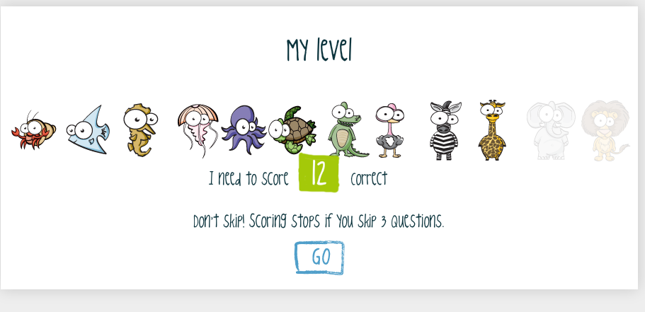
Avenue:PM
Uses a gaming format
Provides feedback
Includes auto scoring and data graphing
Stimulus passages increase at .5 grade levels
Notes:
Avenue has several unique features as progress monitoring tools. Avenue is designed to incorporate a game-like environment. As students move across reading passages they are able to see their progress within a level and across levels.
Second, a student’s responses are automatically scored, recorded and graphed, saving teachers time.
Third, Students receive immediate feedback.
Fourth, the reading passages are graduated at .5 grade levels to allow students to “move up” a level in a shorter period of time.
All reading passages begin at the end of the first grade reading level and progress at .5 grade levels through the 6th grade.

Slide 4
Slash- Completed- Scored
Notes:
The Slash assessment is based on the early research of conducted by Hammel, Wiederholt & Allen TOSCRF. For more information a reference list is available on the website lt.umn.edu/dhh, Links to Documents.
The Slash is a tool that can be used as an indicator of students’ ability to identify words within a sentence or a short story with automaticity or fluency and comprehension of the context.
The sentences appear on the AVE:Slash screen in uppercase letters without spacing or punctuation. The students are instructed to click between the words to build a meaningful sentence.
As the student clicks between words, a space appears. The student may review the sentence for meaning and make corrections as needed within one minute or indicate that he or she is done.
Video directions are provided on the Avenue:Slash student app.
Avenue:Slash is designed for young students at the early stages of reading through approximately the early 4th grade reading level. Avenue:Slash has also been used with students who have language differences or language delays in grades the middle and upper grades.
The sentences are graduated in syntactic and sematic difficulty. Level 1 begins with basic Noun + Verb statements. Grammatical structures and context increase in complexity as the student moves from Level 1 through Level X.
A chart indicating the syntactic structures included in each of the levels and approximate reading levels is available on the website lt.umn.edu/dhh, Links to Documents.

Slide 5
MAZE passage completed
Notes:
Avenue: MAZE as a reading assessment. Deno and Marsten developed the MAZE assessment protocol as a CBM tool to monitor students progress in silent reading comprehension and fluency. Numerous research studies have focused on the technical characteristics of the MAZE. A list of references may be found on the front page of the Avenue website lt.umn.edu/dhh~ Links to Documents.
Avenue: MAZE as a measure of reading silent reading comprehension and fluency. Deno and Marsten developed the MAZE as a CBM protocol. Numerous research studies have focused on the technical characteristics of the MAZE. A list of references may be found on the front page of the Avenue:PM website lt.umn.edu/dhh~ Links to Documents.
The Avenue: MAZE is a timed task. At the elementary levels, students are presented with a short passage with every seventh word deleted and replaced with a set of three words set below the deleted word.
Two of the words are distractors. One word is the correct response. The distractors used in Avenue: Maze are words that are grammatically and semantically incorrect.
The student reads the passage and clicks on the word that completes the sentence in the passage correctly. The student has one minute to respond to the reading task. If the student completes the passage before the end of one minute, the student taps or clicks on the “Done” button.
At the end of one minute, the screen changes to “Times Up”! The student can review the correct and incorrect items and view the score on the game bar. Video illustrated directions and practice tasks are built into the software.
The passages include narrative and expository readings with a higher number of narrative passages at reading levels 1 through 3rd grade and a higher percentage of expository passages at reading levels 4 through 6 grade.
Passages within a level are approximately equivalent in difficulty. Students’ performance on passages within a level may vary depending on the students’ background knowledge, vocabulary, and motivation. Therefore, using scores across three or four passages and across time provides a more robust data base for decision making.
.
All students begin at reading level 1 (the snail) or passages that are typically read at the end of 1st grade. If a student completes three passages meeting the goal without error, he or she will move up a level to 1.5.
If a student meets the goal of the number of correct minus incorrect responses within a level on 5 occasions, he or she will move up a half grade reading level.
If the student does not meet the goal, the student moves back within a reading level or moves down a half level.
The goal for each reading level is based on a number of studies among a representative sample of general education students using paper-pencil Maze passages. As data are collected with a larger normative sample using the Avenue:PM software, the goals may change.
A chart depicting the reading levels and goals set for each level is available on the Avenue website lt.umn.edu/dhh~ Links to Documents. (See chart)

Slide 6
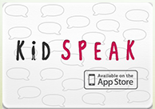
Kidspeak
Notes:
KidSpeak is a measure of oral reading fluency. ORL – is the most frequently used Progress monitoring tool in elementary schools today. It is backed by more than 30 years of research among hearing chidlren in elementary schools… it is not recommended for use with Deaf children.. .. We cannot compare fluency in signed production at this time.
In KidSpeak, available on the ipad.. The student is presented with a passage on the screen, is prompted to begin recording as he or she reads for one minute. At the end of one minute, the screen changes to “Times Up”! and clicks on the “Done” button. The passage and recording is them sent to the teacher’s computer where it is scored by the teacher or a teacher’s aide and graphed automatically.
The passages are the same passages as used in the MAZE that include narrative and expository readings with a higher number of narrative passages at reading levels 1 through 3rd grade and a higher percentage of expository passages at reading levels 4 through 6 grade.
The score for Kidspeak is based on the number of correct words read in one minute.

Slide 7
WordMark
Notes:
WordMark a tool that may be used to monitor students progress in written expression in grades 3 and above, specifically for students who have language differences. WordMark uses a CBM scoring protocol to monitor students progress in writing. Several studies have been conducted with students who are deaf or hard of hearing in grades 3 through 12. A list of references may be found on the front page of the Avenue website lt.umn.edu/dhh~ Links to Documents.
In Avenue:WordMark, students are presented with a randomly selected story starter or topic to write about. The student may elect to select a new topic or to begin to write a topic of his own choosing. Once the topic is selected, students are given one minute to think about what they will write. At the end of one minute the students are prompted to type their story on to the computer screen using the computer keyboard.
Avenue:WordMark is not available on tablet devices such as the ipad.
This is a timed task of three minutes to ensure that consistent comparisons may be made in a student’s score across time.
At the end of three minutes or if the student elects to quit before three minutes, the student clicks on the Save button which sends the writing sample to the teacher to score.
To score a passage the teacher clicks the data button next to the student’s name, then clicks the WorkMark button and then clicks the Score WM passages.
A list of the student’s writing samples are indicated as scored or waiting to be scored. The teacher or an assistant may score the writing sample using the CBM rules for scoring (Correct-Incorrect Word Sequences). Video instructions for grading WordMark are available on the Avenue website lt.umn.edu/dhh~ Instructions for Teachers.
No grade level goals have been established for WordMark at this time. When students engage in paper-pencil writing tasks, the approximate rate of weekly growth is +2 Correct Word Sequences (CWS).
A baseline of writing performance scores can be established by using the mean score of three writing samples completed within a week. With instruction we can anticipate that the student will progress at approximately the same rate of +2 CWS weekly, however, we have no studies at this time that demonstrate the differences in keyboard versus handwritten expression.
Studies using WorkMark demonstrate the efficiency of scoring, that is, saving teachers’ time and increasing scoring accuracy. WorkMark tracks the correct and incorrect word sequences, automatically counts the number of words written, indicates the possible number of words spelled incorrectly and calculates the Correct and Incorrect Word sequences as scored by the teacher or a designated assistant.
WordMark records the data in a visually graphic display and a printable data table.

Slide 8
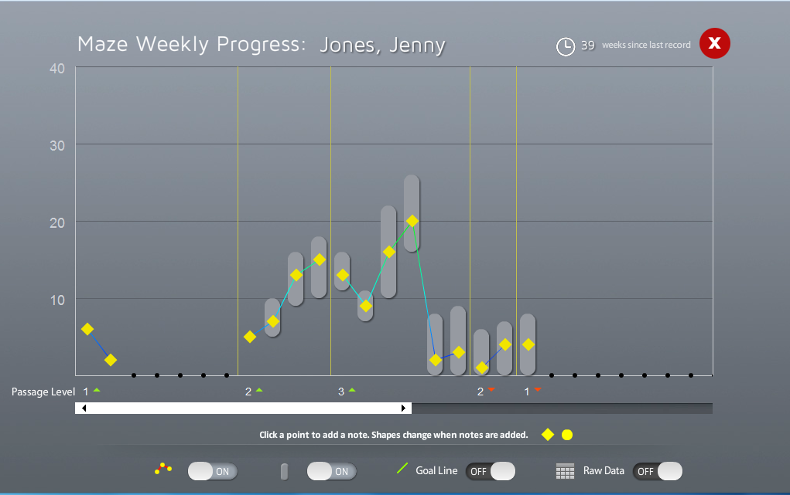
Using the Data
Notes:
Data are presented in dynamic data charts that illustrate performance over time.

Slide 9
Research Correlations: Reading Levels
Slash- Teacher Reported Reading levels and Highest Level Reached in AVE r=.61
MAZE- Teacher Reported Reading levels and Highest Level Reached in AVE r=.57, p>.01
N=103 DHH students

Slide 10
MAZE Error Analysis
Lexicon | C+I Answers | % correct | Expected I | Actual I | Chi Square
Noun/pro | 7047 | 35.10 | 969 | 891 | 6.25
Adjective | 1459 | 7.27 | 201 | 169 | 4.97
Verb/ adverb | 6240 | 31.08 | 858 | 795 | 4.61
Conjun | 709 | 3.53 | 97 | 117 | 3.91
Determiner | 2553 | 12.72 | 351 | 437 | 21.08*
Preposition | 2068 | 10.30 | 284 | 351 | 15.65*
Totals | 20,076 | 100% |  | 2,760 | Chi-square 56.47 *p<.05
Notes:
Relationship between frequency of use and performance level change on Slash and Maze.
Significant Moderate Correlations for both Maze and Slash (Kendal Tau-b, .50-.59)
Highest correlations at higher grade levels
Maze Tau-b=.67, p.<.01 (Reading Level 3)
Slash Tau-B=.73, p<.01

