Slide 1
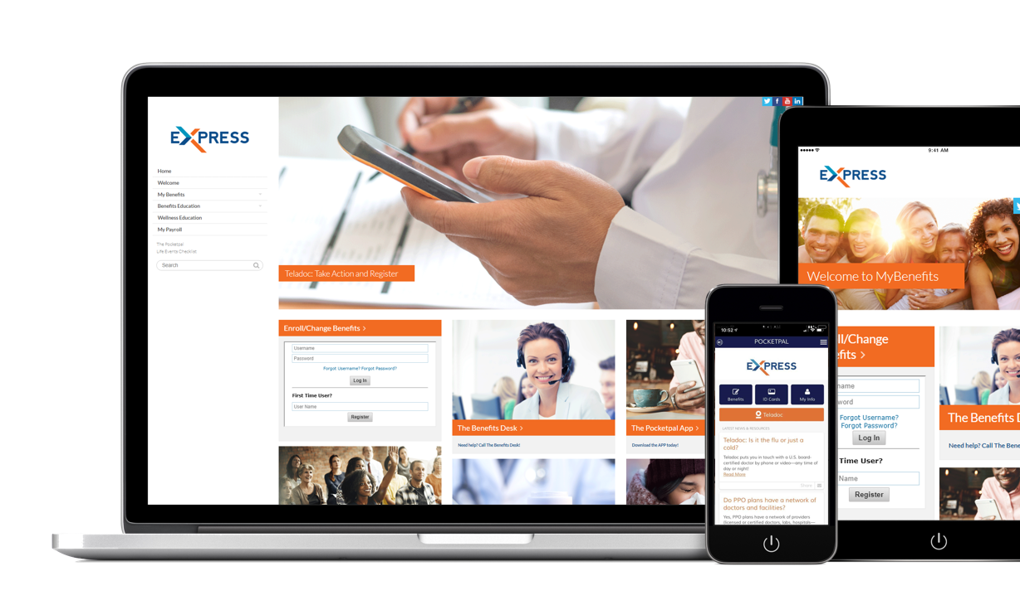
Unleashing the Power Benefit Communication
©2019 YourTouchpoints. All rights reserved.

Slide 2
Imagine the Possibilities
Amazing things happen when employees know:
Why you are providing benefits
What is available
How to use it
Who can help
When it matters most
Just imagine the possibilities when employees:
Take more responsibility for their health
Become wiser benefit consumers
Are increasingly loyal advocates for your company
Unleashing the power of benefit communications impacts the entire program you put in place.
So, how is your current communication strategy working for you?

Slide 3
How Benefit Communication Really Works
To unleash the power of benefit communication, we begin with understanding and then communicating WHY your company offers benefits in the first place.
Most companies want to take care of their employees, but let’s face it, there is more to it than that. Benefits play a huge role in employee attraction, retention, health and productivity, plus the value employees place in your company, and your ability to control cost.
That’s why we propose sitting down and conducting a Communication Blueprint workshop to uncover your WHY and key messages around your benefit plans, claims issues, cost control needs, and other important topics.
Most benefit advisors think helping their clients communicate around open enrollment is the best way to educate employees. But statistics prove nothing could be further from the truth!
79% of companies who say they have great employee
engagement with their benefits, have a year round
communication strategy. IFEBP: International Foundation of Employee Benefit Plans
“
“
How does that work?

Slide 4
By Keeping Benefits Front-of-Mind With Your Employees
Unleashing the power of employee communication means leveraging the relationship between the right content and the best communication platforms available.
After we spend an hour to uncover your WHY and develop the other key messages you need to communicate to your employees, our platform does the rest.
Your Communication Blueprint is uploaded, and messages go out on the date and time we have them scheduled.
So, how does your team get the content to your employees?

Slide 5
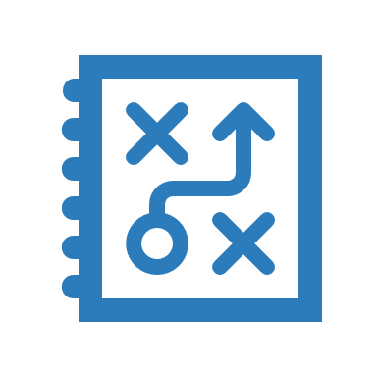
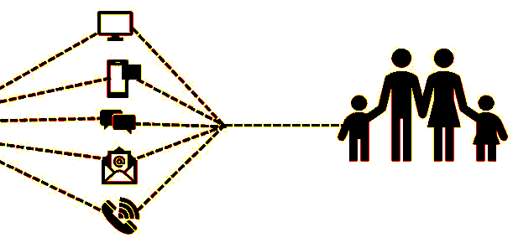
They Don’t… Our Platform Does
Historically, benefit communication occurs only around open enrollment. Why? Because, communicating year round takes time and resources most benefit advisors and their clients don’t have.
Our platform eliminates these challenges and delivers communication directly to your employees and their dependents. Because it is loaded with timely, relevant, high quality content and takes care of delivery for you. Your only time investment is the hour or so it takes to develop your Communication Blueprint, and the occasional progress review meeting with your advisor to gauge what is most effective and adjust your blueprint when needed.
Through your customized portal and app, as well as via text and email, we deliver valuable, purposeful content when it is needed, right to your employees’ phones.
Year-round, convenient benefit communication increases the awareness of plan options and tools, promotes proper utilization, and drives the value perception of your benefits program.
Initial Conversation and Discovery
Create Better Consumers &
Increase Benefit Value Perception
Communication Blueprint Workshop
Motivate & Reward
Implement Communication Blueprint
Educate & Empower
So, how will you know it’s working?

Slide 6
First, we know that 79% of employers surveyed by the IFEBP say their most effective engagement tool is ongoing monthly communication. Here are a few other nuggets:
92% of Americans have cell phones, 82% of those being smart phones.
92% of all text messages are opened within 3 minutes.
98% of all text messages are opened.
Our analytics are configured to report on what you need to know. Your private dashboard tracks outgoing activity and its impact. We measure SMS message delivery and open rates for all emails. We track employee use of the portal and the app including sessions, page views, and the top 15 pages visited.
This intel empowers us to measure the impact benefit communication has on employee behavior, finely tune messaging, and adjust plan design as needed.
Schedule your Communication Blueprint workshop today!
We prove it works!
So, now what can you do?

