Slide 1
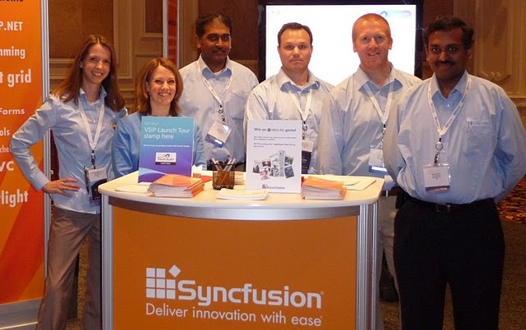
Welcome!
Notes:
C

Slide 2
Syncfusion, Inc. – Company Overview
Founded in 2001 by industry-leading architects
Headquarters located in Research Triangle Park, NC
Global client list of Fortune 100 companies
Broad range of enterprise-class software components for the Microsoft .NET platform

Slide 3
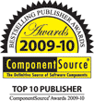
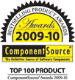
Industry Recognition
Consistently recognized in the software industry for innovation, product excellence, and leadership

