Slide 1
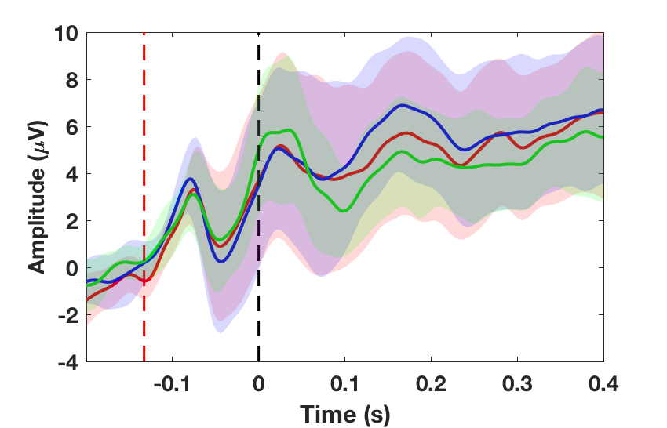
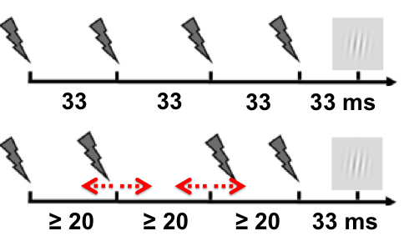
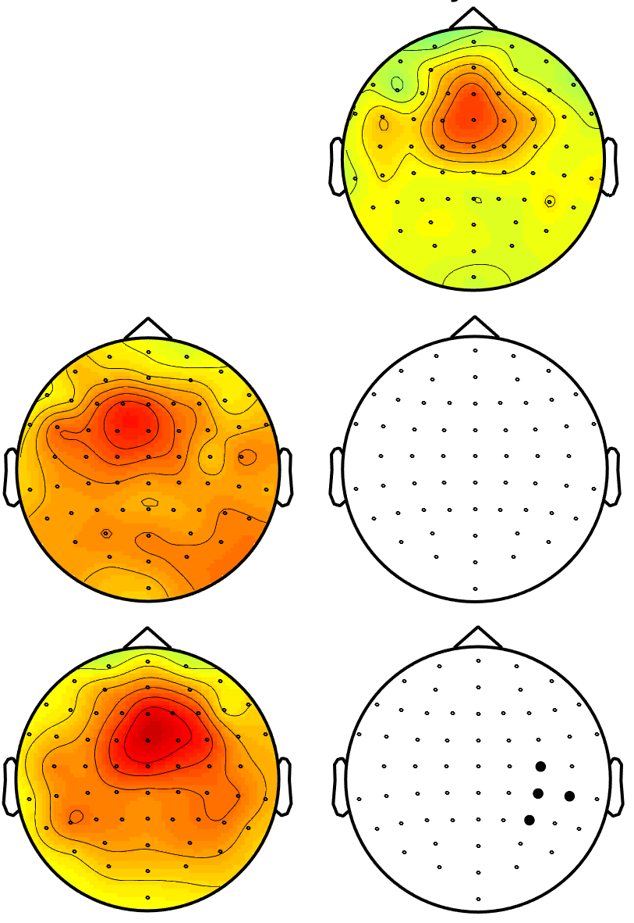
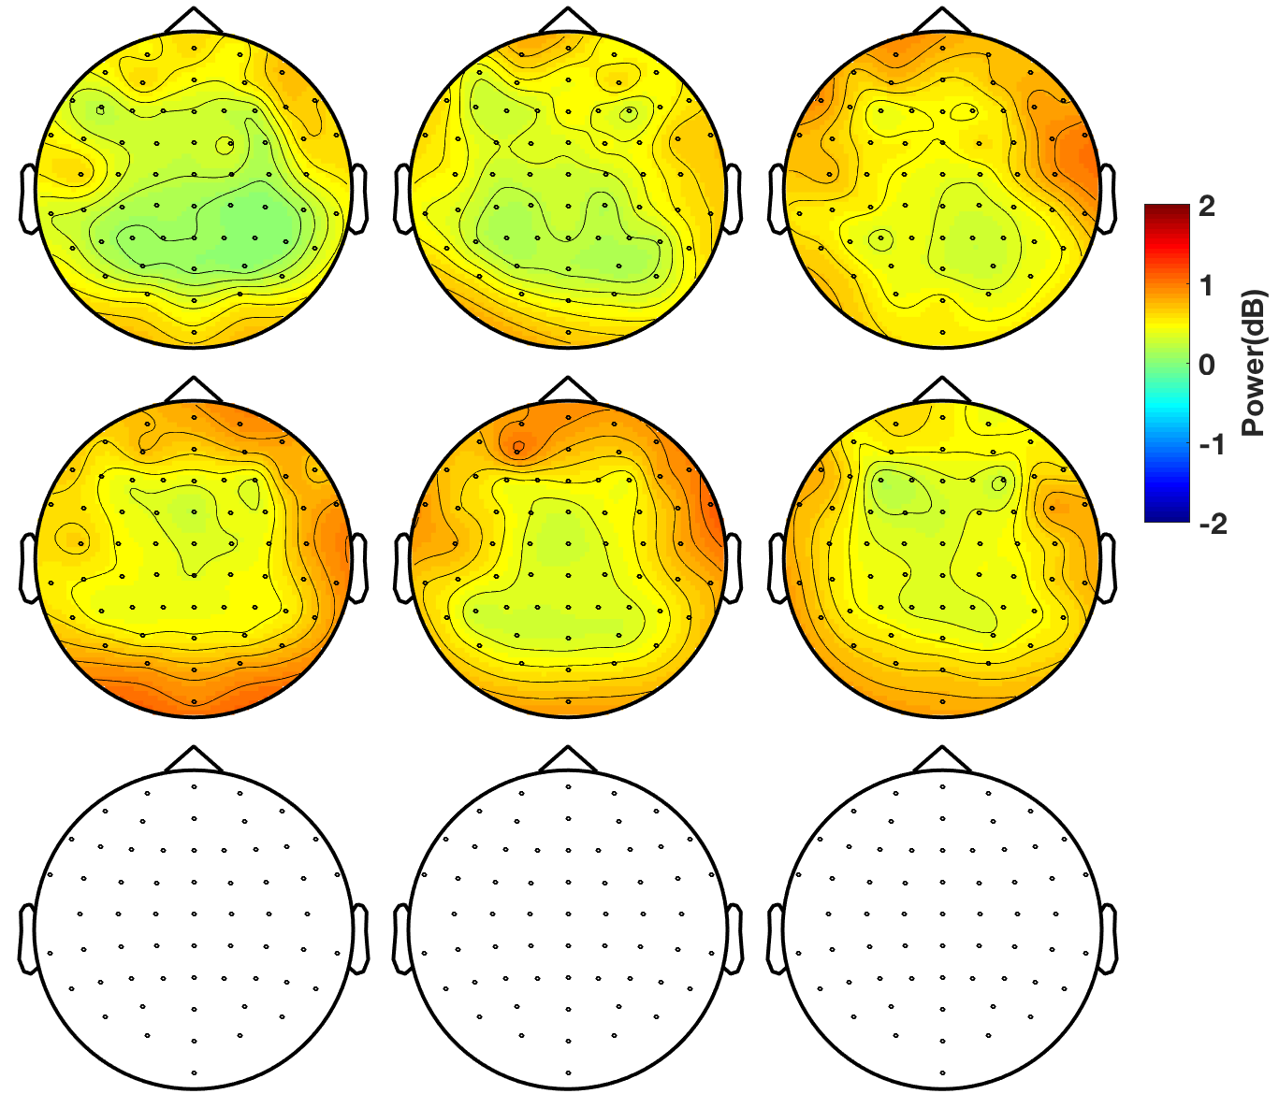
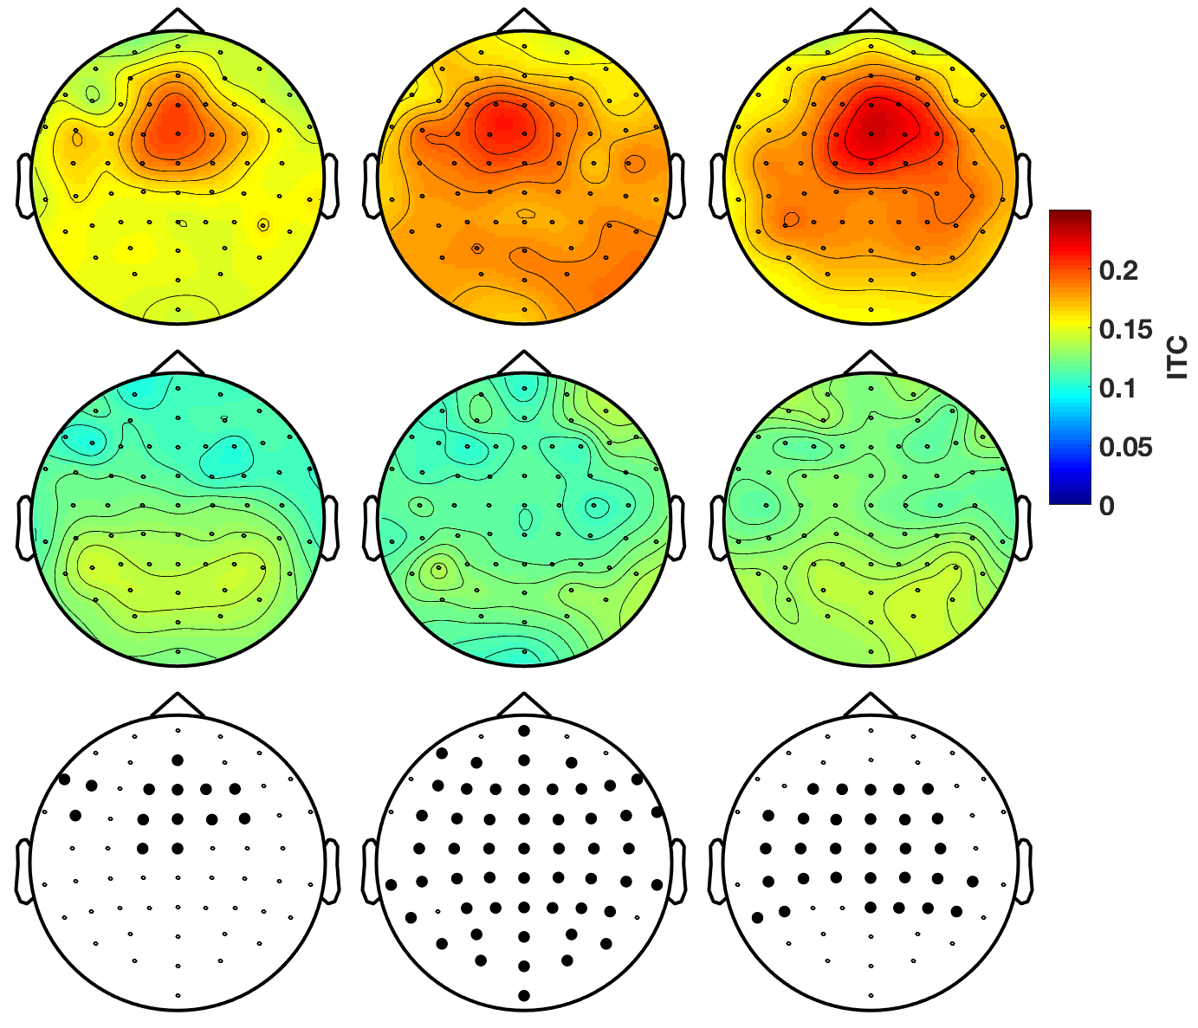
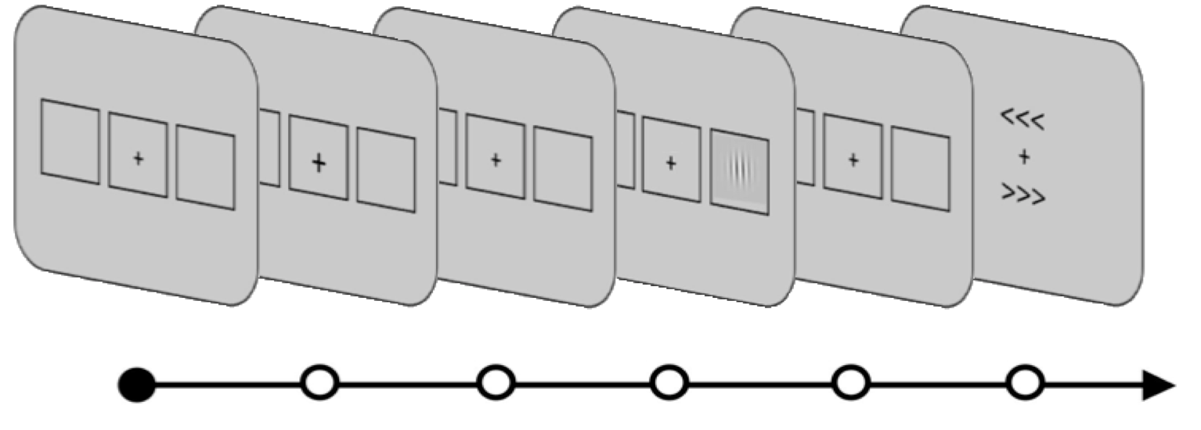
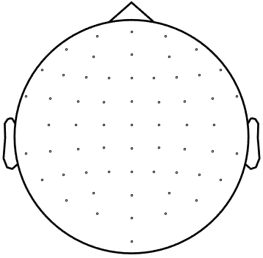
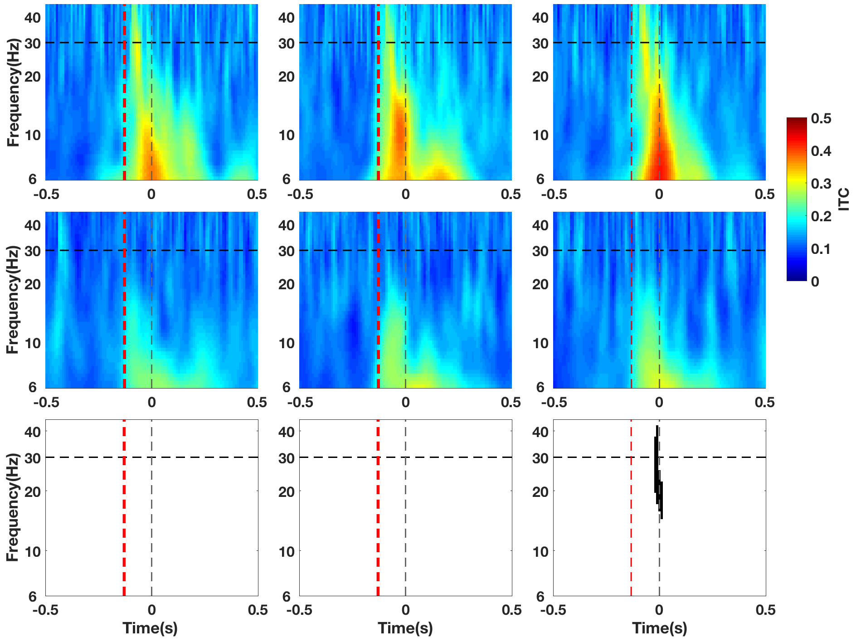
Non-specific impact of Transcranial Magnetic Stimulation sound patterns on cortical oscillations and visual detection
Chloé Stengel, Adrien Martel, Julià L. Amengual, Antoni Valero-Cabre
FrontLAB, Institut du Cerveau et de la Moelle épinière (ICM), CNRS UMR 7225, Paris, FRANCE
BACKGROUND
METHODS
EEG RESULTS
Transcranial Magnetic Stimulation (TMS) is a method of non-invasive brain stimulation widely used in fundamental research studies to causally modulate brain activity and cognitive functions. However, simultaneously with the brief electromagnetic field delivered to the cortex, each TMS pulse generates a brief but intense clicking sound. In order to cancel the influence of this auditory stimulation, experimental designs contrast active stimulation with a sham TMS condition that mimics the auditory stimulation associated with TMS. However, very few studies have studied the specific impact of such auditory stimulation on task performance¹.
Crossmodal sensory interactions are ubiquitous in the brain². In the domain of visuo-spatial attention and perception, in particular, sounds delivered shortly prior or simultaneously to the onset of a visual stimulus have been shown to modulate visual detection performances³. Additionally, auditory stimulation can phase-reset cortical oscillations in the auditory but also visual cortex⁴ and, lastly, a large literature has shown that trains of clicking sounds can entrain cortical oscillations following the frequency of the auditory train through a phenomenon called Auditory Steady-State Response (ASSR⁾⁵. Collecting more knowledge about the effects of auditory stimulation during task performance is crucial to better judge if sham TMS constitutes a good control condition for the sensory side effects of TMS.
Recordings done on 11 healthy right-handed subjects.
1. Auditory Event-Related Potentials
Position of Sham TMS coil
TMS coil
Sham TMS
Rhythmic
Random
Single Pulse
All Patterns (Sham TMS)
Sham TMS elicited clear auditory ERPs (at Cz).
The shape of the ERPs did not differ between sham TMS patterns
90°
Audio speaker
Placed in a frontal right location, above electrode FC2 on EEG array.
Sham TMS patterns
Sham TMS
No stimulation
Rhythmic
Random
Single Pulse
Rhythmic
(30Hz frequency-specific)
2. Entrainement of high-beta oscillations during 30Hz rhythmic sham TMS
Random
(non frequency-specific)
Rhythmic
Random
Single Pulse
Rhythmic
Random
Single Pulse
Rhythmic
Single Pulse
(no frequency content)
Sham TMS
Sham TMS
133 ms
Each pattern is tested in different blocks with sham TMS trials and no stimulation trials randomly interleaved in each block.
Power (dB)
ITC
Conscious visual detection at 50% visibility threshold
No stimulation
No stimulation
Random
-1.±0.5
-0.233
[-0.133, -0.033]
0
0.033
1
(s)
Sham TMS vs. No stimulation
Sham TMS vs. No stimulation
Single Pulse
Fixation
Cue
TMS
Target
Fixation
Response
Time
GOALS
Each trial could be: Left Target /Right Target /No target
Participants had 3 possible answers : Left /Right /Not seen
Topographies shown for the signal during sham TMS delivery window [-133 0]ms, for frequencies [25-35]Hz.
Blank topographies show statistical results, bolded electrodes reached significance (p<0.025).
Characterize the impact the auditory stimulation associated to sham TMS on brain activity and behavioral performance.
Investigate if such impact may interact with the effects of active TMS pulses.
BEHAVIORAL RESULTS
Rhythmic sham TMS did not increase oscillation power at the frequency contained in the burst.
Sham TMS phase-locked oscillations in the high-beta band but this effect was not specific to rhythmic sham TMS, instead it was stronger for single sham pulses.
Sham TMS
No stimulation
4. Oscillatory phase-locking in response to auditory stimulation
CONCLUSIONS
Rhythmic
Random
Single Pulse
FCz
Pre-target rhythmic sham TMS did not entrain cortical oscillations at the frequency present in the clicking train
Auditory stimulation
Crossmodally modulated perceptual decision-making processes
Phase-locked cortical oscillations
The absence of sham TMS-driven oscillatory entrainment strengthens the use of sham control designs in active TMS entrainment experiments. Moreover, we bring evidence that sham TMS does not induce states of neural activity (namely increased fronto-parietal high-beta oscillatory activity) that have been reported elsewhere^{6,7} to contribute to the facilitation of visual perception.
Nonetheless, the non-specific effects of auditory stimulation on perceptual decision-making processes and oscillatory phase-locking that we report call for new studies to allow a better understanding of the effects of sham TMS on the brain.
REFERENCES
Duecker and Sack, 2015, Frontiers in Psychology.
Shams and Kim, 2010, Physics of Life Reviews.
Lippert et al., 2007, Brain Research.
Romei et al., 2012, Current Biology.
Picton et al., 2003, International Journal of Audiology.
Vernet et al., 2019, Scientific Reports.
Stengel et al., 2019, Bioarxiv.
Sham TMS
Rhythmic
Random
Single pulse
Pre-target auditory stimulation did not modulate the perception of the visual target.
No stimulation
AKNOWLEDGEMENTS
*
* : Main effect (p<0.05)
ED3C Graduate School (Univ. PMCU-ParisVI) doctoral fellowship to CS, FYSSEN (France) postdoctoral fellowship to JLA; ANR OSCILLOSCOPUS and IHU-A-ICM funds to Dr. AV-C for research expenses; IFRAD foundation for equipment funds.
The authors have no conflicts of interest to declare.
Sham TMS vs. No stimulation
Rhythmic
Random
Single pulse
Time-frequency analyses for electrode FCz (in which high-beta ITC was the strongest). Visual target onset marked as time 0. Last row shows statistical results.
Further information :
chloe.stengel@icm-institute.org, antoni.valerocabre@icm-institute.org
However, pre-target auditory stimulation modulated subjective perceptual decision-making processes
Single Sham TMS pulses phase-locked oscillations in a broad frequency band.

