Slide 1
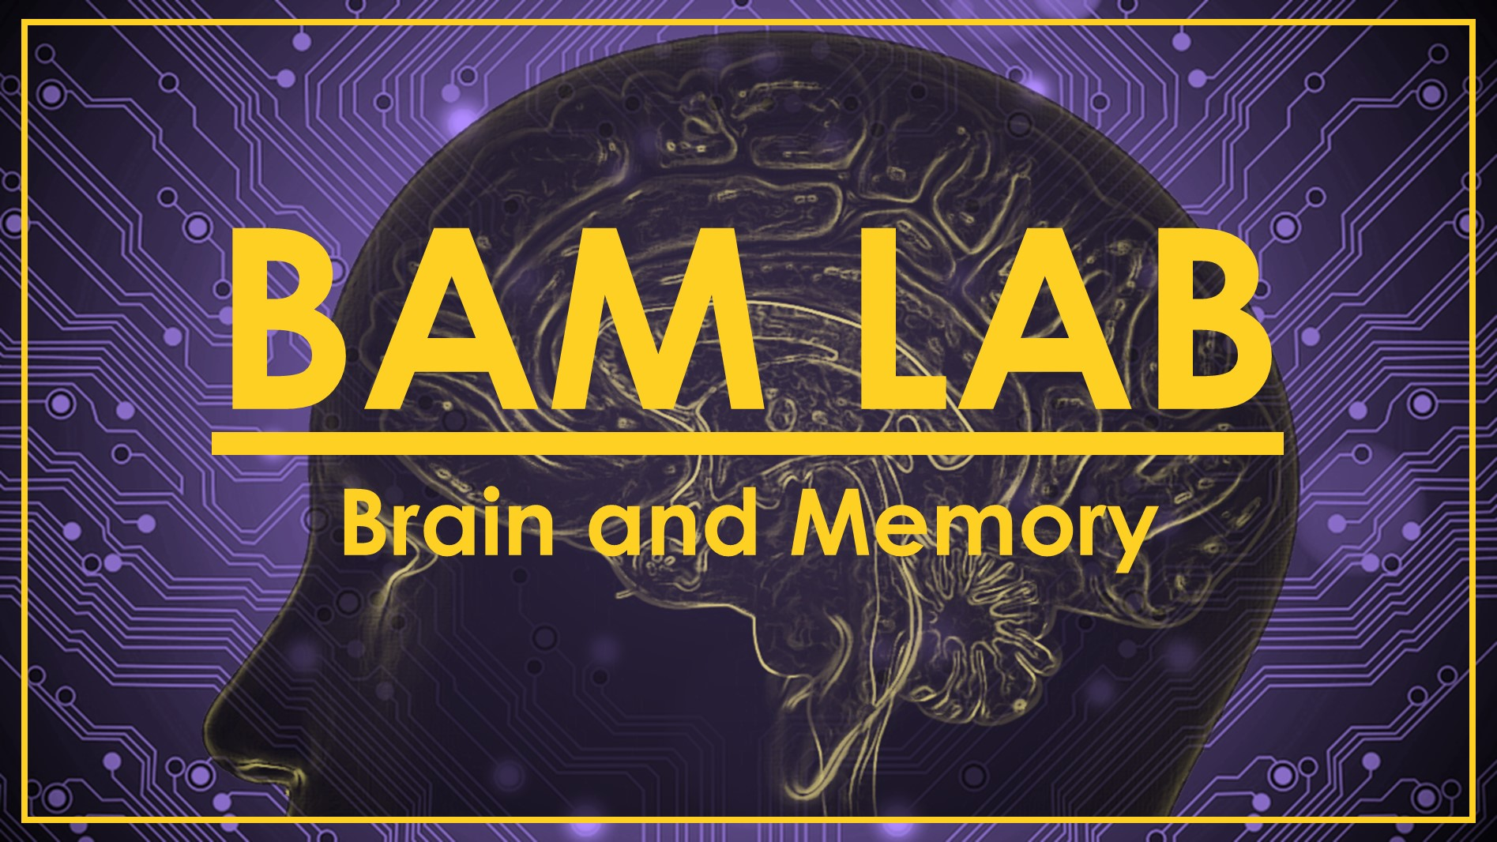
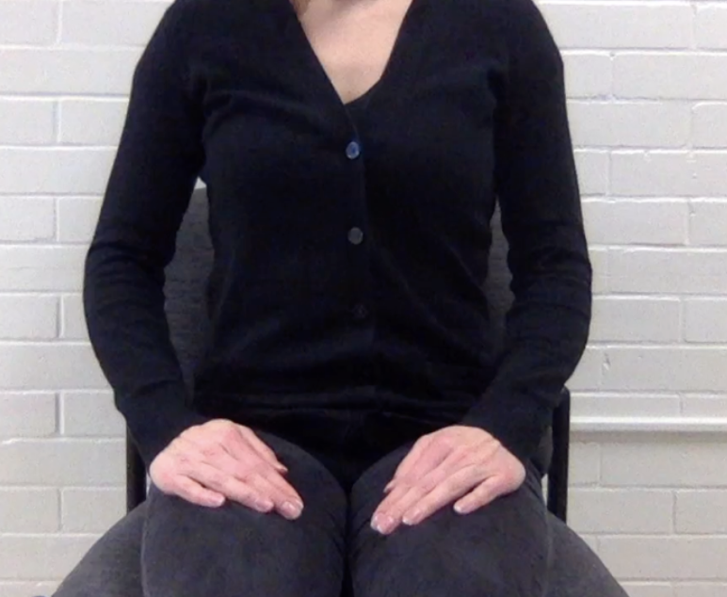
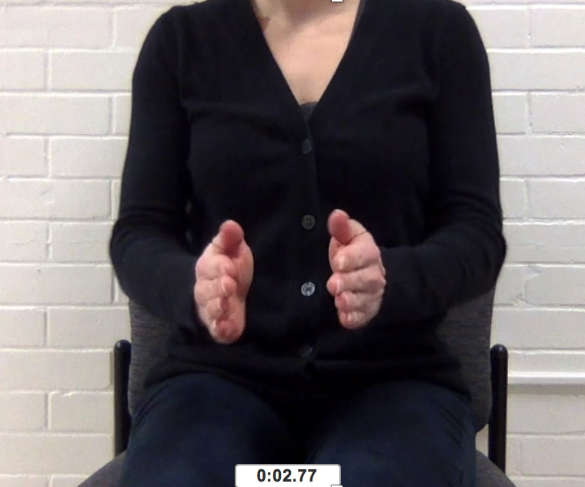
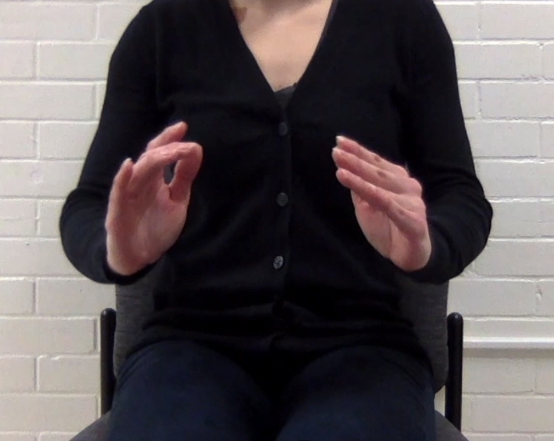
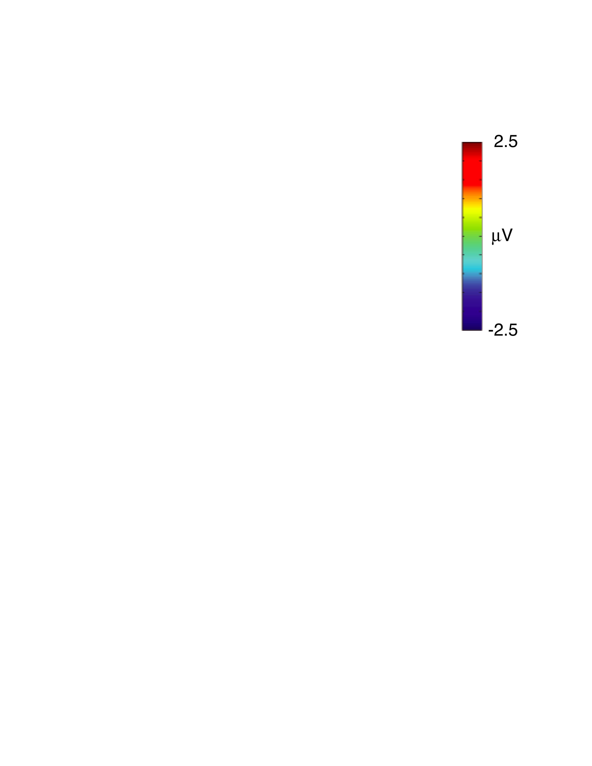

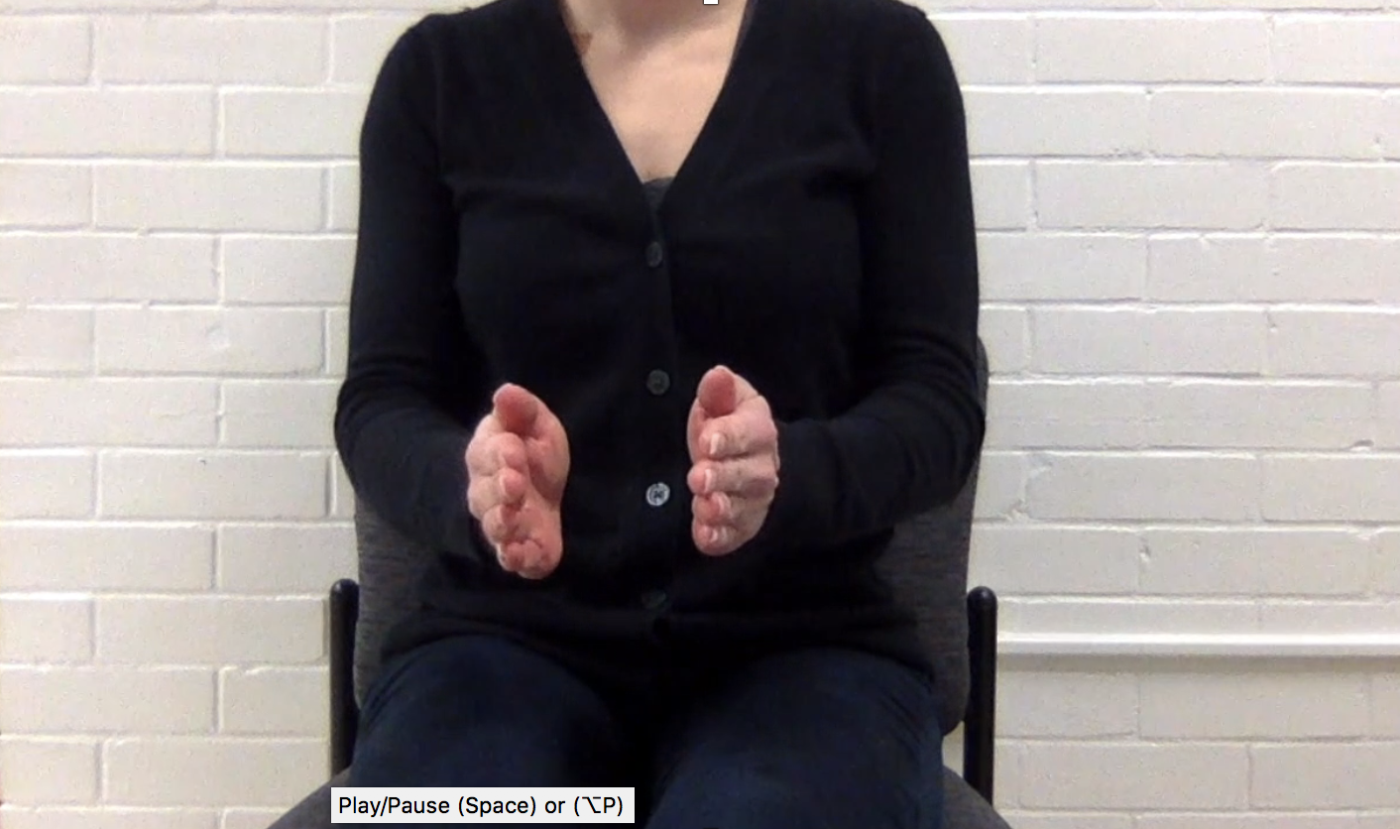

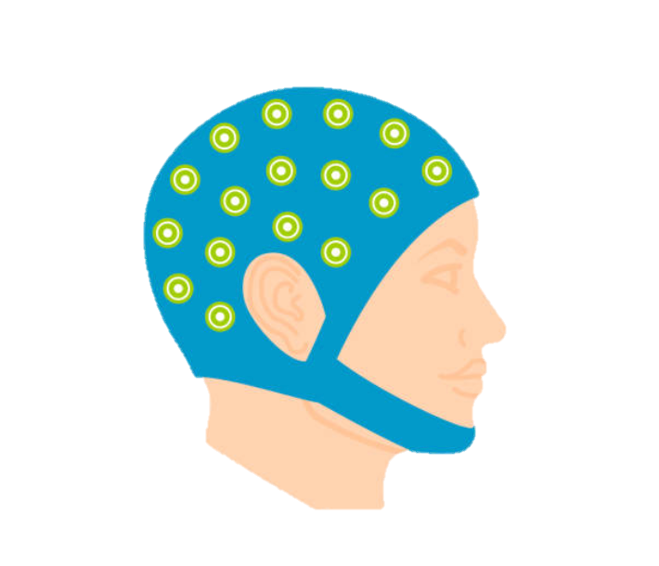
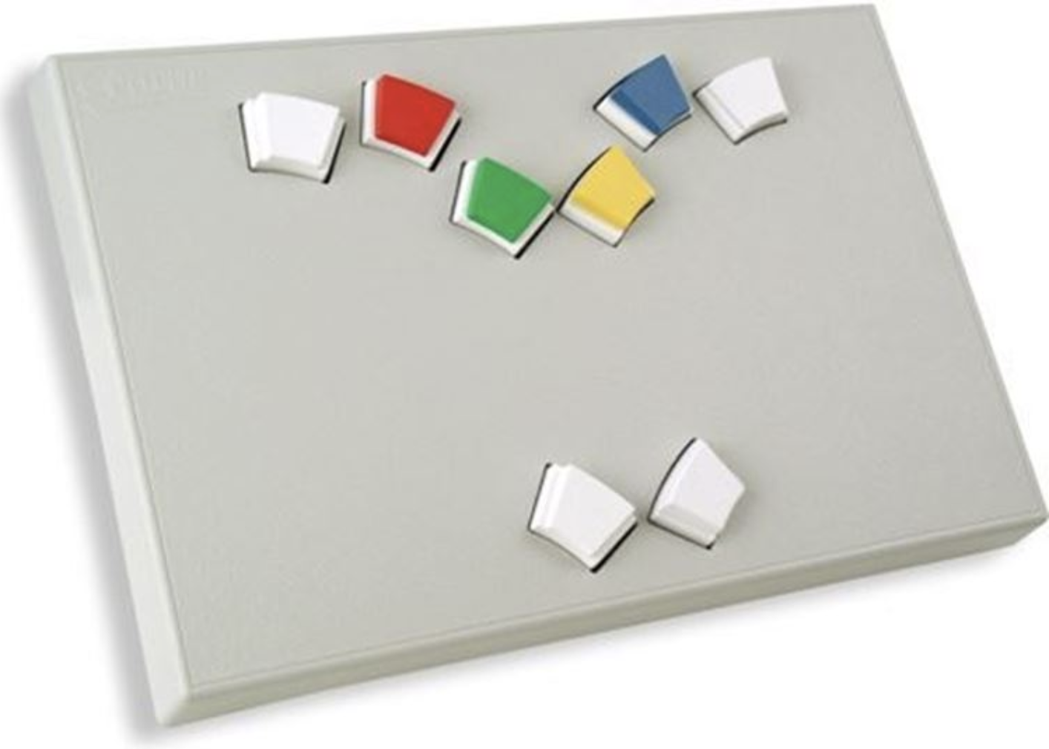
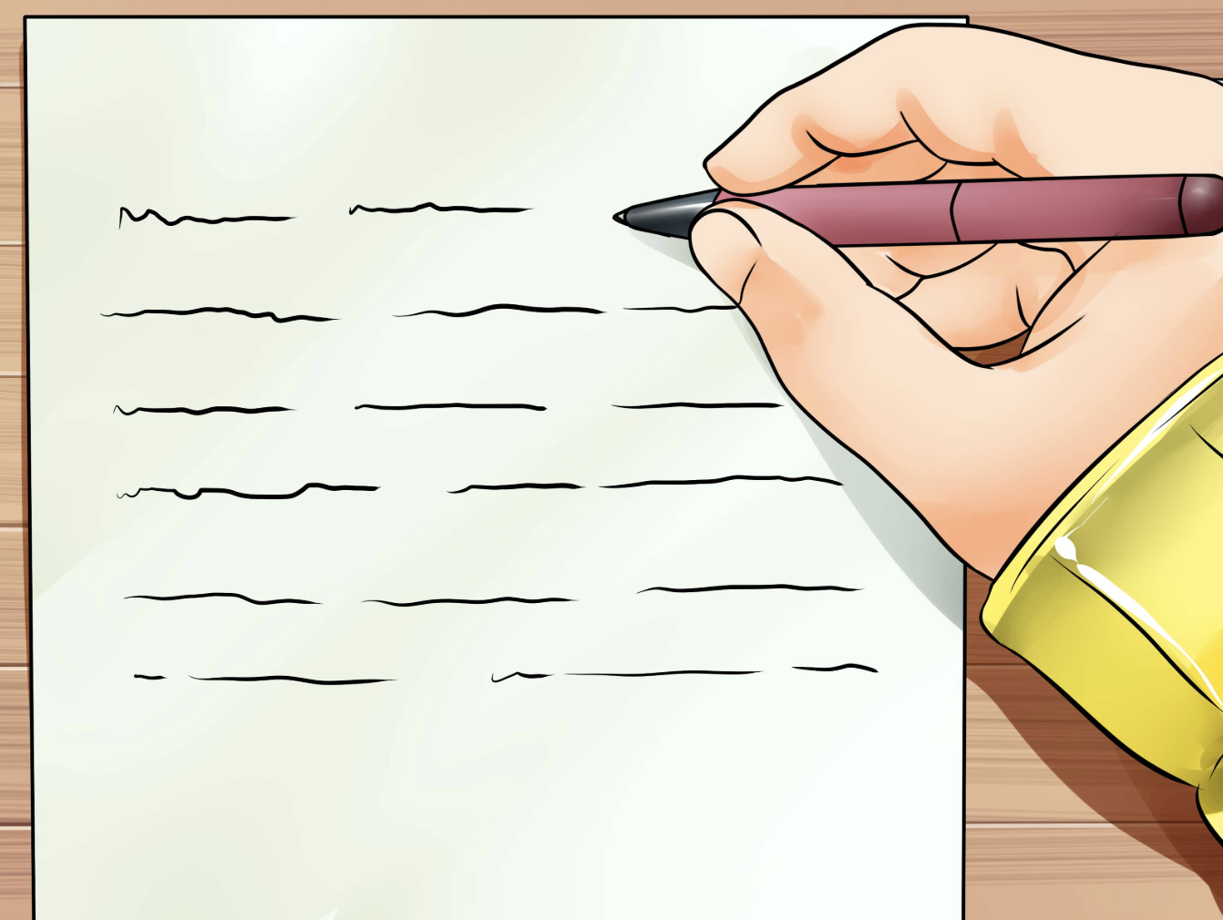
An ERP study of the beneficial effects of gesture on associative memory formation
Stanley H. West*, Brianna E. Cairney, & Heather D. Lucas
Psychology Department, Louisiana State University
*Correspondence to swest19@lsu.edu
How does co-speech gesture affect memory?
Stimuli
Gesture is an integral part of human communication that has been shown to benefit language comprehension and memory.
Co-speech gestures can include:
      Iconic gestures: hand movements that mimic speech
      Beat gestures: small hand movements for emphasis¹
  Gestures may benefit memory by:
      Dual coding: providing a visual representation of information, which may enhance imagery² and/or
      Attentional highlighting: calling attention to parts of speech³
While both iconic and beat gestures can enhance memory via attentional highlighting, only iconic gestures can support dual coding.
To compare these accounts, we recorded study-phase ERPs and tested recall for unrelated word pairs with the first words (W1s) paired with iconic, beat, or no gestures.
Iconic gesture
Beat gesture
No gesture
He thought about
the narrowing
turtle
He thought about
the narrowing
turtle
He thought about
the narrowing
turtle
(W1)
(W2)
Mean W1-W2 SOA = 1714 ms (range = 1519 – 1917); SOA & ISI held constant across conditions.
Behavior: W1 gestures enhanced imageability ratings; only iconic gestures enhanced recall
Ease-of-imagery ratings for all word pair types
Recall of co-gestured
W1s
Recall of W2s paired with
co-gestured W1s
*
*
*
iconic-gestured word pairs
p = .06
*
n.s.
n.s.
Hypotheses
Pair Imagery Ratings
Number of W1s recalled
Number of W2s recalled
beat-gestured word pairs
If gesture benefits memory via Attentional Highlighting:
  both iconic and beat gestures will improve memory
If gesture benefits memory via Dual Coding:
  only iconic gestures will improve memory
  iconic-gestured pairs may be perceived as more imageable
  Iconic-gestured pairs may elicit greater N700 amplitudes, an ERP component linked to concreteness and imagery in prior work⁴
non-gestured word pairs
ERPs: W1 gestures enhanced W2 N700 ERPs, suggesting facilitated associative imagery.
Analyses focused on ERPs elicited by the non-gestures W2s (e.g., narrowing turtle) so as to examine the impact of the co-W1 gesture on brain activity while holding sensory input constant.
Factorial mass univariate analyses revealed differences in five frontal electrodes (in white) from 790-1000 ms, consistent with N700.
+4 μV
concrete language
AFz
abstract language
Co-gestured W1s:
narrowing turtle*
Non-gestured W2s:
narrowing turtle
Scalp distributions from 790-1000 ms
+3 μV
+3 μV
+2.5
N700
Lucas, Hubbard, & Federmeier, 2017
200
400
600
800 ms
μV
Methods
AFz
Participants
N = 30 young adults, 23 female
Mean age = 20 yrs (range = 18-27)
All native speakers of English
Stimuli & Procedures
Participants watched videos of an actor reciting 108 sentences ending in unrelated verb-noun (W1-W2) pairs:
  36 with iconic-gestured verbs
  36 with beat-gestured verbs
  36 with non-gestured verbs
Stimuli presented in 3 blocks of 36, followed by a free recall test
After viewing each video, participants had 4 seconds to rate from 1-6 how easy it was to generate mental images of the word pairs
Continuous EEG recorded from 32 electrodes
+3 μV
+3 μV
N700
iconic –
none W2s
beat –
none W2s
iconic –
beat W2s
-2.5
Pz
N700s for W2s with iconic gestures > no gestures [t(29) = 4.48, p < 0.001]
Significant difference between beat > no gestures [t(29) = 2.96, p = 0.006]
No difference between iconic and beat gestures [t(29) = 1.56, p = 0.13]
iconic
beat
none
* W1 ERPs are provided for display purposes only and were not formally analyzed.
Conclusions
  Iconic gestures, but not beat gestures, enhanced recall for unrelated word pairs, suggesting that these memory benefits stemmed from the presence of semantic content rather than attentional highlighting.
  Both trial-by-trial imagery ratings and imagery-related ERPs (N700) were largest for word pairs accompanied by iconic gestures, suggesting that mental imagery may mediate the relationship between gestures processing and enhanced memory.
  However, imagery and ERP effects of beat gestures were not distinguishable from those of iconic gestures, leaving open the possibility that beat gestures can also be effective at enhancing imagery.
  These results tentatively support a dual-coding based theory of the beneficial effects of iconic gestures on memory.
McNeill, D. (1992). Hand and mind: What gestures reveal about thought. University of Chicago press.
Paivio, A. & Csapo, K. (1973). Picture superiority in free recall: Imagery or dual coding? Cognitive Psychology, 5, 176-206
Biau, E., & Soto-Faraco, S. (2013). Beat gestures modulate auditory integration in speech perception. Brain and Language, 124, 143-152.
West, W. C., & Holcomb, P. J. (2000). Imaginal, semantic, and surface-level processing of concrete and abstract words: an electrophysiological investigation. JoCN, 12, 1024-1037
Notes:
Electrodes analyzed: AFz, Fz, F3, Fc1, Fc2
Time window: 790 - 1000 ms
Imagery Ratings: Iconic (mean = 3.75, sd = 0.66); Beat (mean = 3.49, sd = 0.64); None (mean = 3.31, sd = 0.59)
Iconic – Beat t(29) = 1.97, p = 0.059, 95% CI [-0.01, 0.52] Trending
Beat – None t(29) = 2.2, p = 0.036, 95% CI [ 0.01, 0.34] Significant
Iconic – None t(29) = 3.39, p = 0.002, 95% CI [ 0.17, 0.70] Significant
Recall W1: Iconic (mean = 9.3, sd = 4.1); Beat (mean = 6, sd = 3.5); None (mean = 5.4, sd = 3.2)
Recall W2: Iconic (mean = 8.7, sd = 3.7); Beat (mean = 6.7, sd = 4.1); None (mean = 5.7, sd = 3)
Recall W1+W2: Iconic (mean = 17.9, sd = 7); Beat (mean = 12.7, sd = 7.1); None (mean = 11.1, sd = 5.9)

