Slide 1
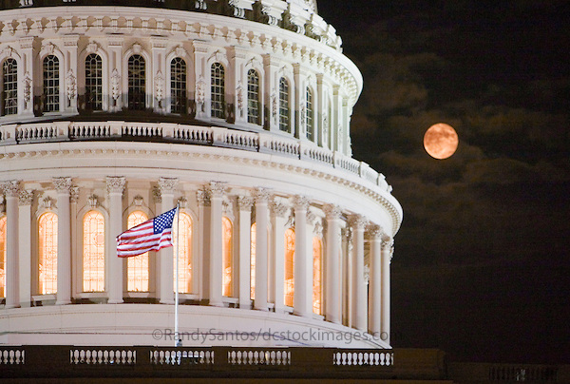
Federal Update on Early Childhood
Sharon Walsh
ITCA and DEC
April 2015

Slide 2
President’s 2016 Budget
Part C - Recommends a $65 million increase over current funding which would bring the FFY 2016 to $504 million.
Proposal would reserve $15 million of this increase for “Pay for Success pilots to expand early screening and early intervention services.”

Slide 3
619 Preschool Grants program
Recommends a $50 million increase which would bring the program to $403 million in FFY 2016.
Proposes flexibility in the use of early intervening funds for preschool.
“The Administration is requesting additional flexibility to allow LEAs to provide CEIS to children ages three through five.”

Slide 4
Other Proposed Increases
An increase in mandatory funding for CCDBG to $6.582 billion (from $2.917 billion in FY 2015);
An increase discretionary funding for CCDBG to $2.805 billion (from $2.435 billion in FY 2015);
An increase of the Child and Dependent Care Tax Credit (CDCTC) to a max of $3,000 for family with one child under age five in child care and $6,000 for family with two or more children under age five, for families with incomes up to $120,000;

Slide 5
Others…
An increase in Head Start/Early Head Start to $10.1 billion (from $8.6 billion);
$750 million for Preschool Development Grants, an increase from $250 million in FY 2015;
An extension and expansion in the Maternal, Infant and Early Childhood Home Visiting Program (MIECHV), proposing $500 million for FY 2016 and continued expansion to over $2 billion annually by 2025; and
A freeze in funding of $637 million for the Title V Maternal and Child Health Services Block Grant.

Slide 6
ESEA Reauthorization
Secretary’s priorities include dedicated early childhood investment
House Education and the Workforce Committee chairman’s bill does not include an early childhood investment
Initial Senate draft bill released by Chair Alexander (TN) did not include early childhood investment
Ranking chair Murray (WA) is pushing to include dedicated funding for early childhood in ESEA

Slide 7
Senator Murray
“I believe Congress should only pass an education bill that expands access to preschool programs. This is a particularly important issue to me.
As a mom, and when I was a preschool teacher, I saw firsthand the kind of transformation that early learning can inspire in a child – not just to start kindergarten ready to learn, but also to succeed later in life.
That’s why law enforcement, business groups, military leaders, and so many others all support expanding access to early childhood education.
Congress needs to catch up with the Democratic and Republican governors and legislators around the country”

Slide 8
Maternal, Infant, and Early Childhood Home Visiting (MIECHV) program
Home Visiting expired March 31, 2015
Designed to improve the health of at-risk children through EB home visiting programs.
The home visiting programs reach pregnant women, expectant fathers, and parents and caregivers of children under the age of 5.
House Bill just passed 392 to 37 to extend program for 2 years
Senate did not act on this bill before recess; expected to pass first day back in session

Slide 9
Children's Health Insurance Plan (CHIP)
CHIP expires September 30, 2015
Reps. Upton and Pitts & Sen. Orrin Hatch released new discussion draft bill to reauthorize CHIP
Senate and House Democrats have already introduced a bill to reauthorize it
House Bill just passed 392 to 37 to extend for 2 years
Senate did not act on this bill before recess; expected to pass first day back

Slide 10
TANF Reauthorization
TANF expires Sept 30, 2015
Tom Reed (R-NY) introduced the “Preserving the Work Requirement for Welfare Act”
The bill would prohibit the administration from waiving the work requirement in the Temporary Assistance for Needy Families (TANF) program.

Slide 11
Providing Resources Early for Kids (PRE-K) Act
The PRE-K Act introduced in Senate - Tim Kaine (D-VA), Mazie K. Hirono (D-HI), Dick Durbin (D-IL), Kirsten Gillibrand (D-NY), Tammy Baldwin (D-WI), Brian Schatz (D-HI), Sherrod Brown (D-OH), and Ron Wyden (D-OR).
Designed to expand access to high-quality early learning programs for children from birth to age five.
Establishes federal-state partnerships that incentivize states to improve quality of state preschool programs and expand programs to serve more children in need.
Similar legislation to be introduced in the House by Reps. Mark Pocan and Mike Honda.

Slide 12
Upcoming Head Start Act
House Ed and Workforce Committee announces comment process for plans for Early Head Start/Head Start
White Paper released for comment
Comments due June 1, 2015

Slide 13
Other Bills…
Early Hearing Detection and Intervention Act (EHDI).
H.R. 1344; last reauthorization was in 2010
Representatives Brett Guthrie (R-KY) and Lois Capps (D-CA) introduced bill to reauthorize EHDI for 5 years
State grants to develop infant hearing screening and intervention programs
“Strong Start for America’s Children Act”
From last Congress
Expected to be introduced in House and Senate

Slide 14
Child Care and Development Block Grant Act of 2014
Last Congress completed the Reauthorization of the Child Care and Development Block Grant (CCDBG)
First time in over 17 years.
Senate passed by 96-2 in March 2014
Bipartisan, bicameral bill announced in September before recess
Passed House on September 15th
President signed into law

Slide 15
Child Care and Development Fund (CCDF) Plan
Office of Child Care (OCC) announced a new deadline for the 2016–2018 State and Territory CCDF Plans
Plans are now due March 1, 2016.
Extension designed to allow grantees more time to respond to the new provisions
Current State CCDF Plans will be extended until then
Effective dates for specific provisions in the new law remain the same.
States had been concerned about lack of time available to implement the new law

Slide 16
President Obama at Northwestern University - October 2014
“If we make high-quality preschool available to every child, not only will we give our kids a safe place to learn and grow while their parents go to work; we’ll give them the start that they need to succeed in school, and earn higher wages, and form more stable families of their own. In fact, today, I’m setting a new goal:
By the end of this decade, let’s enroll 6 million children in high-quality preschool. That is an achievable goal that we know will make our workforce stronger.”

Slide 17
FFY 2014 Appropriations
New Preschool Grants
$250M in grants to States for preschool grants
Grants were awarded to 18 of the 40 states
Grants are jointly administered by ED and HHS
Early Head Start/Child Care Partnerships
ACF funded $500 million in grants
Supports creation of Early Head Start/Child Care (EHS-CC) Partnerships and expansion of EHS
Notes:
Asks states to identify and support:
Priority Schools- lowest achieving 5% of Title I Elementary schools and Title I secondary schools with graduation rate < 60%.
Focus Schools- 10% of Title I schools with greatest achievement gaps and secondary schools with the greatest graduation rate gaps .
All other schools District ID achievement gaps and design intervention locally with community input

Slide 18
Other Administration Initiatives
Federal Campaign on EC Inclusion
Current effort across ED and HHS
Focus - “all children have access to and full participation in high-quality early care and education settings.”
Development of a Federal policy statement, activities and resources
Race to the Top Early Learning
20 states in total have these grants

Slide 19
Online Updates
Dept of Education's Office of Early Learning list serv and monthly newsletter at
www.ed.gov/early-learning

