Slide 1
Segregation of Duties: A Cybersecurity Safeguard
Notes:
“Thanks Caren for that introduction. My Cyber Quick Hit today is going to focus on Segregation of Duties: A cybersecurity safeguard – More specifically Segregation of Security Management Duties... Our goal today is to establish what our risks are and look at how segregation of duties helps with mitigating those risks.
1

Slide 2
What is Our Risk Appetite
Notes:
Established risk management practices in banking should be extended to IT operations. For example, Segregation of Duties is a solid foundation for sustainable risk management. Your chief lending officer would not approve loans, nor would one person handle outgoing wires; yet IT sets up and monitors email, keeps the network running, arranges penetration testing, reports to the board, and works directly with auditors. In this session, we will discuss Segregation of Duties in IT governance.

Slide 3
What Are The Risks?
Potential Fraud
Human Errors
Security Breaches
Information Theft
Circumvention of Security Controls
www.onShore.com
Notes:
The FFIEC has dedicated an entire section of their IT Handbook and that will be our guide in defining SoD as it pertains to our risk appetite. First lets talk about Separation of Duties at a basic level before we jump into specifics around the FFIEC expectations.

Slide 4
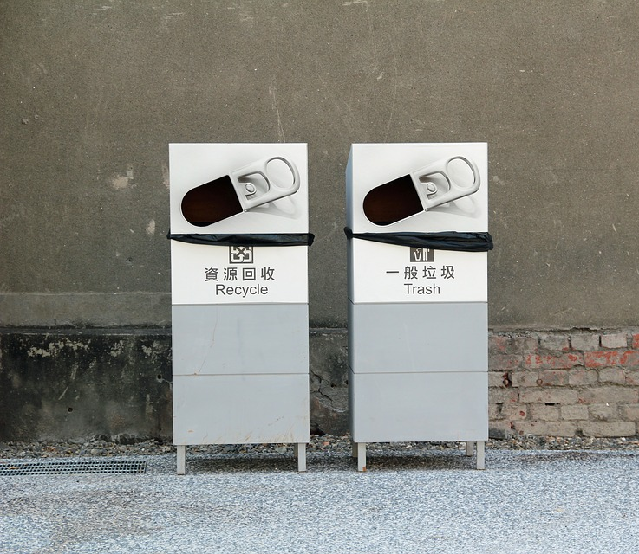
Segregation of Duties
Notes:
It is easy to end up with overlap as the skills and experience needed are often found by resources in more than one department and so it is very important to be clear about who is responsible and accountable for what and to whom.

Slide 5
Segregation of Duties
Reduce the likelihood of fraud
Limits abuse and errors
Detect and prevent security breaches
Catch and prevent information theft
Remove the ability to bypass security controls
www.onShore.com
Notes:
Walk through slide quickly

Slide 6
Goal in Segregation of Duties
Notes:
There are ultimately two goals that we are looking to achieve and we aren’t going to get them accomplished all at once. It is a process – the goals are… slide

Slide 7
So what do our goals look like?
Take away the ability for individuals to have conflicting duties
Remove the responsibility for reporting on themselves or their superiors
www.onShore.com
Notes:
What do they look like
Bullet 1 - As in your systems administrator who is responsible for executing a vulnerability scan should not be responsible for reviewing the results. This is no different than having a bookkeeper who has the authority to approve payment
Bullet 2 - Segregation of Duties is a well-known concept in the banking and business world but few have given thought to the subject in regards to Information Security.

Slide 8
Test Your Segregation of Duties
Notes:
The only way to verify your Segregation of Duties is working is to regularly test… and you need to ask yourself the following questions… slide

Slide 9
Test your Segregation of Duties
Can any one person alter, destroy or steal data without being detected?
Does any one person have influence over controls design, implementation and reporting of effectiveness of those same controls?
www.onShore.com
Notes:
Begin thinking about how you answered your SoD questions and whether the answers were true to either question. - I know the questions seem a bit vague but the goal here is that by following some of the next steps I outline you can answer with a confident No to both of these.

Slide 10
Achieving Your Goals
Notes:
If you look at what FFIEC IT handbook calls out so that by following the handbook you can essentially answer no to both of the SoD questions. While we don’t have time to jump into each of the sections I want to outline them as first steps towards determining your risks and how to go about SoD.
There are going to look are five key areas:
Information Security Risk Assessment
Information Security Strategy
Security Controls Implementation – This helps define SoD
Security Monitoring
Lets jump into the how to achieve our goals after walking through the items outlined in the FFIEC IT Handbook – next slide

Slide 11
Designate an individual responsible for each of your security processes and the process owner’s and report to audit committee chair.
Use a 3rd party to monitor security, conduct surprise security audits and security testing.
Have an individual (CISO) responsible for IS report to the board of directors.
Have an individual (CISO) responsible for IS report to audit committee as long as internal audit committee doesn’t report to CFO.
How to?
Notes:
Whether the responsibility is left to the CIO, CISO or CTO (unlikely the CFO) in any financial organization the following should be true:
Understand the infrastructure to the nth degree – you can’t protect what you don’t understand
Has read the FFIEC IT Handbook
Leaves their EGO at home
While expected to meet all three we know that that is just the beginning and this Segregation of Duties isn’t easy when not everyone at the table has the expertise or experience, but not impossible. Accomplishing SoD and a strong security process portfolio often requires a 3rd party to come in and help get the right information into the hands of the board members to make decisions that will insure they keep their risk appetite in check and continuously are improving their security posture.

Slide 12
Importance of Segregation of Duties
Notes:
– I want to emphasize that while the FFIEC IT Handbook calls out the importance of it… this isn’t the first time we have heard nor is it new in our businesses but perhaps is relatively new in how we look at it when talking about IT Security… next slide

Slide 13
Importance of
SoD
All businesses bound by FFIEC involve control techniques surrounding SoD and are subject to review by external auditors.
FFIEC calls out GRC at the corporate leadership level and then again at the IT management level.
Notes:
Considering auditors in the past have listed deficiencies in SoD why not have a discussion with your external auditors?
Segregation of Duties is key to minimize opportunity for unauthorized access and fraud.

Slide 14
Chain of Custody
Notes:
by implementing SoD you can truly achieve a Chain of Custody that can be easily followed and insure accountability and transparency throughout the process. Next slide

Slide 15
Take Away…
Go back to the test
There is help from 3rd party vendors
Know your Risks and control your chain of accountability
Notes:
Get help from 3rd party IT Security companies… We are here at onshore and we provide CISO mentoring and other CISO services to help organizations that don’t have the internal resources or have the resources but need help getting them the experience and knowledge they need. This doesn’t have to be a permanent engagement but often we find that by engaging a 3rd party you gain valuable resources but at a fraction of what it would cost to hire fulltime employees.
Know yoru Risks and control that chain of custody
End with a story – Shifting the perspective from Operations to management – What happens when there is a missing management layer – the Achilles heel… is not your Security Operations it is the lack of security management. My experience with a publicly traded company

Slide 16
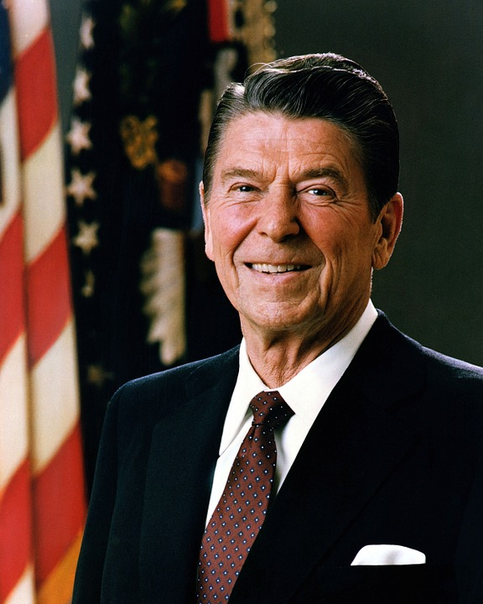
Management Layers
Trust but Verify
Notes:
Mane

Slide 17
Thank You
Email: Chris.Johnson@onshore.com
Twitter: untangledcj
LinkedIn: chrisjohnson1337msp

