Slide 1




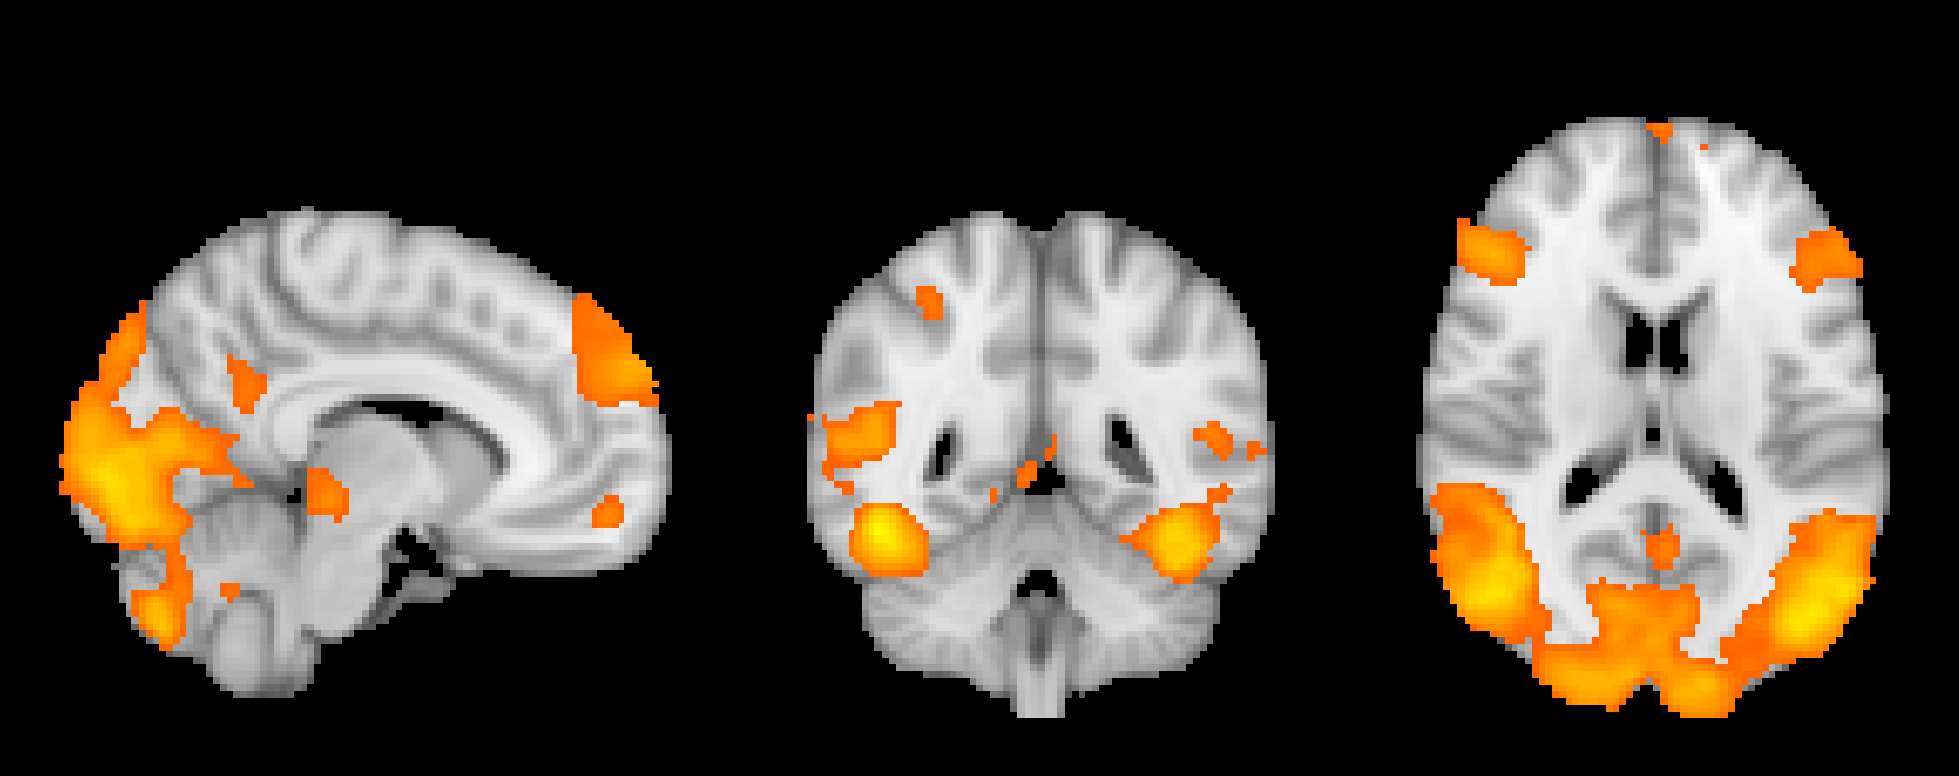
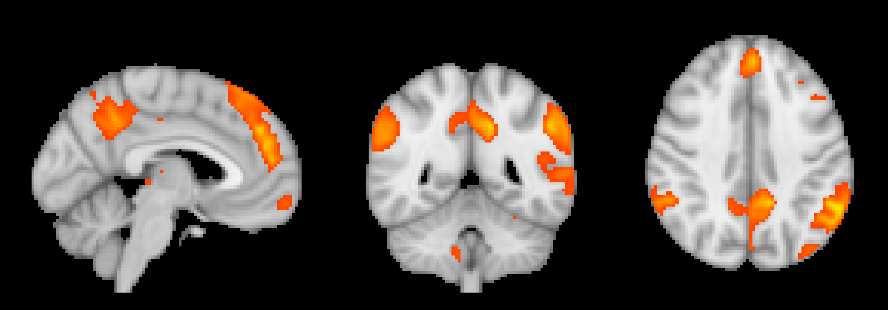
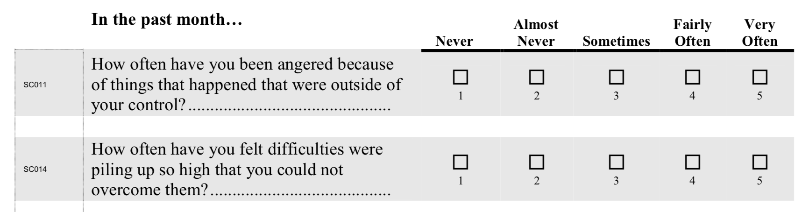
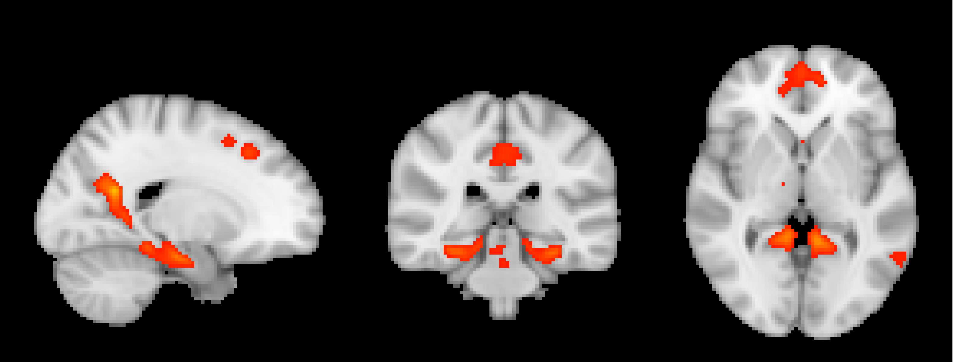
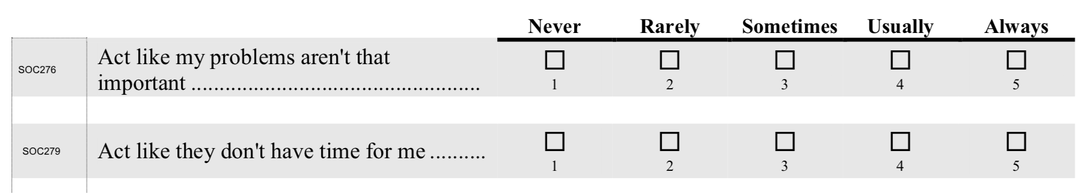
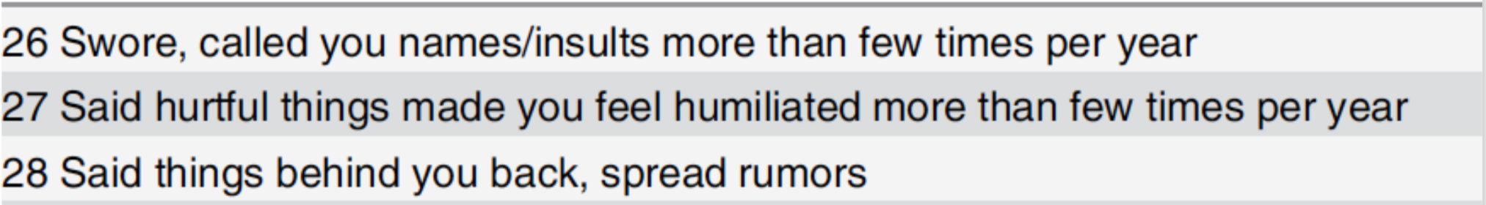
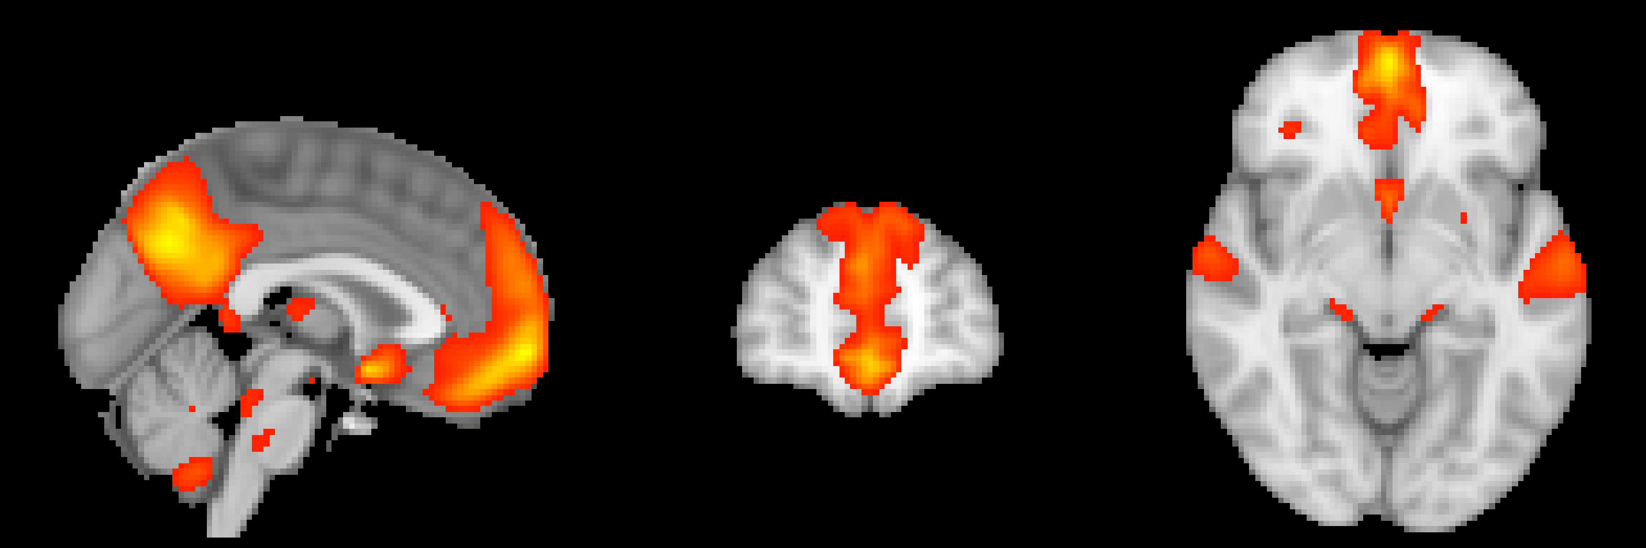

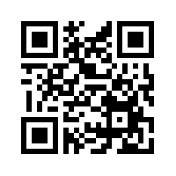
Brain Network Activation during Emotional Response
Impacted by Perceived Stress in Adolescents
E M Schuttenberg¹, AM Seraikas¹, EN Oot^{1,5}, JT Sneider^{1,3,4}, MM Silveri^{1,3,4}, LD Nickerson^{2,3,4}, JE Cohen-Gilbert^{1,3,4},
¹Neurodevelopmental Laboratory on Addictions and Mental Health, McLean Hospital; ²Applied Neuroimaging Statistics Laboratory, McLean Hospital;
³McLean Imaging Center, McLean Hospital; ⁴Department of Psychiatry, Harvard Medical School; ⁵Boston University School of Medicine
Introduction Imaging Methods
Adolescence is a distinct period of development marked by substantial brain remodeling, particularly in networks subserving inhibitory control that are susceptible to stress.^{1,2}
Stress has been shown to negatively impact mental health³ and peer stress is specifically implicated in the early onset of socio-emotional disorders (e.g. depression, anxiety).⁴
This study evaluated network activation during performance of an emotional Go-NoGo task^{5,6} and associations between network activation and self-reported stress and peer rejection or abuse.
Whole brain multiband echoplanar (EPI) blood oxygen level dependent (BOLD) data were acquired on a 3T Siemens TIM Trio (Siemens, Erlangen, Germany) with a 32-channel phased array head coil (TR: 750ms, TE: 30ms, voxel size: 2.8x2.8x2.8mm).⁶
Preprocessing (slice scan time correction, linear trend removal, high-pass temporal filtering, spatial smoothing, motion correction) and first-level statistical analyses were performed using FSL. GLM regressors modeled NoGo trials within positive, negative, neutral, scrambled conditions. Contrasts of parameter estimates were calculated between negative and neutral conditions and were averaged across all participants in a second-level GLM in order to identify brain regions recruited in response to increased emotional distraction during inhibitory (NoGo) trials (p < 0.05, corrected for multiple comparisons).
Task-related activation of key brain networks was explored using network template spatial maps⁹ derived from Human Connectome Project data (https://www.humanconnectome.org/study/hcp-young-adult).¹⁰
Template network maps were regressed against the full set of brain activation maps for Negative NoGo > Neutral NoGo contrast to estimate the impact of negative emotional stimuli during response inhibition on the strength of activation of each associated network. Correlation analysis was done to examine task-related network loadings relative to perceived stress, perceived rejection and peer emotional abuse.
Results
Figure 1 shows activated regions observed in response to the presence of negative emotional images during inhibitory control (Negative NoGo > Neutral NoGo contrast).
Figure 1. Activation on Negative NoGo > Neutral NoGo Contrast
Figure 2: Greater perceived stress was significantly associated with lower accuracy on inhibitory trials.
Figure 2. Go-NoGo Performance
Participants, Procedures and Performance
Participants: 45 healthy adolescents (age = 13.9 ± 0.6 years, 25 biological females). Participants provided consent prior to participation. The study was approved by the McLean Hospital Institutional Review Board.
Study visit: Cognitive testing and emotional questionnaires (NIH Toolbox),⁷ Maltreatment and Abuse Chronology of Exposure (MACE)⁸ interview, and MRI and fMRI data were collected.^{5,6}
Networks Associated with Self-Report Measures
Figure 3b.
r₇₅ = -.321, p = .004
Perceived Stress NIH Toolbox (sample questions)
Figure 3a. Anterior DMN Sub-Network
Weaker activation of the anterior DMN sub-network (Figure 3a) was associated with greater perceived stress (Figure 3b) and greater peer emotional abuse (p = .03).
r₄₂ = -.415, p = .005
Perceived Rejection NIH Toolbox (sample questions)
Figure 4b.
Figure 4c.
Weaker activation of medial temporal DMN (Figure 4a) was associated with lower perceived stress (Figure 4b), perceived rejection (Figure 4c) and peer emotional abuse (p = .009).
Figure 4a. Medial Temporal Lobe DMN Sub-Network
Peer Emotional Abuse (MACE) (sample questions)
r₄₂ = -.348, p = .02
r₄₂=-.368, p=.01
r₄₂ = -.348, p = .02
Figure 5b.
Figure 5c.
Weaker activation of the ventromedial PFC DMN sub-network (Figure 5a) was associated with greater perceived stress (Figure 5b) and perceived rejection (Figure 5c).
Go-NoGo Task^{5,6}
Figure 5a. Ventromedial Prefrontal DMN Sub- Network
Participants were asked to make a button press for every letter except X while ignoring background images.
Participants had to actively inhibit presses on NoGo trials (‘Xs’=25% of trials).
Background images were selected from the International Affective Picture System (IAPS) and were positive, negative, neutral or scrambled.
r₄₂ = -.376, p = .01
r₄₂ = -.396, p = .008
Discussion
These findings suggest internalized stress may alter engagement of networks related to emotion regulation and social cognition during response inhibition during negative relative to neutral emotional distraction. Specifically, activity of DMN sub-networks associated with autobiographical recall (anterior & temporal lobe), theory of mind (anterior), and affective processing (ventromedial) was associated with perceived stress and rejection.
Findings could reflect increased impulsivity and self-reflective processing, elicited by both negative and neutral stimuli that could serve as an early marker for later mental health problems, such as increased depression and anxiety symptoms.
Table 1. Emotional Go-NoGo Performance: Measures & Trial Type
Measure | Negative | Positive | Neutral | Scrambled
Go Accuracy (%) | 97.6 ± 3.2 | 98.5 ± 2.0 | 98.7 ± 1.8 | 98.8 ± 1.6
NoGo Accuracy (%) | 51.7 ± 18.1 | 56.0 ± 16.8 | 57.0 ± 20.3 | 61.9 ± 15.8
Go Reaction Time (ms) | 367.5 ± 40.3 | 359.4 ± 39.4 | 353.0 ± 35.3 | 355.6 ± 39.0
Data represent mean ± standard deviation.
Spear, L.P., 2012. Adolesc Health, 52(2), 7-13.
Spear, L.P., 2000. Neurosci Biobeh Rev, 24(4), 417-463.
Tottenham, N. et al., 2016. Neurosci Biobehav Rev, 70(4), 217-227.
Gogtay, N. et al., 2004. Proc Nat Acad Sci USA, 101(21), 8174-8179.
Cohen-Gilbert J.E., Thomas, K.M., 2013. Child Dev, 84(6), 1954-1956.
Cohen-Gilbert, J.E. et al., 2017. Front Psychol, 8,1650.
Hodes, R.J., et al., 2013. Neurology, 80 (11 Suppl 3): S1.
Teicher, M.H., Parigger, A., 2015. PLoS One, 10(2).
Nickerson, L.D., 2018. Sci Rep, 8(1), 17543.
Smith, S.M. et al. 2015. Nat Neurosci. 2015: 18(11): 1565-7.
This study was supported by:
K01 AA022392 (Cohen-Gilbert)
R01 AA022493 (Silveri)

