Slide 1
Stepping Up Use of IGDIs for Data-based Intervention Decision Making with Infants and Toddlers
Jay Buzhardt Charles Greenwood Dale Walker
Judith Carta Susan Higgins Sarah Petersen
Juniper Gardens Children’s Project
University of Kansas
Notes:
Letting it happen…helping it happen…making it happen: Greenhalgh, T., Robert, G., MacFarlane, E, Bate, P, & Kyriakidou, O. (2004). Diffusion of innovations in service organizations: Systematic review and recommendations. The Milbank Quarterly, 82, 581-629. http://dx.doi.org/10.1111 /j.0887-378X.2004.00325.x
Eccles, M. P., Armstrong, D., Baker, R., Cleary, K., Davies, H., Davies, S., & Sibbald, B. (2009). An implementation research agenda. Implementation Science, 4, 18-25.

Slide 2
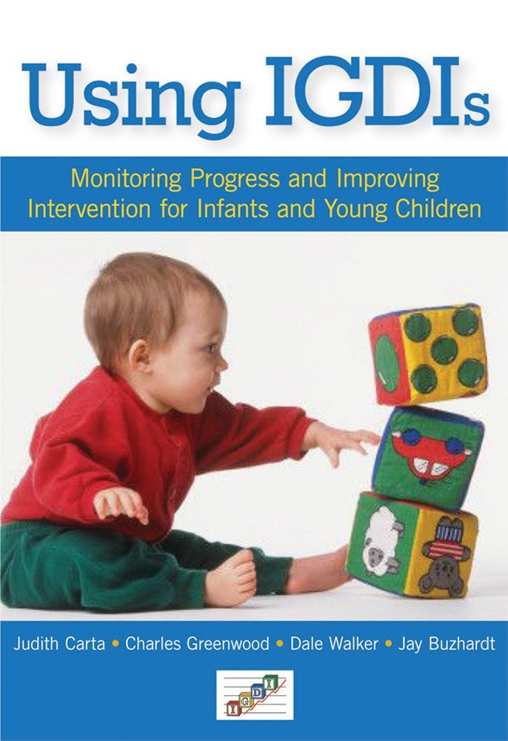
What Are Infant & Toddler IGDIs?
Individual Growth and Development Indicators (IGDIs) for Infants and Toddlers (www.igdi.ku.edu)
General Outcome Measure
Universal Screening
Progress monitoring within RTI framework
Carta, J. J., Greenwood, C. R., Walker, D., & Buzhardt, J. (2010).
Using IGDIs: Monitoring progress and improving intervention
results for infants and young children. Baltimore, MD: Brookes.
IGDI Measures include:
ECI (Communication)
ESI (Social)
EPSI (Cognitive Problem Solving)
EMI (Movement)

Slide 3
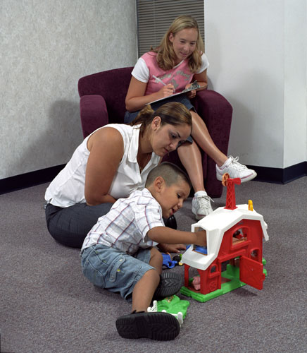
Common Features of IGDIs
Individual Growth and Development Indicators (IGDIs) for Infants and Toddlers
Brief, 6-minute observational assessments
Play based using commercially-available toys
Administered by service providers (home visitors, center-based teachers, parents, etc.)
Technically sound (see website)
Sensitive to short- and long-term growth
Website Reports to manage data collection and report on individual and group progress accessible to stakeholders

Slide 4
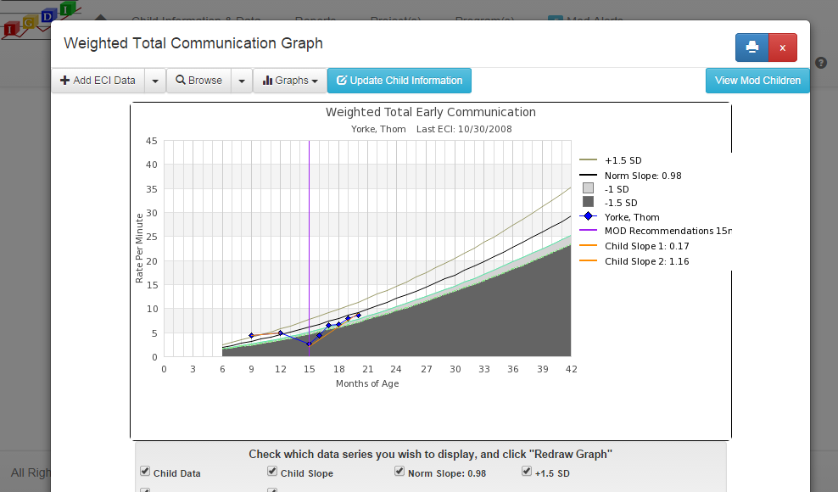
Web-based Implementation Support
Online data system to support IGDIs for early identification, data-based decision making, and data reporting
Usability-tested, secure, cloud-based data management system
Progress monitoring graphs
Individual child and program-level aggregated reports
Data-based decision making system for children at risk for delay
User account management tools
Data entry tools

Slide 5
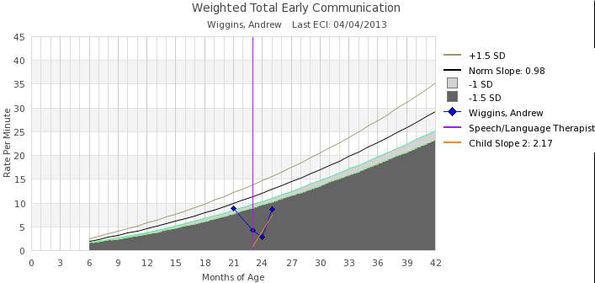
Sample Progress Monitoring Graph: Total Communication Score

Slide 6
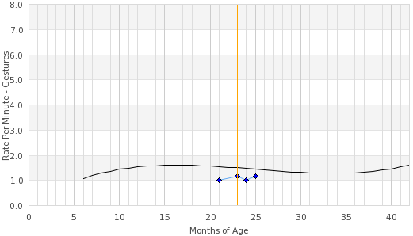
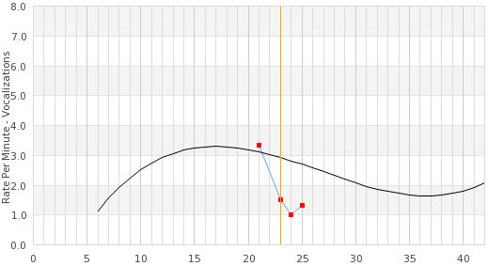
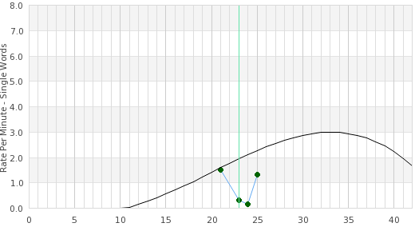
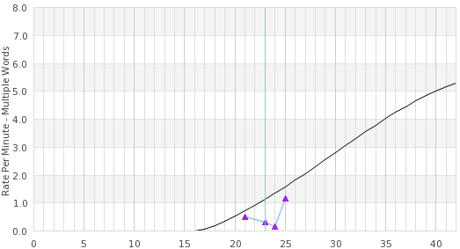
Sample Progress Monitoring Graphs: Communication Key Skill Element Scores
Gestures
Vocalizations
Single Words
Multiple Words

Slide 7
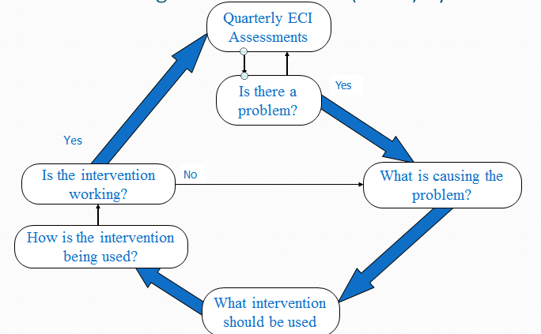
Additional Intervention Decision Making Support: The Making Online Decisions (MOD) System

Slide 8
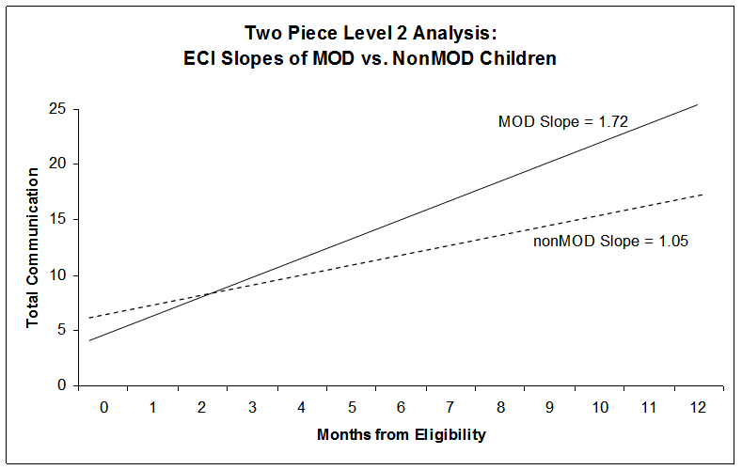
MOD’s Effect on Communication

Slide 9
Implementation Barriers
IGDI uptake can be slow and uneven
Sometimes difficult for program leaders to know if IGDIs would be a good fit
Challenges moving from adoption, to full implementation
Infant/toddler community unsure how to use data for intervention decision making and differentiation of services provided
Implementation barriers more pronounced for ‘distant’ programs
Often less engaged with IGDI support staff

Slide 10
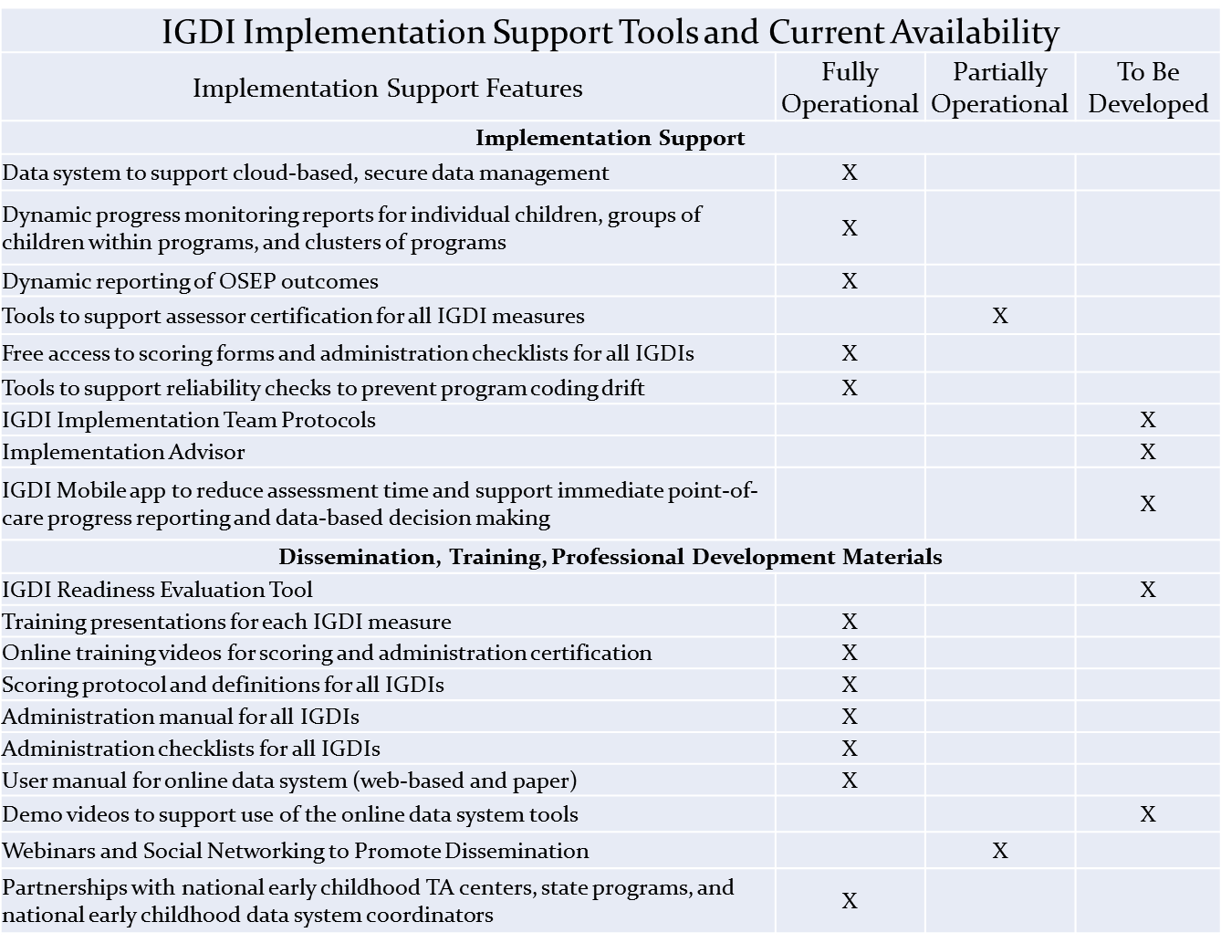
IGDI Implementation Support Tools and Current Availability

