Slide 1
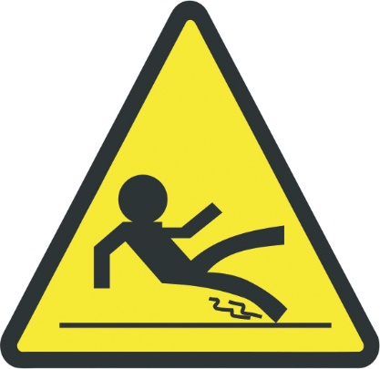
Don’t Let Your Business
Slip
Steve Davis
President
Safe Surface Technologies
Notes:
Introduction slide, sample handout and folder handout.
I placed the wet floor caution person sign on here to identify, yes there is a caution sign here, but this sign doesn’t change the floor. It is still slippery when wet!

Slide 2
Safe Surface Technologies
Issues: Slips and falls affect more than your finances. They impact the quality of those under your care – and, may also may determine your public and client reputation.
Author Russell J Kendzior: “We are living in a slip-and-fall epidemic.”
In one year, 21,200 Americans died as a result of a fall. (National Safety Concil, 2003 ed.)
Each year that number rises 1.5 to 2% due to rising population.
(For 2013- that number is approximately 29,500).
The leading cause of workers’ compensation claims -- and the leading cause of occupational injury for people aged 15 to 24 years.
In 2013, 296,130 of the 1,162,210 nonfatal occupational injuries and illnesses reported, were associated with slips and falls.
Compensation and medical costs associated with employee slip-and-fall accidents is approximately $70 billion, annually, (National Safety Council, 2003 ed.).
Notes:
Shock slide! Go for big shock here.
Identify for 2010 and forward the means of totaling costs has changed, and I am continuing to await the NFSI and the National Safety Council to explain how their totals are worked out.
Falls are now calculated into different categories. Falls from same level, from lower level.

Slide 3
Safe Surface Technologies
Here are the results of some of the court cases related to slips and falls
Court case awards trucker $15 million from Walmart after slipped and falling on wet slippery floor while making a delivery to their store.
Court awards woman business owner $12.2 million after she slipped and fell on wet slippery floor while stopping at a quick stop for a newspaper.
Man wins $1.78 million in suit against motel after falling on a wet slippery exterior concrete floor.
* Common wording in every lost court case is slippery floor caused by wetness, moisture on solid floors! Second reason for the lost cases, (breach of duty to protect), is due to failure to prevent slips and falls by the organization who was sued by the plaintiffs.
Notes:
On your sample tiles, when they are dry, there is practically no noticeable changes to what you are looking at or feeling! Now add water! What do you feel now! Pause for effect.

Slide 4
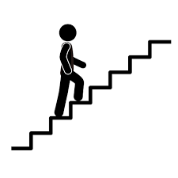
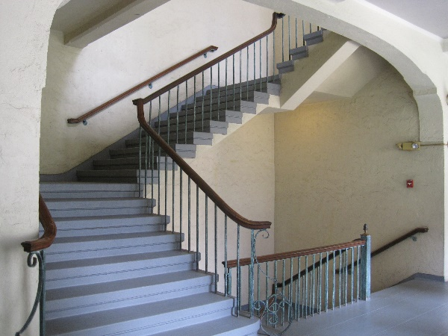
Safe Surface Technologies
The risks your institution may face: For example, on a college campus, 1200 students live in one dormitory with four, four-story stairwells and only a housekeeping elevator.
For one day= 192,000 stair steps taken. (For our example, each student, one trip down and one trip up per day).
For one week= 960,000, stair steps taken.
For one semester= 16 million stair steps taken.
For two semesters = 32 million stair steps taken.
Note: This is only for the students. This is not for housekeeping, family members, staff, faculty, or friends from other dormitories.
Over two semesters, if, and this is if you are 99 percent safe, that leaves one percent, or 320,000 stair steps that might generate a slip, trip and/or fall.
What if we included other variables, such as a spilled drink once a week, or an occasional rain storm and students had wet shoes?
Notes:
Example is only one dormitory from Seattle University where I went to school! That was before the renovations. But the concept is the risk! Is one percent really a safe bet?

Slide 5
Safe Surface Technologies
Solutions (How we can help you)
Our total focus: Decrease risk for slips, trips and fall… and, your liability for these
Based on current minimum standards of safety as set by ANSI, NFSI, and recommended by ADA and OSHA.
(OSHA does not make standards).
Collaborate with you to create a safer work/living environment for your clients, employees and/or students
Help to avoid increases in workers compensation costs or losing liability related insurance coverage
Fake falls and lawsuits- it’s particularly hard to fake a fall when there is increased traction on the ground!
All surfaces and work are warrantied for two years
Notes:
Walkway Auditor Certification
Restaurants and the department of agriculture, pores in the flooring collect germs, which are hard to clean out? I am currently waiting to hear back from the Montoursville Office for Food Safety to discuss how restaurants, hotels and other eateries prepare food on their floors? When according to the FDA’s Chapter 6-201.11 Floors, Walls, and Ceilings. Except as specified under § 6-201.14 and except for antislip floor coverings or applications that may be used for safety reasons, floors, floor coverings, walls, wall coverings, and ceilings shall be designed, constructed, and installed so they are smooth and easily cleanable.

Slide 6
Safe Surface Technologies
Our solutions:
Affordable (especially when compared in terms of any litigation costs or renovations)
Can be accomplished in a scheduled, on time, on budget manner without disruption to business
Comply with American Disabilities Act
Meet or exceed ANSI Standards (B101.1 and B101.3)
Provide for Peace of Mind
Notes:
We work with your schedule, not Monday through Friday. If you have a need to have us work with your floors at two in the morning, until 6 in the morning, and they must be fully dry and ready for people to go to work at 6 am. They will be done by 6 am.
Peace of mind by definition is presenting a sense of calm knowing an absence of conflict exists.

Slide 7
Safe Surface Technologies
How we work
Test floor surfaces for coefficient of friction
Clean and degrease floors
Test flooring for pre-treatment coefficient of friction, (COF) dry and wet results.
Apply treatment, to one small area first to determine appropriate treatment time, then to whole selected area
Following treatment time, apply neutralizer
Re-clean floors to ensure removal of all treatment and neutralizer materials
Dry floor as completely as possible
Retest COF dry and wet to assess results. (Dry and wet COF results are provided to you in a written report following treatment of selected area).
Advise about the correct maintenance of floors to maximize COF
As further follow-up, at one month, three months and six months, will audit floors by testing and evaluating treatment conditions.
Notes:
This is the process for

Slide 8
Safe Surface Technologies
Institution on lawsuits- or case where organization took on slippery floor prevention! (Dated November 2010, Relatively new)
Booher vs Hampton Inn, Boohers’ attorney’s lost the case due to fact the Hampton Inn had recently began working on walking surface- slip and fall prevention and bathtub- slip and fall prevention prior to the Boohers’ family member fall injury. Therefore there was no breach of duty to protect their hotel’s clients from slip and fall incidents/accidents and the defendants, Hampton Inn, won the case.

Slide 9
Safe Surface Technologies
Thank you!
Steven Davis
President, Safe Surface Technologies
570.939.1000
Steven@SafeSurfaceTech.com

