Slide 1
Building a Database Monitoring Tool using Splunk
^{Presented by} Chuck Ezell
Development, Tuning & Automation Practice Lead
Datavail is the largest provider of remote database administration in the U.S. with nearly 500 DBAs, 24/7 support and onsite/offsite, onshore/offshore delivery.

Slide 2
Agenda
Getting Started
Real World Datavail Projects
What Kinds of Data Can be Collected
Formatting Custom Data
Segregating Data & Indexing
Getting Everything into Splunk
Searches & UI Features
Creating Visuals & Reporting
Case Study (AS/400 Monitoring Application)

Slide 3
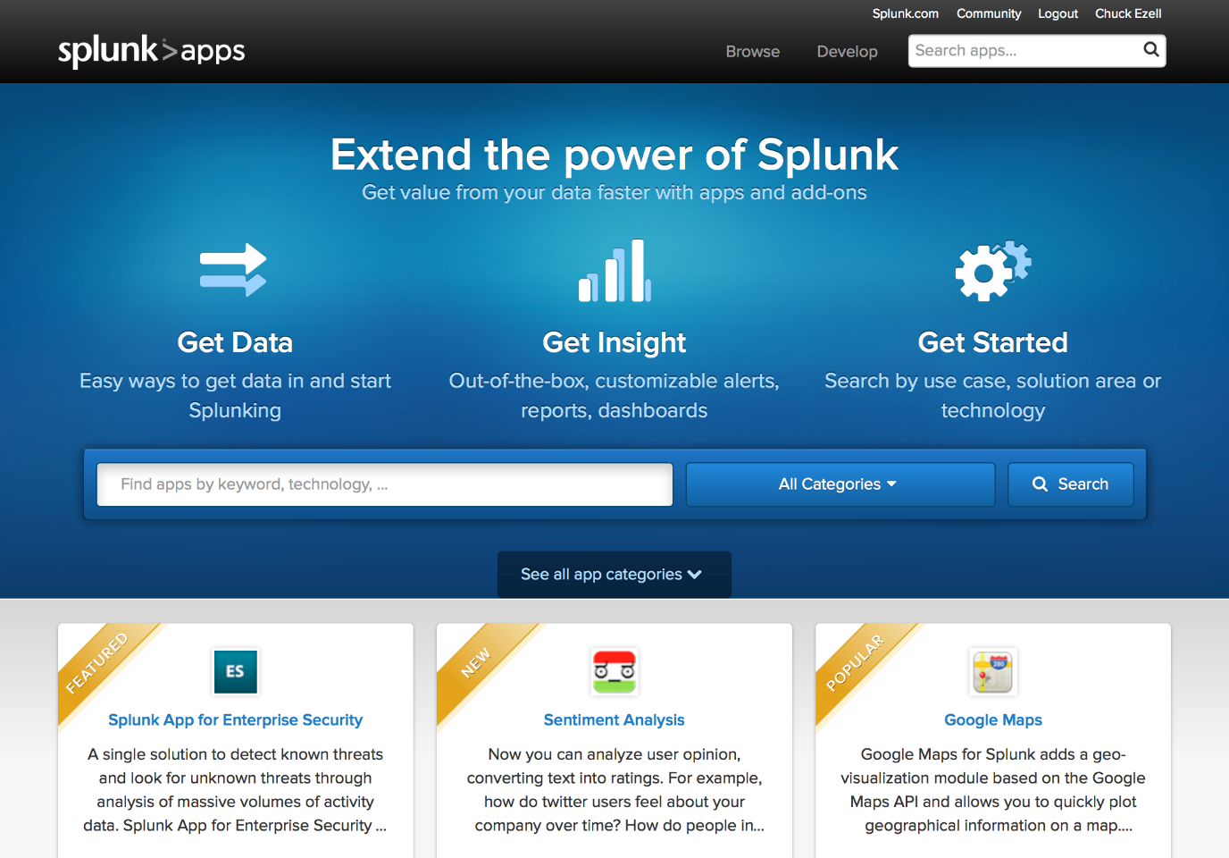
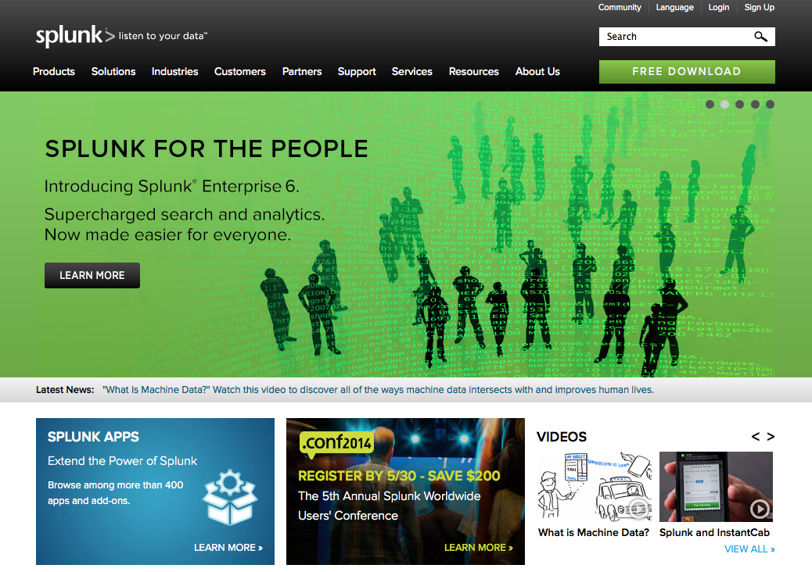
Getting Started
Get Splunk
http://www.splunk.com
Create Account
Download
Explore Splunk Apps

Slide 4
What You Need
Access to Logs (database, application, etc)
Windows, Linux, Mac, AIX environment to run the Splunk Interface
Storage Space to collect & index log data (suggested 200GB – 5GB/Day * 40 Days)

Slide 5
What Can We Put in Splunk?

Slide 6
Capture Opportunities
Oracle Alert Logs
DB Exception Logs
User Session Data
Concurrent Requests
SQL IDs, SQL Profiles & Outlines
SMON/PMON
DBWR/LGWR
Listener Logs
Code Changes
XDO Processing Times
RAC Interconnect Balance
Trace Logs
Custom Scripted Data
Direct Scripted Extractions
Direct SQL Extractions

Slide 7
Some Quick Examples
Datavail Splunk Projects

Slide 8
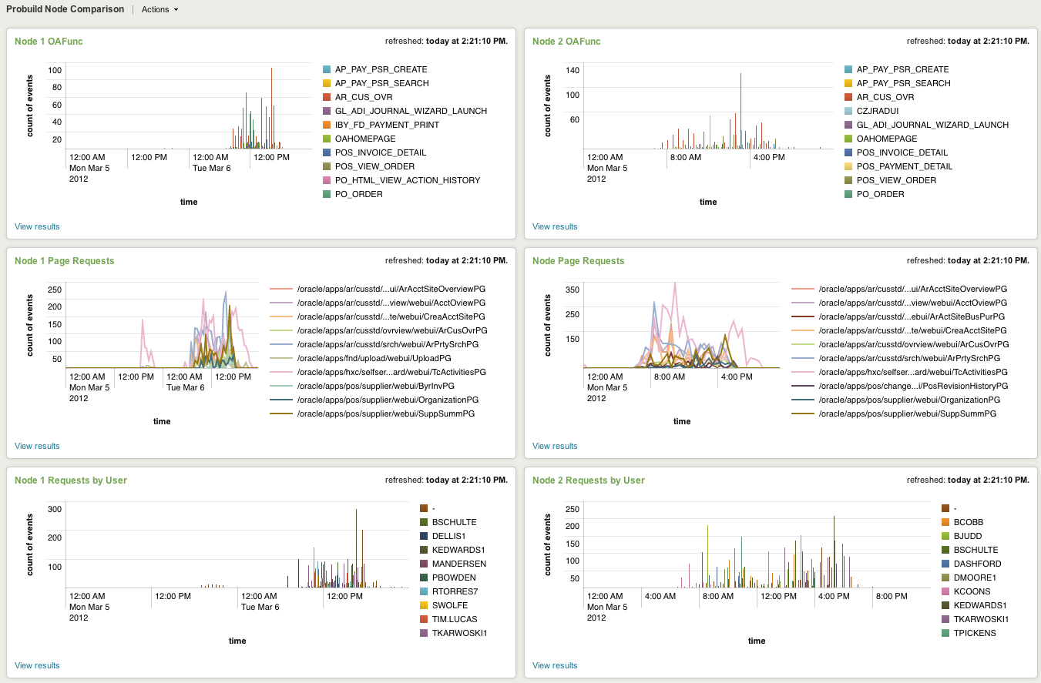
Apache Node Monitoring

Slide 9
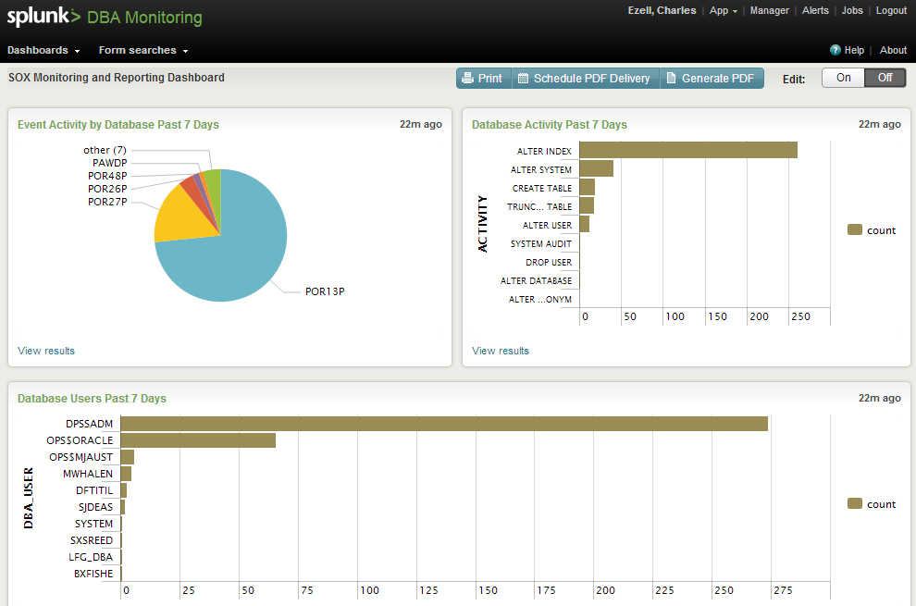
Sox Compliance Monitoring

Slide 10
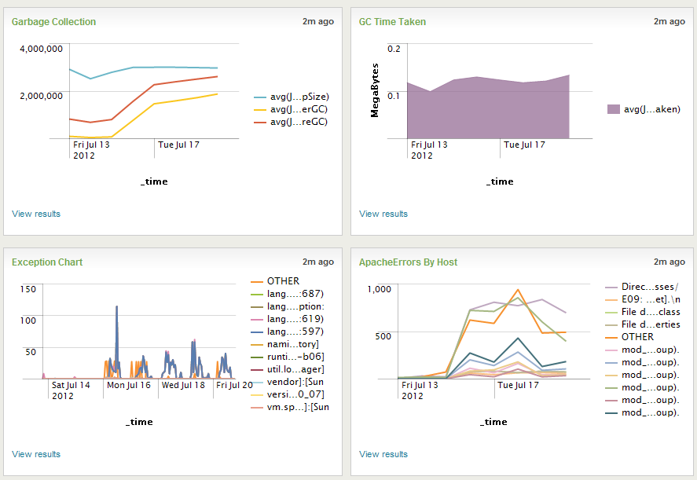
Application Server Monitoring

Slide 11
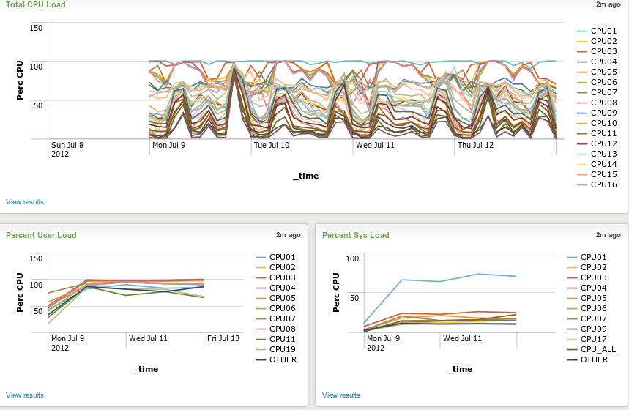
NMON Monitoring

Slide 12
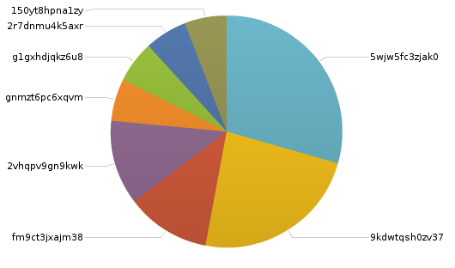
Oracle RAC Alert Logs
Top 10 RAC Problem SQL IDs

Slide 13
Client Side Monitoring

Slide 14
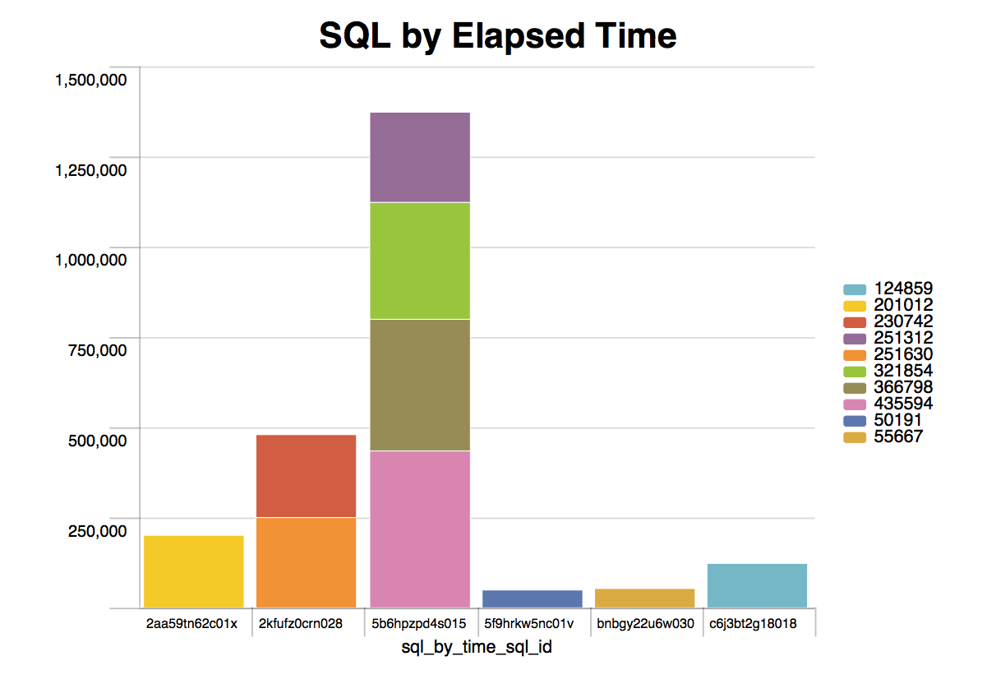
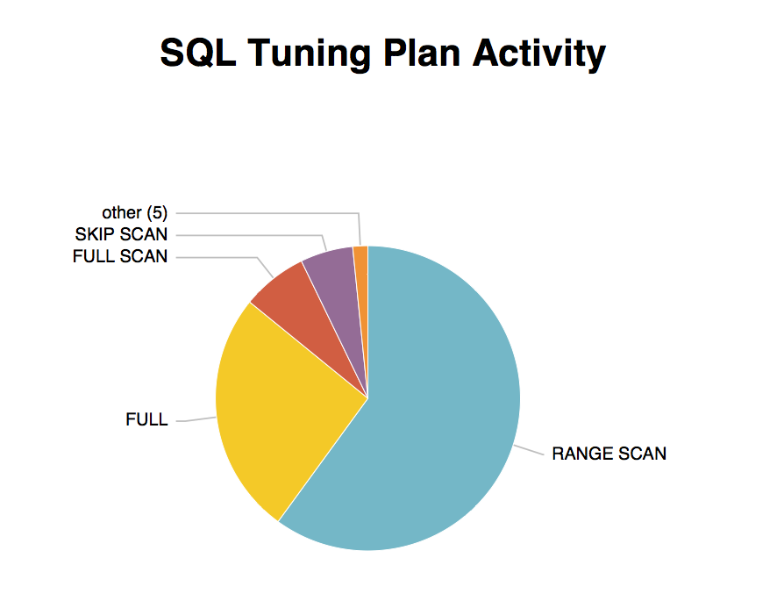
DB Health Checks

Slide 15
Getting Data Into Splunk

Slide 16
Getting Data Into Splunk
Files & Directories
Upload Files, Index Local Files or Directories, Writing to Syslog
Forwarding across TCP
Listen on a TCP port for incoming data
Forwarding across UDP
Listen on a UDP port for incoming data
Extraction using Scripts
Create and run custom scripts to collect or generate data (e.g. awk, perl, bash, php, java, .NET, SQL, etc…)

Slide 17
Get the Format Right
Apache Access Logs
192.168.94.5 - A13442 [04/Apr/2012:10:51:00 +0000] "POST /forms/lservlet;jsessionid=11bed2dbe239234b24aa13b5238eee8b975d07d0435bc565f8fe86ce6ff0740e.e3qTaN4LchmPe34Ma30Na3qSchr0 HTTP/1.1" 200 2 0 "-" "Mozilla/4.0 (Windows 2003 5.2) Java/1.6.0_17"
192.168.94.5 - - [04/Apr/2012:10:51:00 +0000] "POST /forms/lservlet;jsessionid=0fb9ba37d2d821bf7dca1f7ffd73a1ea25db4a2d2b57dbe6b39a9319a1d97bc4.e3qTaN4LchmPe34Ma30Na3qSchr0 HTTP/1.1" 200 2 0 "-" "Mozilla/4.0 (Windows 2003 5.2) Java/1.6.0_17"
192.168.94.5 - - [04/Apr/2012:10:51:00 +0000] "POST /forms/lservlet;jsessionid=9f726783cc8b0b9ab2ae75ccb18de20e1032d9c7ec70d72304539dbc443c8633.e3qTaN4LchmPe34Ma30Na3qSchr0 HTTP/1.1" 200 2 0 "-" "Mozilla/4.0 (Windows 2003 5.2) Java/1.6.0_17"
192.168.94.5 - A47612 [04/Apr/2012:10:51:00 +0000] "POST /forms/lservlet;jsessionid=9f44b2d8b86d9b31f274694db11a0b8e6a34e22a45d4e5a905978761a3e21e92.e3qTaN4LchmPe34Ma30Na3qSchr0 HTTP/1.1" 200 2234 1 "-" "Mozilla/4.0 (Windows 2003 5.2) Java/1.6.0_17"

Slide 18
Get the Format Right : Direct SQL Extract
We start with a basic v$sql_plan monitoring script.
SELECT
'sql_plan_timestamp=""'|| to_char(timestamp,'mm-dd-yyyy hh24:mi:ss') || '”, database='||b.name||', plan_hash_value='||plan_hash_value||', sql_id='||sql_id||’, operation="'||operation||'", options='||options||', object_name='||object_name||’, object_owner='||object_owner|| ', optimizer='||optimizer||', cost='||cost||’, cardinality='||cardinality||', cpu_cost='||cpu_cost||', io_cost='||io_cost||’, time='||time||', filter_predicates="'||filter_predicates||'"' as sql_plan_info
FROM V$SQL_PLAN a, v$database b
WHERE (options like '%SKIP%' OR options like '%FULL%'
OR options like '%PUSH%’)
AND object_owner != 'SYS’
AND timestamp > (sysdate – 1)
ORDER BY timestamp asc;
SELECT
to_char(timestamp,'mm-dd-yyyy hh24:mi:ss'), b.name,
plan_hash_value, sql_id, operation, options, object_name,
object_owner, optimizer, cost, cardinality, cpu_cost, io_cost
FROM V$SQL_PLAN a, v$database b
WHERE (options like '%SKIP%' OR options like '%FULL%'
OR options like '%PUSH%’)
AND object_owner != 'SYS’
AND timestamp > (sysdate – 1)
ORDER BY timestamp asc;
Then format the output into key/value pairs.
'sql_plan_timestamp=""'|| to_char(timestamp,'mm-dd-yyyy hh24:mi:ss') || '”

Slide 19
Get the Format Right : Direct SQL Extract
Then add that SQL to a shell script.
Set cron to run it and produce the output.
sql_plan_timestamp="09-30-2013 02:51:01", database=OADEV, plan_hash_value=1649080325, sql_id=696c56fyx1rwn, operation="INDEX", options=FULL SCAN, object_name=GL_SETS_OF_BOOKS_U2, object_owner=GL, optimizer=, cost=1, cardinality=1, cpu_cost=7521, io_cost=1
sql_plan_timestamp="09-30-2013 02:51:01", database=OADEV, plan_hash_value=2300147657, sql_id=36dx1vwfqmn2j, operation="TABLE ACCESS", options=FULL, object_name=FND_PRODUCT_GROUPS, object_owner=APPLSYS, optimizer=, cost=2, cardinality=1, cpu_cost=7271, io_cost=2
sql_plan_timestamp="09-30-2013 02:51:01", database=OADEV, plan_hash_value=171240807, sql_id=7m21y56326kha, operation="INDEX", options=FULL SCAN, object_name=GL_SETS_OF_BOOKS_U2, object_owner=GL, optimizer=, cost=1, cardinality=1, cpu_cost=7521, io_cost=1

Slide 20
Get the Format Right : Direct iostat Export
Same approach will work with other scripts
# Splunk disk io logging script
#Disk IO from iostat Write Queues/Requests
iostat -xk | awk 'NR >5 {now=strftime("%m-%d-%Y %T");printf "iostat_timestamp=" now ", device=" $1 ", read_request_merged_per_sec="$3 ", write_request_merged_per_sec="$4 ", read_request_per_sec="$5 ", write_request_per_sec="$6 ", average_queue_size="$9 ", average_request_size="$10 ", average_io_request_service_time="$11 ", percent_cpu_time=%"$12 "\n "}' | sed '1d;$d' >> splunk_iostat.log;
# Disk IO from iostat Read/Writes
iostat -d | awk 'NR >3 {now=strftime("%m-%d-%Y %T"); printf "iostat_timestamp=" now ", device=" $1 ", transfers_per_sec="$2 ", block_read_per_sec="$3 "b, lock_write_per_sec"$4 ", block_read_total="$5", block_write_total="$6 "\n "}' >> splunk_iostat.log;

Slide 21
Segregating Data
Indexes (not like dba table index)
What's in an index?
An index is a collection of databases, which are subdirectories located in $SPLUNK_HOME/var/lib/splunk.
Indexes consist of two types of files: rawdata files and index files (and some metadata).
Why Use Multiple Indexes?
Distributes Indexing Activity
Segregates Data
Provides Granular Control over Events
Provides ability to control data visibility
Segregate Field Extractions
Oracle
MySQL
SQL Server
NoSQL

Slide 22
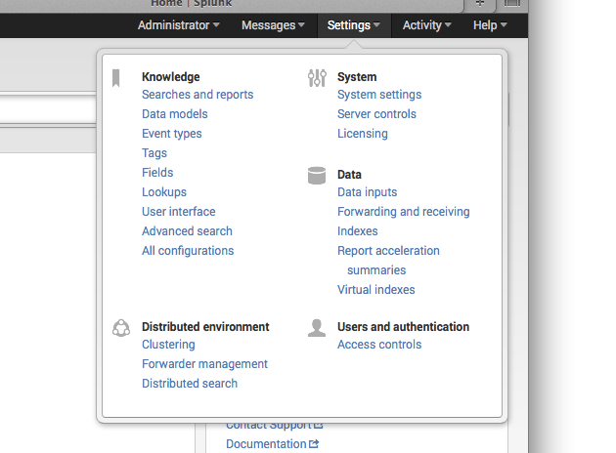
Creating Indexes

Slide 23
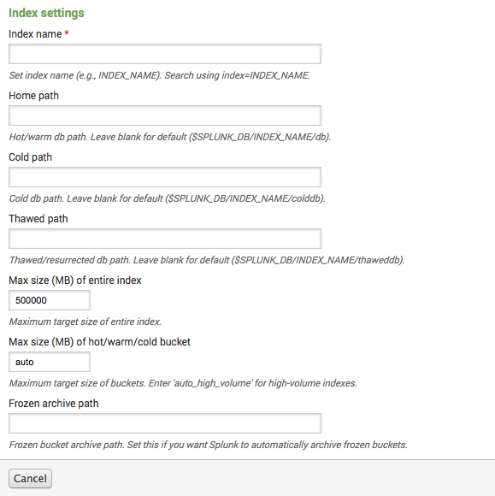
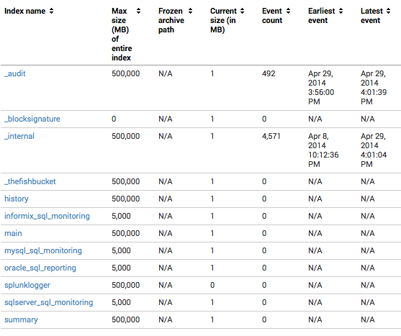
Creating Indexes
oracle_sql_reporting

Slide 24
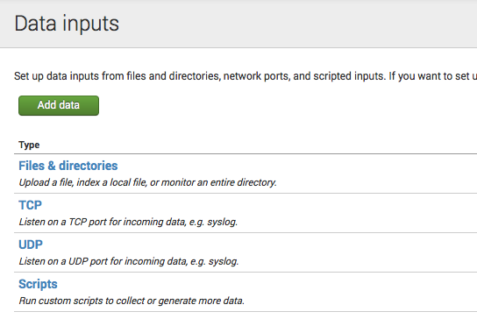
Getting Data into Splunk
Files & Directories
Upload Files, Index Local Files or Directories

Slide 25
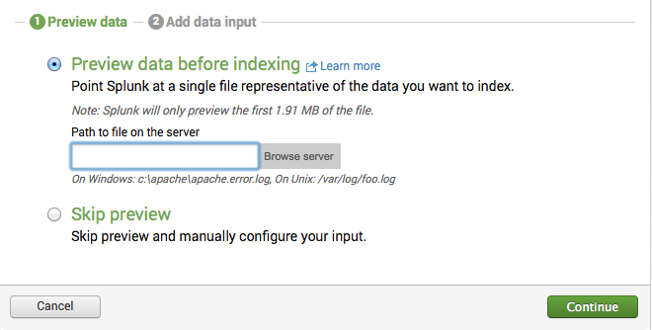
Getting Data Into Splunk
Browse to the file you want to import
.log, .out, .txt, .csv
Select New Data Input

Slide 26
Getting Data Into Splunk
Select Select the Target Index

Slide 27
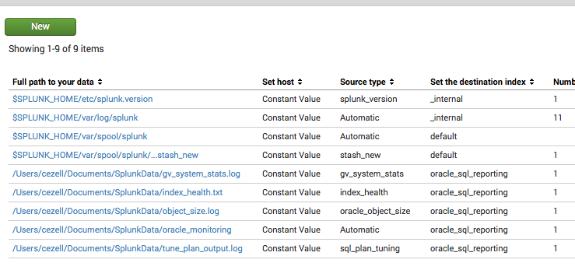
Getting Data Into Splunk
Check the paths, Index & Permissions

Slide 28
Using Splunk Features

Slide 29
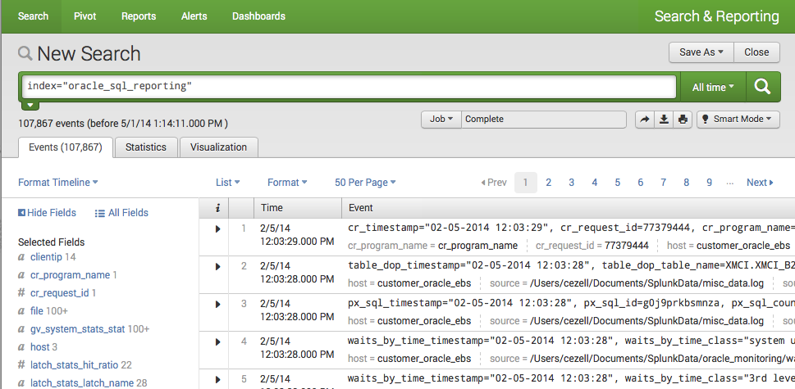
Searching
Splunk Search Features
Fields & Key Values
Search Functions
Charting, Reporting & Aggregation

Slide 30
Search Screen & Language
index=“*”
| pipe feature
| sendmail to=“chuck.ezell@datavail.com
| convert
| fields + (filter to add fields)
| fields – (filter to remove fields)
sourcetype=“*” (set sourcetype explicitly)
timechart count by host (count by any field)
addtotals fieldname=sum
chart count by fieldname
| cluster *values* (group by function)
any fieldname search as fieldname=“*”

Slide 31
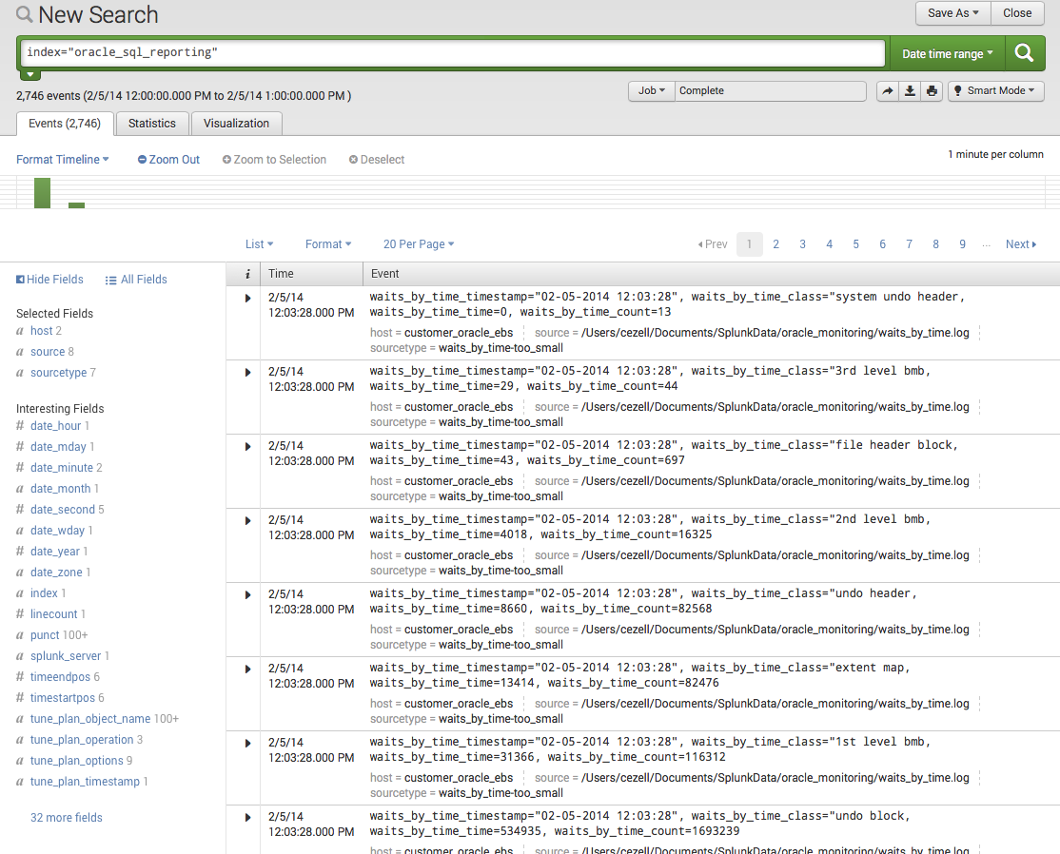
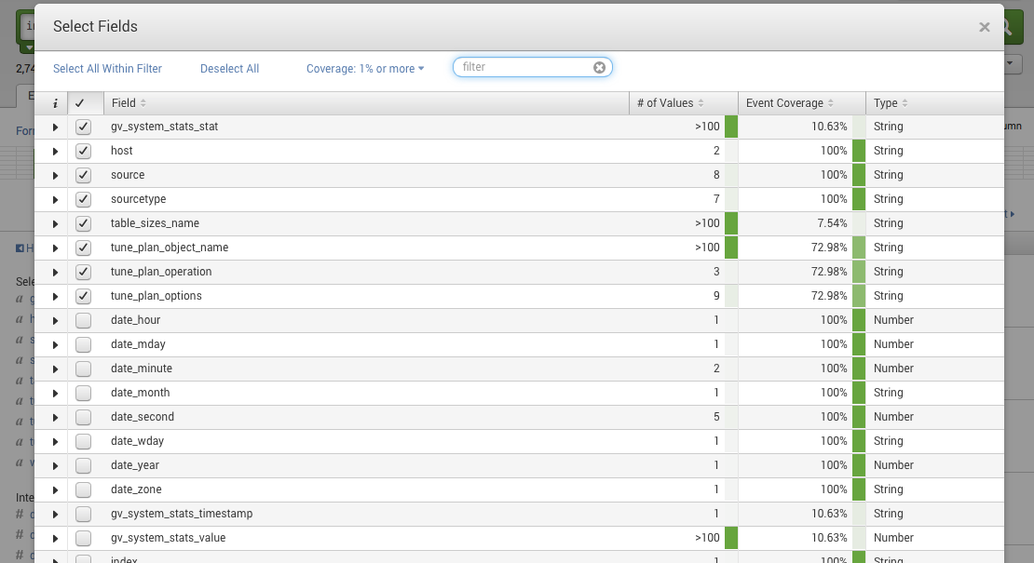
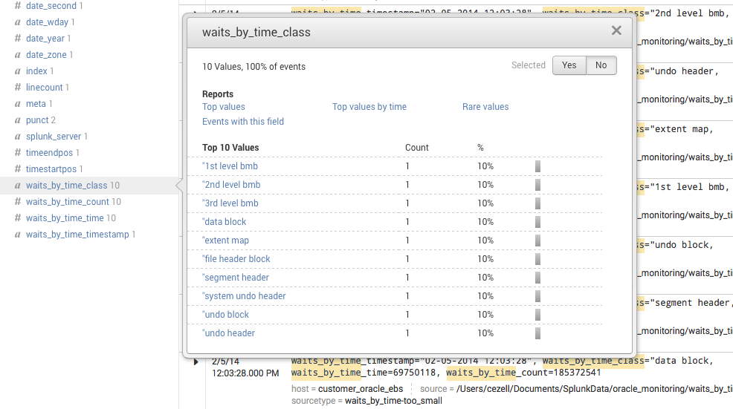
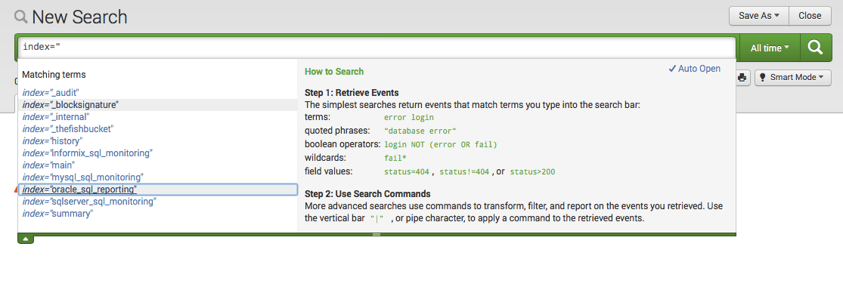
Performing Searches
Explicit or Wildcard searches: both are valid

Slide 32
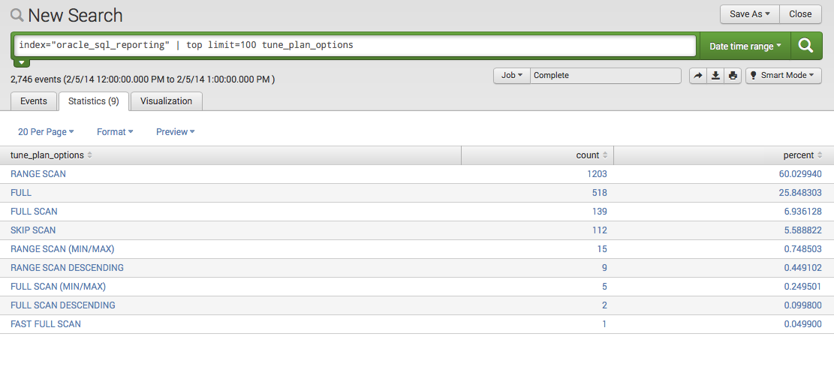
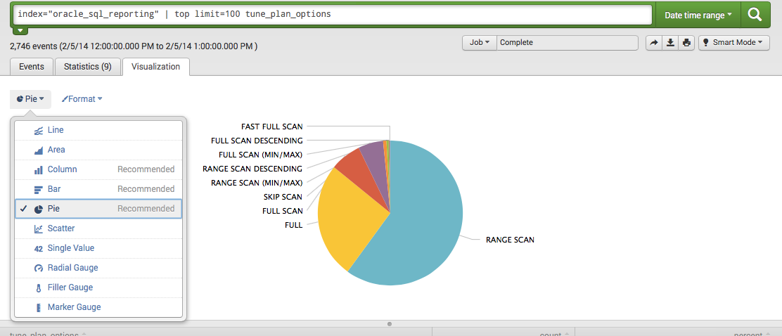
Searches & Reports

Slide 33
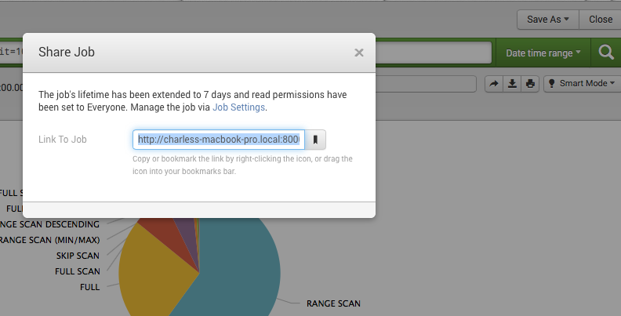
Searches & Reports

Slide 34
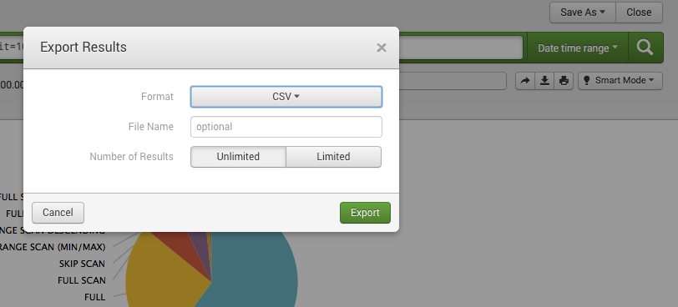
Searches & Reports

Slide 35
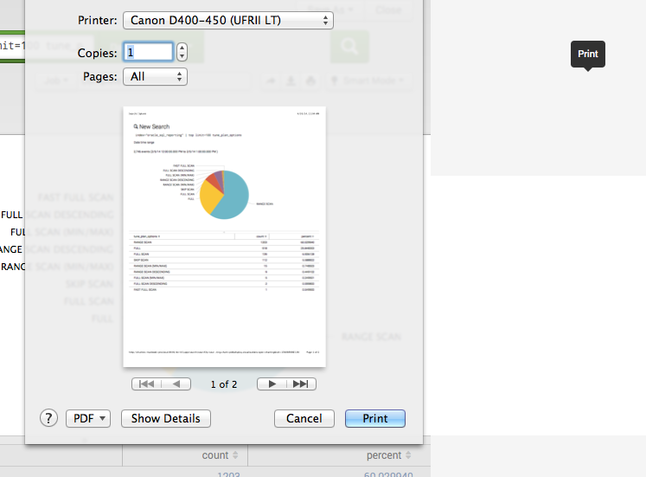
Searches & Reports

Slide 36
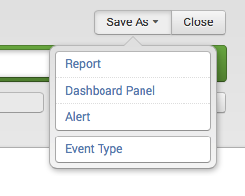
Searches & Reports

Slide 37
Dashboards
Multiple charts in one place
Monitor multiple data sources from varied locations in one view
Create segregated views for specific audiences
Create a central reporting interface for launching other reports & searches

Slide 38
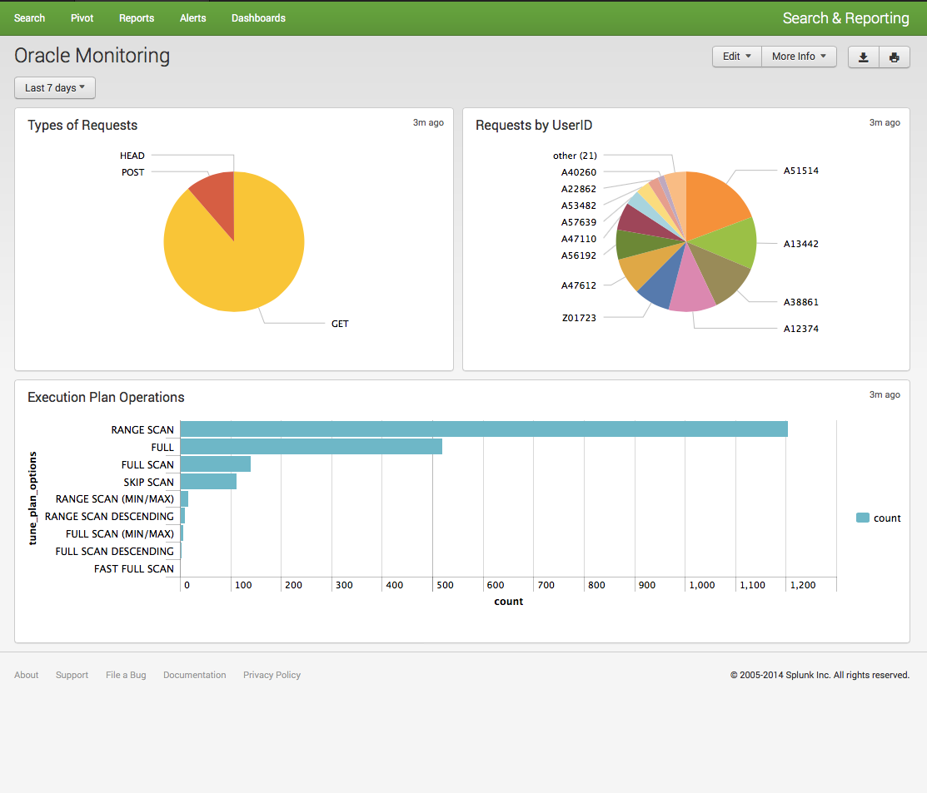
Creating Dashboards

Slide 39
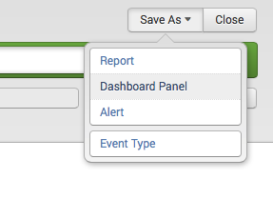
Creating Dashboards

Slide 40
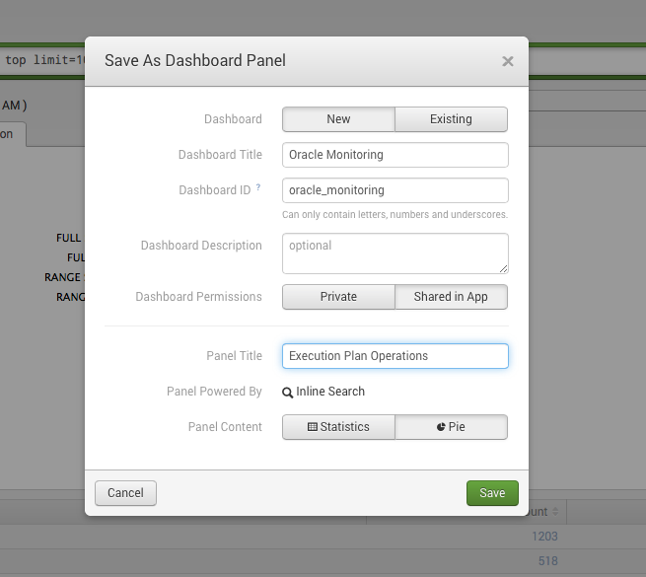
Creating Dashboards

Slide 41
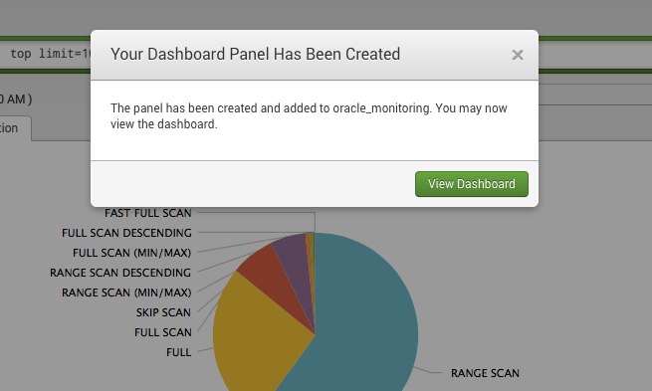
Creating Dashboards

Slide 42
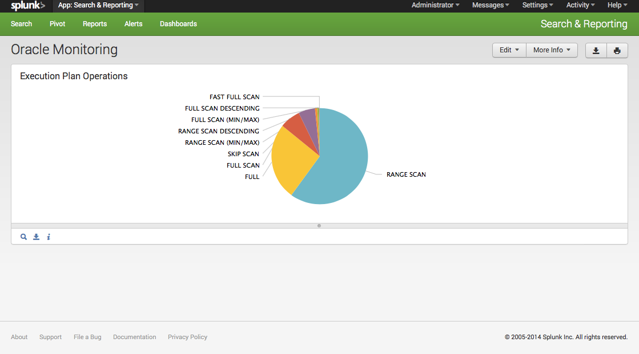
Creating Dashboards

Slide 43
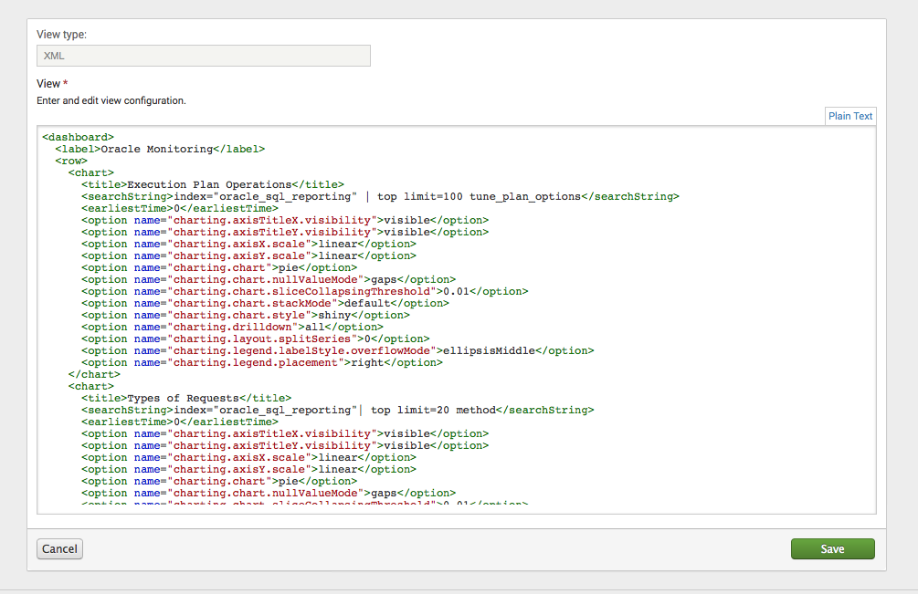
Edit Dashboards

Slide 44
Editing Visuals

Slide 45
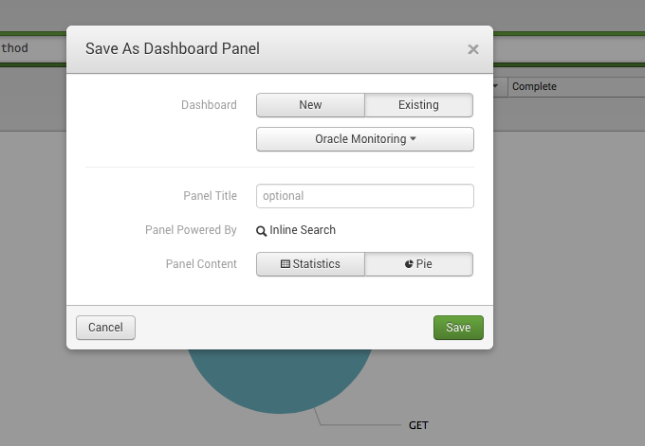
Adding to Existing Dashboards

Slide 46
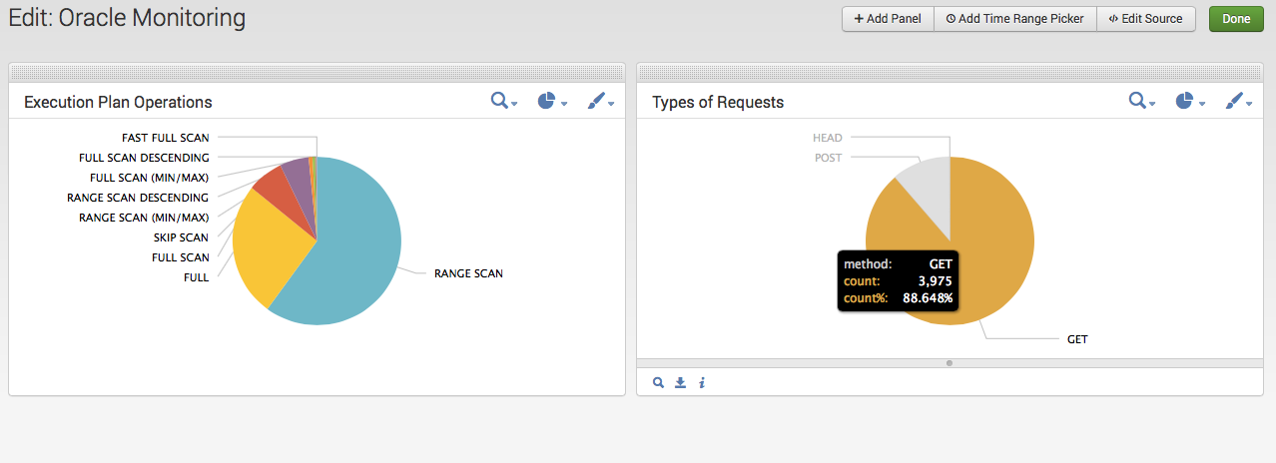
Adding to Existing Dashboards

Slide 47
Case Study
Customer: One of Canada’s Largest Banks
Problem: No insight into daily DB2 activity on highly utilized AS/400 systems. Quest Foglight is currently in use to monitor all other AIX, Linux, DB2, SQL Server, Java/JVM systems but nothing in place to provide real time monitoring details on AS/400 systems.
Solution: Use Splunk to monitor key metrics

Slide 48
AS/400 Metrics to Splunk
Logical Flow of Metrics Collection
>>> FTP >>>
Flat File
Metrics
RPG/SQL
Indexed

Slide 49
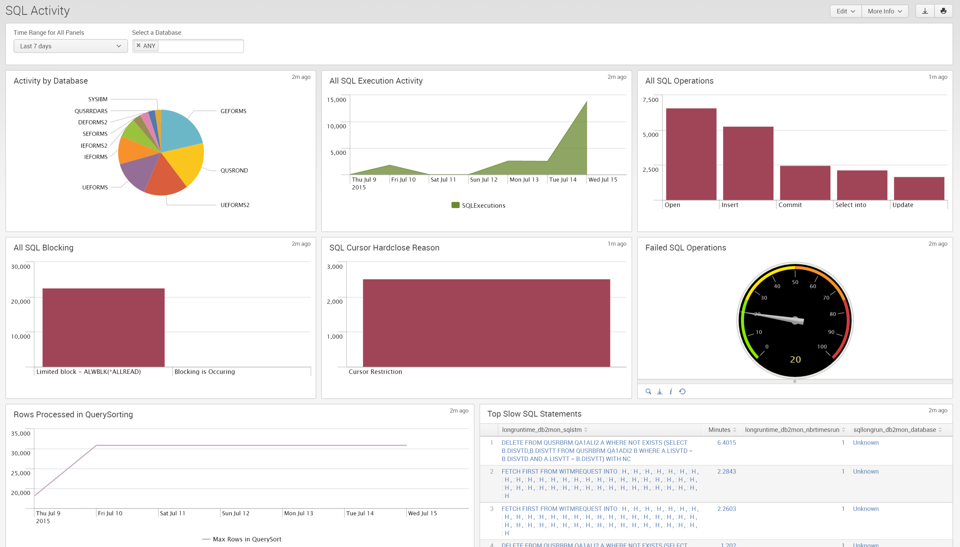

Slide 50
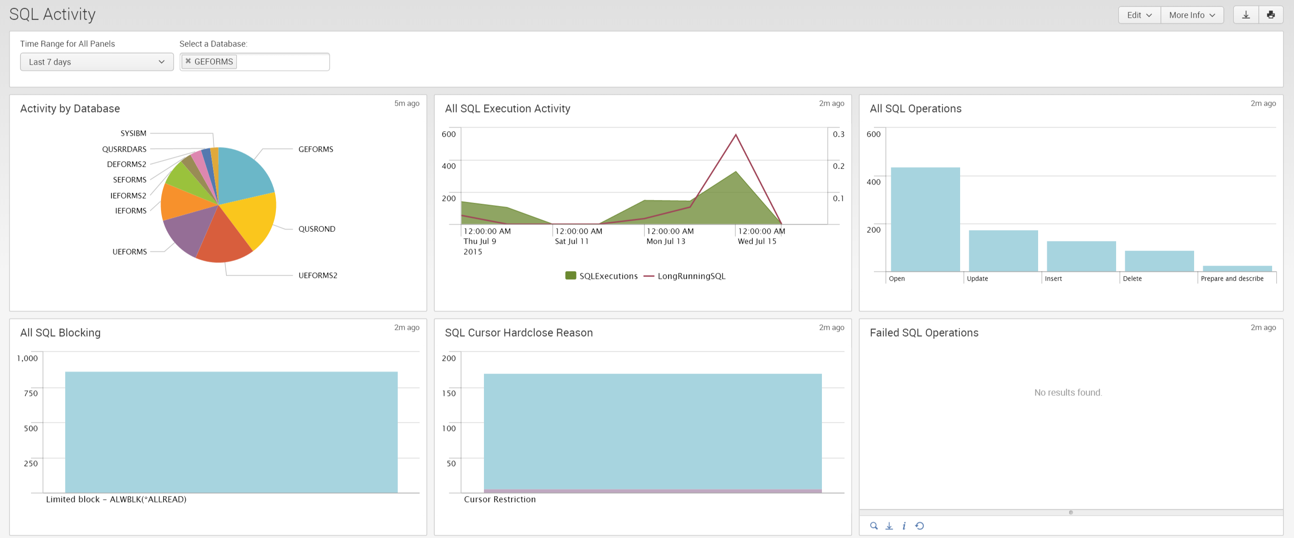

Slide 51
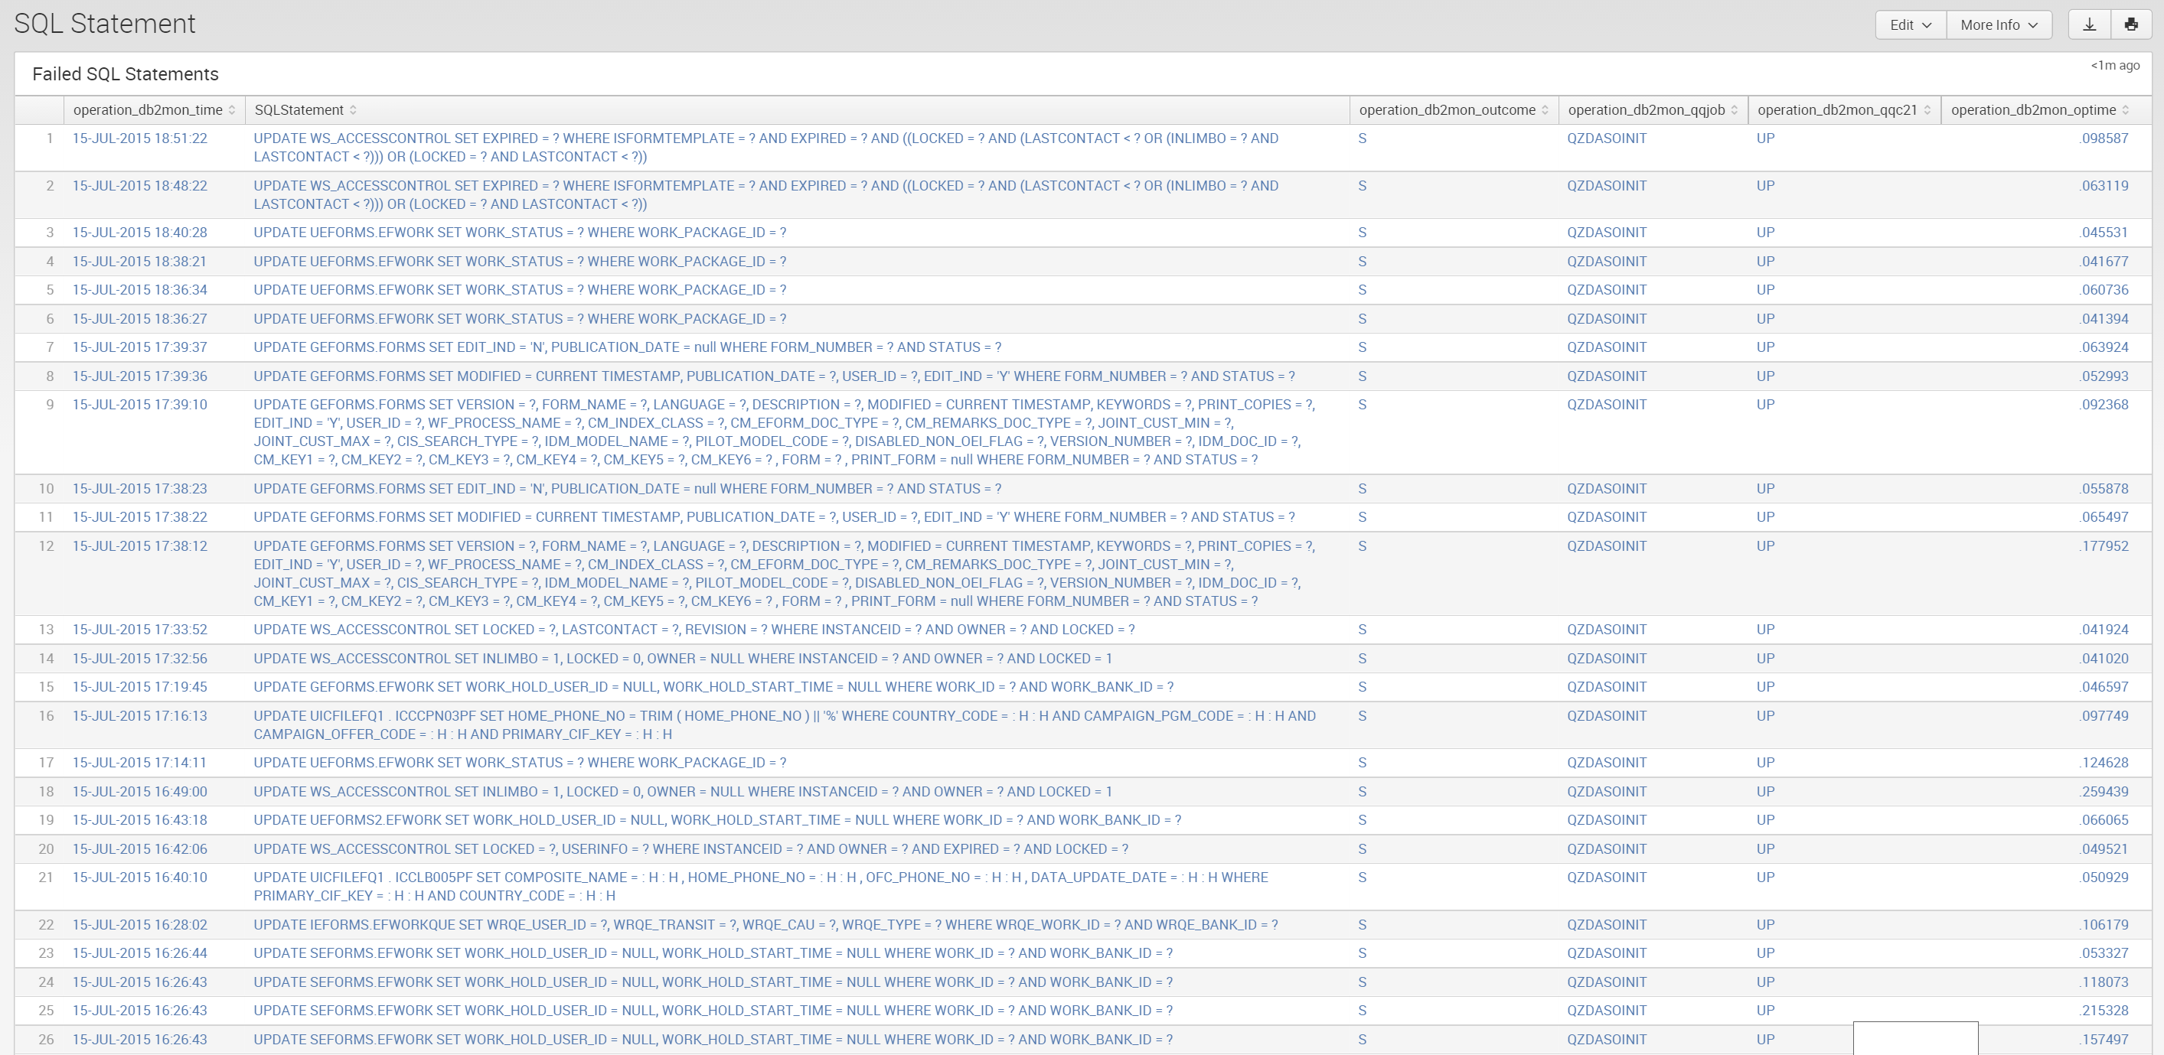

Slide 52
What We Skipped Today
Permissions
Forwarders via TCP
Syslog via UDP
App Installs
App Creation
Custom .conf Files
Splunk Cloud
Client Side Monitoring
Terminal App Tails
Distributed Monitoring
Alert Reporting
Custom Reports
Administration Features
Splunk & Hadoop (NoSQL)
Splunk APIs (Python/Javascript)
BugSense Mobile

Slide 53
Questions?
^{Presented by} Chuck Ezell
Development, Tuning & Automation Practice Lead
Datavail is the largest provider of remote database administration in the U.S. with nearly 400 DBAs, 24/7 support and onsite/offsite, onshore/offshore delivery.

