Slide 1
Tuning ETLs for Better BI
^{Presented by} Chuck Ezell
Development, Tuning & Automation Practice Lead
Datavail is the largest provider of remote database administration in the U.S. with nearly 400 DBAs, 24/7 support and onsite/offsite, onshore/offshore delivery.

Slide 2
Agenda
OLTP and OLAP an approach for tuning
More than just data: peeling back the layers
Components & Layers of Common ETLs
Component Points of Failure
Source, Transformation & Target Tuning Points
Common Fails & Misconceptions
Monitoring ETL Activity (tools to make it easy)
Recap & Questions

Slide 3
OLTP/OLAP
Organization of Data
OLTP Online Transaction Processing
Best for relational database transactions.
Emphasis is on Fast Query & Relational Data Integrity
Emphasis very normalized data
Business Process Data ERP, CRM (operational, workflows, etc…)
Insert, Update & Delete activity
OLAP Online Analytical Processing
Best for structured, redundant data.
Emphasis is on ability to aggregate & analyze
Emphasis on de-normalized & fewer tables
Data Warehouse : DW or EDW (trending, historical, analytical, etc…)
Write (loading) & Reads (complex selects)
Most often both OLTP and OLAP systems exist within all ETLs but the tuning of each is different.

Slide 4
What is ETL?
Extracting data from various sources, performing transformations and loading transformed data into a target environment.

Slide 5
What is an ELT?

Slide 6
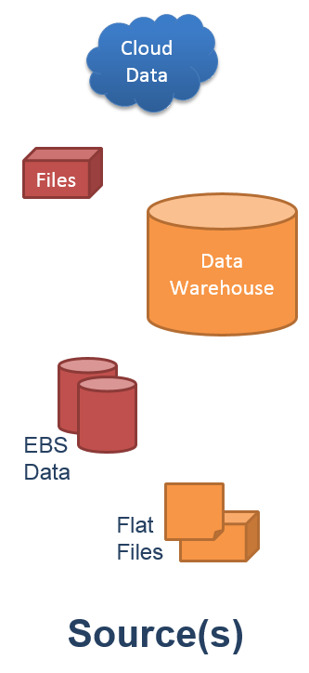
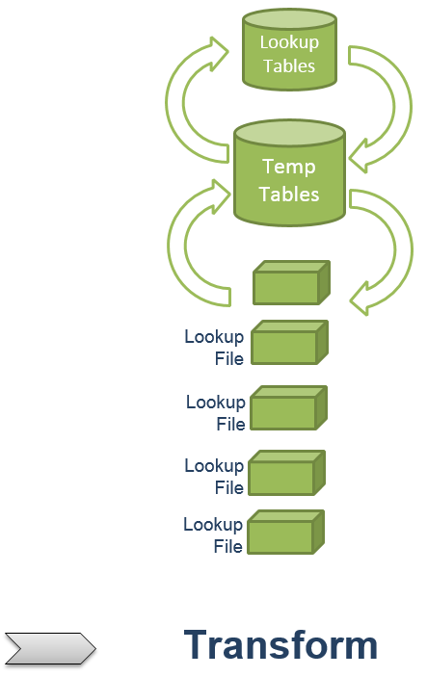
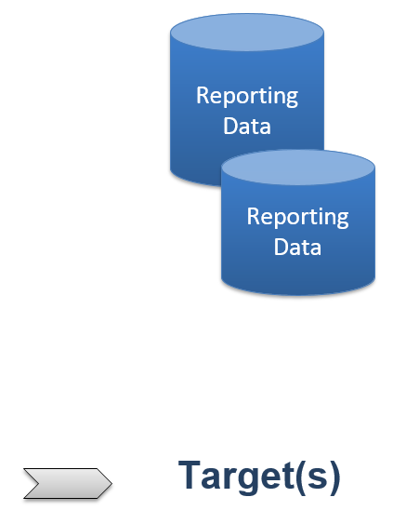
ETL Stages

Slide 7
ETL Component Layers
Network Speeds
Storage
OS Architecture
Disk/CPU/RAM
Host Server
CPU/RAM
Database Setup
Application Setup
Data Structure
Code Base
Data

Slide 8
Bird’s Eye View
Tuning Ideas & Concepts

Slide 9
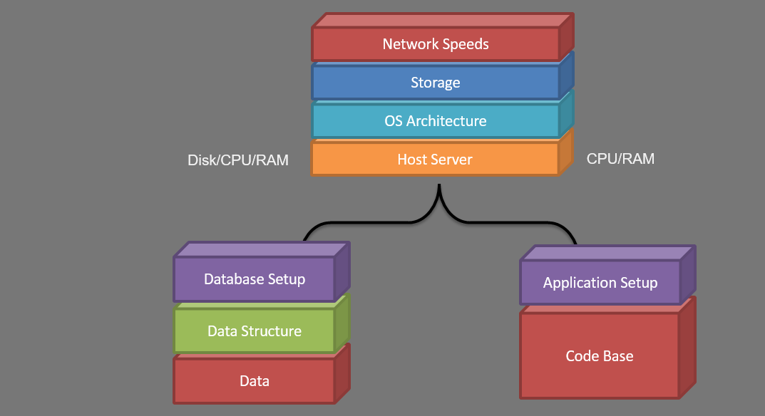
Stage Component Points of Failure

Slide 10
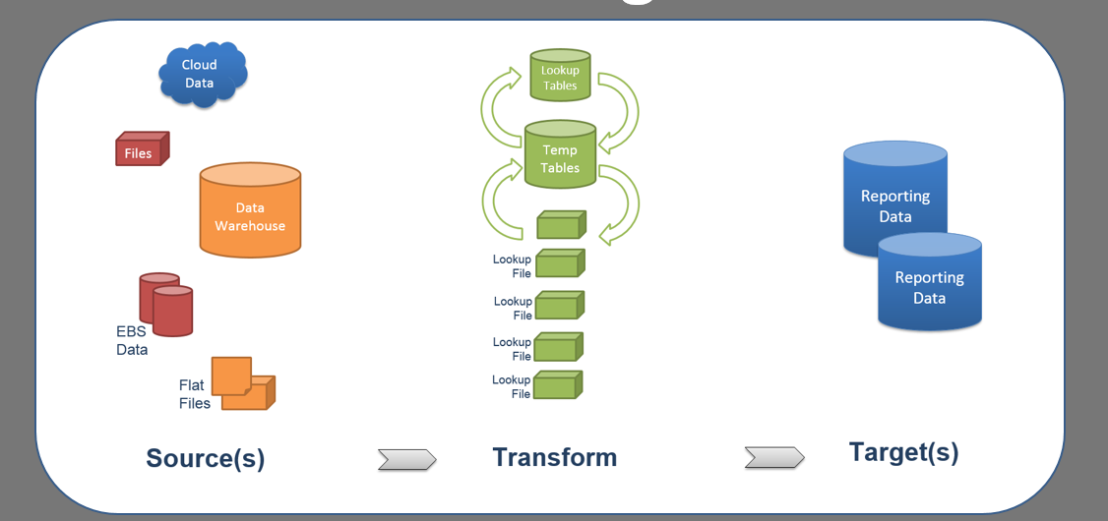
Stage Component Points of Failure
Network
Latency
Limited RAM
IOP & CPU
Bottlenecks
Disk (I/O)
Too Much
In-Memory
File System or
Cache Fragmentation
Poor Code
Limited Space

Slide 11
Source Bottlenecks
Source is often OLTP structured data
A traditional tuning approach will apply
Factor in DML causing Fragmentation & Stats problems
Find poor plans and tune in traditional fashion
SQL Code (better filtering, use of custom and vendor functions)
Statistics
Indexing & Table Fragmentation
Conflicting Sessions or Processes during ETL
Offload or replicate data for better isolation

Slide 12
Transform Bottlenecks
Depending on your ETL, high % could be in-memory
RAM & Temp space is critical (the more the better)
Filesystem lookups can be slow (lack of indexing)
Filesystems can become fragmented (depending OS)
SQL Code (in memory merges and joins)
Statistics can hinder on temp tables
Indexing could slow a process down
Lack of proper temp space will cause failures (watch logs & ASM)
Filesystem lookups perform better if they’re converted to DB table lookups

Slide 13
Target Bottlenecks
OLAP Write speeds and I/O are overlooked
Indexing and Stats can be problematic
Loading could be single inserts in a loop
SQL Code
Inserts can benefit from HINT “APPEND” or “APPEND_VALUES”
Inserts and Updates could benefit from PARALLEL hinting
Stats and Indexing added after loads and performed in Parallel (split out tasks)
Confirm Async I/O settings in OS and DB
Use Bulk Loading where possible

Slide 14
Framing Common Problems

Slide 15
What do we want from ETLs?
Setting goals will affect our approach however, there are two main goals for any and all ETLs.
Speed
Consistency

Slide 16
Common Problems Seen
Doing too much in-memory
Doing too much from filesystem
Not considering network speeds or drive speeds
Not considering system or session conflicts
Not taking advantage of ASYNC features
Not Partitioning
Not providing enough resources to database
Not reviewing workflow logs
Not knowing the business purpose of the data or each task
Using HINTs too much or wrongly (ordered, cardinality, parallel)

Slide 17
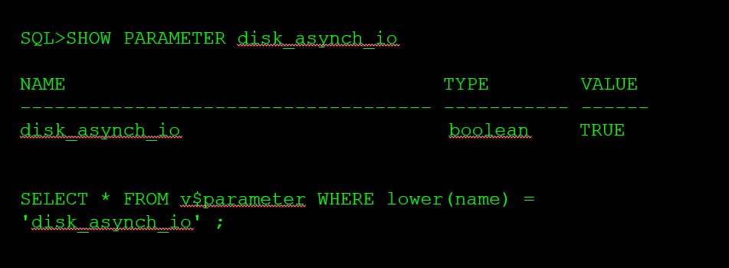
Checking ASYNC I/O Settings
ASM bypasses the filesystem layer in this case because
ASM I/O is entirely controlled by this parameter.
AIO needs to be enabled/disabled by setting
disk_asynch_io to parameter values TRUE/FALSE.

Slide 18
Checking ASYNC I/O DB Settings
If You’re using ASM this setting will be ignored.
filesystemio_options has four options:
"asynch" : means buffered I/O + Async I/O
"directIO" : means Direct I/O only
"setall" : means Direct I/O + Async I/O
"none" : disables Async I/O and Direct I/O

Slide 19
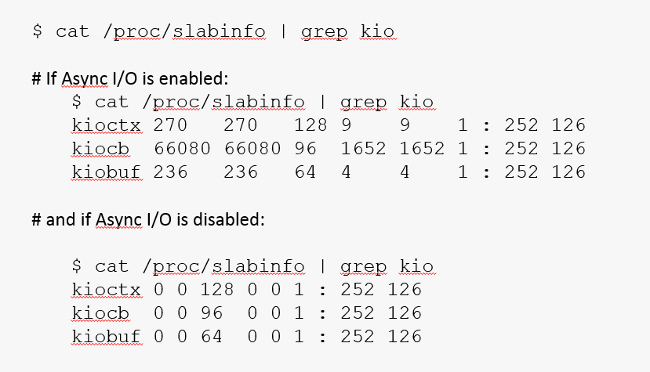
Checking ASYNC I/O System Settings
Settings in Linux

Slide 20
Checking ASYNC I/O System Settings
AIX
Use iostat –A
The iostat -A command reports back asynchronous I/O statistics if the kernel modules are loaded
global asynchronous I/O requests (avgc, maxgc & maxreqs)

Slide 21
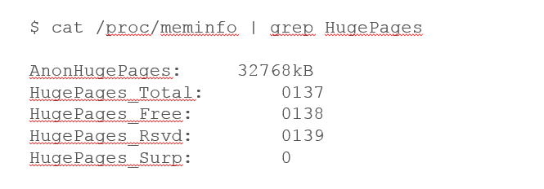
Checking HugePages / LargePages
Linux
Enabling HugePages makes it possible for the operating system to support memory pages greater than the default (usually 4KB).
Using very large page sizes can improve system performance by reducing the amount of system resources required to access page table entries.
To verify the use of huge pages:

Slide 22
Checking HugePages / LargePages
AIX (metalink Note ID 372157.1)
Verify the use of large memory pages:
Get the PID of the ‘pmon’ process:
PID=$(ps –ef | grep pmon | grep ${ORACLE_SID} | awk ‘{print $2}’)
Look at the memory usage of the PID:
svmon –P ${PID}

Slide 23
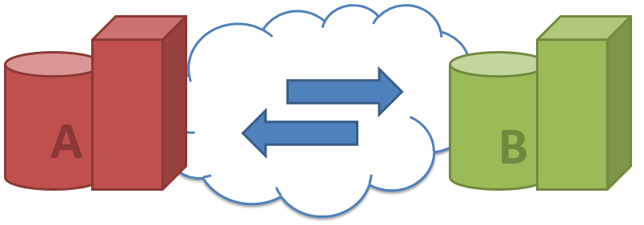
Testing for Network Latency
Testing connection speeds between servers is critical to determine if your slowness might be due to network I/O or configuration.
ping
nc (netcat)
iperf

Slide 24
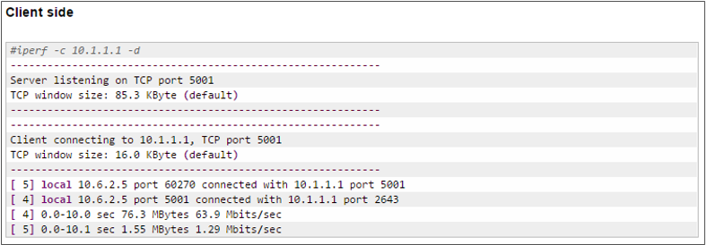
Testing for Network Latency
Testing connection speeds between servers is critical to determine if your slowness might be due to network I/O or configuration.
ping
nc (netcat)
iperf

Slide 25
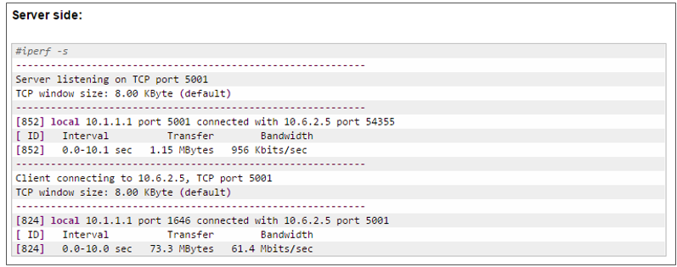
Testing for Network Latency
Testing connection speeds between servers is critical to determine if your slowness might be due to network I/O or configuration.
ping
nc (netcat)
iperf

Slide 26
Monitoring Activity
Finding the DB Bottlenecks

Slide 27
Monitor Sessions

Slide 28
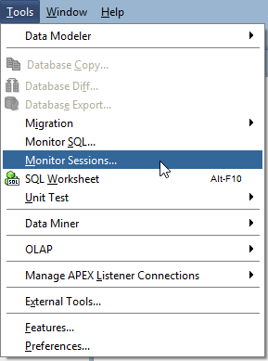
Monitor Sessions

Slide 29
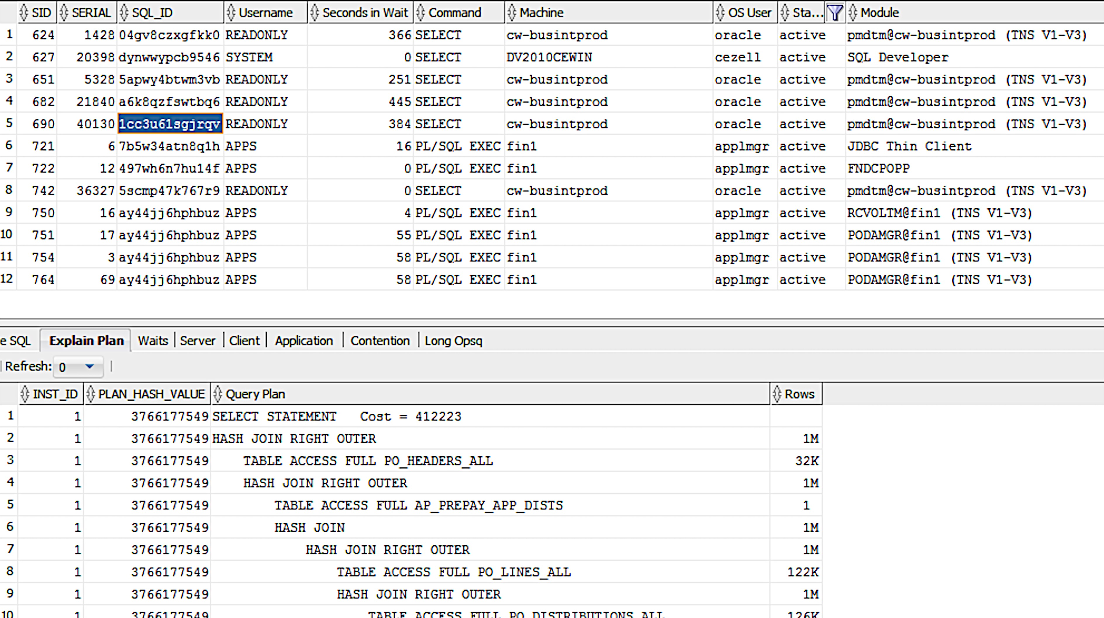
Monitor Sessions

Slide 30
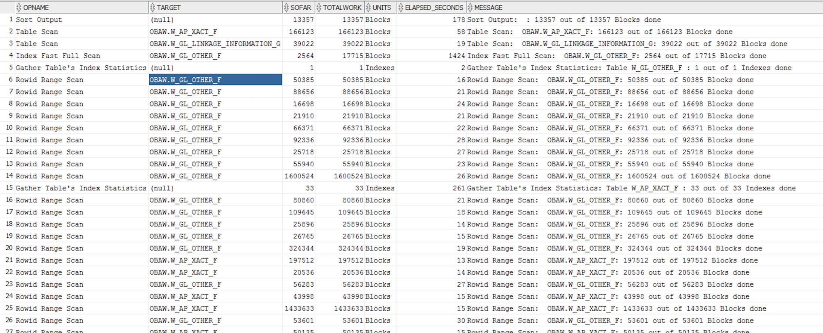
Monitoring Long Operations
v$session_longops

Slide 31
Monitoring Long Operations
v$session_longops

Slide 32
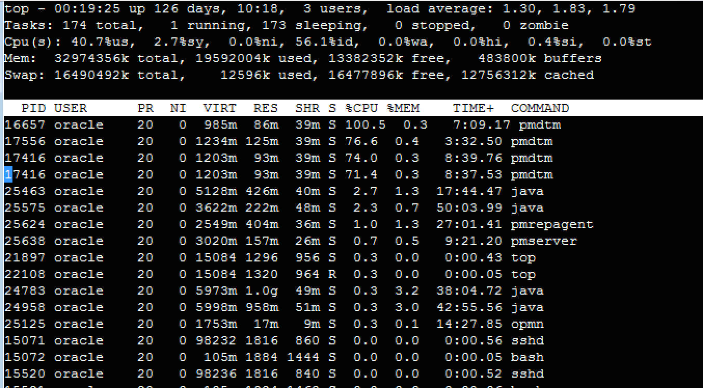
Monitoring Tools: Putty & Top

Slide 33
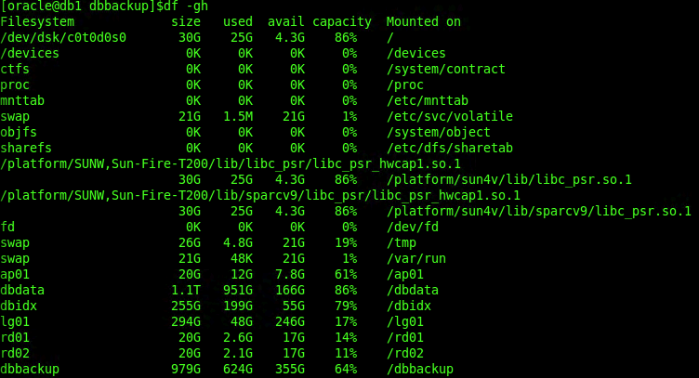
Monitoring Tools: df
Determining what mount points you have and how big they are
use df -gh
You’ll need sudo or root

Slide 34
Monitoring Tools: hdparm
Testing underlying Drive Speeds & Mount Points is critical to finding bottlenecks within your ETL process.
*NIX you probably already have the tools you need:
hdparm
You’ll need sudo or root

Slide 35
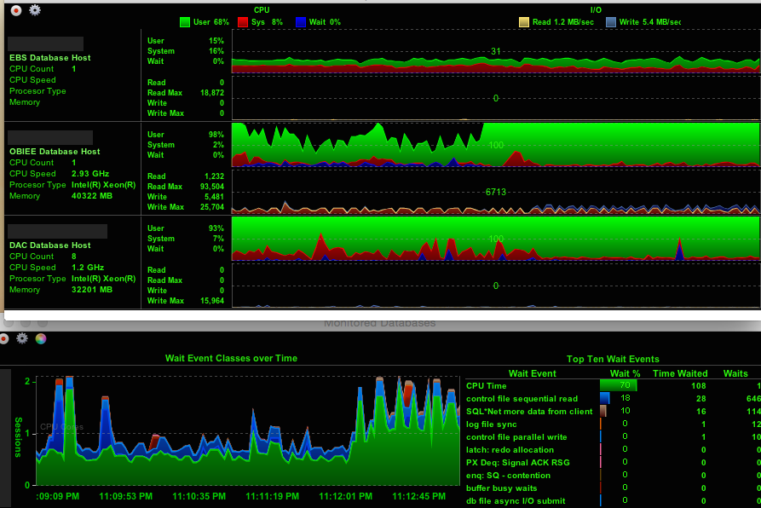
Monitoring Tools: DB Time Monitor

Slide 36
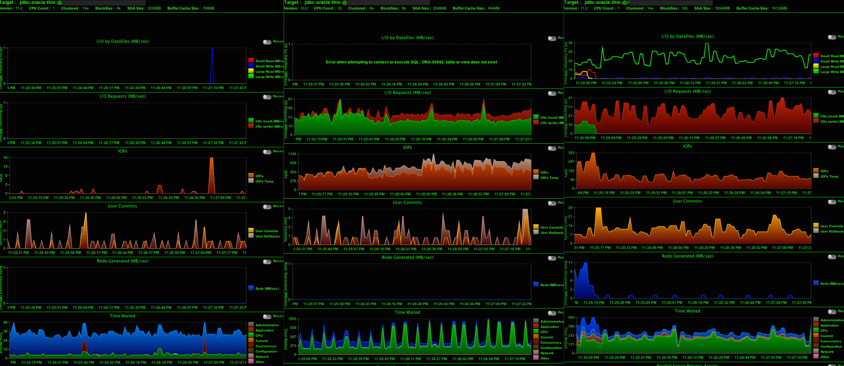
Monitoring Tools: DB Time Monitor

Slide 37
Monitoring Tools: DB Time Monitor

Slide 38
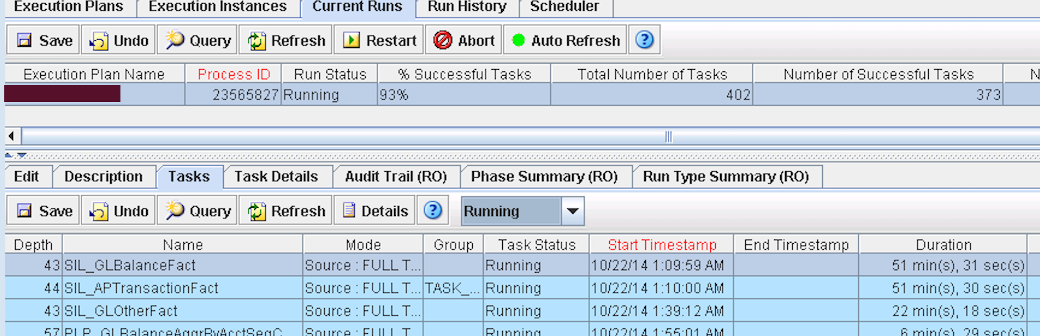
Monitoring in DAC
DAC serves the following purposes:
- DAC is a metadata driven administration and deployment tool
- Manages Application Configuration
- Manages the execution of warehouse loads
- Provides a monitoring capabilities

Slide 39
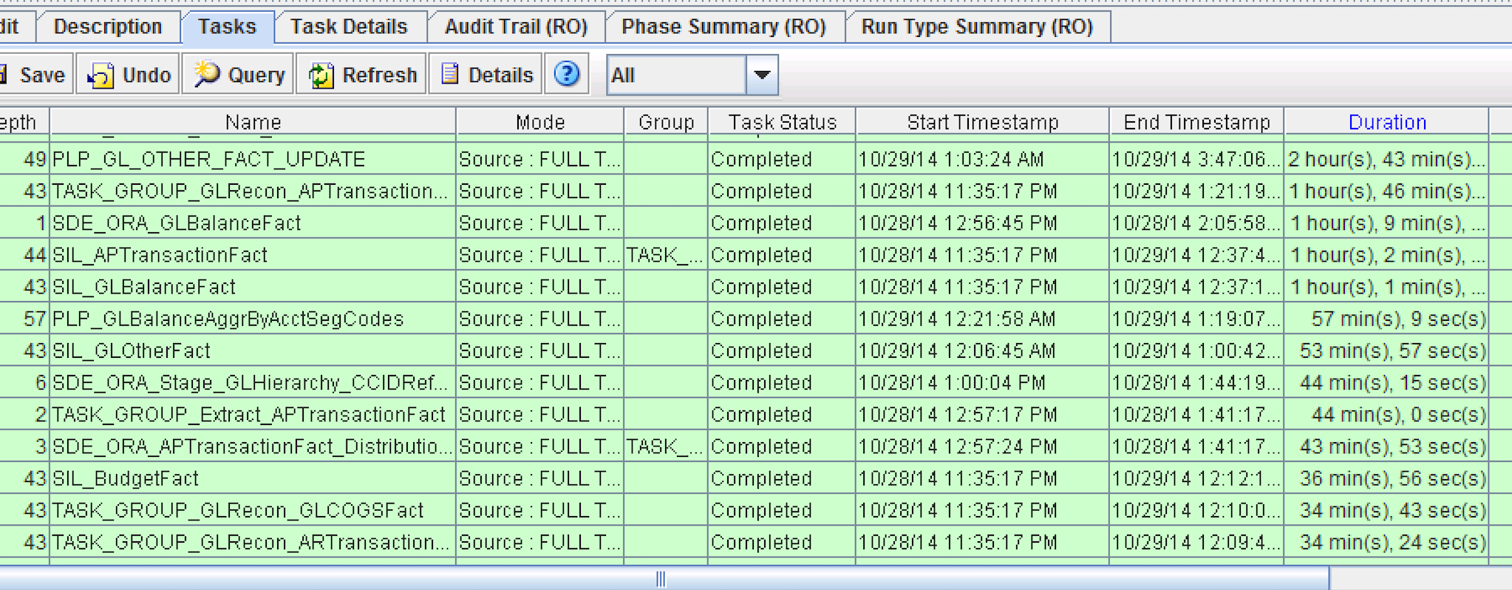
Monitoring in DAC

Slide 40
In Closing
OLTP and OLAP an approach for tuning
More than just data: peeling back the layers
Components & Layers of Common ETLs
Component Points of Failure
Source, Transformation & Target Tuning Points
Common Fails & Misconceptions
Monitoring ETL Activity (tools to make it easy)
Recap & Questions

Slide 41
Questions? Chuck.Ezell @ Datavail.com or Kelley.Weir@Datavail.com
^{Presented by} Chuck Ezell
Development, Tuning & Automation Practice Lead
Tuning ETLs for Better BI
Datavail is the largest provider of remote database administration in the U.S. with nearly 400 DBAs, 24/7 support and onsite/offsite, onshore/offshore delivery.

