Slide 1
Purpose & Values Activation - Spain
Second Half 2017

Slide 2
P&V Activation
P&V
Main Stream
Cooking
Contest
Empowering P&V
Workshop
Secret
Santa

Slide 3
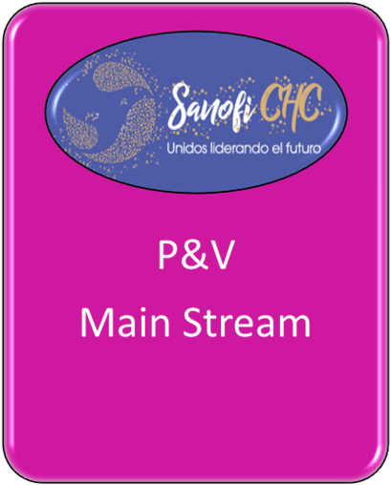
P&V Activation
ACTIVITY
Develop a Main Stream Concept based on the P&V for the 1ST National Sales Conference once the whole CHC Integration was completed & One Sales Force
MAIN GOALS
Empower the new CHC division by strengthening the sense of unity through the P&V.
Each of the “dots” that built the Main Stream Logo represent the integration of the best CHC Team

Slide 4
Main Stream Logo
Together Leading The Future
Purpose
Serve Healthier & Fuller Lives
Values
Integrity
Courage
Respect
Team Work

Slide 5
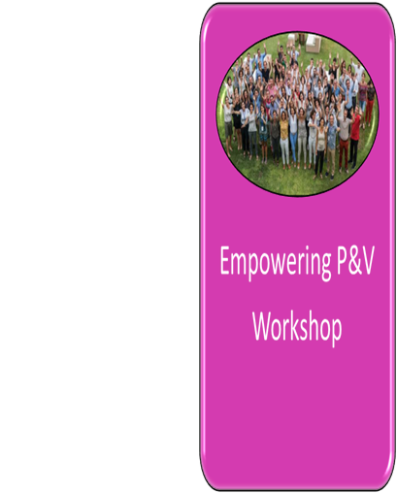
P&V Activation
ACTIVITY
Workshop to empower P&V through the whole CHC organization & Business Partners/ Transversal Teams
MAIN GOALS
Generate an environment that encourages the transmission of the Purpose & Values : Teamwork, Respect, Integrity, Courage
• Link values ​​with the team
• Visualize the 4 values ​​to get them internalized
• Identify specific situations where values have been and could be lived in our daily life
• Work as a team to fully live the P&V

Slide 7
EMPOWERING VALUES WORKSHOP
Timming | PHASES | SPEAKER | Groups | Where | Matrerial | Talking Points
15:25 | Introduction | Ambassadors | 4 of 20 pax | Rooms: Courage, Respect, Integrity Teamwork | Values Slide | General instructions of the dynamic: In each room, 2 of the 4 values ​​are worked in depth and dialogue will be generated among the members.
15:30 | PHASE I: Identify values | Ambassadors | 2 of 10 pax /room | Rooms: Courage, Respect, Integrity Teamwork | Personal Objects | The group is divided into 2. Each participant will bring a personal object, image or resource that they personally assign to one of the company's values ​​and expose it to their group. (The Ambassador begins to share his reflections).
16:00 | PHASE II: Visualize values | Ambassadors | 2 of 10 pax /room | Rooms: Courage, Respect, Integrity Teamwork | DIN A1 cardboards, colored markers, glue stick, scissors and magazines | Each team will work two values ​​with the methodology of "Visual thinking" associating the value to images. From cuttings of magazines a visual history is created that serves to understand its essence.
16:20 | PHASE III: Make them your own | Ambassadors | 2 of 10 pax/room | Rooms: Courage, Respect, Integrity Teamwork | White DIN A1 Cardboards | Participants will have to identify situations that can be found in their work in which they can apply that value.
16:40 | Sharing | One or two representatives per group. | 4 of 20 pax | Rooms: Courage, Respect, Integrity Teamwork |  | Each team presents the rest the visual history that has been built around each Value and the scenarios in which they can apply that they have identified.
16:45 | FASE IV: Show them | Ambassadors | 4 of 20 pax | Rooms: Courage, Respect, Integrity Teamwork | 4 flags, paints, brushes, markers, templates letters and numbers, spray graffiti | Same groups. They are asked to express that value on the flag through images or words. We make the closing here.
17:05 |  |  |  |  |  | Time to change clothes for the activity
18:00 | FASE V: Expand | Ambassadors and representatives | All | Catamaran | Flags + boat microphone | Ambassadors will energize the moment to raise the flags while sailing together

Slide 8
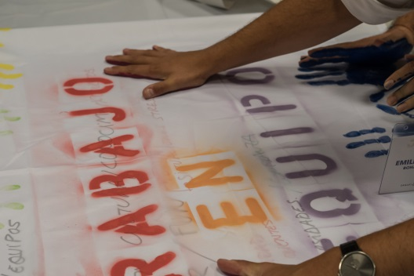
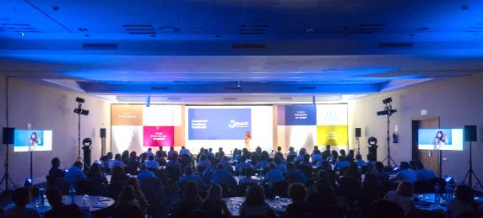
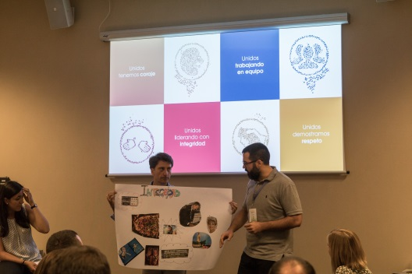
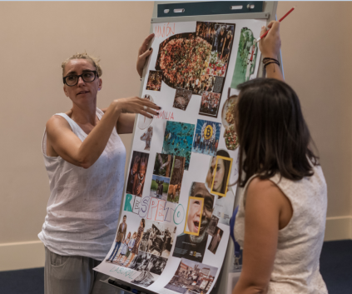
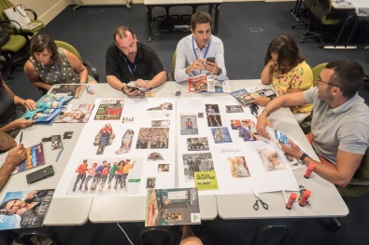
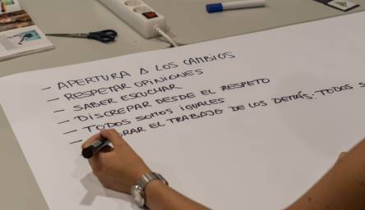
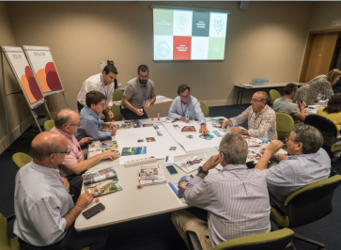
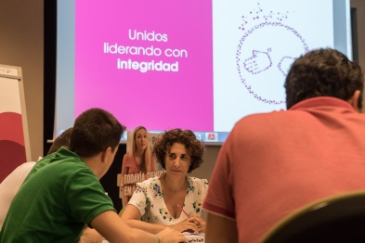
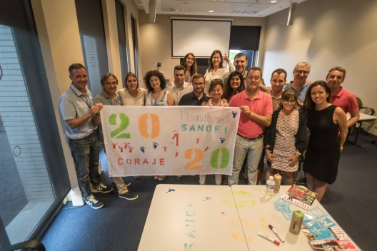
Workshop Dynamic

Slide 9
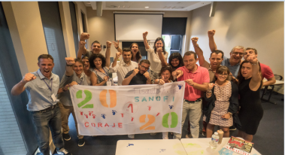
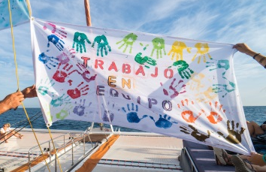
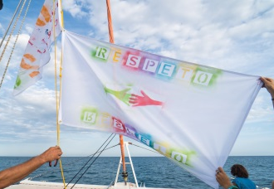
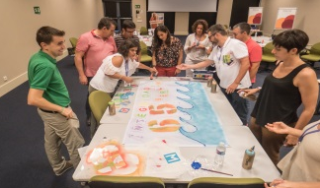
Workshop Output → Value Flags

Slide 10
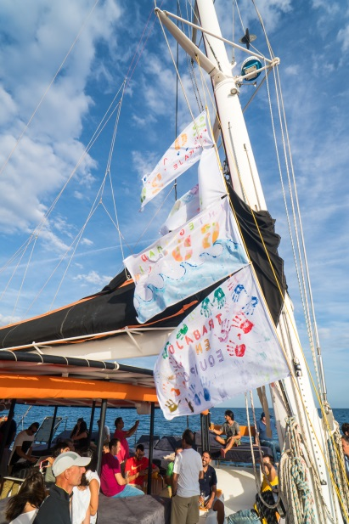
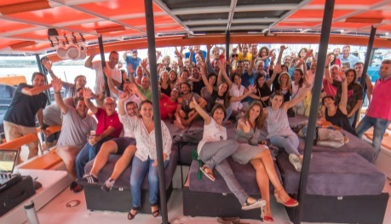
Sailing Together
Our Values should guide our course from now on. In this journey that we undertake as a new team, we navigate together being guided by our P&V.

Slide 11
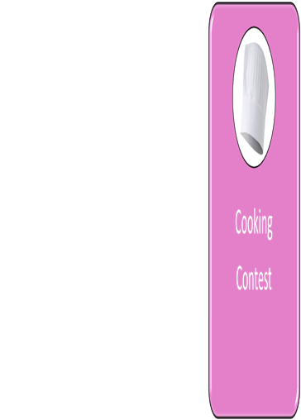
P&V Activation
ACTIVITY
Cooking Contest
MAIN GOALS
Integration of the CHC business - One Sales force
Create links between the team
Bring alive the P&V:
Team Work
Respect
Courage
Integrity

Slide 12
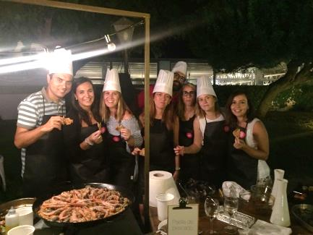
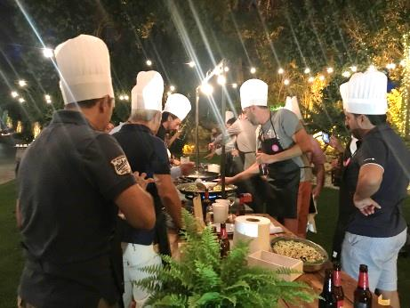
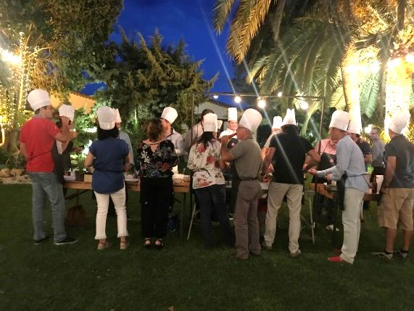
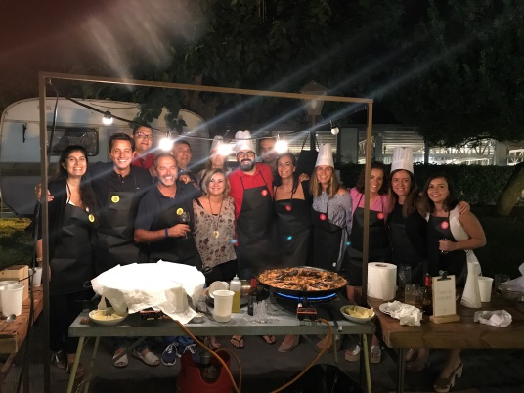
TEAM WORK COOKING CONTEST

Slide 13
P&V Activation
ACTIVITY
Secret Santa – Christmas Lunch
MAIN GOALS
Get ready for Christmas celebrating all together – Team Work & Respect
Secret
Santa

Slide 14
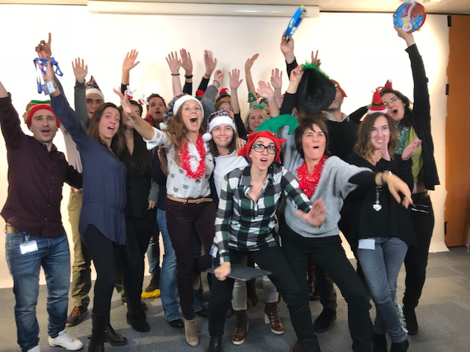
Stealing Secret Santa- Exchange Christmas presents in a particular way “Stealing Santa”:
Opening And Stealing
Each player must open an unopened gift or steal from previously opened gifts, empowering the value of Respect by respecting each others decisions.

Slide 15
Purpose & Values Activation - Spain
November 2017

