Slide 1
Titular sección
P&V Activation – First Halft 2017
Subtitle

Slide 2
Engaging the team to Serve Healthier and Fuller Lives

Slide 3
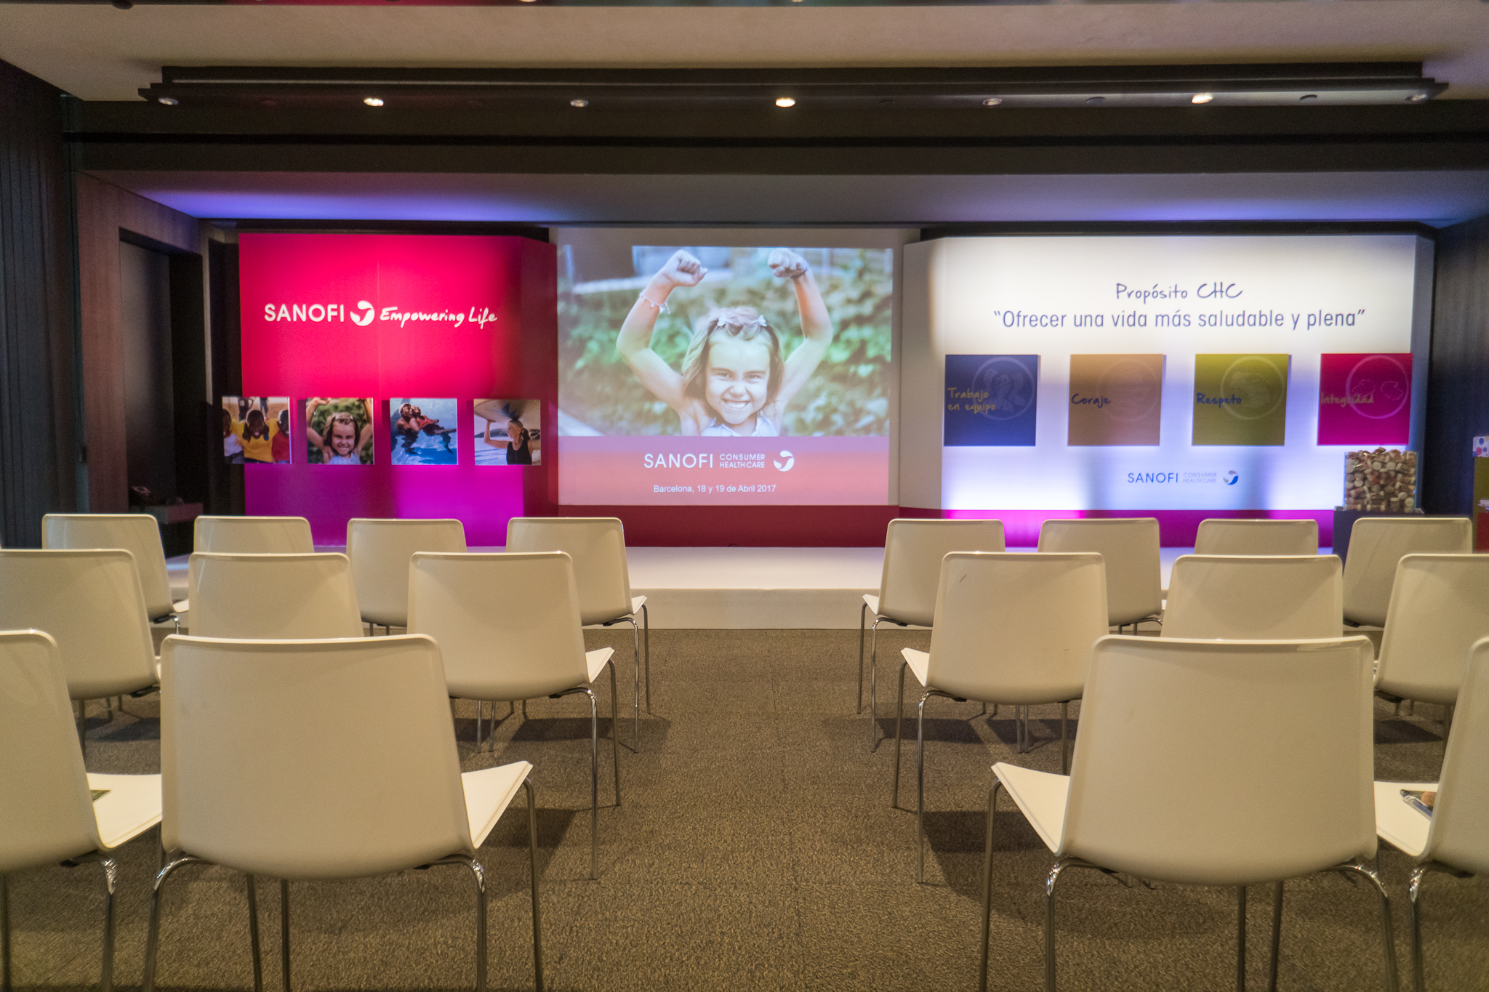
Sales Conference Barcelona, April 18 -19 2017
Painting contest
3

Slide 4
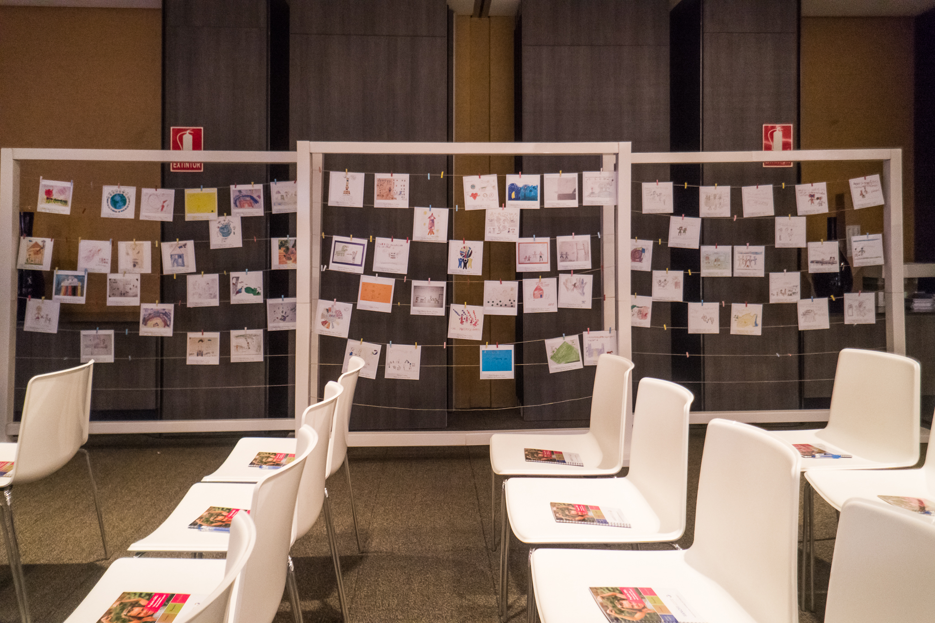
The paintings
Nuestra aspiración
4

Slide 5
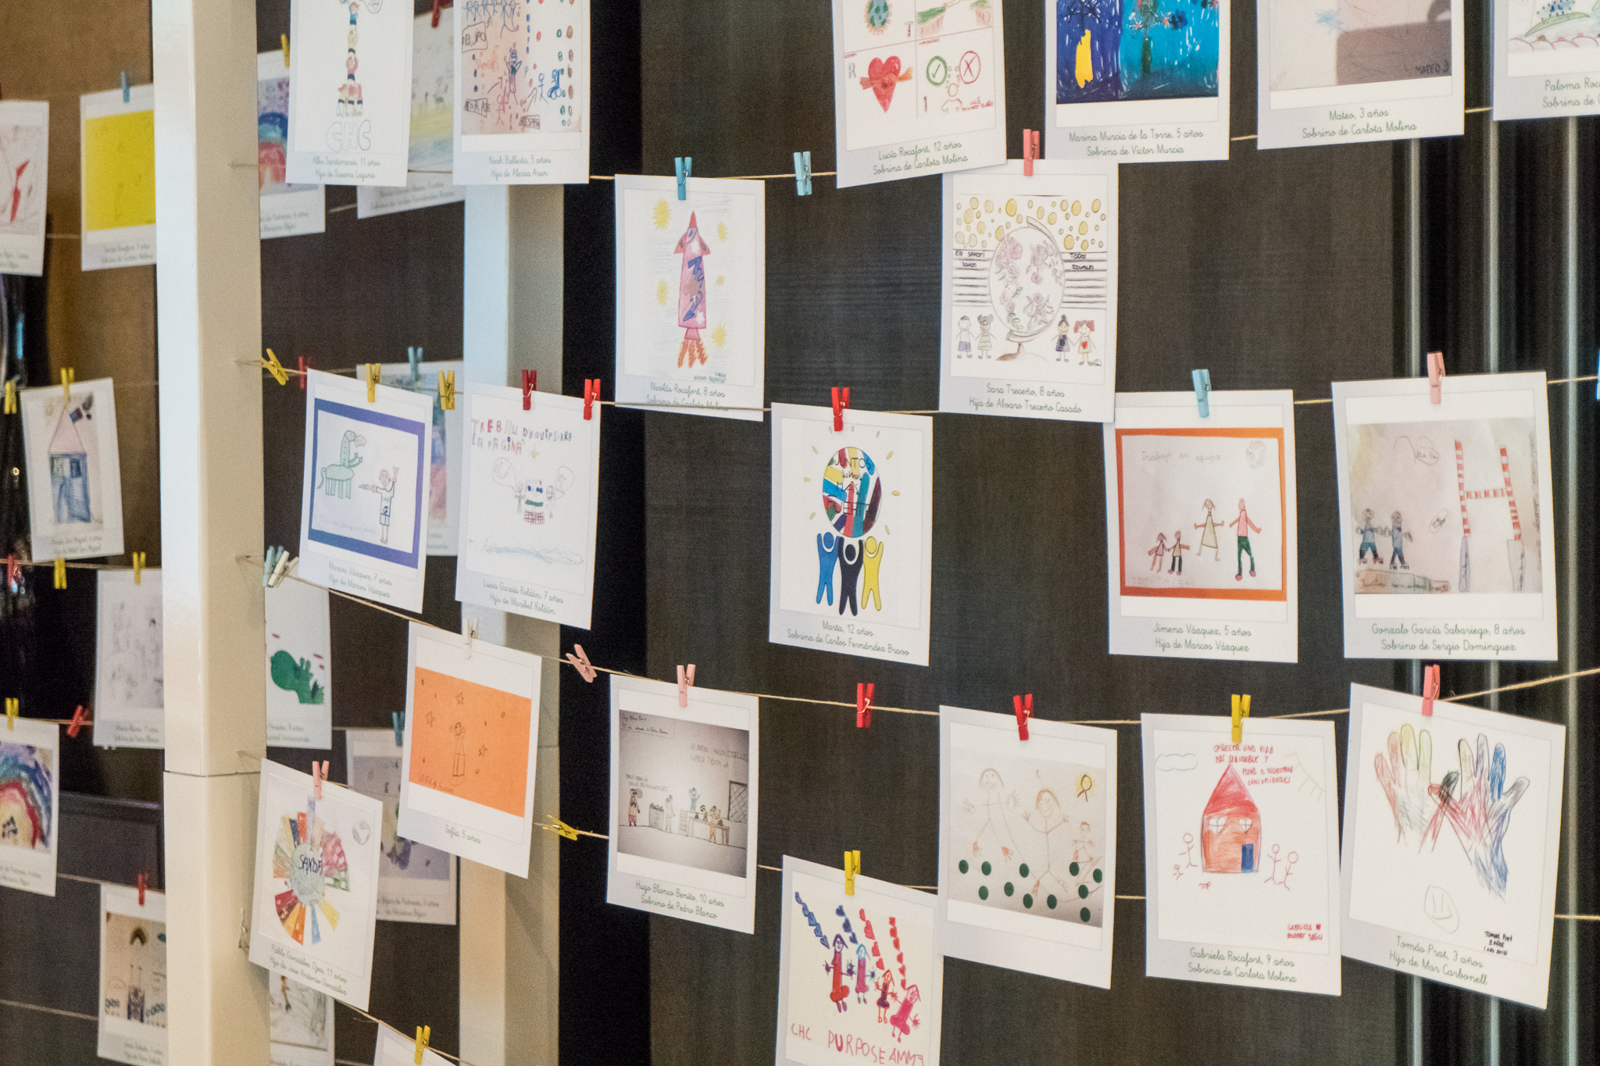
The paintings
Nuestra aspiración
5

Slide 6
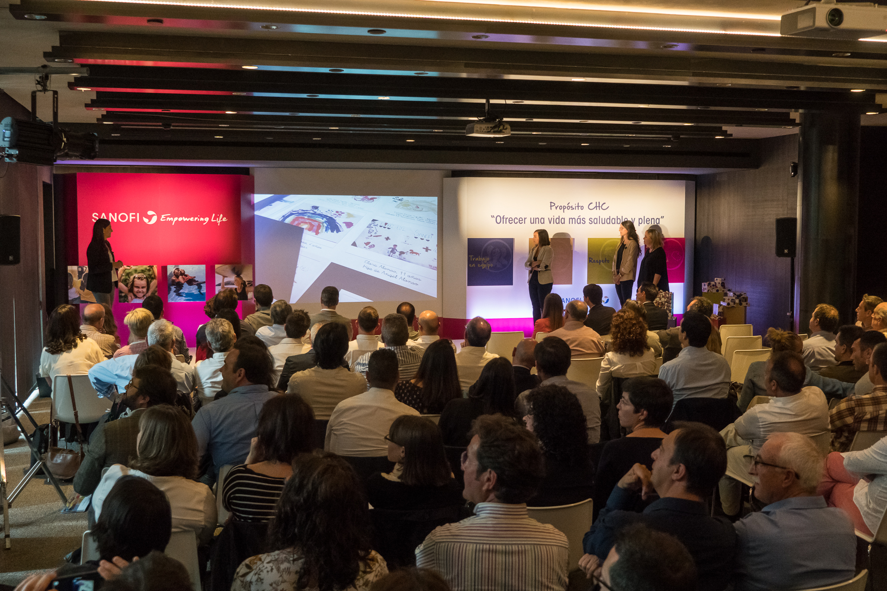
The Ambassadors
Nuestra aspiración
6

Slide 7
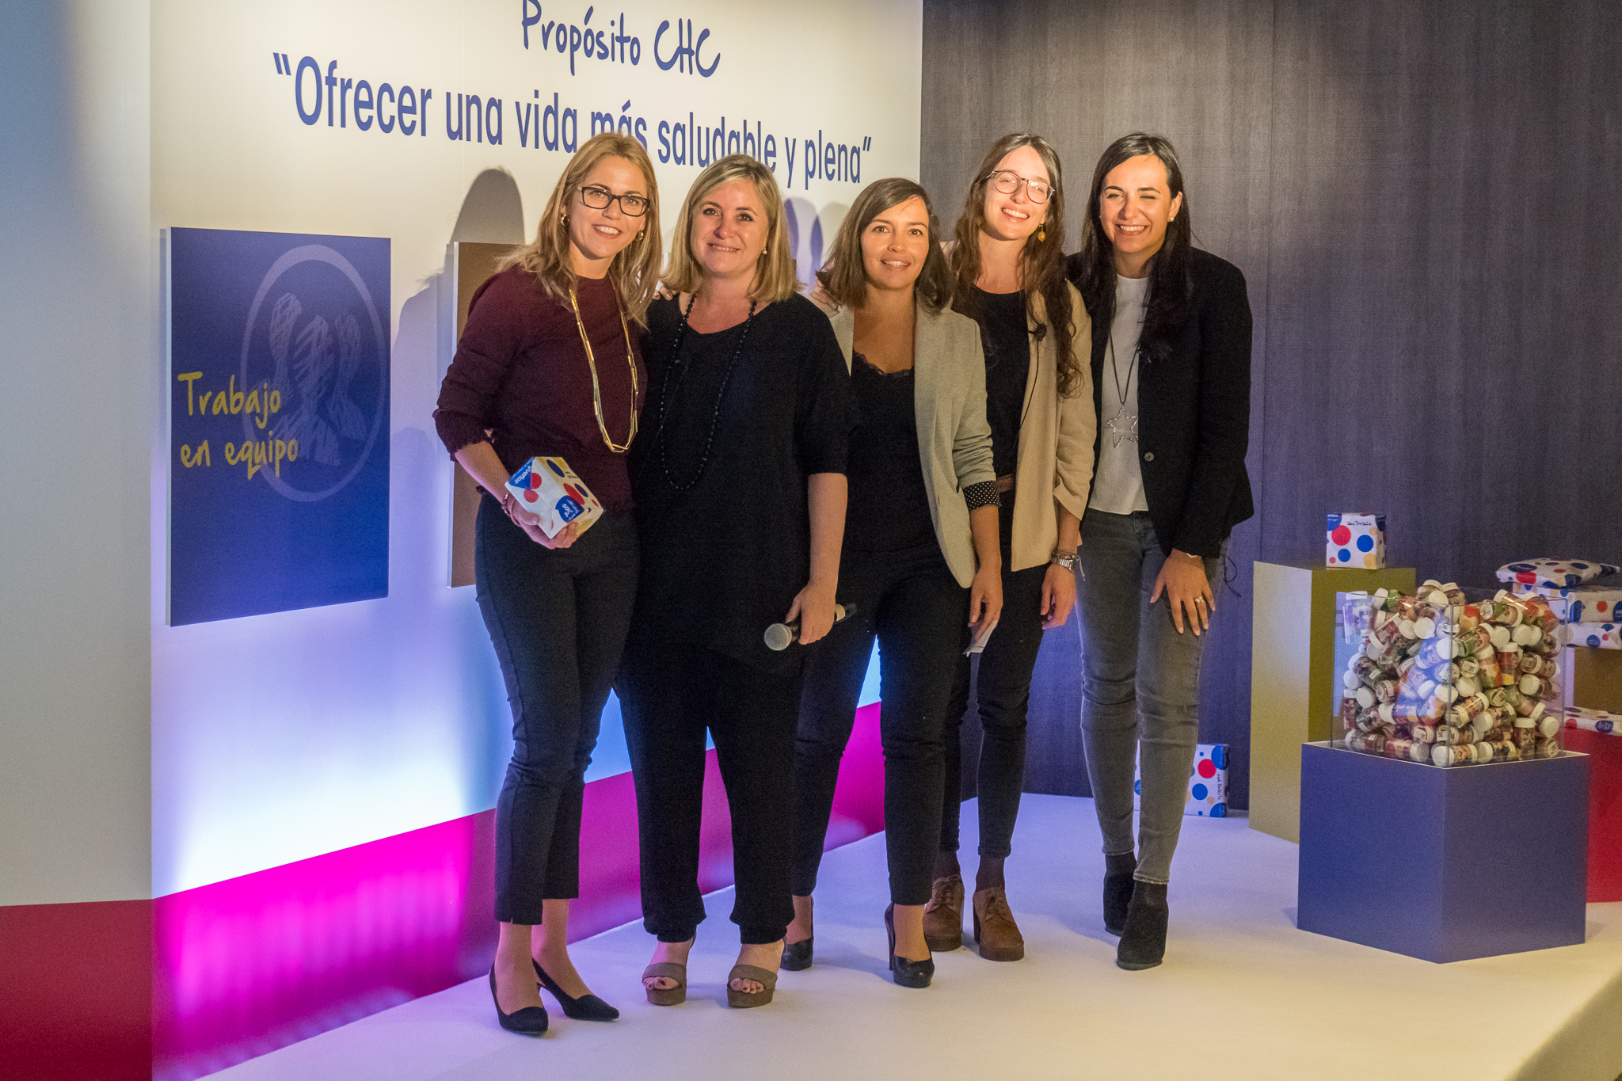
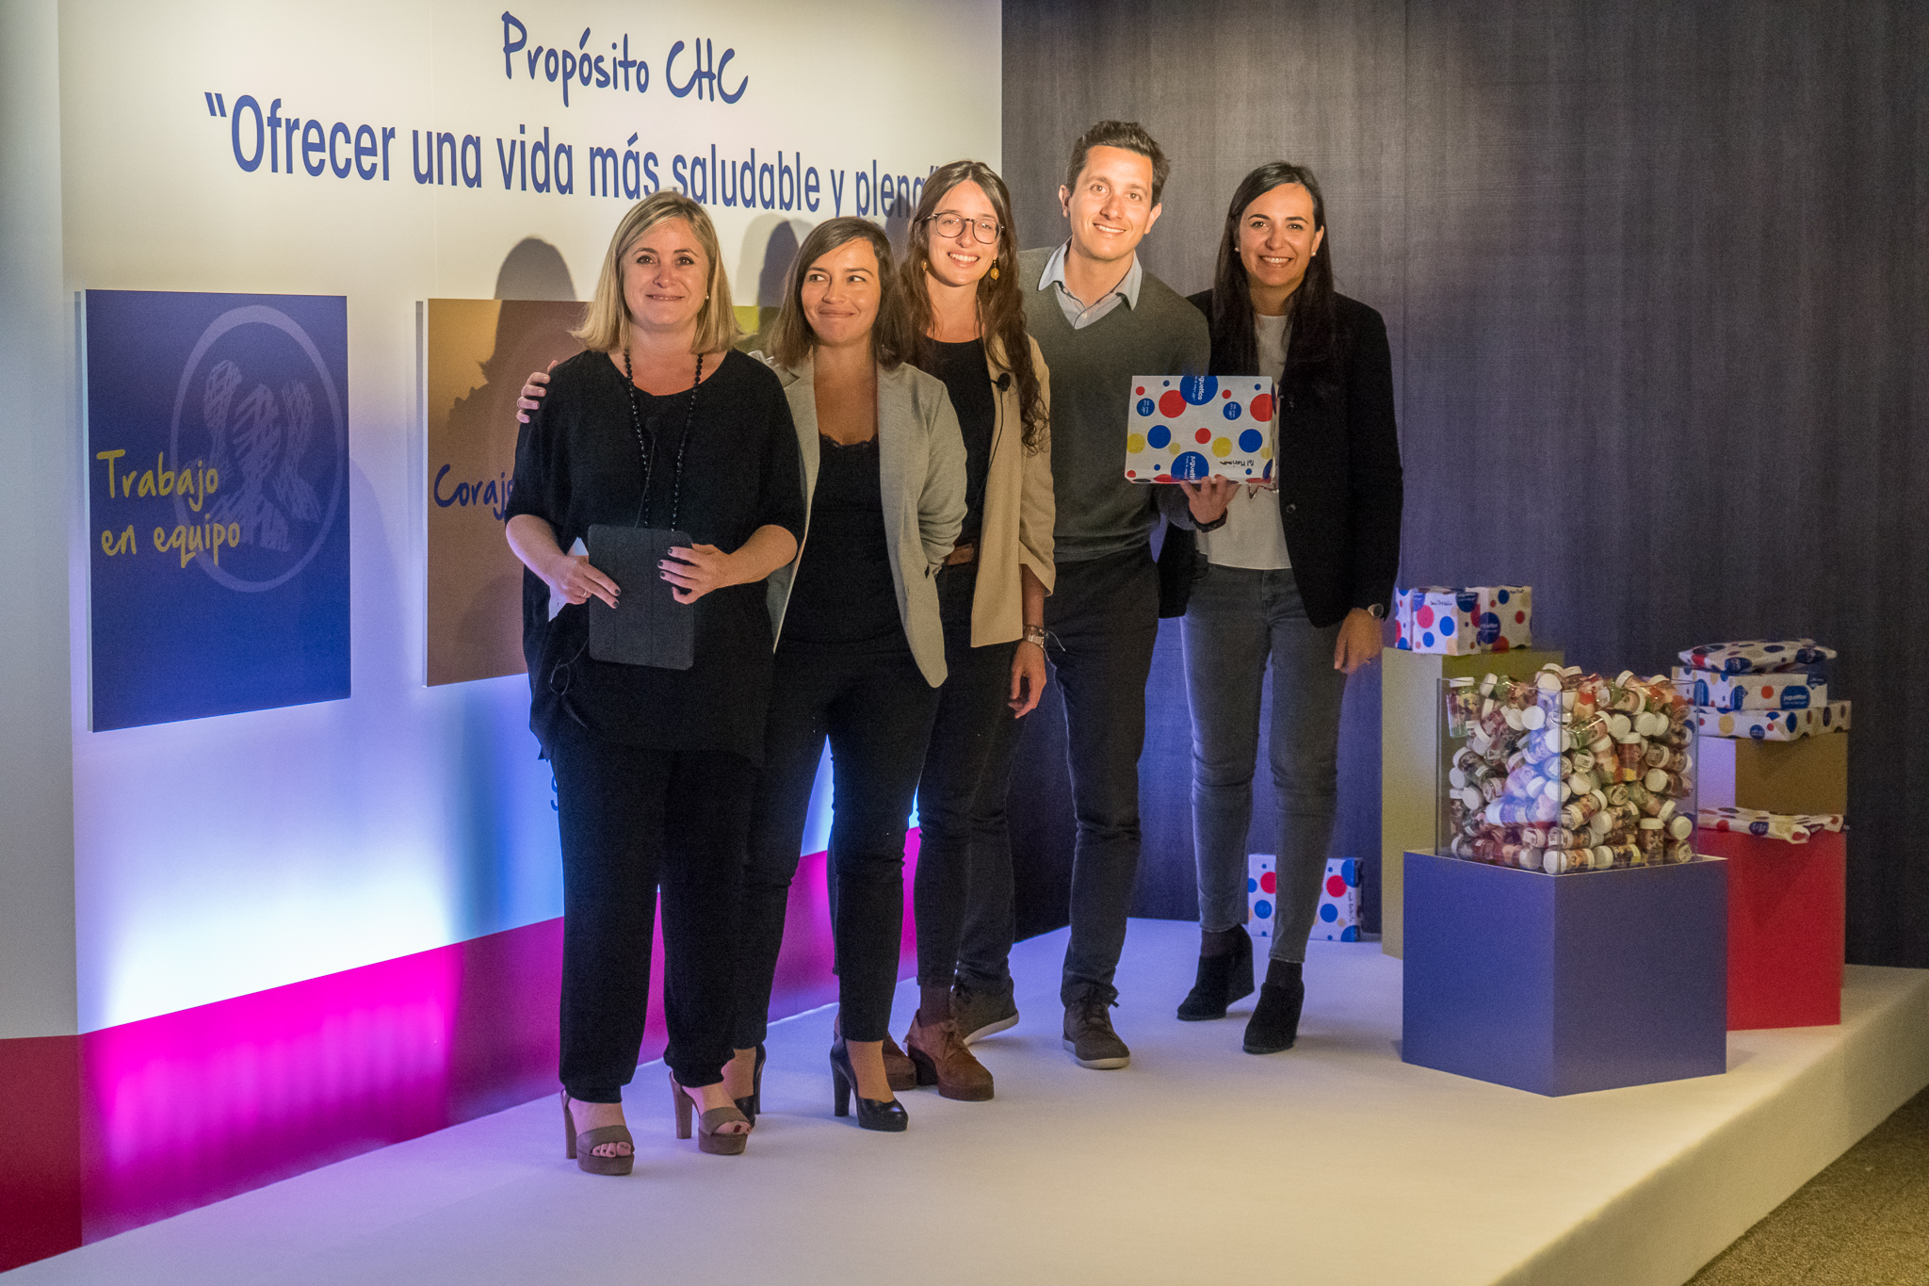
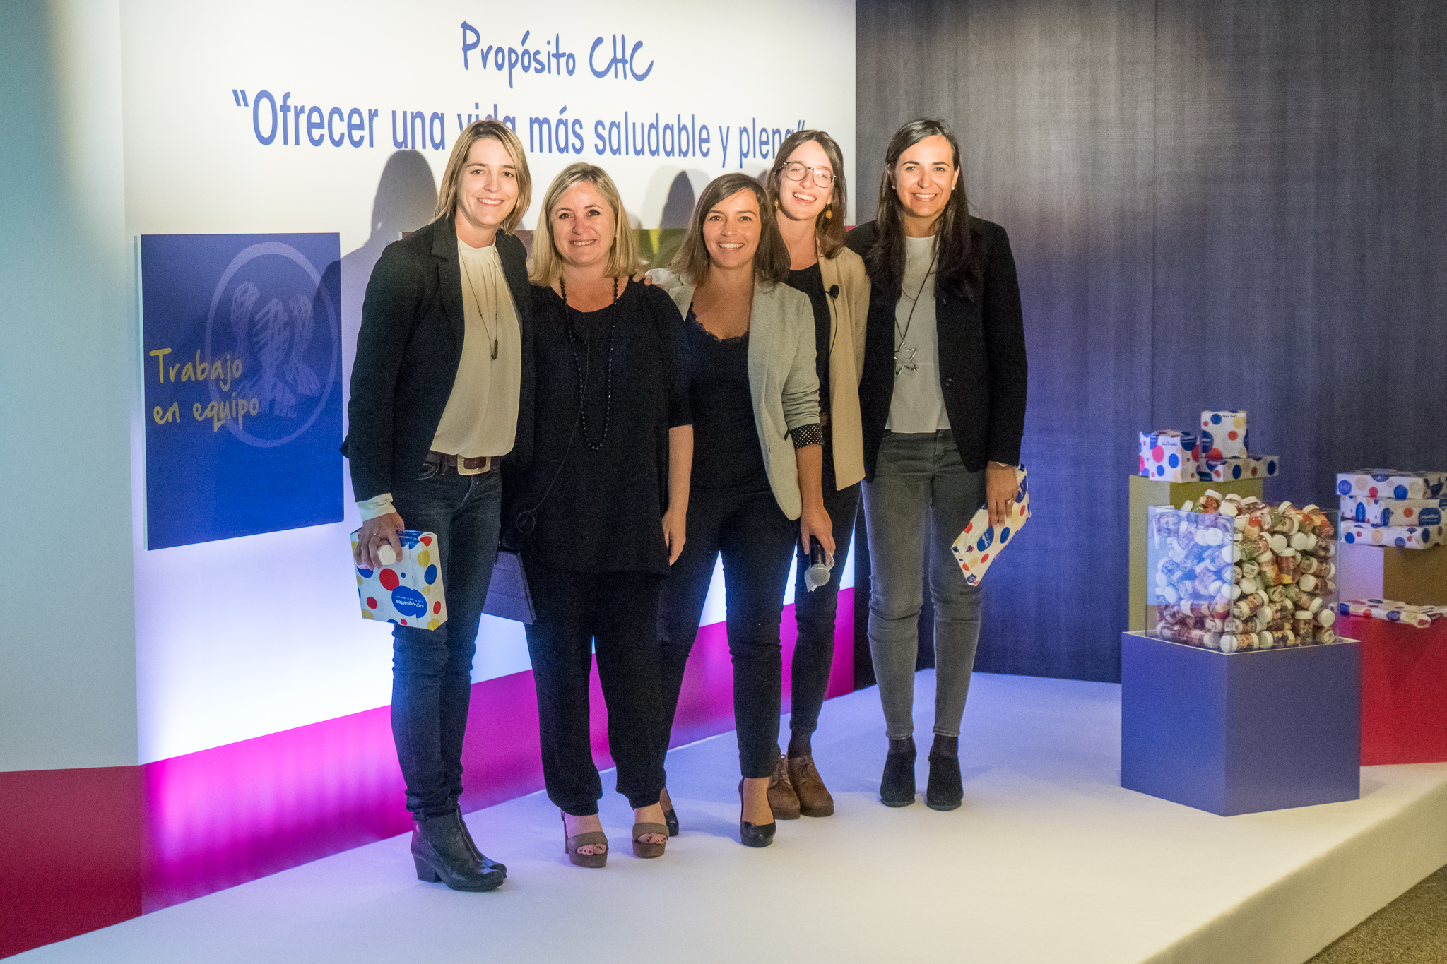
The Winners
Nuestra aspiración
7

Slide 8
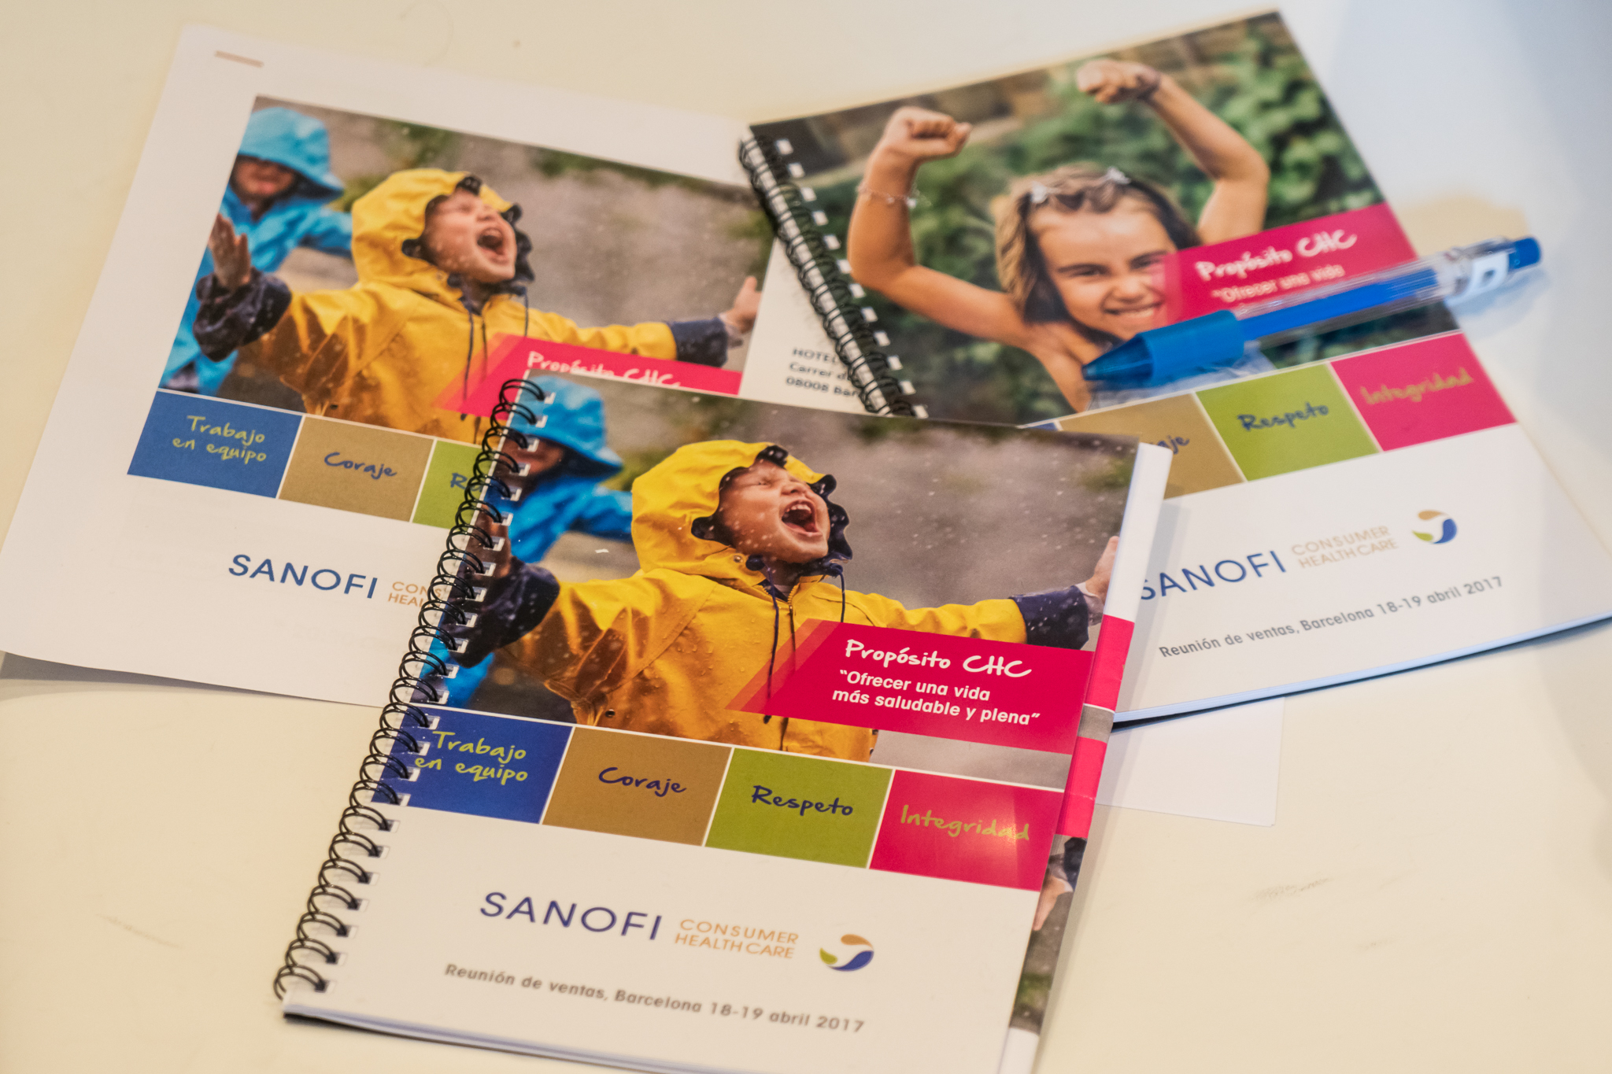
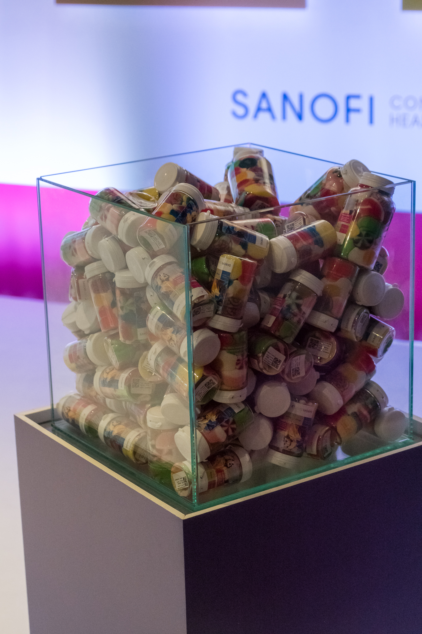
Inspiring Agenda and Notebooks
Nuestra aspiración
8

Slide 9
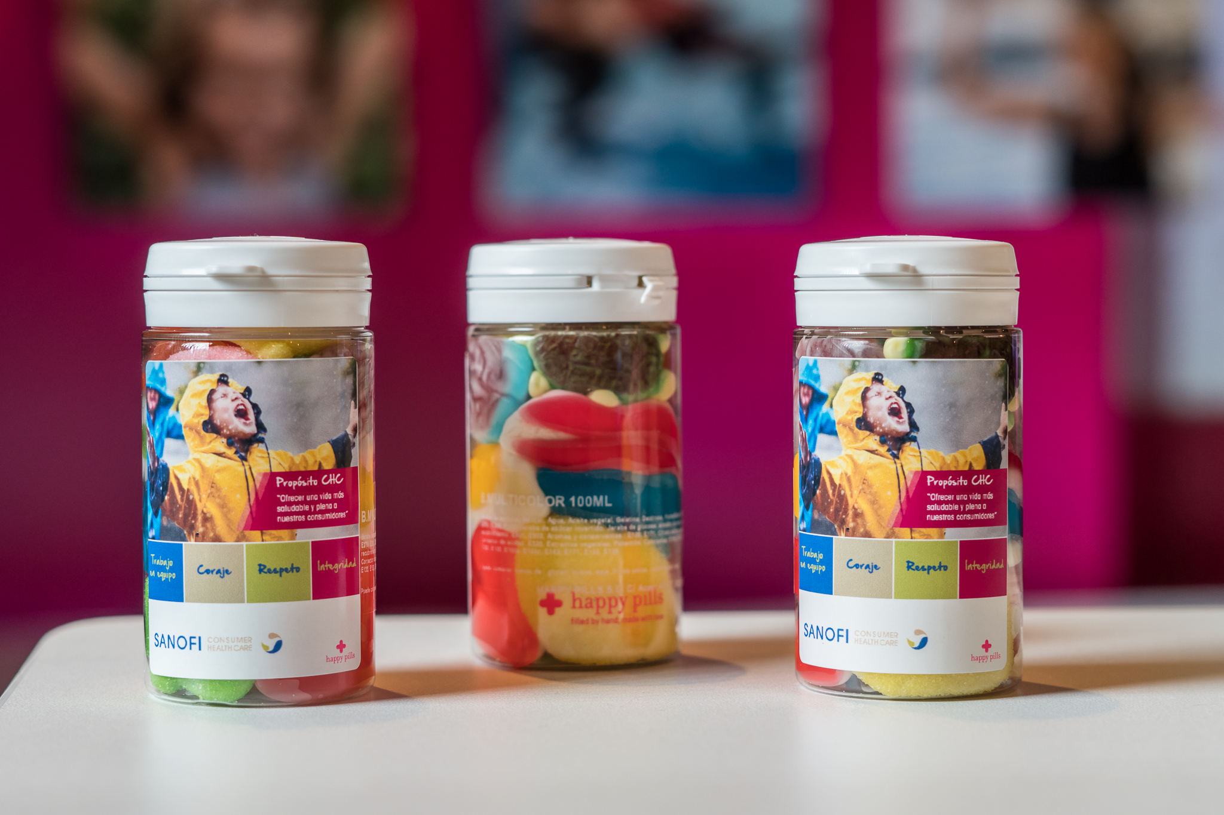
Happy pills for a healthier and happier life
Nuestra aspiración
9

Slide 10
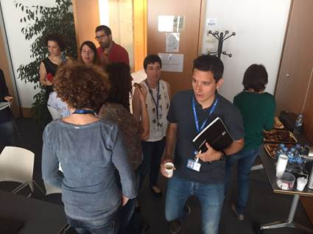
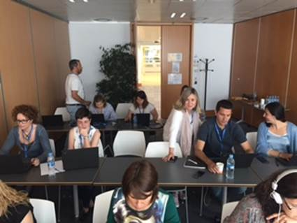
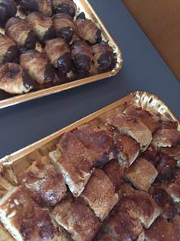
E-learning Breakfast
"Essentials on Anti Bribery and Corruption“ e-learning May 2017

Slide 11
One team, one purpose, shared values
Living and serving together
a healthier and fuller life

