Slide 1
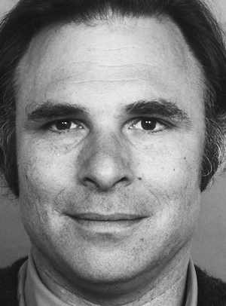
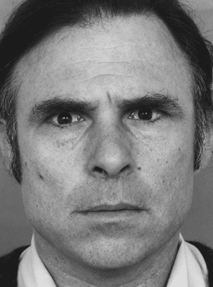
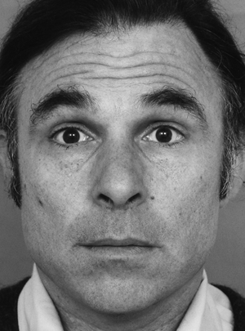
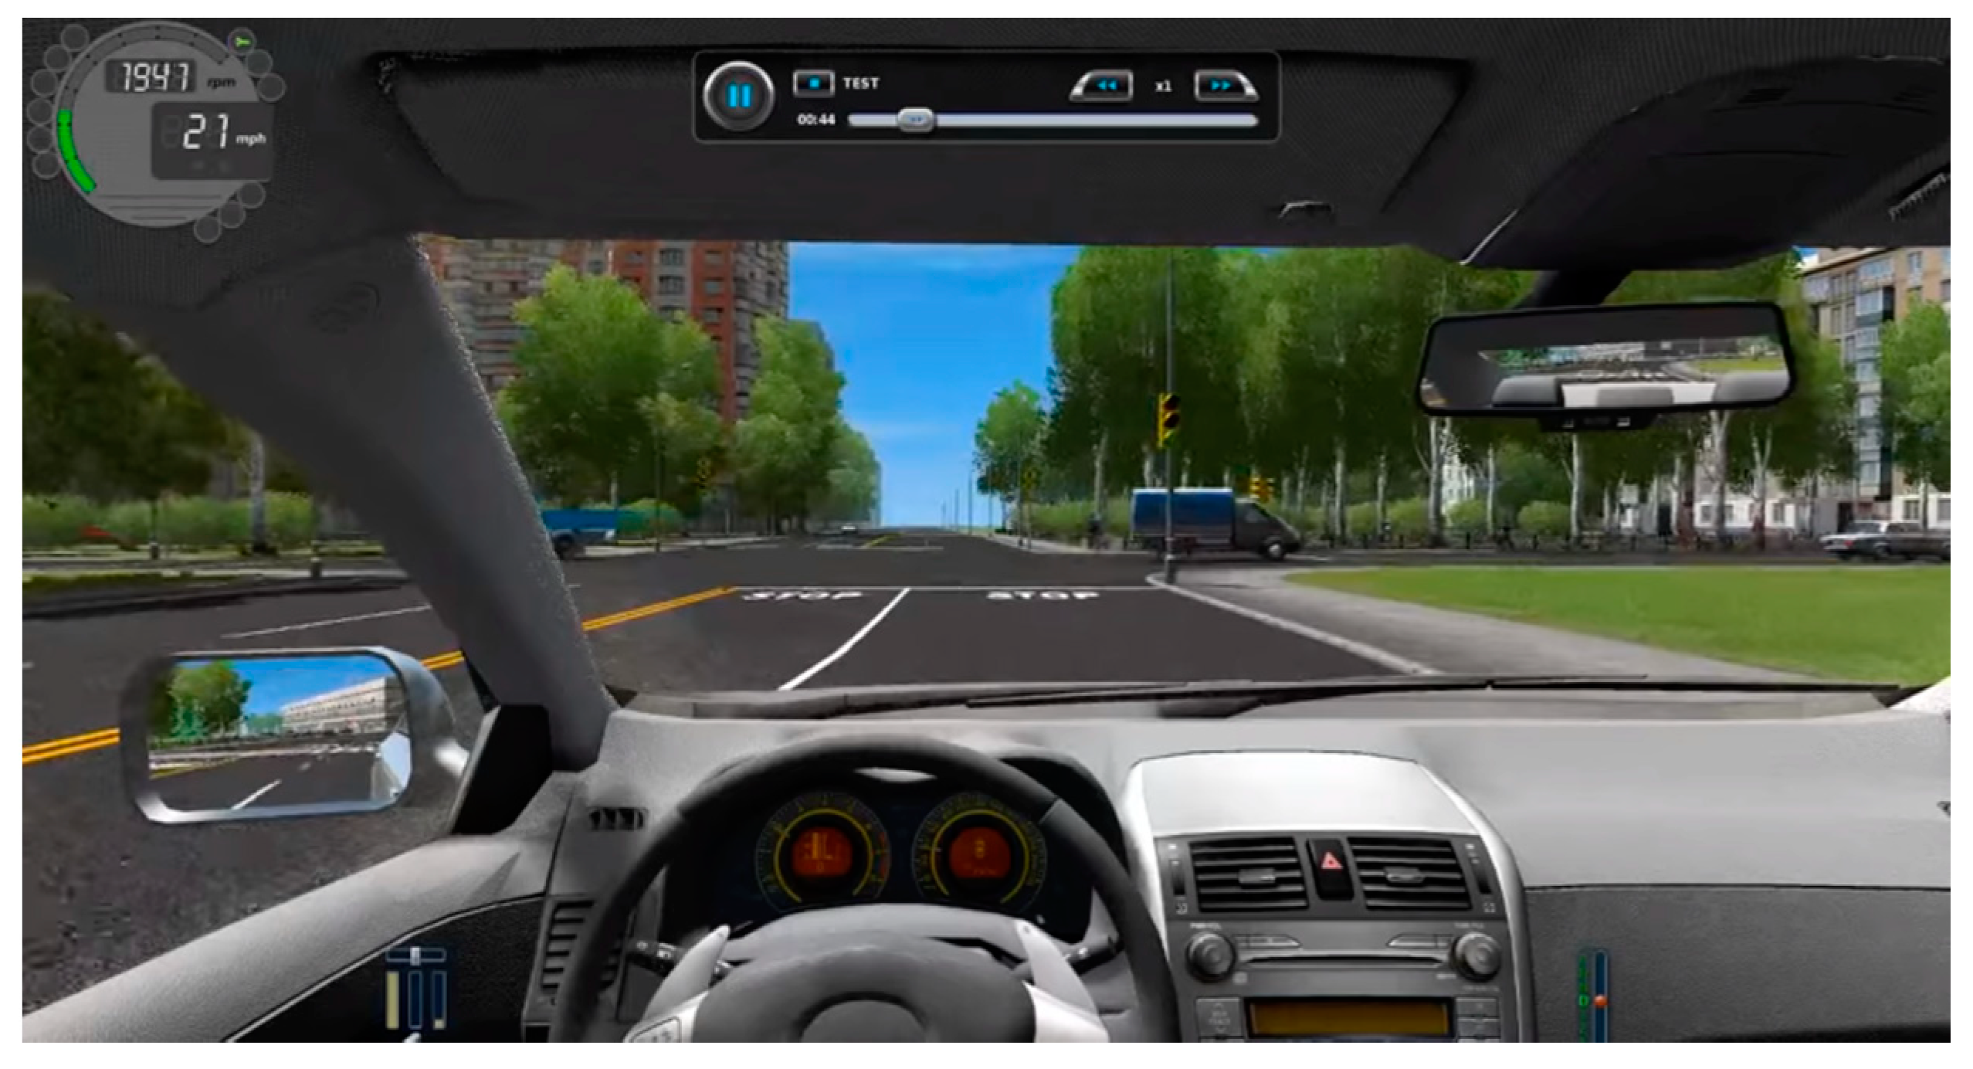
The Effect of Emotion on Driving Performance
Lauren Hunter, Devanie Coombs, Sydney Jackson, Kayla M. Williams, & Carole Scherling, PhD
Department of Psychological Science, Belmont University
Background
Results
Aggressive behavior: Actions elicited by negative, high arousal stimuli. Actions can include:
excessive honking
speeding
reckless maneuvers
Accidents
Previous Research on emotions and driving behavior:
Emotions, particularly anger, create maladaptive driving behaviors (Roidl, Frehse, & Höger, 2014)
Maladaptive driving behaviors linked to increased incidence of accidents (Deffenbacher, 2001).
Current Study: Assess if negatively-valenced music increases aggressive driving behavior and negative facial affect.
Mood induction and driving behaviors
No significant findings.
Trend: Anger (2.73) have more accidents than happy (1.40), F(1,15) = 3.867, p=0.5.
Mood induction and facial affect
a) Happy condition reveals increase in overall negative affect: t(28)=-1.99, p=0.05.
Happy (1.02) compared to Angry (0.67)
b) Emotional specificity: Happy reveals increased anger facial affect: t(28) = -2.37, p = 0.025.
Happy (1.37) compared to Angry (0.69)
Discussion
Angry mood induction correlates with some aggressive driving behaviors, such as accident rates (Roidl, 2014).
Facial affect during the driving simulation does not match our mood inductions.
“Catharsis” in anger induction when listening to mood-congruent music, hence showing less negative facial affect (Dingle & Sharman, 2015).
“Frustration” in happy induction when listening to mood-incongruent music, which may lead to expression of negative facial affect.
Future studies should investigate emotional induction beyond approach emotions (like happy and anger) and investigate the effects of withdrawal emotions (such as sadness).
Hypotheses
Angry mood induction increases negatively-valenced mood and leads to more aggressive driving behaviors.
Angry mood induction reveals expression of more negative facial affect versus happy mood induction which shows more positive facial affect.
Method
References
Participants
45 Undergraduates
18-22 years old (M = 19.54, SD = 1.45)
78% Female and 22% Male
88.6% Caucasian, 9.1% African American, 2.3% Other
Measures
Two mood inductions: Word search and Music.
Emotional Expressive Behavior System (EEB; Gross and Levenson, 1993).
City Car Driving Statistics Records – An in-game record keeping program for driving infractions
Experimental Procedures:
Group assignment: Angry or Happy condition
Practice driving session
Mood induction #1 via word search task
Mood induction #2 via music and Testing driving session
2 mood-congruent playlists (Spotify): Happy or Angry
Researcher created and piloted in student cohort)
Deffenbacher, J. L., Lynch, R. S., Oetting, E. R., & Yingling, D. A. (2001). Driving anger: Correlates and a test of state-trait theory. Personality and Individual Differences, 31(8), 1321-1331.
Dingle, Genevieve & Sharman, Leah. (2015). Extreme Metal Music and Anger Processing. Frontiers in Human Neuroscience. 9. 10.3389/fnhum.2015.00272.
Roidl, E., Frehse, B., & Höger, R. (2014). Emotional states of drivers and the impact on speed, acceleration and traffic violations—A simulator study. Accident Analysis & Prevention, 70, 282-292.
Contact email: lauren.hunter@hunterempire.com

