Slide 1
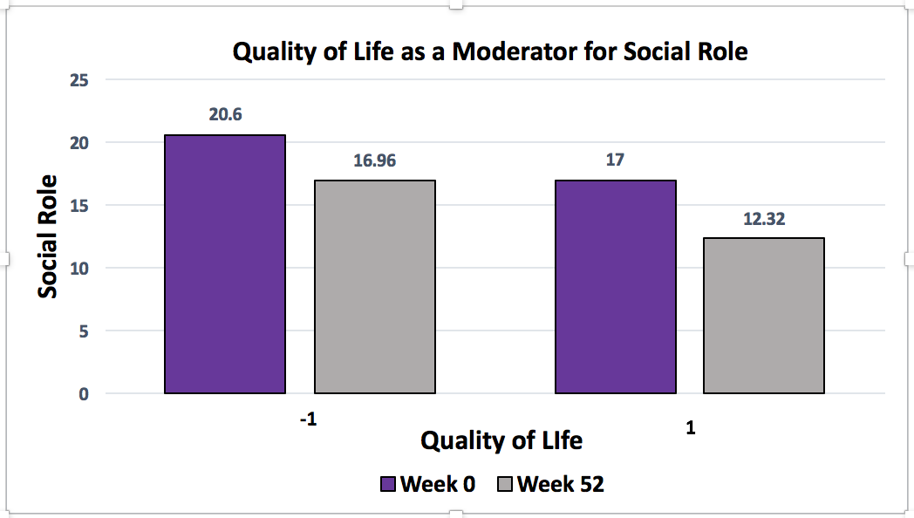
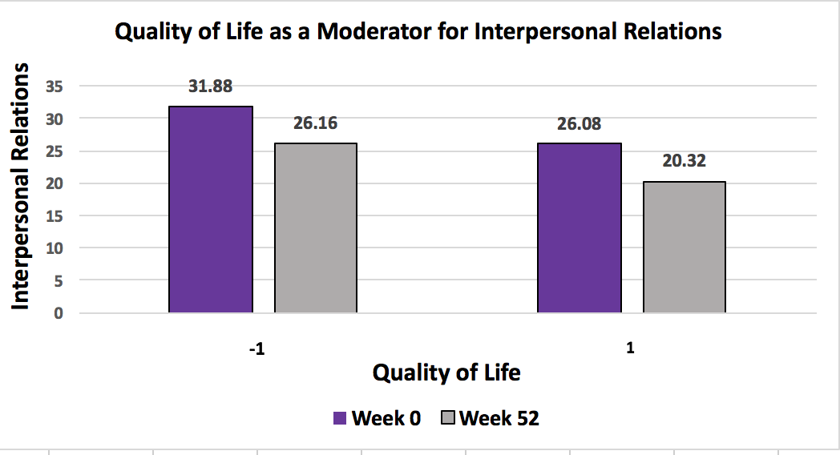
Quality of Life as a Moderator for Interpersonal Relations and Social Role
Within Psychotherapy
Anne-Marie N. Romain, William F. Chaplin, Ph.D.
St. John’s University
Introduction
Researchers and clinicians have constantly been interested in the study of quality of life (QoL) and how it relates to clinical treatments and patient outcome. QoL has become an important outcome measure in modern medicine as it grounded in the perspective of the client rather than the clinician.
Subjective QoL or subjective well-being is part of the definition of health according to the World Health Organization: “a state of physical, mental and social well-being, not merely the absence of disease and infirmity” (Amir, Roziner, Knoll, & Neufeld, 1999; WHOQOL). QoL is a multidimensional construct encompassing many parts of a client’s perspective on how well they are living based on three essential aspects: emotional well-being, physical state and social function (Gosney & Motl, 2008; Amir, Roziner, Knoll, & Neufeld, 1999). Our research focused on the aspect of social function and the role it plays in shaping a client’s perspective of their QoL.
Even though the term QoL is rooted in subjective experience clinicians and researchers have identified several psychosocial concepts that might be related to QoL and affect the total measurement such as self-efficacy, social support, social role, and interpersonal relations (Wedgeworth, LaRocca, Chaplin, & Scogin, 2017; Williams & Hankey; 2015; ) Many assessments of QoL contain or relate to subscales such as social role and interpersonal relations (Ferrell et al., 1990; Schalock, 2000). Despite the overlapping content very few studies have sought to explore the correlations between various psychosocial concepts and Quality of Life as a whole.
Result
People with higher QoL at baseline showed less distress of SR at baseline by 1.8 points.
People with higher QoL at baseline also showed less improvement in SR distress over time (.012) show less of a decrease)
People with higher QoL at baseline showed less distress of IR at baseline by 2.9 points. People with higher QoL at baseline also showed less improvement in SR distress over time (.012)) show less of a decrease)
We fit a mixed effects regression model to the change in IR and SR over time. We found that both IR and SR showed small but significant improvement over the course of psychotherapy (B=-.04, p< .0001), (B= -.02, p< .0001), respectively
Methods
Participants- Longitudinal data was collected on 283 adult therapy clients as they underwent therapy at a community mental health training clinic. The sample size consisted of 153 (54.1%) women, 96 (33.9%) men and 34 (12%) participants who declined to report their gender. The mean age was 33.5 years old with a standard deviation of SD=11.8.
Procedures - All clients at the clinic completed measures of symptomatic distress, the OQ (Outcome Questionnaire) at their first appointment and then on a biweekly basis. (OQ-45; Lambert et al., 1996). The (OQ) is a 45-item measure that broadly assesses a variety of common mental health symptoms. The measure is designed to be used repeatedly in clinical and research contexts to assess change in symptoms among patients undergoing psychotherapy. The OQ can be scored to yield three subscales Symptom Distress (SD—25 items), Interpersonal Functioning (IR—11 items), and Social Roles (SR—9 items) as well as a total score. “Symptom Distress” is a subscale that reflects the symptoms of the most common disorders: anxiety disorders, affective disorders, adjustment disorders and stress related illness (e.g. “I feel stressed at work/school” ) “Interpersonal Relations” is used to evaluate complaints such as loneliness, conflicts with others, family problems and etc. “Social Role” items measure the extent to which difficulties in the social roles of worker, homemaker or student are present. Conflicts at work, overwork, distress and inefficiency in these roles are assessed. Both IR and SR are reversed scored so High scores indicate destress while ow scores indicate adequate SR and IR.
BI-Weekly Longitudinal form (BILs). This self-report instrument was evaluates the thoughts, feelings, and personality of a client. Clients complete the BIL at their first appointment and then at alternating biweekly intervals. The scale has 37-item divided into seven subscales that measure positive outcomes over time. Our research specifically utilized the items that measured how the client viewed their “Quality of Life”. It includes three items and utilizes Domain 2 (Psychological) of the World Health Organization's Quality of Life (WHOQOL) to determine a client’s perspective of how “well” their life is going. The items are “I enjoy life” , “My life is meaningful”, and “I am able to concentrate”.
Hypothesis
Aim: The purpose of this study is to further examine QoL in the context of psychotherapy and to study the psychosocial concepts that have been suggested to be parts of QoL. Specifically, we observed the interactions between interpersonal relations, social role and quality of life.
Hypothesis #1: In this research, we examined Quality of Life as a moderator for Interpersonal Relations and Social Role. We hypothesized that a low score on distress in interpersonal relations would relate to a high score on Quality of Life. We hypothesized that the same inverse relationship would exist between social role and quality life
Hypothesis #2: Our secondary hypothesis, was that Quality of Life would not moderate a change in Symptom Distress but only for the subscales of IR and SR.
Strengths
Since the study was longitudinal we were able to examine the change of the variables over time. This is advantageous is it makes it easier for the researcher to observe trends within the study. Another strength of the study was since the participants came from a community based mental health clinic the sample size was large and diverse.
Conclusions
The data suggests that Quality of Life was indeed moderating the overall change, effect of time, for Interpersonal Relations and Social Role. The findings showed that clients with higher quality of life on the beginning of therapy saw a slower improvement on social role/interpersonal change than those who had scored lower. They however had initially reported lower distress in SR and IR which could be related to their report of a higher Quality of Life. Clients who had reported a lower QoL had also reported higher distress in SR and IR and saw a faster improvement in these subscales over the course of psychotherapy. These results support our hypothesis that QoL could be a moderator for IR and SR and that they can be considered subparts of the complete construct. Also, our results showing no significant correlation between QoL and Symptom Distress provided added support for our hypothesis that IR and SR are related to QoL as a whole.
Limitations
Some of the limitations of this study were that the BILs and OQs are subject to inaccuracies as clients may not always complete them. As it is a biweekly measure, sometimes clients may find them tedious and redundant and therefore not complete them fully. The data can get messy, as everyone might not have the same amount of data for every measure or might not have an equal number of BILs in their files.

