Slide 1
Changing Your Approach, From Reactive to Proactive Tools to Keep Your Database Humming
Presented by Chuck Ezell
VP & Practice Lead, Development, Tuning & Automation Datavail
©Datavail, 2015

Slide 2
Agenda
Reactive vs. Proactive?
Planning for Success
Finding an Approach that Works
Common Performance Issues
5S Approach is Proactive
Tools for Insight: Bridging the Gap
Correlation is Key

Slide 3
Long Live the Reactive
“…into 2015 and beyond 80% of outages impacting mission critical services will be caused by people and process issues.
More than 50% will be caused by change, configuration, release integration and hand-off issues.”
Although 75% of the overall system problems are often caused by 25% of the activity, there are rarely “silver bullets” that provide the solution to problems. Ultimately, tuning is a people and process problem as well as the solution.

Slide 4
Thinking Proactively
“In an emergency, you rarely get one consistent piece of advice. You usually have two or three people with two or three different ideas. So you want to have your own set of thoughts.
-Rudy Giuliani, Former Mayor NYC
“Every defect is a treasure, if the company can uncover its cause and work to prevent it across the corporation.” -Kilchiro Toyoda, founder of Toyota

Slide 5
Reactive vs. Proactive
Many approaches out there are from hardware/architecture perspective or deal with daily peripheral issues and monitoring.
Many tools & approaches are thoughtfully created to help us deal with reactive situations.
What works in reactive situations often applies when proactively planning (in both cases we’re mitigating.)
However, we should go beyond “preparedness” and “emergency response.”
Proactivity is more than just “having a plan.”

Slide 6
Being Fully Proactive
Being proactive is having a plan with:
A consistent baseline approach that is a documented, repeatable process that focuses on results and reduces or prevents downtime.

Slide 7
Planning for Success
The general who loses a battle makes but few calculations beforehand. Thus do many calculations lead to victory, and few calculations to defeat: how much more no calculation at all! It is by attention to this point that I can foresee who is likely to win or lose.
-Sun Tzu, The Art of War

Slide 8
Finding An Approach That Works
The mindset of health checks should be comprehensive and not an attempt to “spot check” isolated areas.
There are rarely “silver bullets” that can be located and found at the high level (or low level for that matter) that can, at the turn of a knob, fix all the problems.
As the problems developed over time it follows that fixing these problems require a measured approach to tuning the system back to a healthy state.

Slide 9
Best Practices
Data is so inter-woven, making corrections in one place affects performance in others.
Adding indexes can speed select performance but it can slow DML or tuning one SQL statement can fix a portion of a Concurrent Request or a single report but slow stats job.
It’s a “spotty” approach to fixing one problem today and tomorrow you’ll have 10 more like it.
Go beyond single SQL statements and parameter teaks.
The answer isn’t always updating stats or increasing SGA.
Baseline Your Environment First

Slide 10
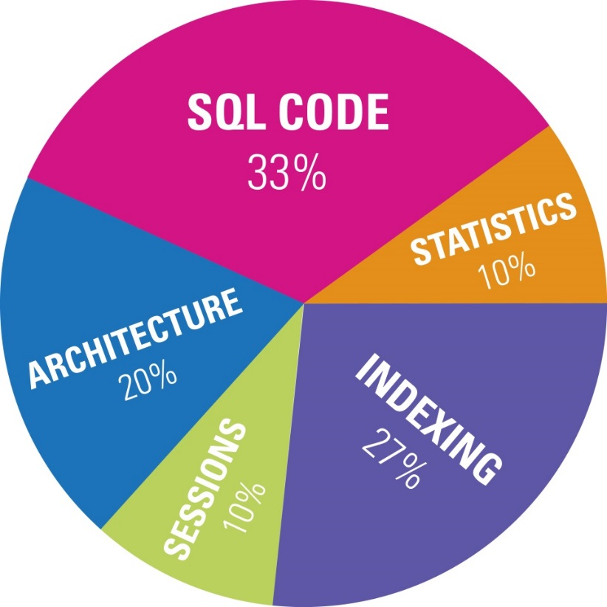
Common Performance Problems
“What are the top 3 performance issues that you encounter with your SQL Servers?”
-- Stack Exchange User

Slide 11
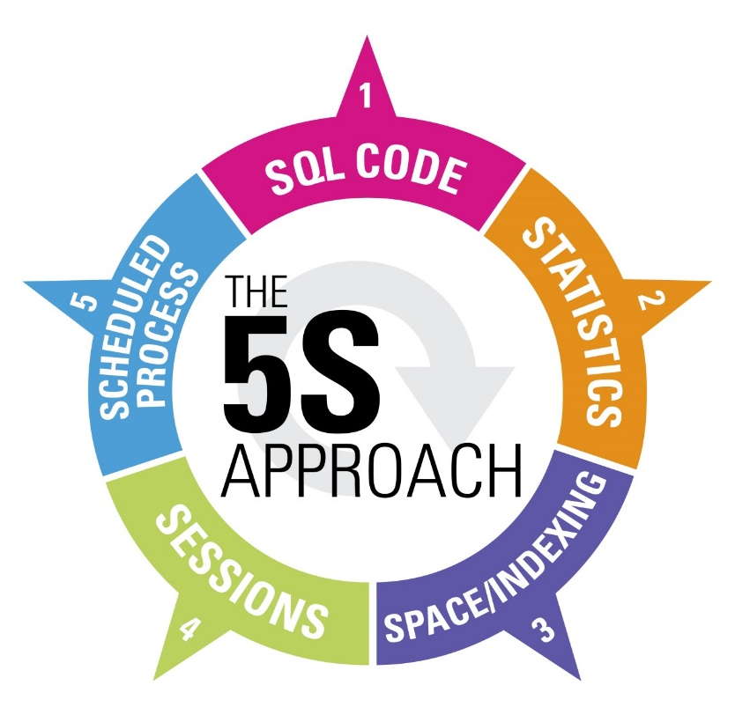
The 5S Approach Is Proactive
SQL Code
Statistics
Segmentation
Sessions
Scheduled Processes

Slide 12
SQL Code Execution
SQL by Elapsed Time & CPU Consumption
Blocking Sessions by Object
Optimizer decisions found in v$sql_plan (e.g. Full Table Scans or Index Skip Scans)
Any Package Change within time frame
Parallel Execution Problems
SQL Profiles & Baselines (Snapshot Retention)
Duplicate SQL Statements (unstable or not using bind parameters)

Slide 13
Object Statistics
Statistics missing on Objects?
Review Stats Schedule and methodology
Eliminate statistics on Global Temp tables
Waits by Objects & v$sql_plan_history

Slide 14
Segmentation (Space/Indexing)
Waits by Object
Cardinality of Tables found in v$sql_plan (can/will be different during runtime)
Clustering Factor of Indexes (indicative of fragmentation)
Tables & Index Fragmentation
Purging Runtime & Log Data (transient)
Invalids & Unusables

Slide 15
Session & Scheduled Process
Top waits by tables (hot objects to target for reorg)
Conflicts with scheduled processes (e.g. ETL Loads)
Waits from session and module perspective (e.g. Any SQL with Blocks from WRH$ASH in the past 24 hours )
Sorting and Memory Hogs by session & module
Review waits and blocks by objects (contention)
Correlation is often key in proactivity.

Slide 16
Beyond the 5S Approach
Drive Speeds
OS Parameters
Application Details (e.g. JVM Sizing, Background Processes)
DB Parameters
Instance Details (e.g. SGA, DB Version Features)
Table Space Naming
Redo/Undo Log Sizing & Frequency
I/O Waits
Snapshot & AWR Retention

Slide 17
Tips for Insight: Bridging the Gap
We need a tool that reflects the proactive mindset and approach we should take.
The 5S Approach to Health Checks is a great way to mitigate issues before they occur.
The only “best practice” you should be using all the time is “Use Your Brain”. – Tom Kyte

Slide 18
Proactive Data Health
Correlating details we’ve captured to Proactively manage the health of the data down to the block level.
Table fragmentation
High Cardinality found in v$sql_plan
High Clustering Factor on indexes
Row Chaining by table
Tables found in v$sql_plan activity
Wait activity by table object or Blocking
Package or Object change in -x days
Plan Reorg Activity
for Top Tables

Slide 19
Proactive Plan Executions
Correlating details we’ve captured to Proactively manage the SQL execution and improve performance.
Duplicate SQL Statements (reduce dups)
Isolate bottlenecks in v$sql_plan table (cardinality, full table scan, index skip scans)
Blocking Session & Waits by Objects
Review SQL History for multiple plan hashes indicative of unstable plans.
Plan SQL Tuning Tasks for DBAs

Slide 20
What, Why & How Often
Proactivity is having a plan with: a consistent baseline approach that is a documented, repeatable process focusing on results and reducing or preventing downtime.
Full Assessments (110+ Points)
Monthly Reviews
Weekly/Daily
Frequency & Consistency

Slide 21
Thinking Proactively
“In an emergency, you rarely get one consistent piece of advice. You usually have two or three people with two or three different ideas. So you want to have your own set of thoughts.
-Rudy Giuliani, Former Mayor NYC
“Every defect is a treasure, if the company can uncover its cause and work to prevent it across the corporation.” - Kilchiro Toyoda, founder of Toyota
Good Luck Treasure Hunting!

Slide 22
Questions & Resources
Download these resources at www.Datavail.com
White Paper: The 5S Approach to Improving Database Performance
Blog: Selecting Application Code Profiling Tools
Webinar: Building a Database Monitoring Tool Using Splunk.
Performance Monitoring & Profiling Application Code
Chuck Ezell
Chuck.Ezell@datavail.com
Datavail.com
866-828-7843

