Slide 1
Our Purpose & Values
Algeria

Slide 2
Our Purpose …
To Serve Healthier, Fuller Lives

Slide 3
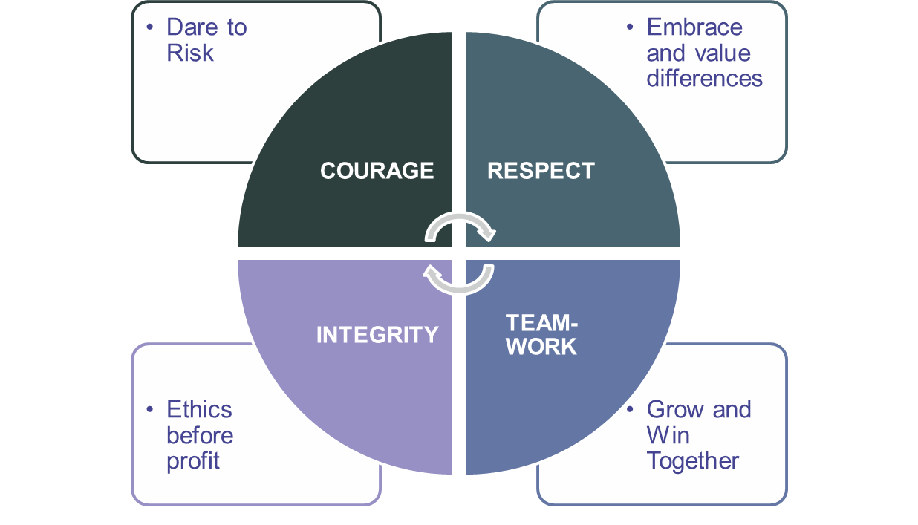
Our CHC Purpose
To Serve Healthier, Fuller Lives
Our Values

Slide 4
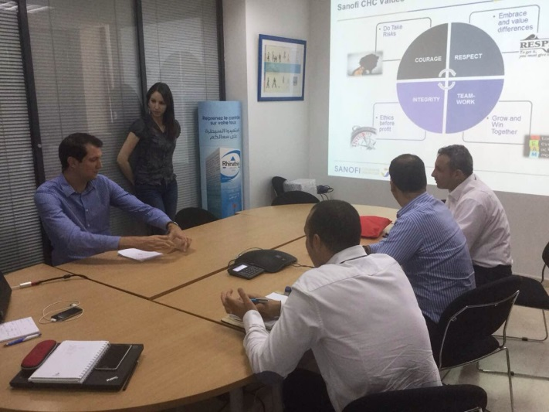
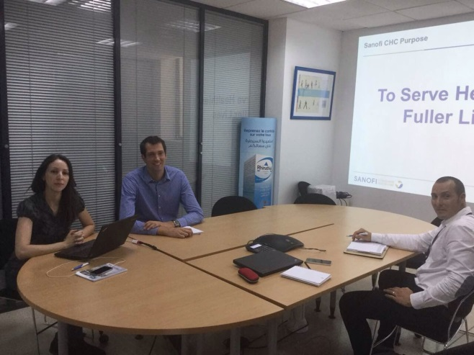
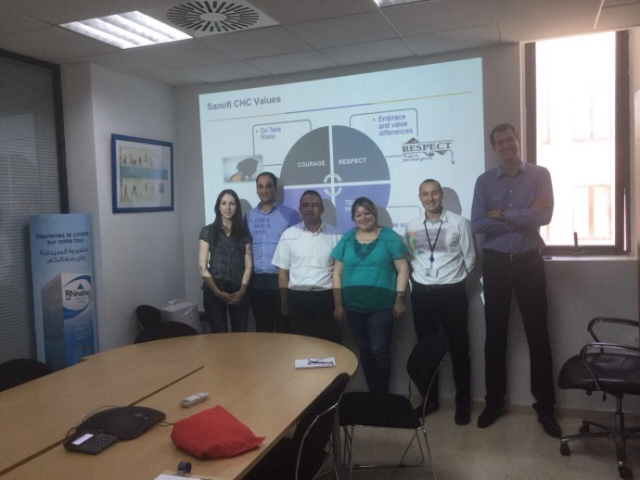
Reflect our Purpose & Values (June, July 17)
P&V Task force to brainstrom around CHC values
Brainstorming around our values to better understand values
Identify behaviors, around which we will live the main values

Slide 5
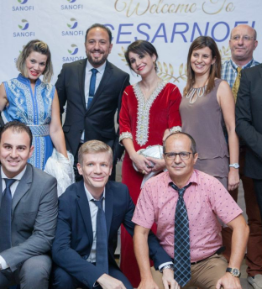
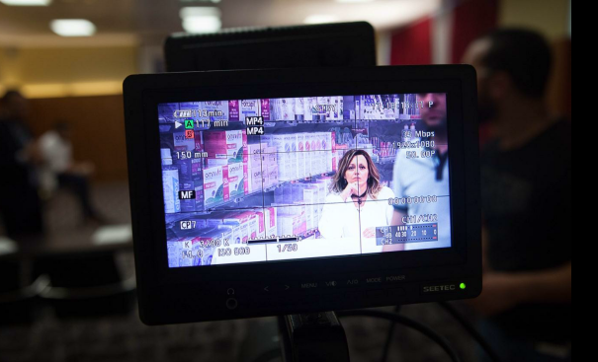
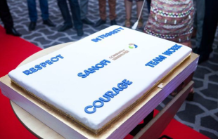
Live our Purpose & Values during cycle meeting (September)
May-Dec
The whole CHC team participate to purpose & values session, and team building around cinema theme, which allowed them to express their creativity to build values stories …

Slide 6
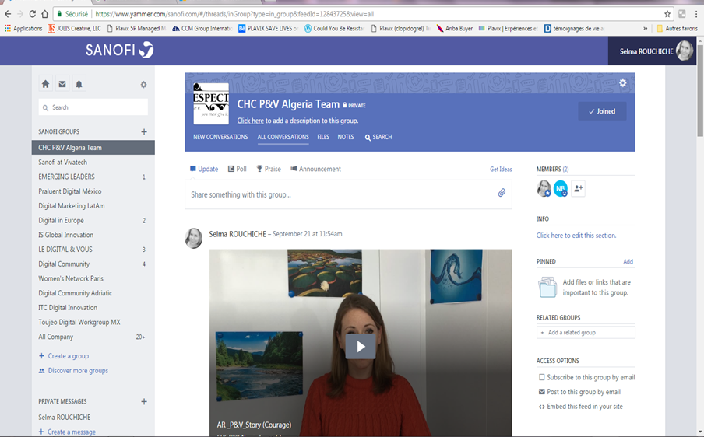
Purpose & Values 2.0 (October-December 17)
CHC digital purpose & values page on Yammer, all colleagues of our business unit (including support functions dedicated to CHC) can share in a fun way ideas & experiences
May-Dec

Slide 7
Purpose & Values 2018 action plan
P&V booklets distributed during cycle meeting (Jan 18)
CHC digital purpose & values page on Yammer, all colleagues of our business unit (including support functions dedicated to CHC) can share in a fun way ideas & experiences (FY)
Photos & videos competition to represent our values, to animate on Yammer (Q1 18)
P&V team breakfasts (FY)
P&V Treasure Islands (Q2/Q4)
P&V animation during Cycle meeting (Q3)
May-Dec
To Serve Healthier, Fuller Lives

Slide 8
Let’s keep the ENERGY!

