Slide 1





Purpose & Values Activation
United Kingdom

Slide 2

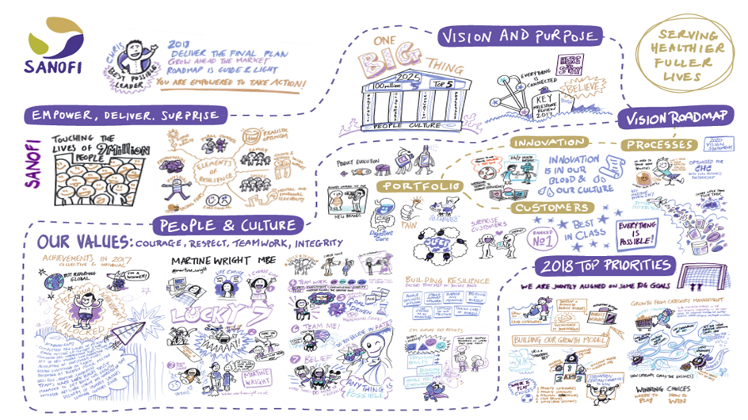
Notes:
Visualising Sanofi CHC – Our purpose & values and what they mean to us, our vision and purpose, our 2018 priorities, our people & culture and our roadmap to success

Slide 3

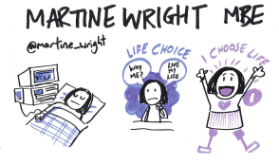
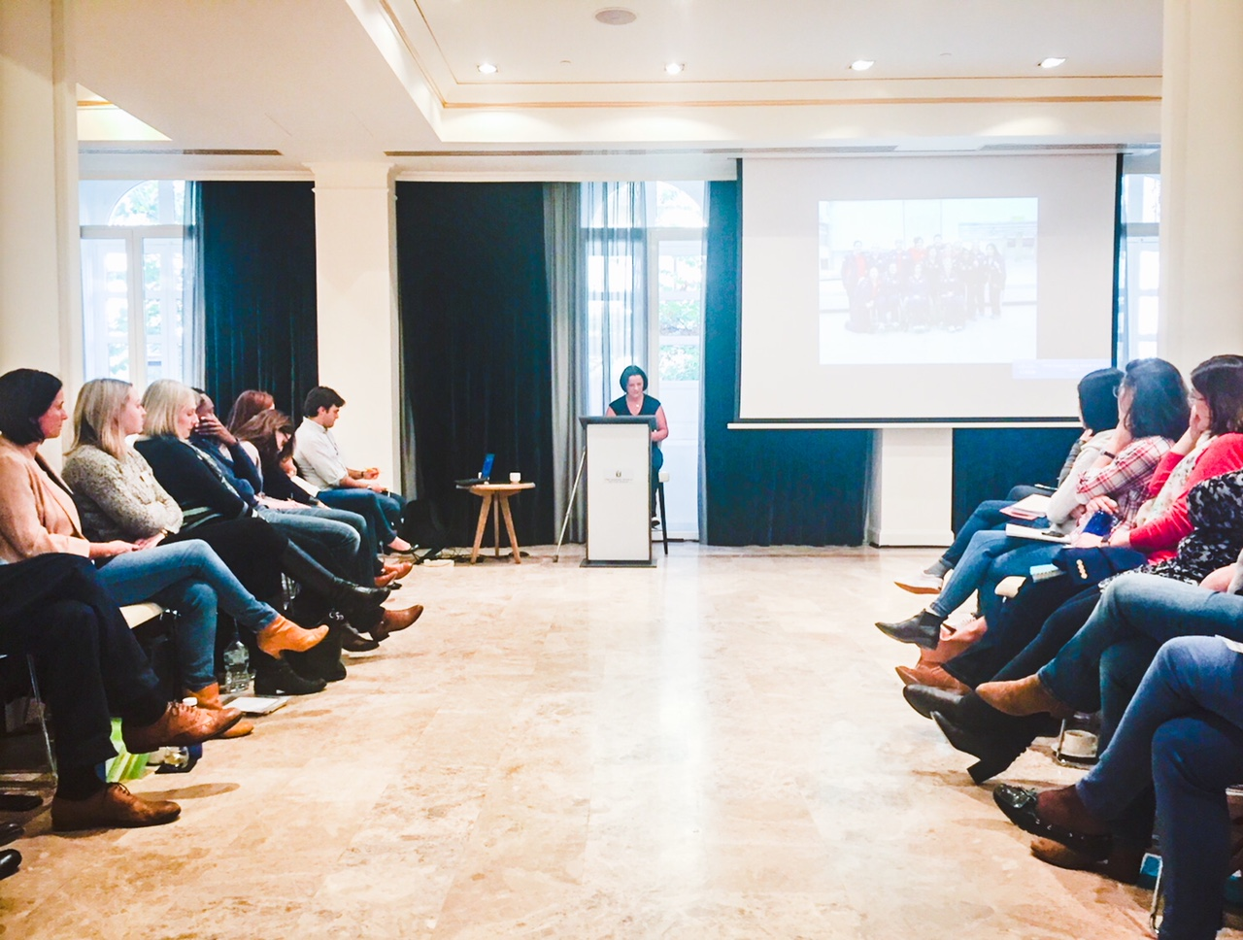
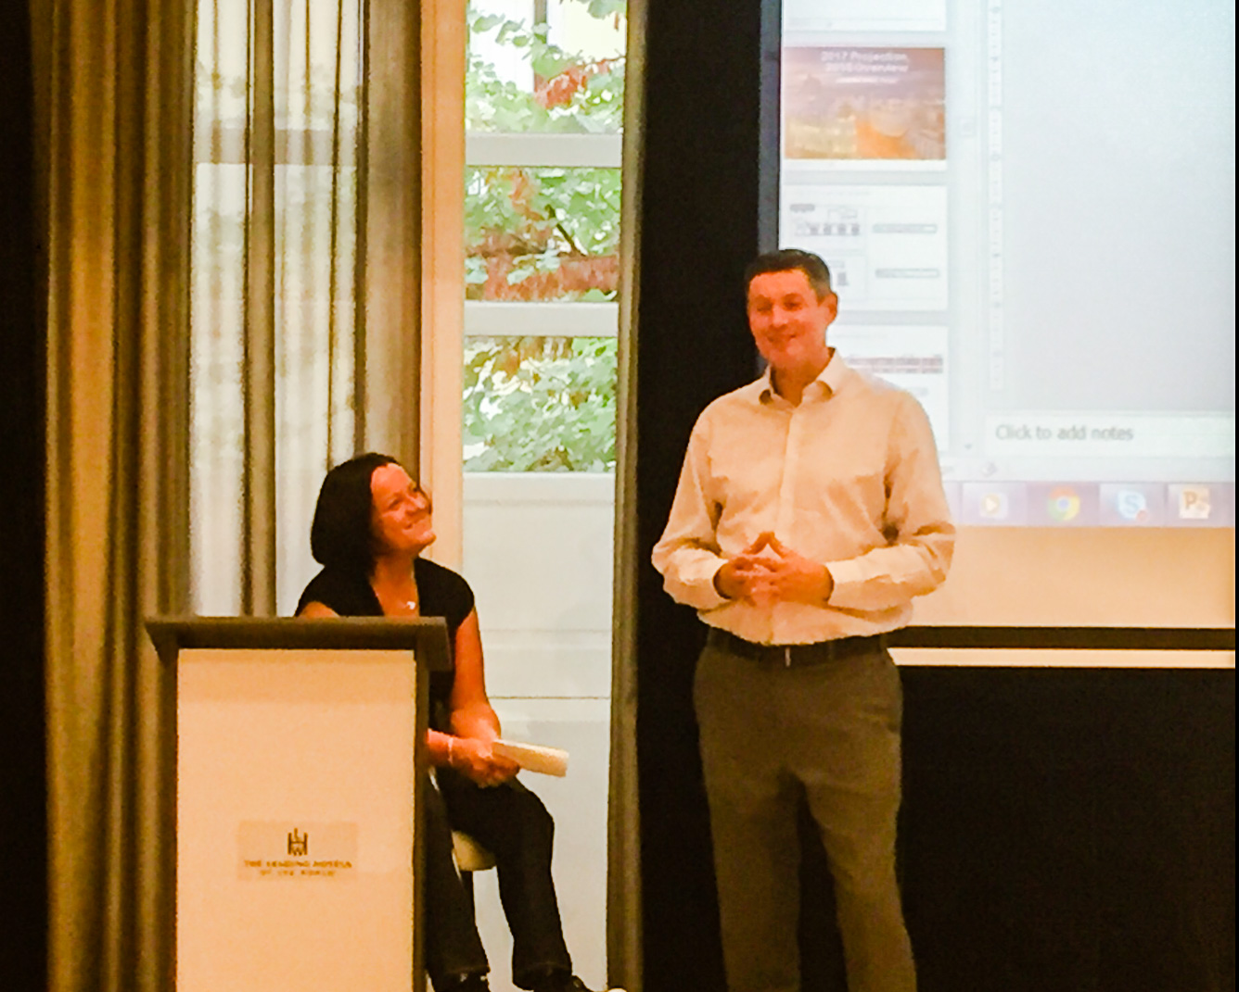


Notes:
Building Courage & Resilience we had a guest speaker at our offsite – Martine Wright MBE, who in 2007 the day after London was awarded the 2012 Olympics and Paralympics was involved in a terrorist incident on the London Underground and as a result lost both her legs. Martine talked us through how she coped, how she built resilience and how she went on to compete and represent Team GB at the 2012 Paralympics

Slide 4





Notes:
Building Teamwork and showcasing Courage through having a fun cookery competition cooking Tapas at our UK CHC team offsite in November 2017.
Whilst a fun competition it allowed people to work in teams with colleagues outside of their function, encouraged people to try something new and to take risks in a safe environment.

Slide 5




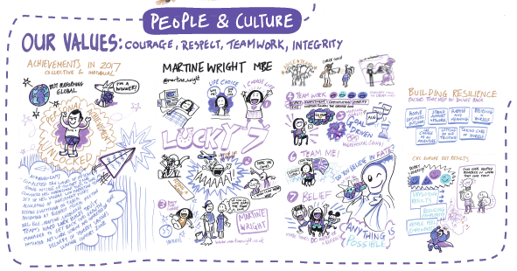
Notes:
Visual prompts and reminders of our purpose and values created and displayed in the office environment as posters, pictures etc. Each value has a description from 2 CHC colleagues as to what that value means for them.
A Purpose and Values recognition book has been created for colleagues to document how others have displayed and lived the values in our work, these are then read out at our 2 weekly “huddle” meetings

Slide 6






NBO – Atrium Launch Event
Growing & winning with our wider business colleagues
Notes:
Growing and winning with our wider business colleagues as they are consumers to! We showcased our NBO launch into the sleep category of Phenergan Night Time with a fun launch in the atrium in Guildford Head Office.
This activation helped to showcase what CHC is doing and help to build wider relationships within other functions and help all employees become advocates or our brands.

Slide 7

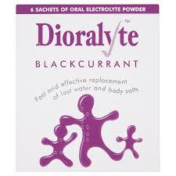


15,000 Sachets of Dioralyte Blackcurrant Rehydration Sachets donated to charity to help fight Cholera in Yemen
Notes:
Ethics before profit with charitable donation to help the crisis in Yemen

