Slide 1
Project SPD III: Investigating Action Research Projects as Strategies for Evaluating Instruction with Individuals with Severe and Profound Disabilities
Cynthia Pearl, PhD
Eleazar Vasquez, PhD
University of Central Florida
The Virtual PD Conference
April 27 & 28, 2015

Slide 2
Project SPD III
Project SPD, Special Educator Preparation in Severe or Profound Disabilities, funded through the Office of Special Education Programs is designed to address the following goals:
Recruit high-quality graduate level scholars including those from traditionally underrepresented groups who have potential to become highly effective special education teachers for students with severe or profound disabilities;
Prepare scholars in an evidence-based Masters in Exceptional Student Education program that includes field experiences in high poverty settings and leads to state certification in Exceptional Student Education and State Endorsement in Severe or Profound Disabilities; and
Retain scholars through completion of the program and induction into the profession through ongoing advisement, financial and academic support, and mentorship.

Slide 3
Project SPD Scholars and Action Research
Action research is a model of professional development in which educators study student learning related to their own teaching and a process that allows them to learn about their own instructional practices and to continue to improve student learning.
The Florida Department of Education requires action research / classroom data of student results as part of accreditation efforts
Graduating Project ASD participants complete an Action Research Project during a practicum in their final semester.
Scholars take the role of teacher as researcher to investigate a teaching or learning strategy and its impact on student learning/behavior.

Slide 4
Action Research Project Steps
Define/research the problem, question, and desired outcome(s).
Determine and record the SPECIFIC goal(s).
Develop implementation design/method.
What research supports the intervention?
What specifically will you do? When?
Identify measurement process and items/tools.
Specifically, what will you measure and how?
Implement the treatment/intervention.
Collect data and record observations.
Write up the report in manuscript format & present findings.

Slide 5
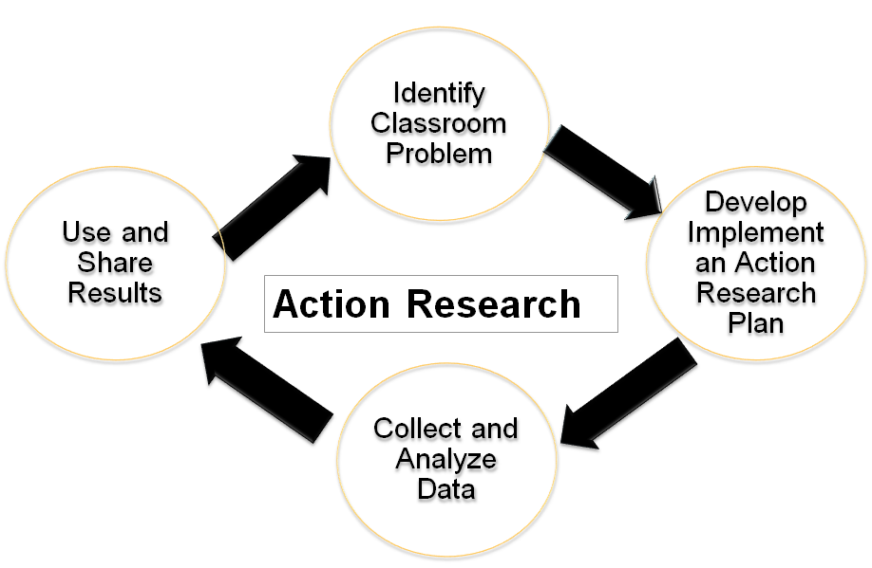
Action Research Process

Slide 6
ARP: Discrete Trial Teaching

Slide 7
ARP: Video Modeling

Slide 8
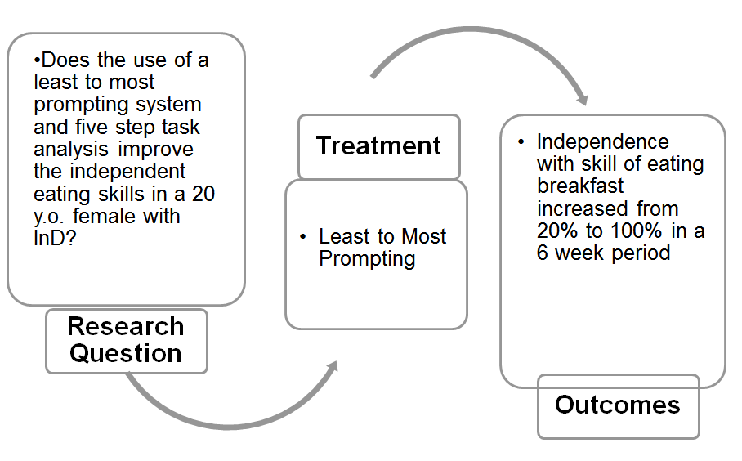
ARP: Least to Most Prompting

Slide 9
Thank You!
Cynthia.Pearl@ucf.edu
Eleazar.Vasquez@ucf.edu
The contents of this presentation were developed under a grant from the US Department of Education, #H325K100209. However, those contents do not necessarily represent the policy of the US Department of Education, and you should not assume endorsement by the Federal Government.

