Slide 1
325T PROCESS Project- Program Improvement
Debra Cote, Ph.D. Kristin Stang, Ph.D. Sara Head, MBA

Slide 2
Description of CSUF
Third largest university in California
Serves the Southern California region, particularly Orange County
Designated Hispanic-Serving Institution
All teaching credentials are awarded at the post-baccalaureate level
Offers credentials in Early Childhood Special Education, Mild/Moderate and Moderate/Severe disabilities
Two hundred seventy-five SPED credentials awarded in 2012-2013

Slide 3
PROCESS Project Objectives
Preparation and Retention of Collaborative, Effective, and Successful Specialists project objectives include:
Guided instruction and practice with data
Integration of specific evidence-based instruction resources
Enhanced professional development for early-career teachers

Slide 4
Rationale for Program Changes
NCATE standards require candidates to create positive learning environments to evaluate student achievement, and to embed EBPs in to teaching (2008). As determined by the Blue Ribbon Panel Report, teacher preparation should follow key principles (i.e., use data to guide practice, proficient in assessment) in program design (2010). Additionally, the Center for Teacher Quality (i.e., California State University) conducts ongoing evaluation of their teacher preparation to meet birth-12 student needs. Clearly, candidates must possess the knowledge and skills needed to meet the needs of all learners (Chandler et al., 2012).

Slide 5
Guided Instruction and Practice with Data
Online seminars
Topics included:
Planning for and Implementing Systematic Progress Monitoring
Developing Student Learning Goals and Progress Monitoring
Data Collection for Measuring Behavior
All seminars are recoded, closed-captioned and uploaded to the project website
http://ed.fullerton.edu/sped/future-students/special-programs/process-project/ebp-webinars/

Slide 6
Integration of Specific Evidence-Based Instruction Resources
Faculty received training on the use and documentation of EBPs.
Faculty integrated specific (IRIS Center) EBP instruction and resources into all course curriculum and field experiences. All syllabi reflect infused EBPs in the courses.
Surveys were developed to assess the effectiveness of these program changes.

Slide 7
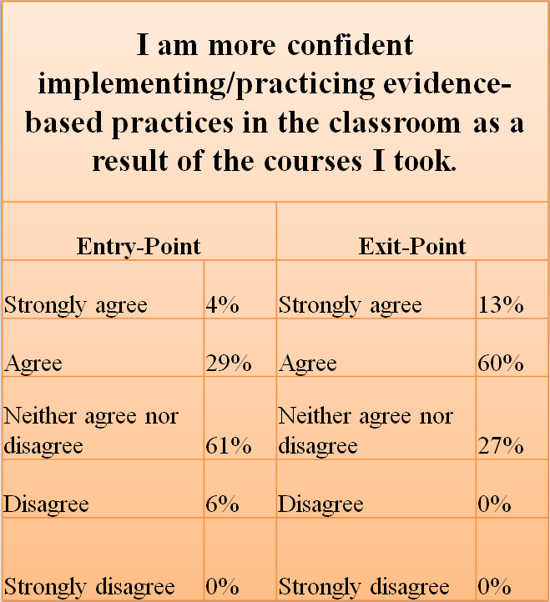
Effectiveness of Program Changes

Slide 8
Enhanced Professional Development for Early-Career Teachers
Workshops
Summer STEAM series
Woodcock-Johnson assessment training
Inclusive education conference
Newsletters
http://ed.fullerton.edu/sped/future-students/special-programs/process-project/teacher-support/

Slide 9
Tutoring Center
Opened in March 2012
RICA support offered
Science/Math CSET support offered in the past, currently seeking tutor
Joint support from PROCESS and College
June 2012−December 2014 Data
Served over 200 students college-wide
850+ appointments
http://ed.fullerton.edu/sped/future-students/special-programs/process-project/tutoring-services/

Slide 10
Project Summary
The PROCESS Project has allowed CSUF faculty, students and LEA partners access to resources.
Many initiatives have already been institutionalized.
During the final year, an emphasis will be on measuring outcomes and expanding support for early-career teachers.
Existing partnerships will continue to be fostered and project initiatives with community partners will be expanded.

Slide 11
References
Chandler, L., K., Cochran, D. C., Christensen, K. A., Dinnebeil, L. A., Gallagher, P. A., Lifter, K.,…Spino, M. (2012). The alignment of CEC/DEC and NAEYC personal preparation standards. Topics in Early Childhood Special Education, 32(1), 52-63).
National Association for Professional Development Schools (NAPDS), Executive Council and Board of Directors of the National Association for Professional Development Schools (2008). What it means to be a professional development school. Retrieved from http://www.napds.org/9%20essentials/statement.pdf
National Council for Accreditation of Teacher Education (2010). Transforming teacher education through clinical practice: A national strategy to prepare effective teachers, Report of the Blue Ribbon Panel on clinical preparation and partnerships for improved student learning. Retrieved from http://www.ncate.org/LinkClick.aspx?fileticket=zzeiB1OoqPk%3D&tabid=715

