Slide 1
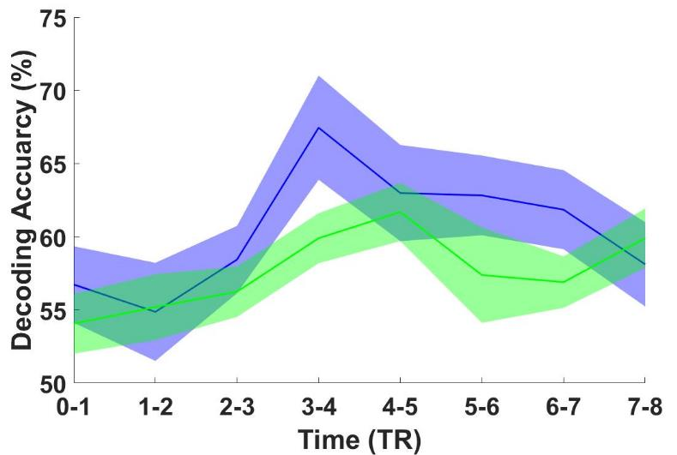
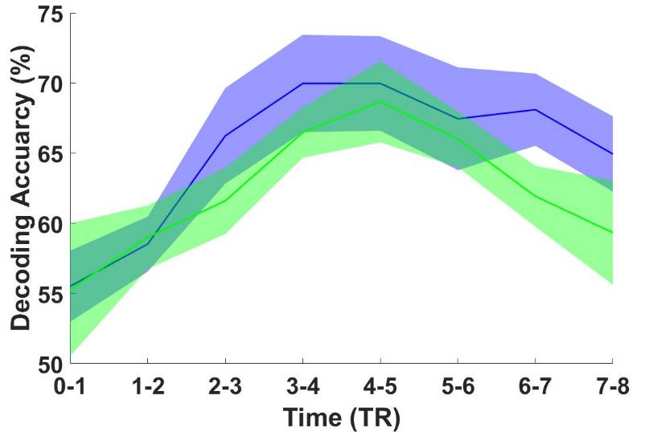
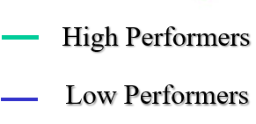
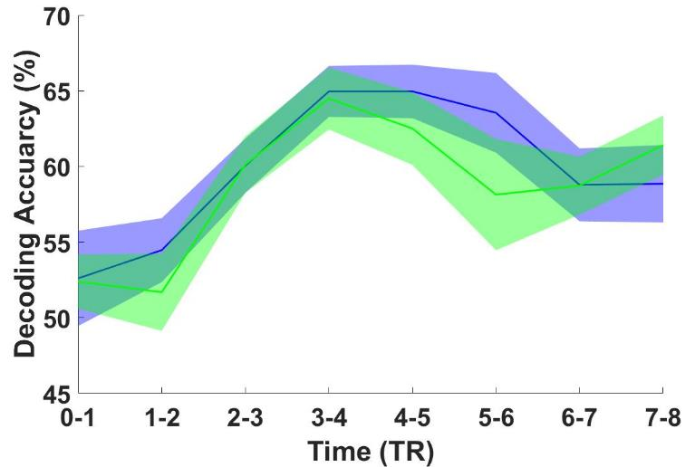
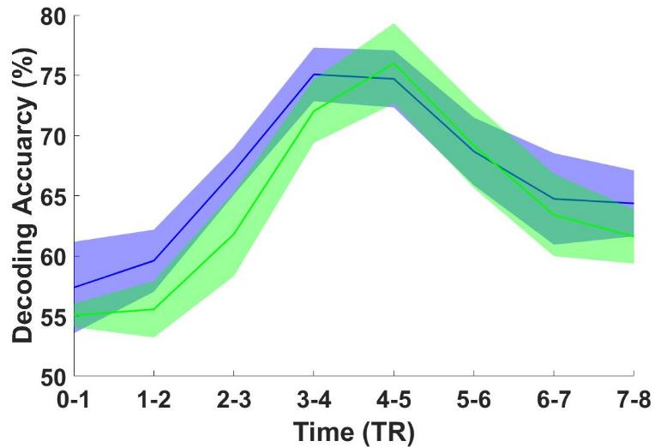
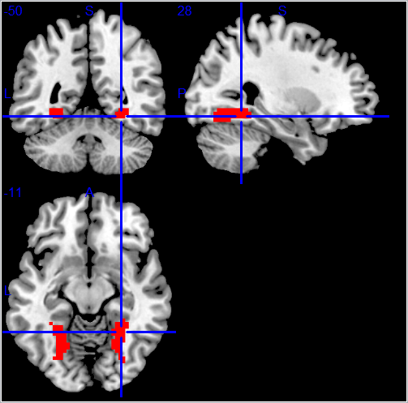
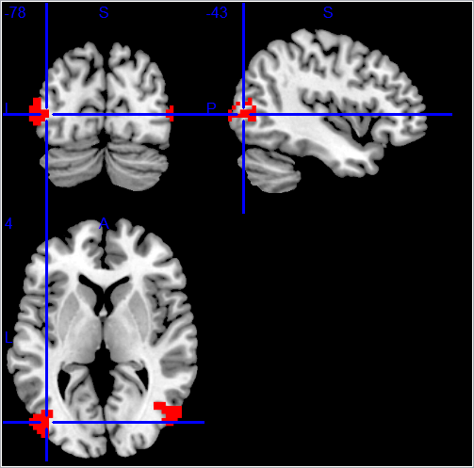
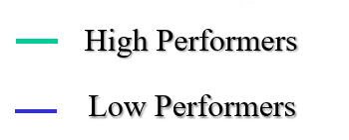
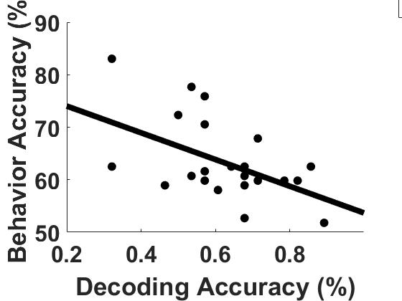
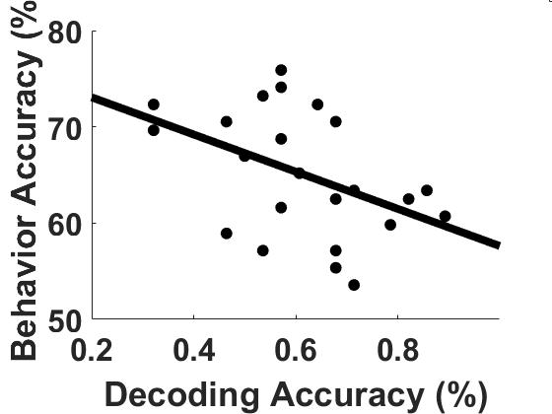
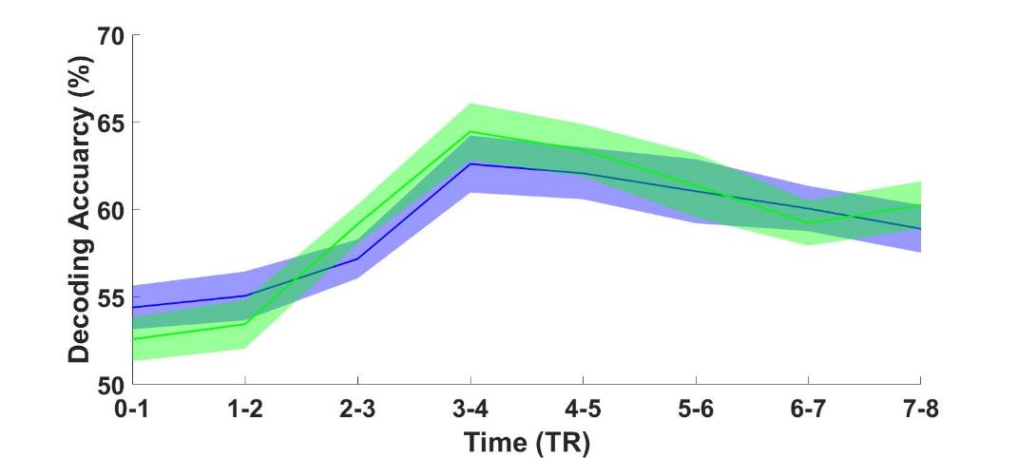
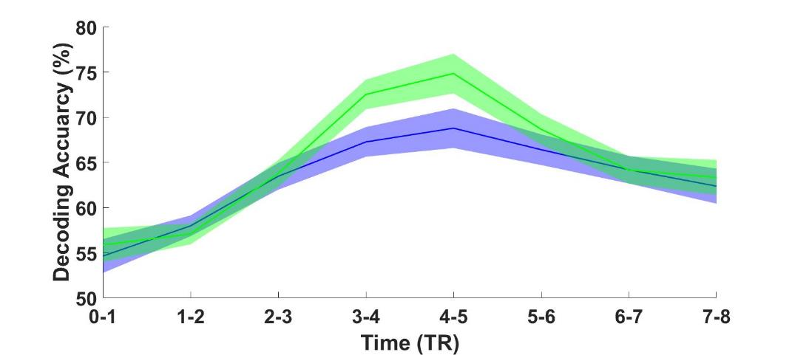
Ying
Distracted by affective pictures: Neural mechanisms revealed by multivariate pattern analysis
Ke Bo , Changhao Xiong, Nathan M. Petro, Andreas Keil, Mingzhou Ding
1 J. Crayton Pruitt Family Department of Biomedical Engineering, University of Florida, Gainesville, FL
2 Evelyn F. and William L. McKnight Brain Institute, University of Florida, Gainesville, FL
3 Department of Psychology, University of Nebraska at Lincoln
4 Department of Psychology and Center for the Study of Emotion & Attention, University of Florida, Gainesville, FL
1,2
1
3
4
1,2
Introduction
Results
A. Unpleasant vs neutral decoding time course for high and low performers
Pictures containing affective scenes are highly potent distractors. When such emotional distractors appear alongside the stimuli from a primary visual task, the performance of the primary task is adversely affected.
In this study we sought to examine the neural basis underlying the distracting influence of affective pictures. Simultaneous EEG-fMRI were recorded while participants detected instances of coherent motion in a random dot kinematogram (RDK) overlayed on IAPS pictures in three categories: pleasant pictures=erotic couples, neutral pictures=workplace people, and unpleasant pictures=bodily mutilations. We hypothesized that stronger neural representations of distractors in ventral visual cortex (VVC) and MT cortex would lead to worse task performance.
Ventral visual cortex
MT
P=0.026
P=0.019
Methods
Figure 2. Behavioral performance. No significance difference was found between groups.
B. Pleasant vs neutral decoding time course for high and low performers
A
Ventral visual cortex
MT
Ventral visual cortex
MT
Paradigm and data acquisition
Figure 1. Timeline of paradigm.
EEG and fMRI were recorded simultaneously from 30 healthy young participants. Data from three subjects were excluded for excessive head movements. Data from another four participants were excluded for below chance level performance accuracy. The data from remaining 23 participants were analyzed and reported here.
The stimuli consist of a random-dot kinematogram (RDK) superimposed on an background image (distractor) from the IAPS library. RDK and IAPS were flickered on-and-off at a rate of 4.29 Hz and 6 Hz, respectively. For each on-and-off cycle of RDK, the dots were moving either randomly or coherently in a certain direction. At the end of each trial, which lasted ~12 seconds, participant was instructed to report the number of coherent motions in the trial. Each participant performed 84 trials. The distracting pictures were divided equally into three categories: pleasant (erotic couples), neutral (workplace people) and unpleasant (mutilated bodies). Coherent motion occurred once in 39 of the trials and twice in 4 of the trials. The rest of the trials did not contain any coherent motions.
Multivariate pattern analysis (MVPA)
MVPA was performed using linear support vector machine (SVM) implemented in LibSVM package. A leave-one-out cross validation procedure was carried out to train and assess the performance of the classifiers. Ventral visual cortex (VVC) and MT cortex were the regions of interest (ROIs). These two regions are important for the performance of the primary task given their role in motion perception.
High Performers
5-15 secs
Low Performers
~11.66 secs
Unpleasant vs neutral decoding accuracy and task performance
Ventral visual cortex
MT
B
Ventral visual cortex
R=-0.49
P=0.019
R=-0.44
P=0.026
Unpleasant vs Neutral
Pleasant vs Neutral
P=1.69x10⁻¹¹
Figure 4. Strength of neural representations of affective distractors in ventral visual cortex/MT and task performance.
MT
Summary
Unpleasant vs Neutral
Behaviorally, task performance was similar whether the distracting pictures contained pleasant, neutral or unpleasant scenes.
Pleasant and unpleasant pictures evoked distinct multivoxel responses in ventral visual cortex and MT relative to neutral pictures.
When the distractors are unpleasant pictures, the more distinct their neural representations in ventral visual cortex and MT, the worse the task performance.
These adverse impacts have different time courses in ventral visual cortex and MT.
Neural representations of pleasant pictures in ventral visual cortex and MT did not correlate with task performance.
Pleasant vs Neutral
P=1.61x10⁻¹¹
Figure 3. Decoding results. (A) ROIs of ventral visual cortex and MT. (B) Decoding accuracy between pleasant vs neutral and between unpleasant vs neutral as a function of TR in a trial.
J. Crayton Pruitt Family Department of Biomedical Engineering
Supported by NIH grant MH112558

