Slide 1
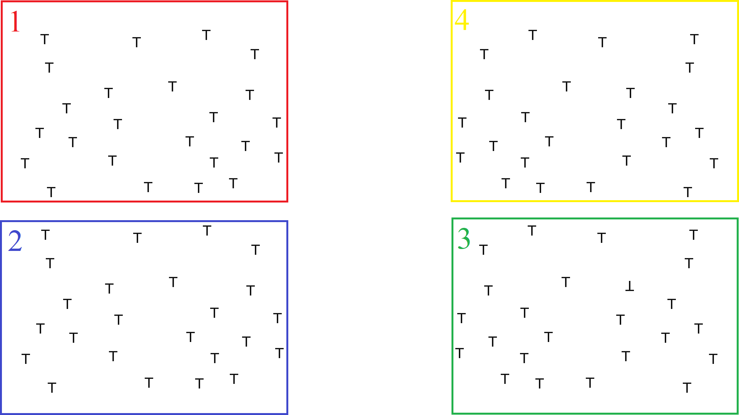
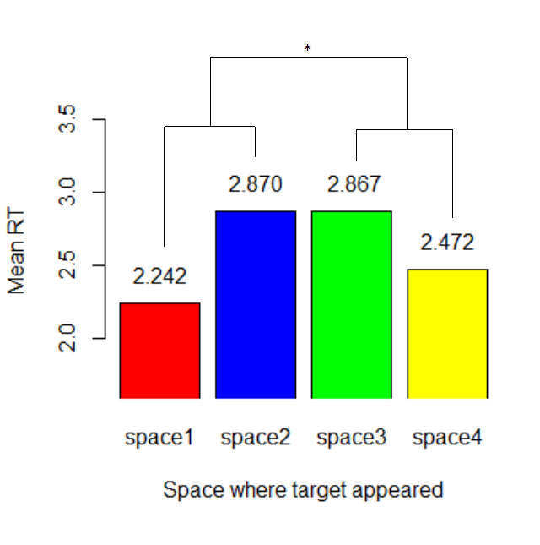
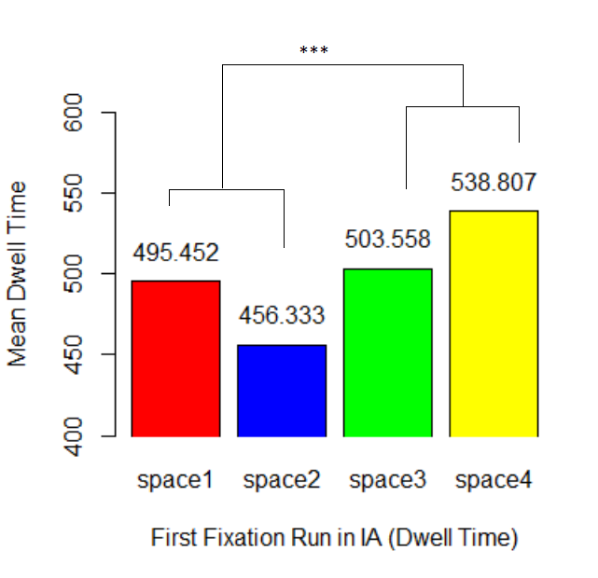
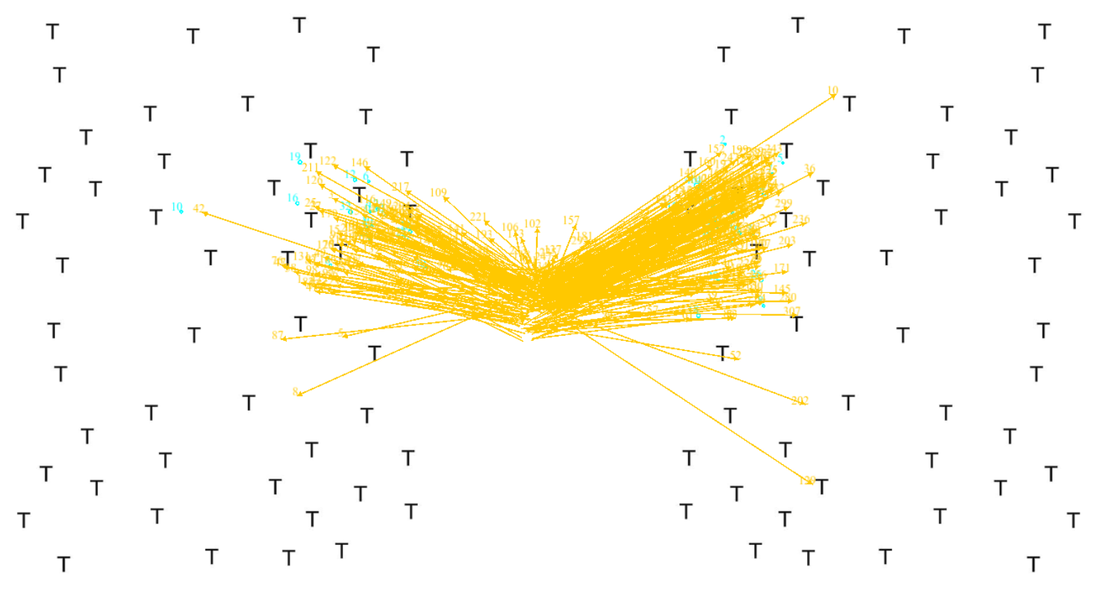
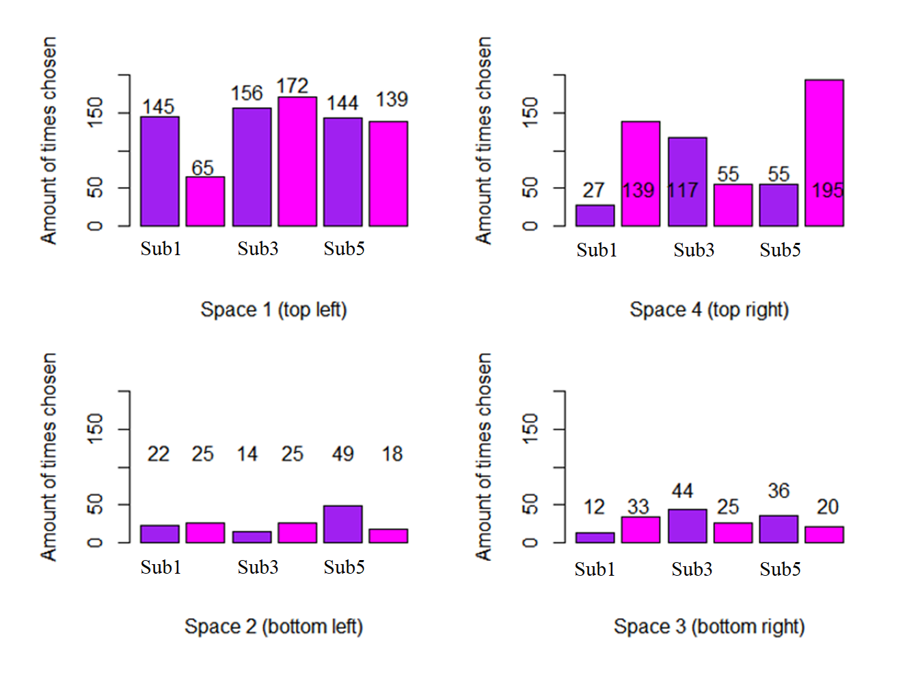
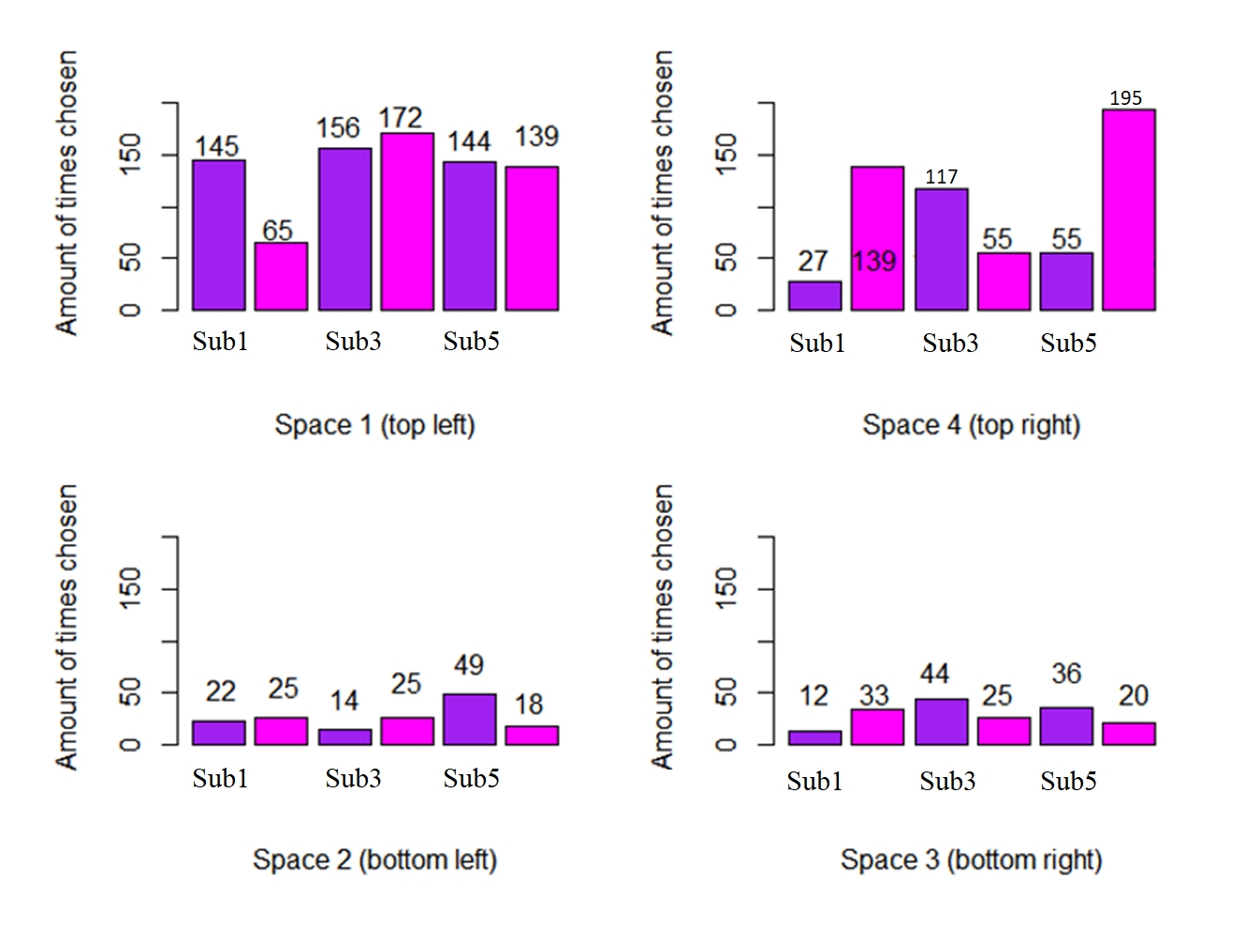
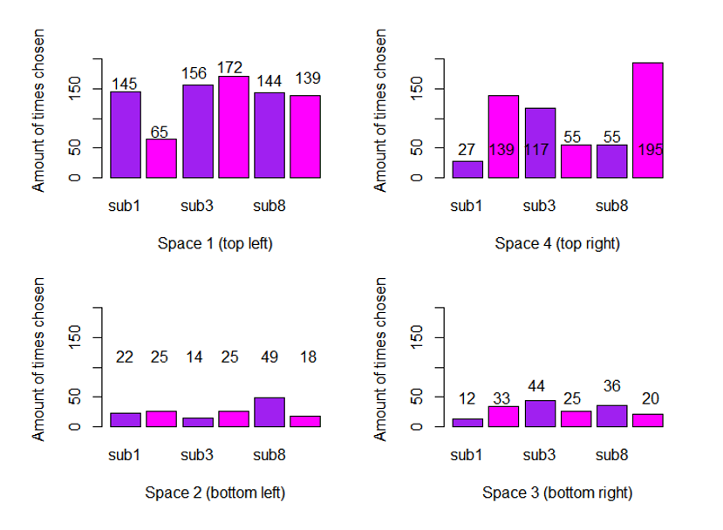
Mechanisms of overt attention in visual search:
Eye tracking, hemifield bias, and willed attention
John Nadra, Aastha Mittal, Jesse Bengson, PhD & George R. Mangun, PhD
Center for Mind and Brain, University of California, Davis
Introduction
Figure 2. The visual search array (color coded by interest area).
Results
In real world vision, eye movements can be driven by either top-down or bottom-up factors. Prior studies utilizing eye movements guided by top-down attention have revealed an upper-left visual field bias in the first saccades of tasks (Durgin et al., 2008). Former studies on willed attention have solidified there are neural differences between cued and fully volitional attention (Bengson et al., 2014). Understanding the biases of the visual system and how they effect the efficacy of visual search provides a further insight into how truly endogenous willed attention is guided. This study investigates how the biases of the visual system effect search strategies in a fully willed paradigm – with no external cues or explicit strategy.
In the analysis of this study, the dwell time of the first run of fixations (within the first interest area of a trial) and reaction times (separated by interest area of the target) were calculated. Then, t-tests were run to assess if there were any significant differences between the left and right hemifields. The dwell time of the first run of fixations showed a significant difference between hemifields (p < 0.001), the reaction time data showed a similar trend as well (p < 0.05). Also, the overall amount of first fixations were recorded, which indicated there is a heavy upper-left bias in the volitional deployment of overt attention within this task. Attention was deployed to the upper visual field first 81% of the trials and the left hemifield was chosen 56% of trials, with specifically the upper left quadrant being chosen 49% of the trials – which is a very strong indication of this bias.
Figure 3. Plots of mean dwell time and mean reaction time with significance testing.
Figure 1. One subject’s first saccade map.
Discussion
The results that we found in this study indicate that there is a distinct bias towards the upper-left quadrant, that does not result from explicit strategy. Former studies indicate this may not be a result of reading from left to right either (Nicholls & Roberts, 2002), which implicates pseudoneglect as the potential cause. Mean dwell time results indicate that search is more effective in the left hemifield, as dwell time is significantly lower when comparing the left to right. Mean reaction time data mirrors this sentiment with a similar trend. Future studies could expand upon these findings by comparing the dwell time of cued vs volitional search.
Figure 4. First fixation rates by interest area.
Methods
Eye-tracking data was recorded from six UC Davis undergraduate students. Participants were told to engage in a complex visual search task, where they were instructed to maintain fixation at the center of the screen until the onset of an array. Then, without using any explicit strategy, advised to saccade until they found a target, which could not be detected using covert attention alone. This task required subjects to make fully volitional decisions regarding where to deploy their attention. To assess the data, we divided the array into four interest areas (Fig. 2) and labelled the data based on the end location of the first saccade.
References
Bengson, J. J., Kelley, T. A., Zhang, X., Wang, J.-L., & Mangun, G. R. (2014). Spontaneous Neural Fluctuations Predict Decisions to Attend. Journal of Cognitive Neuroscience, 26(11), 2578–2584.
Durgin, F. H., Doyle, E., & Egan, L. (2008). Upper-left gaze bias reveals competing search strategies in a reverse Stroop task. Acta Psychologica, 127(2), 428–448.
Nicholls, M. E., & Roberts, G. R. (2002). Can Free-Viewing Perceptual Asymmetries be Explained by Scanning, Pre-Motor or Attentional Biases? Cortex, 38(2), 113–136.

