Slide 1
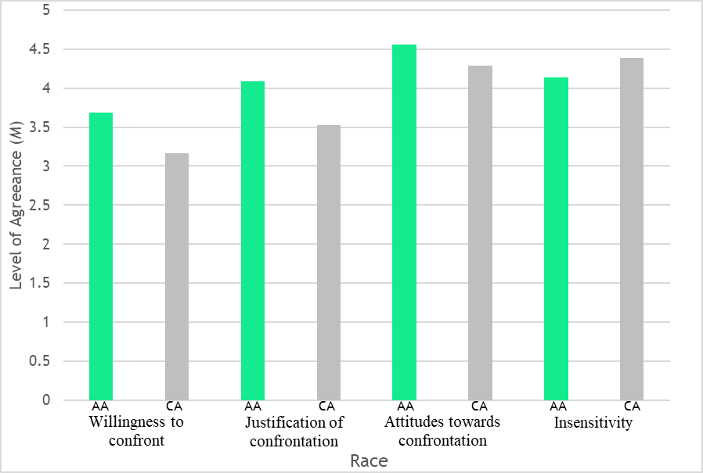
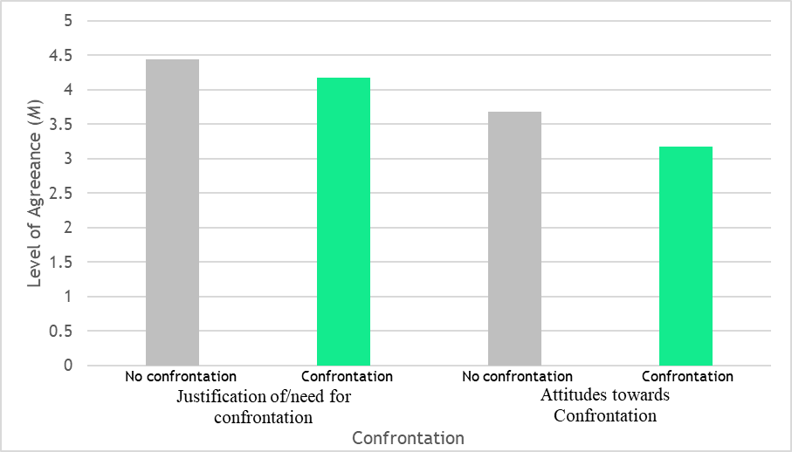
Confronting Microaggressions: The Role of Race and Authority
E’Lashia Pinkard, Dr. Jeffrey Elliott, Ph.D.
Stevenson University
Introduction
Results
The purpose of this study was to determine whether authority level of a microaggressor and race of confronter had an effect on reactions to microaggressions and reactions to confrontations.
Microaggressions are a form of everyday discrimination that are described as intentional or unintentional exchanges that convey hostile, derogatory, and negative slights on an individual or group (Ellis, Powell, Demetriou, Huerta-Bapat, & Panter, 2019).
Microaggressions can be divided into three categories:
Microinvalidations exclude, negate, or nullify the experiential reality of a person.
Microinsults convey rudeness and insensitivity that demean a person’s heritage or identity.
Microassaults are conscious and deliberate derogatory or discriminatory communications with the intention to hurt and demean another.
This study focused on microinvalidations, as it is one of the most difficult and problematic due to its unconscious, subtle, and covert nature (Sue, Capodilupo, & Holder, 2008).
Almost 90% of African Americans and 77% of other ethnic minorities reported experiencing microaggressions daily (Ogunyemi, Clare, Astudillo, Marseille, Manu, & Kim, 2019).
Microaggressions can lead to feelings of doubt, low self-esteem, emotional exhaustion, and lower classroom performance while also predicting cultural mistrust, expectations of rejection, self-stigma, and rumination (Sue et al, 2008).
Confrontation can be effective in changing behaviors and reducing prejudice levels, it can also raise people’s awareness of their biases and promote self-regulation (Ashburn-Nardo, Blanchar, Petersson, Morris, & Goodwin, 2014).
It is believed that targets of discrimination who had a relatively low-power social status often say and do less then they report they would like when discriminatory experiences occur with advantaged individuals (Ashburn-Nardo, et al., 2014).
It was hypothesized that…
participants would rate a microaggression more negatively if there was confrontation than if there was not confrontation.
the confronter of the microaggression would be viewed more favorably if they were Caucasian-American as opposed to a minority.
participants would rate the likelihood of speaking up in the presence of microaggressions higher when they witnessed a confrontation than if no confrontation was witnessed.
participants would rate the likelihood of speaking up when the microaggressor was of lower authority as compared to a high authority figure.
Figure 1. A two-way ANOVA was conducted to determine the effect of race and confrontation on participants’ willingness to confront microaggressions. There was not a statistically significant interaction between the two, (F(4, 146) = .328, p = .615), but the main effect for race was statistically significant, (F(4, 146) = 4.984, p < .001). African Americans (M = 3.69, SD = 0.75) were more willing to confront microaggressions compared to Caucasians (M = 3.17, SD = 0.72).
Figure 1. A two-way ANOVA was conducted to determine the effect of race and confrontation on participants’ justification of confrontation. There was not a statistically significant interaction between race and confrontation, (F(4, 146) = .349, p = .646). However, the main effect for race was statistically significant, (F(4, 146) = 4.220, p =.003). African Americans (M = 4.09; SD =0 .78) justified confrontations more than Caucasians (M = 3.53; SD = 0.78).
Figure 1. An independent-samples t test was conducted to determine differences between African-Americans and Caucasian-Americans on individual items. A statistically significant difference was obtained for microaggressor insensitivity, (t(118) = 3.71, p < .001), and whether people should speak up, (t(118) = 2.104, p = .038). Caucasian-Americans (M = 4.39; SD = 0.69) found the microaggressor to be less insensitive or rude compared to African-Americans (M = 4.14; SD = 0.71) and African-Americans (M = 4.56; SD = 0.59) agreed that people should speak up more compared to Caucasian-Americans (M = 4.29; SD = 0.70).
Figure 2. An independent samples t test was conducted to determine differences between confrontation and no confrontation on individual items. A statistically significant difference was obtained, (t(157) = 3.621, p = .027). Participants who witnessed a confrontation (M = 4.44, SD = 0.69) agreed more with the attitudes of the confronter/audience members as opposed to those who did not witness a confrontation (M = 4.17; SD = 0.73). A statistically significant difference was obtained, (t(157) = 2.237, p = .001). Individuals who witnessed a confrontation (M = 3.68; SD = 0.76) agreed that people should speak up more than individuals who did not witness a confrontation (M = 3.17; SD = 0.96).
Figure 1. Amount of agreeability based on race.
Figure 2. Amount of agreeability based on confrontation
Method
Discussion
The initial hypotheses were not supported. However, secondary analyses found that
African Americans were more willing to confront microaggressors, had more positive attitudes about the use of confrontation, saw confrontation to be more acceptable, agreed that people should speak up more, and found microaggressors to be more insensitive as opposed to Caucasian Americans.
Participants who were exposed to confronted microaggressions agreed more with the confronter and audience members and agreed that people should speak up more as opposed to participants who were not exposed to a confronted microaggression.
Implications
The results could imply that while individuals are not knowledgeable about microaggressions, there may be underlying factors making individuals more sensitive or perceptive to the negative undertones of microaggressions
Limitations
There was only one scenario which makes it harder to accurately measure the participants’ reactions to the microaggression and the confrontation.
Only one type of microaggression was used, so there may have been a better measure or more variability in participants’ reactions, if all three were used.
Future Research
Future research should examine interactions of microaggression severity and the effects of upbringing, community, and sensitivity.
Conclusion
This suggests that educating people about microaggressions and the different types of microaggressions, may lead to greater sensitivity to their occurrences, and therefore might lead to greater willingness to confront if someone recognized it happening.
Participants
The study was comprised of 159 students at Stevenson University who were 18 years or older.
There were 50.6% Caucasians (n = 79), 26.3% African Americans (n = 41), 8.8% Asians (n = 14), 7.7% Hispanic (n = 12), and 6.4% identifying as other (n = 10).
There were 19.9% Males (n = 31), 78.8% Females (n = 123), and 1.3% identifying as Other (n = 2).
Ranging from 18 to 22 years old, the age of participants was skewed (Mdn = 18.00, IQR = 1).
Measures
The use of confrontation (confrontation or no confrontation), authority level of microaggressor (high or low), and race of confronter (black or white) were manipulated within six scenarios.
A 26-item questionnaire was designed to measure participants’ reactions to microaggressions and confrontation.
Of the 26 items, 19 were scored on a 5-point Likert scale and the remaining items included manipulation checks.
Four composite scores were calculated: reactions to microaggressions (6 items), justification of confrontation (4 items), generalized attitudes about confrontation (3 items), and willingness to confront (4 items).
Demographic questions were asked for age, gender, race, and major.
Procedure
Data was collected as a convenience sample from students in introductory psychology classrooms
After obtaining informed consent, the six scenarios were randomly distributed to participants who were asked to read the scenario and respond to the questionnaire.
References
Ashburn-Nardo, L., Blanchar, J., Petersson, J., Morris, K., & Goodwin, S. (2014). Do you say something when it’s your boss? The role of perpetrator power in prejudice confrontation. Journal of Social Issues, 70(4), 615-636. DOI: 10.1111/josi.12082
Ellis, J., Powell, C., Demetriou, C., Huerta-Bapat, C., & Panter, A. (2019). Examining first-generation college student lived experiences with microaggressions and microaffirmations at a predominantly white public research university. Cultural Diversity and Ethnic Minority Psychology, 25(2), 266-279. http://dx.doi.org/10.1037/cdp0000198
Ogunyemi, D., Clare, C., Astudillo, Y., Marseille, M., Manu, E., & Kim, S. (2019). Microaggressions in the learning environment: A systematic review. Journal of Diversity in Higher Education. http://dx.doi.org/10.1037/dhe0000107
Sue, D., Capodilupo, C., & Holder, A. (2008). Racial microaggressions in the life experience of black Americans. Professional Psychology: Research and Practice, 39(3). DOI: 10.1037/0735-7028.39.3.329

