Slide 1
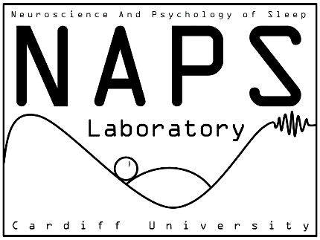
Targeted memory reactivation in REM sleep, but not in SWS, facilitates rule abstraction Sofia I. R. Pereira¹, Ralph Andrews¹, Elena Schimdt¹, Mark van Rossum², Penelope A. Lewis¹ ¹Cardiff University, United Kingdom, ²University of Nottingham, United Kingdom
METHODS
Targeted memory reactivation in REM sleep, but not SWS, facilitates visual rule abstraction.
Memory-linked trigger sounds evoked distinct neural responses in REM, but not SWS.
The benefits of REM TMR required more than one night to emerge.
Acknowledgements: This study was supported by EPSRC and ERC grants.
BACKGROUND
RESULTS
CONCLUSION
Sleep plays an active role in rule abstraction (Lerner and Gluck, 2019).
However, the mechanisms during sleep supporting abstraction and which sleep stage is more important remain unclear.
Therefore, we asked: can memory reactivation in SWS or in REM sleep facilitate visual rule abstraction?
To probe rule abstraction, we used a modified version of the synthetic visual reasoning task (SVRT; Fleuret et al., 2011);
To trigger memory reactivation, we paired abstraction problems with sounds and then replayed these during SWS and REM, a technique known as targeted memory reactivation (TMR; Oudiette & Paller, 2011).
1. The SVRT task
Data are presented as mean ± SEM; α = 0.05; n = 27; Results from t-tests (Figure 3) and from a cluster-permutation analysis (Figure 4) are shown.
Figure 1. SVRT stimuli. Sample images from Problem 1, both in class (on the left) and out of class (on the right). In this case, the rule is that: each picture contains two identical shapes (Fleuret et al., 2011). The ‘squiggly lines’ were introduced as distractors (not a part of the rule), to increase the difficulty level.
Figure 3. REM TMR, but not SWS TMR, improves rule abstraction.
A) In SWS problems, there was no difference between cued and non-cued in any individual session (p > 0.3), or in the change from pre-sleep to day 7, (p = 0.198).
B) In REM problems, there was no difference between cued and non-cued conditions on day 1 (p = 0.550), but at day 7, accuracy was higher on cued compared to non-cued problems (p = 0.002). Accuracy changed more from pre-sleep to day 7 for cued than non-cued problems (p = 0.009).
Within-subject design
2. The experimental design
Summary:
No difference in accuracy before sleep in either group;
Cueing effect after REM TMR (post sleep day 7 – pre-sleep and cued vs non-cued on day 7);
No cueing effect after SWS TMR (post sleep day 7 – pre-sleep);
Lerner I, Gluck MA. 2019. Sleep and the extraction of hidden regularities: A systematic review and the importance of temporal rules. Sleep Med Rev 47:39–50.
Fleuret, F., Li, T., Dubout, C., Wampler, E. K., Yantis, S., and Geman, D. (2011). Comparing machines and humans on a visual categorization test. Proc. Natl. Acad. Sci. U. S. A. 108, 17621–5.
Oudiette D, Paller K a. 2013. Upgrading the sleeping brain with targeted memory reactivation. Trends Cogn Sci 17:142–9.
REFERENCES
Figure 4. ERPs during TMR.
ERPs in SWS (blue top panel) and REM (red bottom panel) elicited by control (new) and experimental (task-related) sounds. A cluster analysis revealed a significant difference between ERPs in response to control and experimental sound in REM within the 200 - 400 ms window (cluster corrected *p = 0.01), n = 26.
Figure 2. Experimental design. A) Participants learned to pair each image (a face or a landscape) with an SVRT problem and its associated sound (Problem-Image Association task). Next, they were trained and tested on the SVRT, where they had to decide whether or not the test sample image followed the same rule as the reference. Then, participants were probed on their ability to recall which sound (speaker symbols) had been paired to which SVRT problem (Problem-Sound Association task). During the night, participants were subjected to TMR. Finally, participants were retested on the SVRT on post-sleep day 1) and on post-sleep day 7. B) Hypnogram depicting the TMR protocol. Half of the sounds played were task-related and the other half were new sounds, which served as controls for auditory responses. Cueing started with the first instance of SWS and REM and terminated once control and experimental sounds had been presented 28 times each.
Summary:
ERPs differ for control and experimental sounds in REM;
No differences in SWS;
Email: PereiraS@cardiff.ac.uk
@NaPScardiff1

