Slide 1
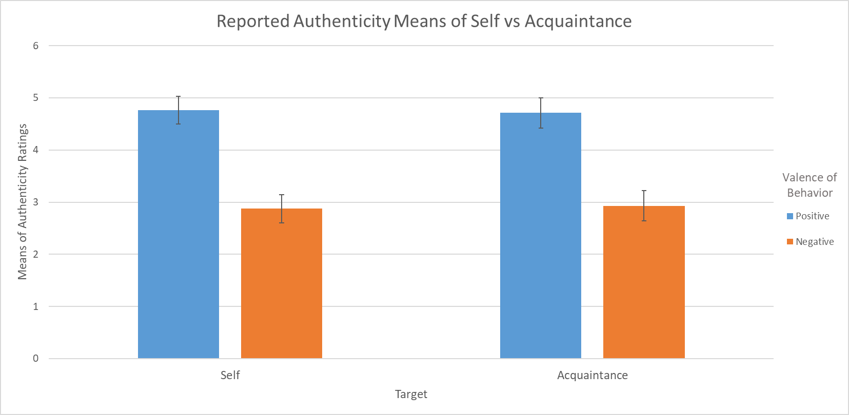
Perceived Authenticity of Self vs. Others
Benjamin Liegner and SoYon Rim
William Paterson University
INTRODUCTION
METHOD
RESULTS
The goal of this project was to examine the factors that influence perceptions of authenticity of positive versus negative behaviors.
Past research has shown that people generally consider their positive characteristics to be more accurate reflections of themselves than their negative characteristics.
Consistent with these findings, Jongman-Sereno and Leary (2016) found that when people judge their own authenticity, they consider their positive behaviors to be more authentic than their negative behaviors.
We examined this bias to see positive behaviors as more authentic than negative behaviors and introduced a moderating variable: self-versus other-judgments.
From past research, we expected that people would see their positive characteristics as more authentic or as their “true self” compared to their negative characteristics. We speculated that it may be due to self-enhancement and self-protection motivations.
If the person being evaluated was not oneself but an acquaintance, the bias to see positive (vs. negative) behaviors as more authentic might be eliminated.
An acquaintance’s positive and negative behaviors should be perceived as equally authentic because self-enhancement and self-protection motivations should not play a role when judging others.
When judging others, it may be easier for people to recognize that both positive and negative behaviors reflect the person as himself or herself.
61 participants (M_{age} = 24 M_{SD} = 8.91) (17 male, 44 female) were recruited from a university subject pool. The experiment was programmed using Qualtrics and presented online.
Participants were randomly assigned to one of the four conditions: Positive-Self, Negative-Self, Positive-Acquaintance, or Negative-Acquaintance.
They were prompted to describe a positive (or negative) characteristic of themselves (or an acquaintance). Subsequently, they described a specific behavior related to that characteristic.
Participants were shown their written behavior and a definition of “authenticity” and instructed to rate how authentic that behavior was to their “true self” (5pt. Likert).
Authenticity was defined as:
“The extent to which a behavior or reaction is consistent with your own personality, desires, goals, attitudes, or values. Behaviors differ in how consistent they are with people’s personalities, desires, goals, attitudes, or values, and thus behaviors differ in the degree to which they are authentic versus inauthentic.”
Lastly, they rated how consistent their characteristic was with the attributes of the definition (5pt. Likert).
Personality, desires, goals, attitudes, and values
Positive (vs. negative) behaviors were rated as more authentic, for both self and acquaintance judgments.
There was a significant main effect of Valence of Behavior on Mean Authenticity Rating, F(1, 57) = 43.77, p < .001. Positive behaviors (M = 4.74, SD = .51) were judged to be more authentic than negative behaviors (M = 2.90, SD = 1.42).
There was no main effect of Target, p = ns.
There was no interaction between Target and Valence of Behavior on authenticity judgments, F(1, 57) = .035, p = .85.
DISCUSSION
Positive behaviors of the self were judged to be more authentic than negative behaviors, confirming past research.
Contrary to our hypothesis, people also judged an acquaintance’s positive behaviors to be more authentic than their negative behaviors.
Perhaps participants still generally felt positively about the acquaintance they thought about and/or felt close to this acquaintance in some way, which led them to show the bias in their judgment of that person’s authenticity.
Future studies could control for or measure the level of relationship positivity and closeness. Another possibility would be to ask participants to imagine someone they do not know (i.e., a stranger) with certain positive and negative characteristics, and then examine the bias in that context.
Step 1
Step 2
Step 3
Step 4
Describe
Aspect
Identify Characteristic
Describe Behavior
Authenticity Rating
Participants were instructed to describe either a positive or negative aspect of themselves or an acquaintance.
Participants then rated this aspect using a variety of Likert measures. (Description, affect, influence, etc.)
Participants then described a behavior relevant to the characteristic they described earlier. This was then followed with a few identification questions about this behavior
Participants were then presented with the written behavior, a definition of authenticity, and then prompted to rate how authentic this behavior was to their “target” (Themselves or Acquaintance)
HYPOTHESIS
REFERENCES
Alicke, M. D., & Sedikides, C. (2009). Self-enhancement and self-protection: What they are and what they do. European Review of Social Psychology, 20(1), 1-48. doi:10.1080/10463280802613866
Fleeson, W., & Wilt, J. (2010). The relevance of big five trait content in behavior to subjective authenticity: Do high levels of Within‐Person behavioral variability undermine or enable authenticity achievement? Journal of Personality, 78(4), 1353-1382. doi:10.1111/j.1467-6494.2010.00653.x
Jongman-Sereno, K. P., & Leary, M. R. (2016). Self-perceived authenticity is contaminated by the valence of one's behavior. Self and Identity, 15(3), 283-301. doi:10.1080/15298868.2015.1128964
People will judge their own positive behaviors to be more authentic than their negative behaviors.
People will judge an acquaintance’s positive and negative behaviors as equally authentic.
For further information, contact:
Benjamin Liegner
liegnerb@student.wpunj.edu
William Paterson University
300 Pompton Road Wayne, NJ 07470
SoYon Rim, PhD
rims@wpunj.edu
William Paterson University
300 Pompton Road Wayne, NJ 07470

