Slide 1


amplify broker partner program
Building a
Partnership
for Success

Slide 2


Who We Are
Founded in 1997
Went public in 2014 (NASDAQ:PCTY)
Disrupters in HR and payroll
software industry
By the Numbers
20,000+ clients
25% year-over-year
revenue growth
13-15% investment of
annual revenue in R&D

Slide 3







Engagement
Development
People Analytics
Culture
Recognition
Payroll
Human
Resources
Time & Labor
Management
Benefit
Administration
Applicant
Tracking
System
Learning
Management
System
Talent
Management
Notes:
Accelerating Engagement, Collaboration, and Community
For over a decade, we worked with partners like you to deliver the best payroll solution. But, as I’m sure you all know, it’s not just about payroll anymore. It’s all about Human Capital Management (HCM).
HCM is essentially the management of people from acquisition to optimization.
HCM solutions help attract, retain, and engage top talent throughout key employee experience touch points, such as onboarding, benefit enrollment, performance management, and more.
Question:
Are you seeing this shift away from payroll and more toward HCM? How is it playing out for your clients? How is it changing what they are asking form you?

Slide 4





Why Do
Benefit Brokers
Work with Us?
Safeguard
& Retain
Payroll & HR Consulting
Competitive
Differentiation
Technology
Notes:
Value props for brokers/FA’s in this arrangement:
1. Safeguard & retain (current business; e.g. we won’t compete with you like ADP or Paychex)
2. HCM Consultant (we’re your SME on HR/Payroll/Engagement/Retention/Regulations, etc.)
3. Competitive Differentiation (Offer your customer better tech, service and support; get better satisfaction, retention and lifetime value)
4. Technology (Open architecture = integration = flexibility; easier to do business)

Slide 5


Amplify Broker
Partner Program
Resources, tools, and incentives
from across our business
to help grow yours.
Notes:
Every area of our our business - bringing more resources to bear to help you grow your business

Slide 6




amplify partner tiers
Stronger
Partnership,
Stronger
Reciprocity
select
No revenue requirements
preferred
Minimum $50,000 per year in new Paylocity product sales
elite
Minimum $250,000 per year in new Paylocity product sales
Notes:
Every area of our our business - bringing more resources to bear to help you grow your business

Slide 7









Reciprocity from Every Area of Our Business
Solutions that Work
Marketing Funds
and Support
Seamless Integrations
Implementation
and Onboarding
Dedicated Partner Support
Channel Resources
A Powerful Portal
Credits and Discounts
Notes:
Every area of our our business - bringing more resources to bear to help you grow your business. Measurably, tangibly.

Slide 8

elite tier
Marketing Support
Amplify Co-Funded Program Support
Hosted Activity
Co-Marketing Support
Notes:
Amplify Co-Funded Program Support
Hosted Activity
Co-Marketing Support

Slide 9

elite tier
Integrations & Administration
Carrier Integration
(Enterprise and Enhanced)
  Unlimited no-cost integration feeds per customer (min. 100+ employees)
  Prioritized integration
Benefit Administration Platform Integrations
(Any supported third-party benefit administration platform)
  No set-up fees or monthly subscription costs
  Employee Navigator fees included at no cost
  Prioritized integration
Flexible Benefit Services & COBRA Administration
  Discount
  Waived setup and renewal fees
Notes:
Carrier Integration
(Enterprise & Enhanced)
Unlimited no-cost integration feeds per customer (min. 100+ employees)
Prioritized Integration
Benefit Admin Platform Integrations
(Any supported 3rd Party Benefit Admin Platform)
No set-up fees or monthly subscription costs
Employee Navigator Fees included at no cost
Prioritized Integration
Flexible Benefit Services & COBRA Administration
Discount
Dedicated Partner Resource

Slide 10
elite tier
Implementation Services
Dedicated Partner Services Team
Partner Hotline/Email
Partner Onboarding Meeting
Custom Implementation Options
Recurring Implementation Status Reports
Partner Business Reviews
Notes:
Dedicated Partner Services Team
Partner Hotine/Email
Partner Onboarding Meeting
Customer Implementation Options
Recurring Implementation Status Reports
Partner Business Reviews

Slide 11

elite tier
Resources & Support
Local Sales Team
Regional Partner Manager
Partner Director
Notes:
Local Sales Team
Regional Partner Manager
Partner Director

Slide 12

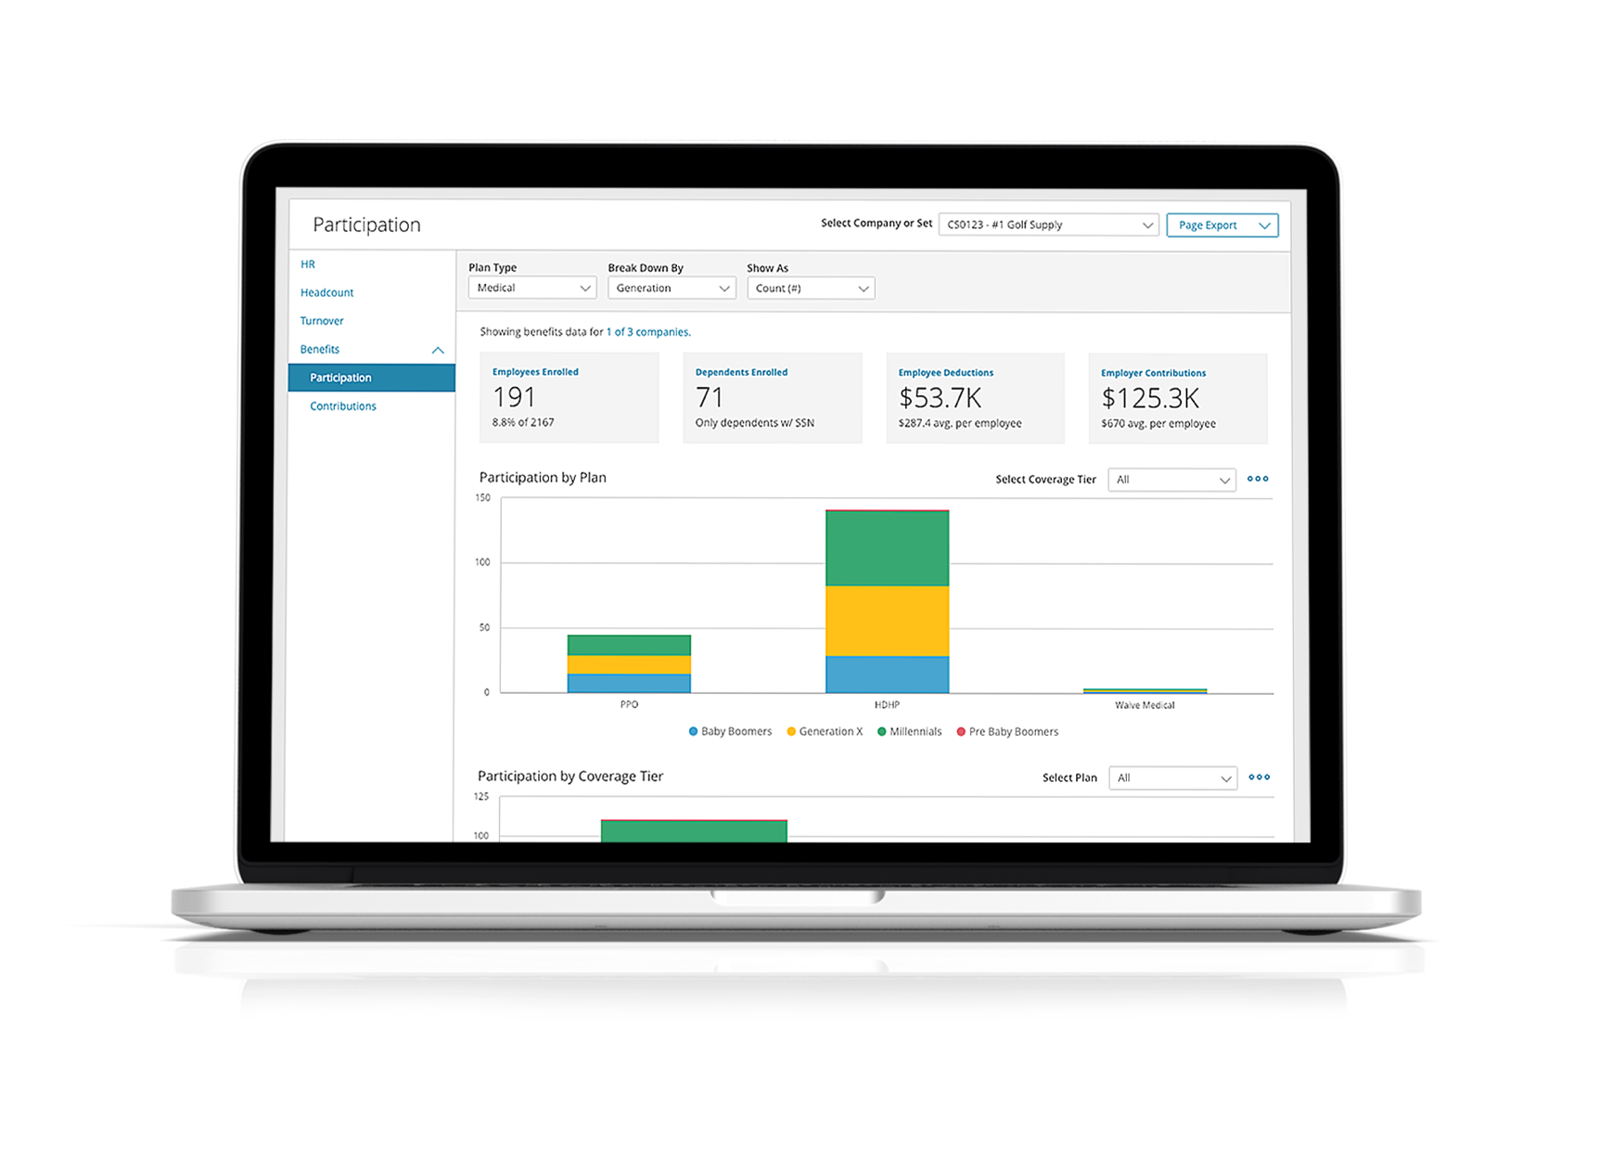
elite tier
Partner Portal
Stay Informed
Get notified of new hires and terminations
to take action.
Use Insights
Spot the biggest opportunities by
tracking key metrics.
Stay Informed
Send Campaigns to client employees
across the trusted Paylocity site and
mobile app.

Slide 13
Pricing Credits for Referred Clients
30% credit
on any Paylocity product
purchased by your clients
elite
Notes:
Every area of our our business - bringing more resources to bear to help you grow your business

Slide 14

amplify partner program
Getting Started
Basic Agreement and
Commitments, Including:
  Onboarding
  Planning
  Promotion
  Growing together

Slide 15
amplify partner program
Benefits of Partnering with Paylocity
Add Industry Knowledge
Expand Service Offerings and Appeal to New Clients
Pre-empt Competition
Deliver High Service Levels
Increase Customer Satisfaction
Grow Your Business Faster — and More Profitably

Slide 16

03020102A
Thank You for Your Time!

Slide 17
Modular Optional Slides for Amplify Program
Preferred Tier

Slide 18
preferred tier
Marketing Support
Amplify Co-Funded Program Support
Marketing Resources

Slide 19
preferred tier
Integrations & Administration
Carrier Integration
(Enterprise and Enhanced)
  Up to (6) no-cost integration feeds per customer (min. 100+ employees)
Benefit Administration Platform Integrations
(Any supported third-party benefit administration platform)
  50% discount on set-up fees or monthly subscription costs
  Employee Navigator fees included at no cost
Flexible Benefit Services & COBRA Administration
  Discount
  Waived setup and renewal fees

Slide 20
preferred tier
Implementation Services
Dedicated Partner Services Team
Partner Hotline/Email
Partner Onboarding Meeting
Custom Implementation Options
Recurring Implementation Status Reports
Partner Business Reviews

Slide 21
preferred tier
Resources & Support
Local Sales Team
Regional Partner Manager
Partner Director

Slide 22
preferred tier
Benefit Advisor Certification
For Enterprise and Enhanced platforms only.
Become Paylocity Certified Benefits Advisors and be the value-added
main contact between Paylocity and your client.
Partners will identify one or two individuals within their agency to be
trained in the “client role” during the Benefits Administration
Implementation, Support, and Open Enrollment experience.
Receive a certification of completion upon successful completion of
the training program.
Notes:
Carrier Integration
(Enterprise & Enhanced)
Unlimited no-cost integration feeds per customer (min. 100+ employees)
Prioritized Integration
Benefit Admin Platform Integrations
(Any supported 3rd Party Benefit Admin Platform)
No set-up fees or monthly subscription costs
Employee Navigator Fees included at no cost
Prioritized Integration
Flexible Benefit Services & COBRA Administration
Discount
Dedicated Partner Resource

Slide 23
preferred tier
Partner Portal
Stay Informed
Get notified of new hires and terminations
to take action.
Use Insights
Spot the biggest opportunities by
tracking key metrics.
Stay Informed
Send Campaigns to client employees
across the trusted Paylocity site and
mobile app.

Slide 24
Pricing Credits for Referred Clients
20% credit
on any Paylocity product
purchased by your clients
preferred
Notes:
Every area of our our business - bringing more resources to bear to help you grow your business

Slide 25
Modular Optional Slides for Amplify Program
Select Tier

Slide 26
select tier
Support from Every Area of Our Business
Marketing
  Eligibility for Amplify co-funded
  program support
Carrier Integration
(Enterprise & Enhanced)
  Up to (4) no-cost integration feeds
  per customer (min. 100+ employees)
Flexible Benefit Services
& COBRA Administration
  Discount
  Waived setup and renewal fees
Expert Integration
& Implementation Support
  Dedicated partner services team
  Partner hotline/email
Resources & Support
  Dedicated local sales team

Slide 27
Pricing Credits for Referred Clients
10% credit
on any Paylocity product
purchased by your clients
select
Notes:
Every area of our our business - bringing more resources to bear to help you grow your business

Slide 28
Section 1
About Paylocity + Client Value Prop

Slide 29
Supporting Your Clients
in the Modern Workplace
66%
of Millennials work
for an employer
that offers a retirement plan.
34%
of those employees participate in the retirement plan offered to them.
5%
of Millennials
save enough
for retirement.
Notes:
Speaking points:
Some of the questions that you might be getting questions from your clients are around the ever changing makeup of the dynamic modern workplace.
The shift in your role and industry is being driven by Millennials entering management and Generation Z joining the workforce.
According to a research report from the National Institute on Retirement Security:
Even though 66% of Millennials work for an employer that offers a retirement plan, only 34% participate and
Only 5% of Millennials save enough for retirement.
As a result, employers – or your clients – are prioritizing engagement and retention.
One way you can help your clients increase engagement and retention is not only through what benefits they offer, but also how they communicate their offerings.
This creates a huge opportunity for you to engage with the younger workforce to increase participation. The key is to do it in a way that speaks to them – technology.
https://www.nirsonline.org/reports/millennials-and-retirement-already-falling-short/

Slide 30
Communication & Engagement
35%
  Millennial
Own Smartphones
Global Workforce
  By generation in 2020
90%
  Millennials
97%
Gen Z
24%
  Gen Z
Notes:
Speaking points:
Elaborating a little bit more on the dynamic modern workplace...
- Millennials and Gen Z make up 59% of the global workforce
According to a Pew Research 2018 study, more than nine-in-ten Millennials own smartphones; 98% of Gen Z owns one
Why am I sharing these statistics with all of you?
Because communicating and engaging with Millennials and Gen Z depends greatly on the channel.
To share information about retirement and 401(k)/benefits, you must make it easily accessible from a mobile device.
1 https://www.manpowergroup.com/wps/wcm/connect/660ebf65-144c-489e-975c-9f838294c237/MillennialsPaper1_2020Vision_lo.pdf?MOD=AJPERES

Slide 31

Access from
Anywhere
Notes:
Speaking points:
From a mobile app to mobile-responsive design, your clients’ employees can access Paylocity solutions where and when they need them.
For you, this means your clients can push notifications right to their employee’s favorite device about 401(k) contributions/open enrollment, for example.

Slide 32
Section 2
Additional Detail on Tech + Integrations

Slide 33

Integration Types
180° integration is unidirectional and scheduled
360° integration flows data back and forth
180° Inbound
180° Outbound
360°
Notes:
Speaking points:
The fourth value proposition that Paylocity brings to our Partners is that of Technology.
The first way we help your clients Leverage Technology is through our strong stance on open integration. Rather than either 1) having an acquired and bolted technology with mutliple usernames/passwords and databases that piece mails purchased software together which creates a clunky user experience and requires manual data transfer on the back end with possible human error of course or 2) being a single database that is closed and doesn’t let any data in or out and doesn't choose to partner with best of breed technologies out there, Paylocity decided to have a single, homegrown, and open system that allows a user to have one database for a company with one username and password which means that one change only has to be made once and it flows throughout the system. We are homegrown and built the software from the ground up and last year alone made over 250+ system enhancements. We are an open not closed platform and have over 300+ best in breed technology integrations to help make our clients lives easier in case they have any unique needs or if their Partners have any preferred technologies they recommend.

Slide 34













integrations
Benefit Administration
180° inbound
180° outbound
360° outbound
Notes:
Speaking points:
These are a sample of integrations we have for 180 inbound. 180 inbound means that data from these particular providers will be sent to Paylocity payroll and HR and accepted on a scheduled basis.
These are a sample of integrations we have for 180 outbound. 180 outbound means that data from Paylocity payroll and HR will be sent to these particular providers on a scheduled basis.
These are a sample of integrations we have for 360. 360 means information is sent from Paylocity payroll and HR to these providers and also from these providers back into Paylocity payroll and HR.
-There is a 360 degree integration between Paylocity and these organizations.
-This means that once all of the necessary employee information is entered accurately, data flows seamless from Paylocity to Principal.
-Employees simply enter information in one system and changes appear automatically in the other.
-With this type of integration, your clients get:
-Improved data accuracy
-Streamlined manual efforts
-Reduced redundancy of tedious tasks
-Increased data visibility
-Enhanced security of vulnerable data
-Increased productivity by saving time

Slide 35
180° inbound integration
[Partner Name]
With this type of integration,
your client gets:
Improved data accuracy
Streamlined manual efforts
Reduced redundancy
of tedious tasks
Increased data visibility
Enhanced security of
vulnerable data
Increased productivity
by saving time
180° Inbound

Slide 36
180° outbound integration
[Partner Name]
With this type of integration,
your client gets:
Improved data accuracy
Streamlined manual efforts
Reduced redundancy
of tedious tasks
Increased data visibility
Enhanced security of
vulnerable data
Increased productivity
by saving time
180° Outbound

Slide 37
360° integration
[Partner Name]
With this type of integration,
your client gets:
Improved data accuracy
Streamlined manual efforts
Reduced redundancy
of tedious tasks
Increased data visibility
Enhanced security of
vulnerable data
Increased productivity
by saving time
360°

Slide 38
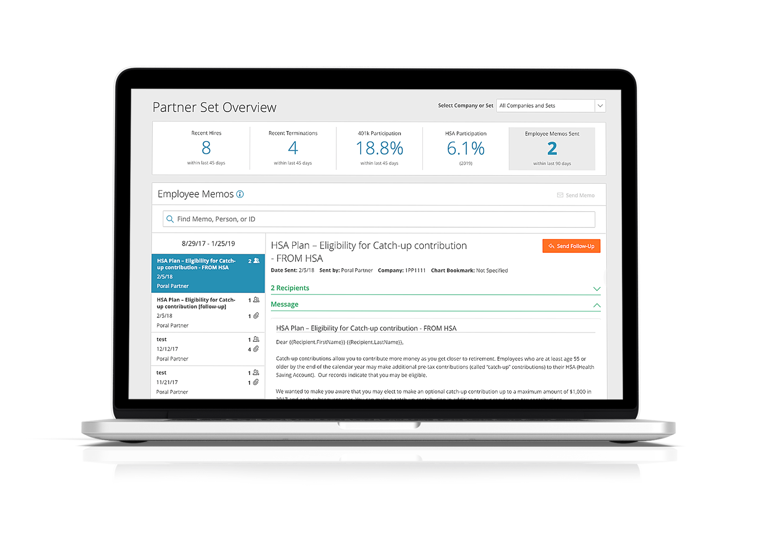
Gain Access with Campaigns
Engage your client’s employees with
Campaigns by sending memos and
bookmarking results through a
trusted channel.
With Memos, you can
Introduce you and your firm to
new hires
Share information and ancillary
plan options
Communicate with employees earlier
to jumpstart open enrollment
Bookmarks allow you to tag a Memo
and track its results.
Notes:
Speaking points:
You can also have your client sign an authorization form to allow you to send memo or emails to your clients' employees to help maximize awareness and insight into what programs or benefits are available. You can also bookmark the messages to see the effectiveness of the campaigns in terms of increased participation.

Slide 39
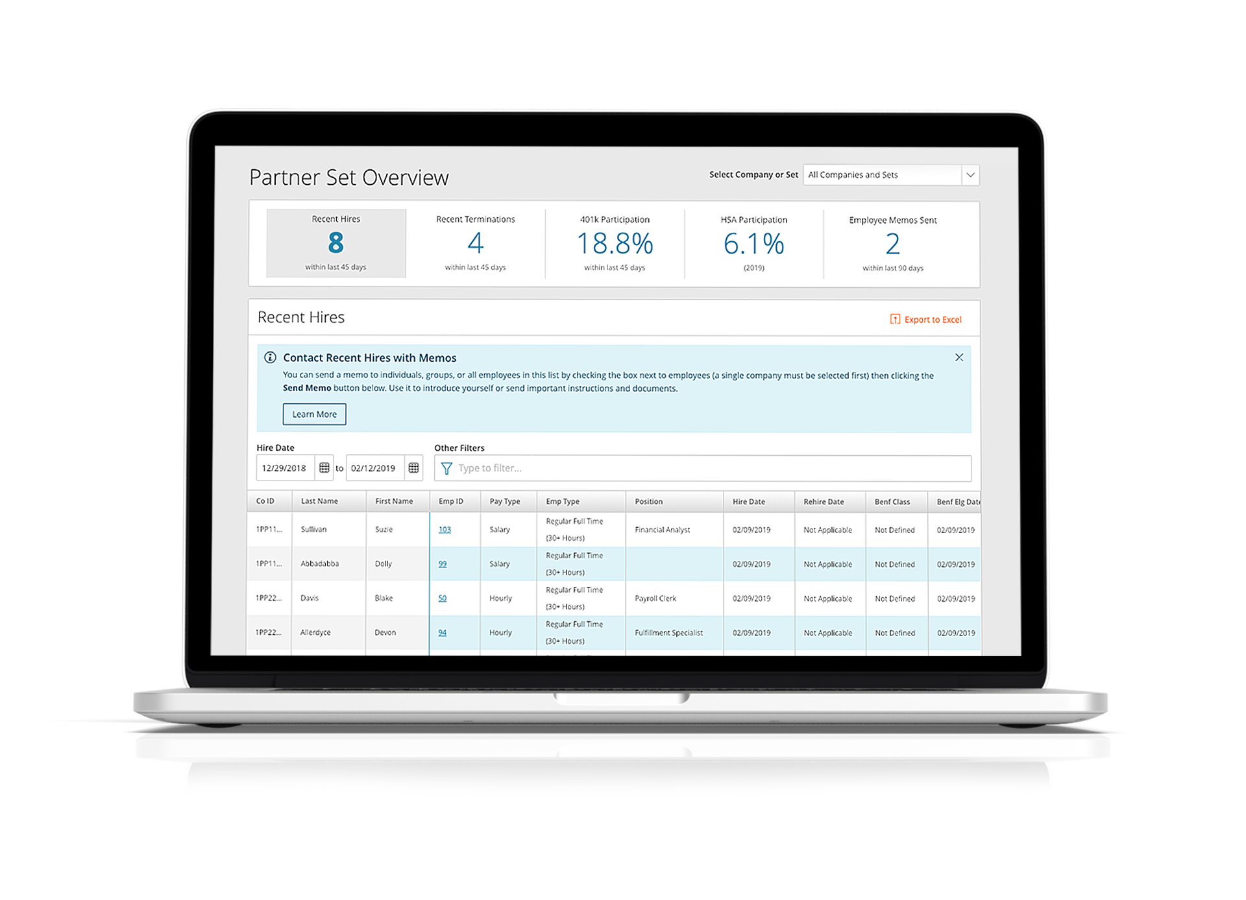
Partner Dashboards
Recent Hires
Get new hires informed and enrolled
as soon as possible.
Terminations
Being aware of terminations gives you
the opportunity to rollover the account.
HR, Headcount, Turnover
Get a complete picture of your clients’
workforce including breakdowns by
generation and ethnicity.
Notes:
Speaking points:
The Partner Portal has dashboards that let you see across all your clients that have Paylocity and have provided signed authorization to us to view this info. This info includes data such as recent hires, recent terminations, and participation in things like HSA, 401k, etc.

Slide 40
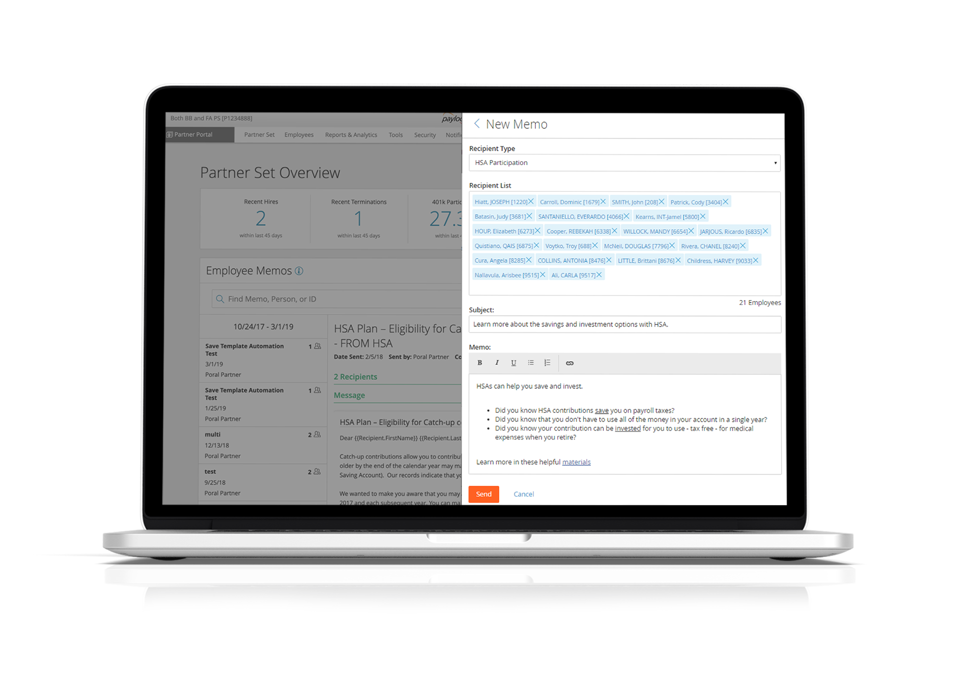
Let’s Take a Closer Look
Many employers turn to HSA plans to help
their employees save on premiums and
taxes. How can you help?
By using memos to educate your client’s
employees on the benefits of an HSA in order
to increase utilization. You can send a Memo
to employees:
Who make minimal HSA contributions to
remind them that their dollars will carry
forward if they don’t use it in a single year.
Who do not contribute to an HSA to
educate them on tax savings and
investment opportunities.
What’s more, you can capture the
impact of this behavior as a bookmark.

