Slide 2
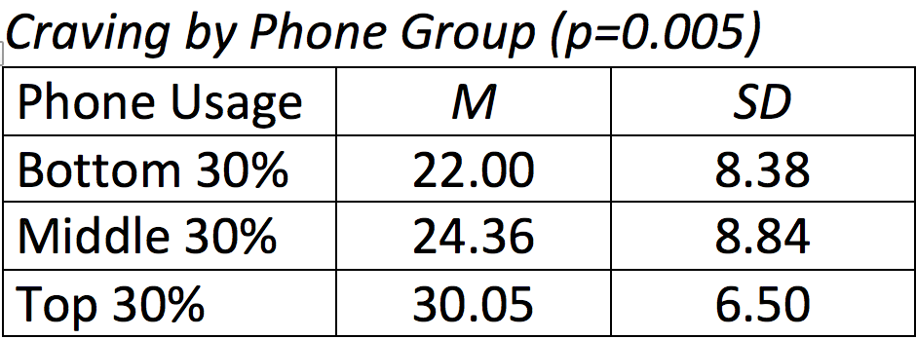
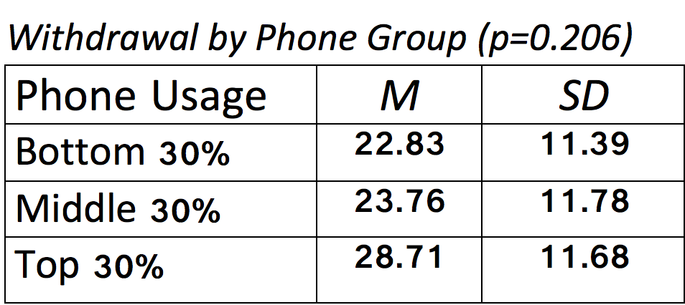
Cell Phone Usage: The Relationship with Craving and Withdrawal
Isabel Rice-Martorell, Brandi Houck, Raahkema Cropper, & Abigael Khuu
Faculty Mentors: Dr. Dorothy C. Doolittle & Dr. Shelia P. Greenlee
Christopher Newport University
Eastern Psychological Association 2020
Abstract
Cell phones play a significant role in an individual’s life through instantaneous connection and the setbacks of detrimental addictions. Sixty-nine college students completed the MMPUS-27 questionnaire, S.T.A.I., and a questionnaire regarding cell phone usage. Results suggest that craving towards the cell phone is positively related to one’s level of general anxiety and excess phone use, however, withdrawal is not. These findings demonstrate the implications of cell phone use in today’s society.
Results
Phone usage was divided among three subgroups for scoring purposes: high phone usage represented the top 30% of the longest times reported on the phone, the middle group of phone users represented 40% of the sample, and the lowest phone users represented the bottom 30% of the sample.
The average craving score of the lowest subgroup was 22.00 (S.D.= 8.388), while the average craving score of the highest subgroup was 30.05 (S.D. = 6.508), suggesting that craving of the cell phone does increase significantly as cell phone usage increases, p = 0.020.
The highest and lowest subgroups suggested significance among phone usage and craving, p = 0.005. Correlational tests suggest significance among craving and general anxiety, p = 0.250. There was no significance among craving and the Do Not Disturb features for studying and sleep, p = 0.766.
ANOVA results suggest no significance among withdrawal and general anxiety, p = 0.914. However, there is a significant difference in withdrawal symptoms among the lowest and highest phone users, p = 0.098.
No significance was shown for relations among usage of the Do Not Disturb feature for studying or sleeping purposes with withdrawal symptoms, p = 0.361.
Introduction
When the average college student wakes up in the morning, the first thing they see is their phone screen. Cell phone usage often continues throughout the entire day, resulting in a feeling of dependency and craving towards the cell phone.
Craving is best described as the dependency of an item for an outlet from undesired emotions (Foers4ter, Roser, Schoeni, & Roosli, 2015). Craving of the cell phone has been compared to addiction disorders through a desire for impulse-control (Jenaro, Flores, Gomez-Vela, Gonzalez-Gil, & Caballo, 2007).
University students are more prone to this craving and internet addiction leading to various negative health effects, such as anxiety, insomnia, and social dysfunction (Jenaro et al. 2007).
Withdrawal is described as having unpleasant feelings when one is away from the phone. The hypotheses of the current study is that higher craving scores and higher withdrawal scores will be related to higher overall cell phone usage and anxiety.
Discussion
In the current study, we investigated the relationships between withdrawal and craving subscales, general anxiety, and daily phone use. The study suggested some very eye-opening findings.
It was unexpected that withdrawal scores and craving didn’t both relate to general anxiety, as it had originally been hypothesized. As the results explained, only craving towards the cell phone is positively correlated with one’s level of general anxiety and excess phone use. The amount of craving to high phone use had a significant difference than those with lower phone use. The do not disturb feature being turned on for sleep and study also did not discriminate based on phone use seen in our study.
In society, there is a growing number of people using cell phones and it is important to see the implications it has on the current and future generations of university students. Excess phone use and general anxiety can impact the well-being of a user, so finding ways to decrease those variables would be helpful to improve the overall mental and physical health of students.
There was a large sample size of university students in the current study, which allowed for a broader spectrum of reach in the findings. Additionally, known and tested measures of anxiety and problematic phone use (MMPUS-27 and State Trait Anxiety Inventory) were utilized. However, the ratio between male and female participants was not equal, as there were 87% female participants. In a future study, additional measures of anxiety and phone use could be tested and discussed. We look forward to continuing this research and adding more variables along the way to examine other ways the cellphone impacts our life.
Methods
Sixty-nine undergraduate students completed self-report questionnaires after completing an informed consent. To ensure no interactions with the cell phones during testing, participants were instructed to put their cell phones in a manila envelope, label the envelope with their name, and place in a basket that was kept in the middle of the room. Participants completed several surveys, including the MMPUS-27 questionnaire (which examines problematic phone use), the StateTrait Anxiety Inventory (indicating the participants general anxiety), and a descriptive questionnaire regarding cell phone usage (questioning the amount of time on one’s phone, regular activities of the phone, and the usage of the do not disturb features). The MMPUS-27 provides a total score and five subscores: Locus of Control, Withdrawal, Negative Life Consequences, Craving, and Peer-Dependence. Participants respond through a 10-point Likert scale ranging from 1 (“not true at all”) to 10 (“extremely true”). The reliability for the MMPUS-27 has an alpha value of 0.92. The State Trait Anxiety Inventory consists of a 4-point scale ranging from “Almost Never” to “Almost Always”.
Acknowledgments to Experimentalist Lab for data collection and input

