Slide 1
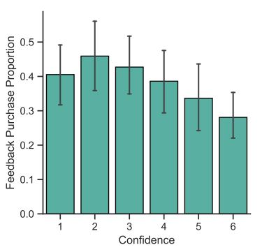
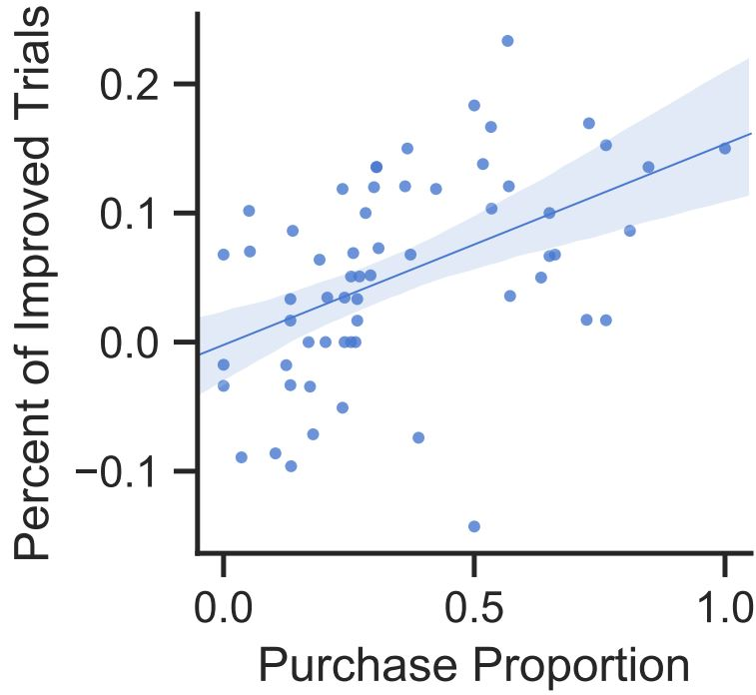
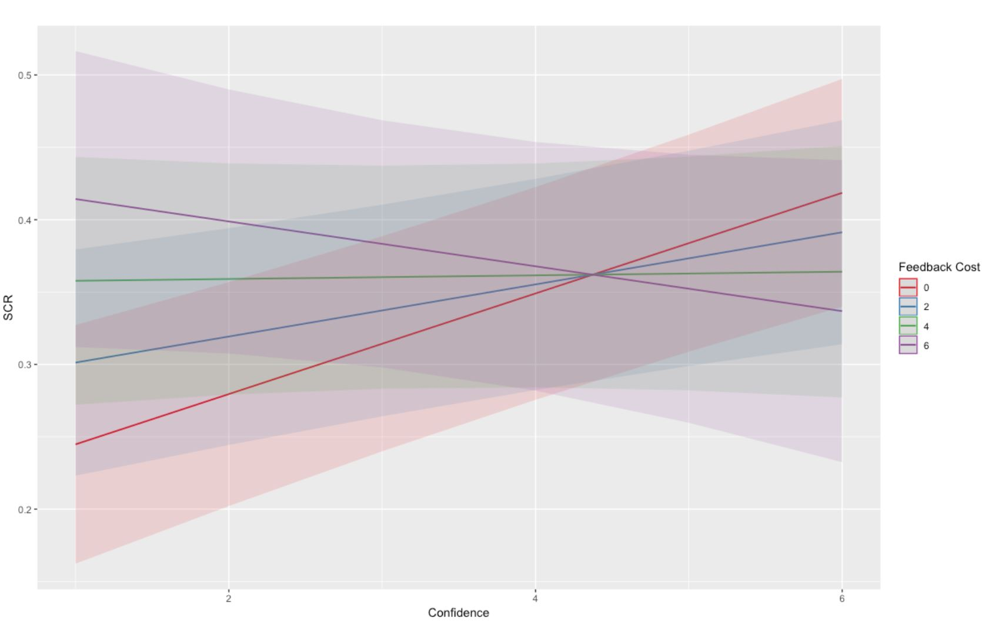
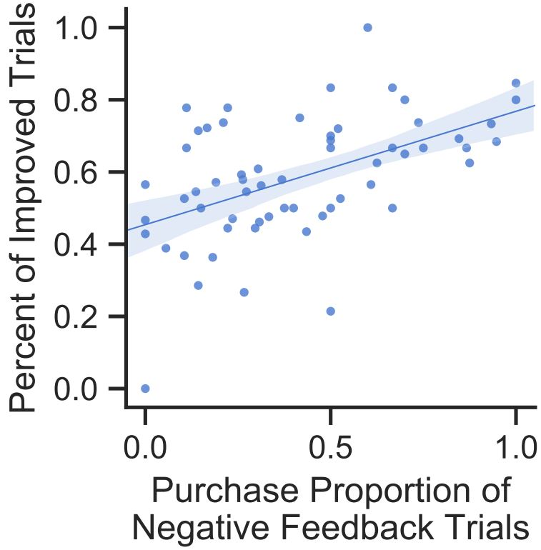
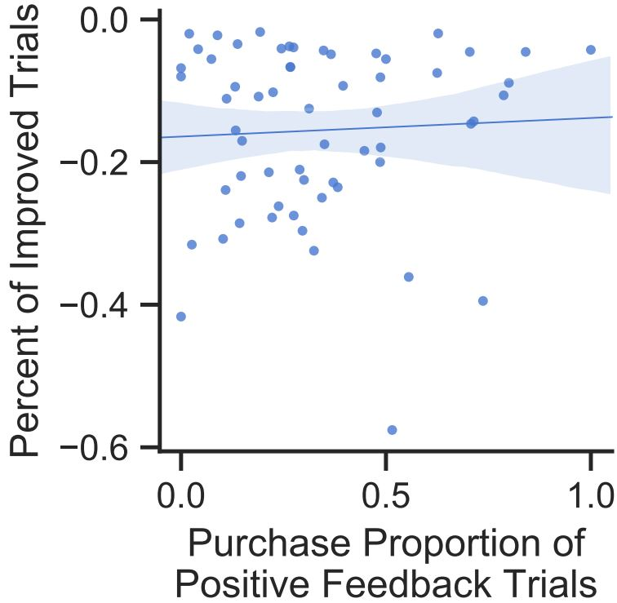
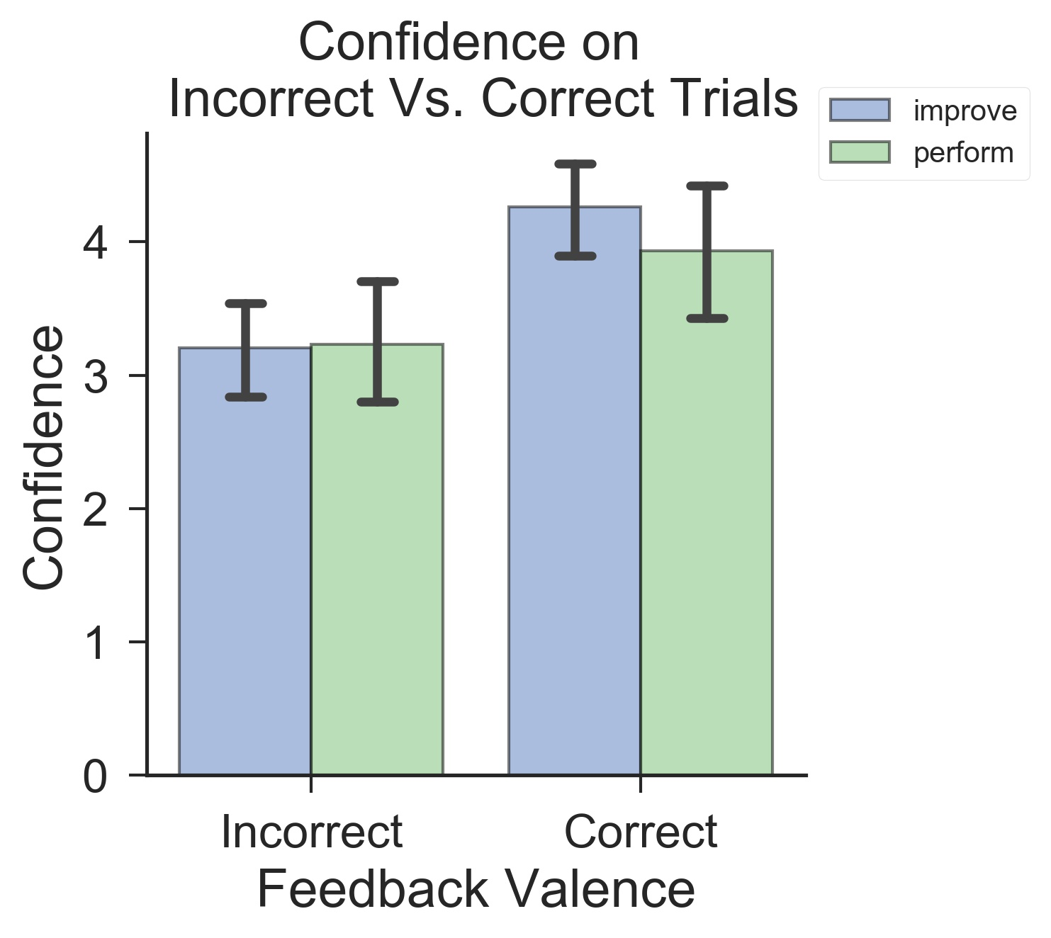
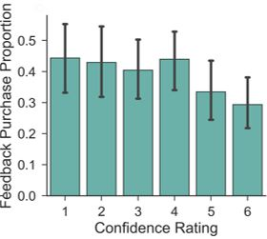
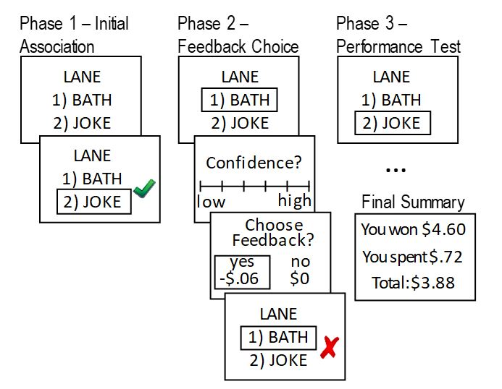
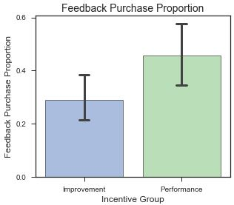
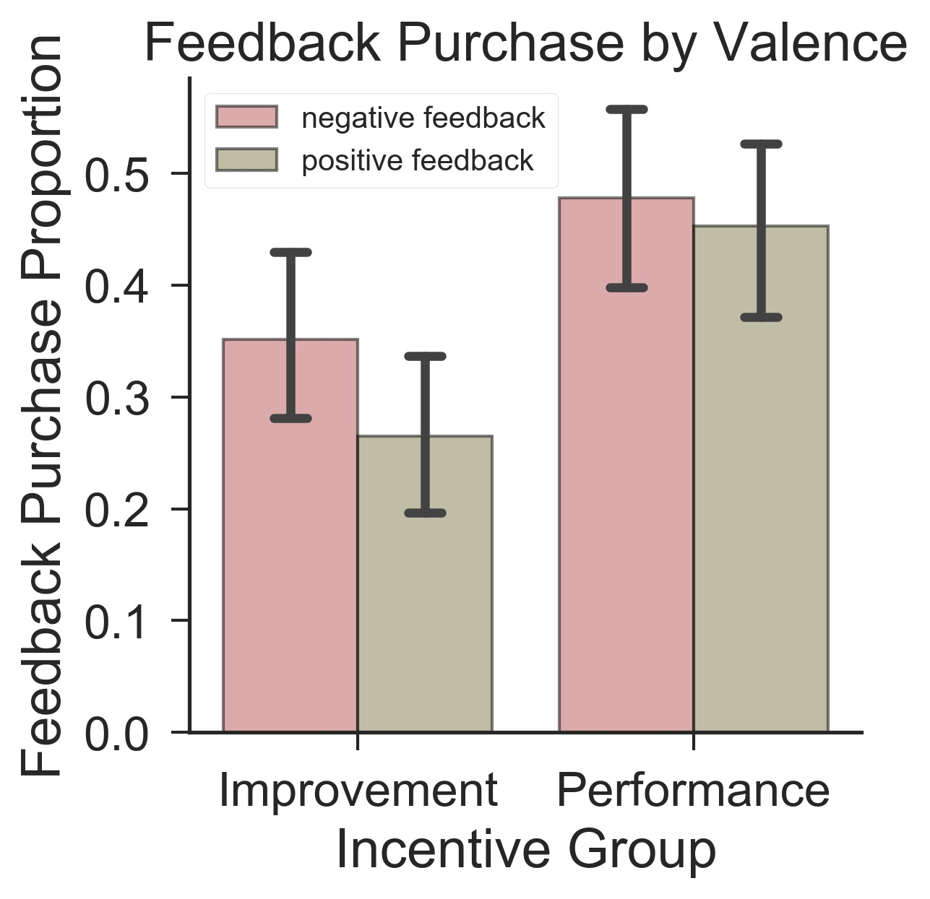
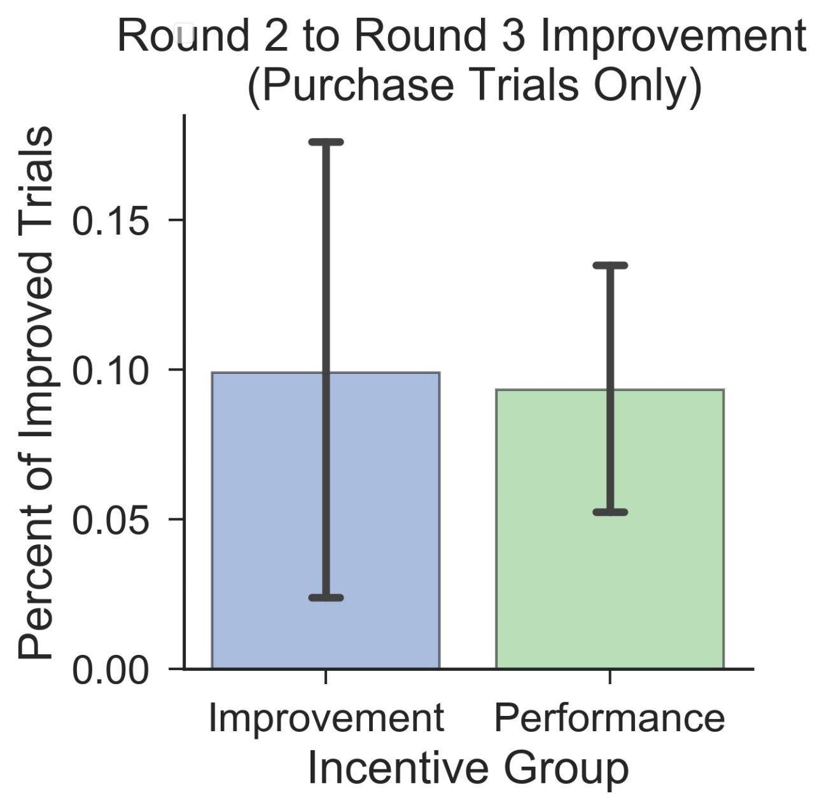
Rewarding for Proficiency or for Improvement:
Incentive Framing and Confidence Influence Feedback-seeking
Christopher J. Cagna, Manuela Iglesias, Da’Quallon Smith, Mauricio R. Delgado, Elizabeth Tricomi, Jamil P. Bhanji
Introduction
Experiment 1 Results
Exploratory Results
Feedback related to performance during a cognitive task is critical for effective performance and learning¹ .
The amount of subjective value (SV) that individuals place on feedback they receive moderates how feedback is processed² .
How SV influences decisions to seek feedback in the first place remains relatively unexplored.
Research Questions
How do individuals come to value feedback in the first place, and how does this influence their decisions to seek it?
Can manipulation of the framing of a monetary reward contingency influence SV of feedback and subsequent feedback-seeking behavior?
Lower confidence predicts
more feedback purchases
OR = .69, 95% CI: [.65,.74], p < .001
More feedback purchases promote improvement of performance
r = .48, p < .001
Lower confidence predicts enhanced SCR to feedback during more costly purchases
b_{conf x cost}= -.008, 95% CI: [-.013,-.004], p < .001
Negative feedback,
in particular, promotes improvement.
Method
EXPERIMENT 1
Participants
60 Rutgers University – Newark (RU-N) undergraduates
[M_{age} = 20.2(2.60) years]
Experimental Task
“willingness-to-pay” ³ word-association task ¹
r = .50, p < .001
r = .05, p = .69
Experiment 2 Results
Improvement group displayed a larger difference between confidence during incorrect trials and confidence during correct trials
b_{group x FB valence}= .28, 95% CI: [.03,.53], p = .03
Conclusions and Future Directions
+
+
Subjective confidence in performance is an important factor in value-based decisions about seeking feedback, especially when doing so is costly to the seeker. This is consistent with other work that has shown an effect of low confidence on information-seeking behavior ⁴ .
Framing of monetary incentives can moderate SV of feedback and promote feedback-seeking, but different reward contingencies (improvement vs. performance) can influence the valence of feedback sought.
Regardless of how it is incentivized, feedback benefits task performance.
Being rewarded for improvement may promote greater calibration between confidence and task performance.
Future work will examine the potential role of trait differences within domains such as goal orientation, self-esteem, and need for cognition.
Lower confidence predicts more feedback purchases: OR = .75, 95% CI: [.70,.80], p < .001
More feedback purchases predict improved performance: t(48) = -3.21, p < .01
3 Phases (60 trials each)
Phase 2 feedback costs:
$.00, $.02 ,$.04, $.06 (15 trials each)
Galvanic skin conductance responses (SCR) recorded after each
Phase 2 purchase decision
Reward: $.09 per Phase 3 correct response
EXPERIMENT 2
Participants
53 RU-N undergraduates [M_{age} = 21.0(4.0) years]
Experimental Task
Same task, but random assignment to an incentive framing contingency, in which participants were instructed that they would earn money based on either Phase 3 performance (n=26) or on improvement in performance from Phase 2 to Phase 3 (n=27)
Performance group purchased more feedback overall: t(51) = -2.20, p = .03
+
+
However, the improvement group purchased proportionately more negative feedback relative to positive feedback:
b_{group x valence}= -.410, 95% CI: [-.814,-.007], p = .04
There was no effect of reward contingency on the relationship between feedback purchases and improved performance: t(48) = -.47, p = .64
References
1. Tricomi, E., & Fiez, J. (2008). NeuroImage, 41(3), 1154-1167.
2. Tricomi, E., & DePasque, S. (2016). Recent Developments in Neuroscience Research on Human Motivation, 19, 175-202.
3. Peters, J., & Buchel, C. (2010). Behavioural Brain Research, 213(2), 135-141.
4. Desender, K., Boldt, A., & Yeung, N. (2018). Psychological Science, 29(5), 761-778
Notes:
Experiment 1, Figure 1 – OR: For a one-unit change in confidence, the odds of someone purchasing feedback becomes 69% less likely (same to say as odds of feedback purchase drop to 31%?); delta-R-squared based on: R-squared of model that includes confidence - R-squared-model that does not include it
Experiment 1, Figures 4 and 5:
Figure 4: Improvement Index value from R2 to R3 for negative feedback trials during Round 2: values can only be positive, since they can only either stay the same or get better
Figure 5: Improvement Index value from R2 to R3 for positive feedback trials during Round 2: values can only be negative, since they can only either stay the same or get worse

