Slide 1
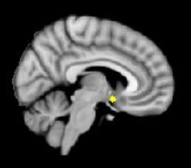
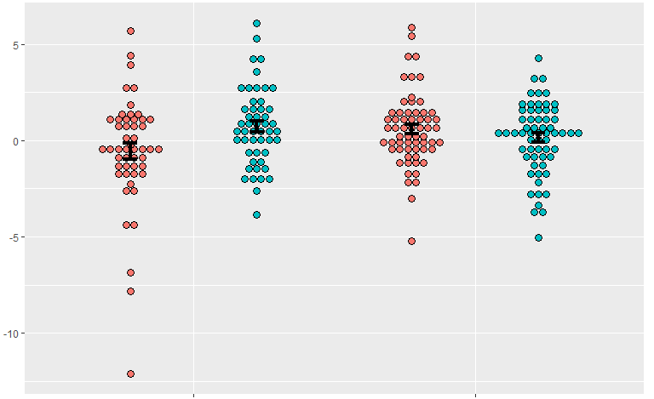
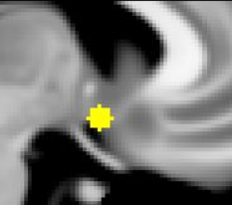
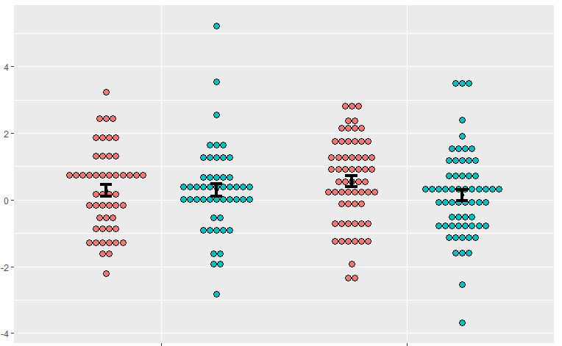
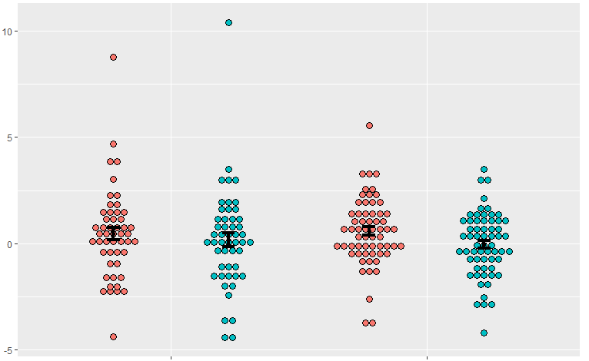
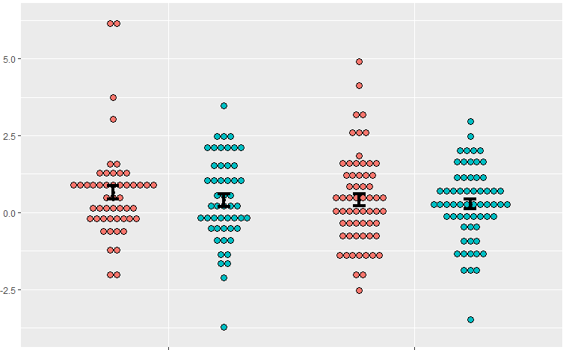
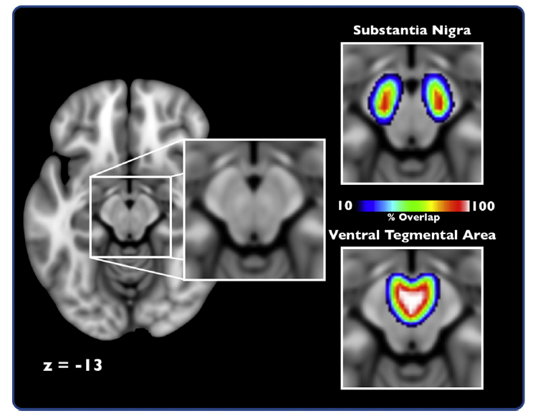
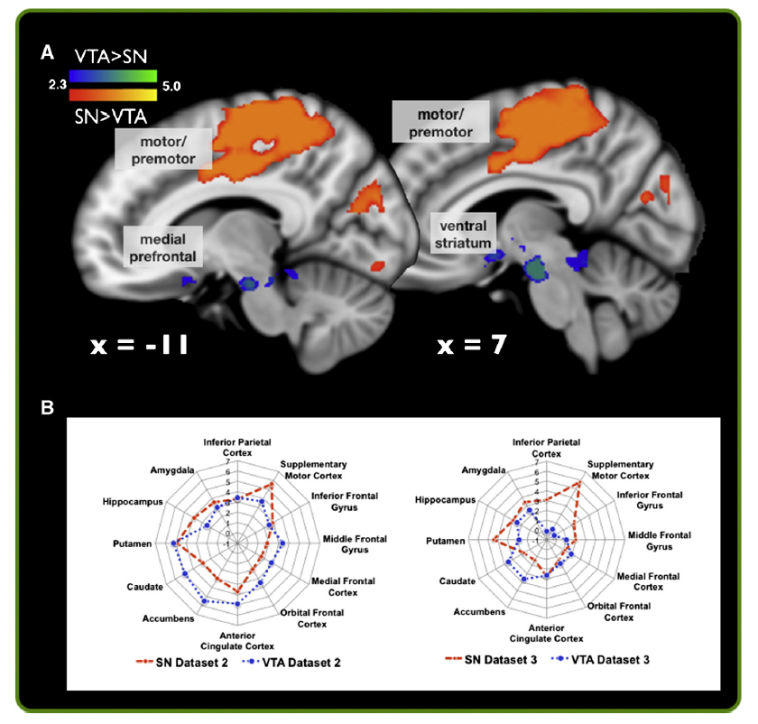
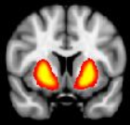
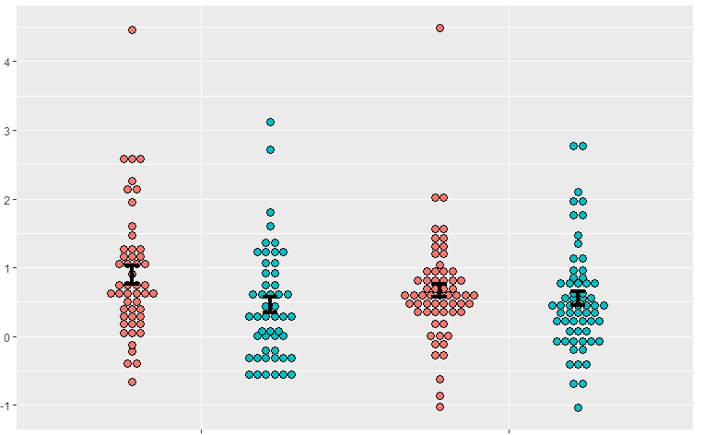
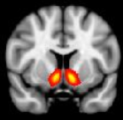
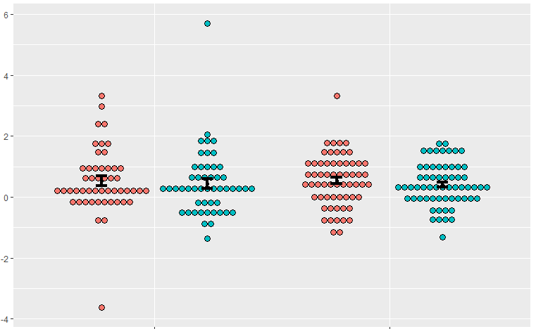
Differential Connectivity of Midbrain Circuits in Parkinson’s Disease
Ian M. O’Shea, David V. Smith, Vishnu P. Murty
Temple University
Introduction
Study Samples
Cortical ROIs
Functional MRI has shown dissociations between dopaminergic networks centered on the Subtantia Nigra (SN) and the Ventral Tegmental Area (VTA)^{1,3,5}
Connectivity of the dopaminergic midbrain is known to mediate the neurobehavioral deficits associated with Parkinson’s disease (PD)
In the early phases of the disease, PD is defined by the degradation of the SN while the VTA is spared²
Prior fMRI studies have characterized SN connectivity in PD using resting-state fMRI, but with smaller sample sizes
These studies did not characterize interactions across SN and VTA, which could be altered by sub-region specific changes in dopaminergic tone
This study combined three public datasets for a total of n = 111 participants
Tessa, C., et al. (2019). PloS one.
Dataset 1
n = 14 controls, 14 PD; aged 36-78
Voxel size: 4x4x5 mm, Resting state: 8 min 10 sec
Badea, L.. Et al. (2017). PloS one. – 2 datasets
Dataset 2
n = 16 controls, 27 PD; aged 45-86
Voxel size: 3.8x3.8x5 mm, Resting state: 8 min 3 sec
Dataset 3
n = 20 controls, 20 PD; aged 57-75
Voxel size: 4x4x5 mm, Resting state: 8 min
Do PD patients have different connectivity from midbrain to cortical areas than healthy controls?
Midbrain Connectivity to Right SGC
**
n.s.
Connectivity (tstat)
A significant group*seed interaction such that controls show greater coupling of VTA versus in SN, which is not apparent in PD (p<0.005).
SN
VTA
Controls
PD
Analysis Pipeline
Midbrain Connectivity to Left SMA
Midbrain Connectivity to Left SGC
Midbrain Connectivity to Left M1
Study Goal
Images preprocessed with FMRIPREP
Motion correction
Registration
Normalization
Images were denoised using ICA-AROMA⁶
Time series extracted from seed ROIs
Connectivity (tstat)
Characterize differences in connectivity from SN and VTA to cortical and sub-cortical regions between healthy controls and individuals with PD
Controls
PD
Controls
PD
Controls
PD
No significant differences in connectivity by seed or group in our other cortical ROIs.
Discussion
Prior Results
Regression run comparing connectivity of target ROIs to SN vs VTA
Group level analysis performed in R
VTA has higher connectivity to the right SGC than the SN in controls, but not in patients with PD
SN has significantly higher connectivity to Putamen in both groups
Given the role of VTA-SGC interactions in guiding motivated behavior, functional coupling in this circuit may be associated with aberrant goal-directed behavior in PD populations.
This differential connectivity in the midbrain could provide a novel target for understanding the pathophysiology and neurobehavioral deficits in PD
Probabilistic midbrain atlas used to show differential connectivity between SN and VTA in healthy controls¹
Sub-Cortical ROIs
Do PD patients have different connectivity from midbrain to sub-cortical areas than healthy controls?
Midbrain Connectivity to Putamen
Future Directions
Connectivity (tstat)
**
Independent component analysis (ICA) and dual regression (DR) may further elucidate these connectivity differences⁴
These analyses can map out ROIs based on fMRI data, rather than using probabilistic atlases
This data may corroborate the data from the first analysis and/or introduce new region-specific difference not originally captured
Dual Regression analysis indicates differences in connectivity in cortical and sub-cortical target Regions of Interest¹ (ROI), which are used in the present study
Increased connectivity of SN with Putamen in both groups (p<0.01, main effect of seed).
SN
Controls
PD
VTA
Midbrain Connectivity to Nucleus Accumbens
Connectivity (tstat)
References
No significant differences in NAcc connectivity across seeds or groups.
1. Murty, V. P., et al., (2014). NeuroImage.; 2. Fearnley, J. M., & Lees, A. J. (1991). Brain.; 3. Dagher, A. & Robbins, T.W., (2009) Neuron.; 4. Leech, R., et al., (2012). Journal of Neuroscience.; 5. Damier, P., et al., (1999). Brain J. Neurol.; 6. Pruim et al., 2015, NeuroImage
Controls
PD

