Slide 1
Off the Menu – A Nutritional Approach to Dry Eye
Melissa Barnett, OD, FAAO, FSLS, FBCLA

Slide 2
Disclosures
ABB
Acculens
Alden Optical
Alcon
Allergan
Anthem, INC
Bausch + Lomb
Bruder
Contamac
CooperVision
JJVC Vistakon
Gas Permeable Lens Institute (GPLI)
Novabay
Ocusoft
Paragon Bioteck
Percept
Science Based Health
Scleral Lens Education Society
Shire
Sjogren’s Syndrome Foundation
STAPLE program
SynergEyes
Visioneering Technologies

Slide 4
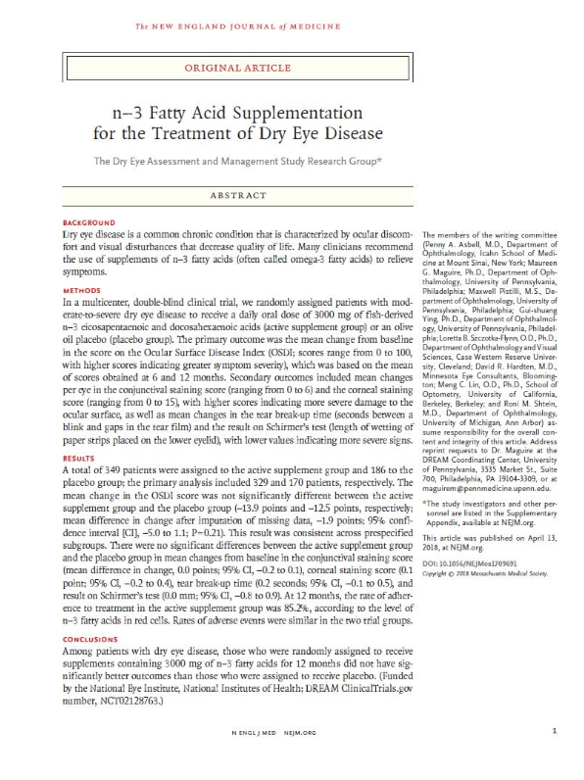
DREAM study DRy Eye Assessment and Management (DREAM)
Supplementation with high dose fish oil or olive oil helped alleviate the symptoms and improve objective signs of dry eye disease (DED) similarly
RCT
NEI -sponsored study
Fish oil (2,000 mg EPA and 1,000 mg DHA daily) or refined olive oil (5,000 mg daily, intended as a placebo)
12-month period
329 patients – omega-3 group
170 patients – olive oil group
Notes:
Randomized control trial
National Eye Institute sponsored study
535 patients
randomized 2:1 of Omega 3 to placebo
27 study sites
OMD 16, OD 11
academic medical centers 12
private practices 15
study over 12 month period

Slide 5
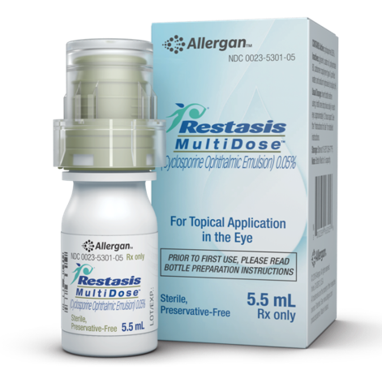
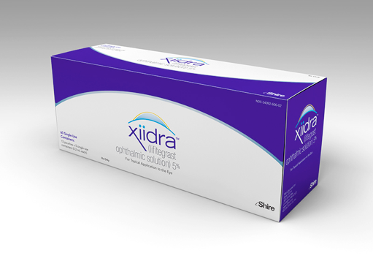
DREAM
Adjunct therapy in DED
Structured to model “real world” conditions
Participants could use current DED therapies
Artificial tears, prescription cyclosporine drops, warm lid soaks and fish oil supplements if less than 1,200 mg EPA + DHA daily
Notes:
up to 1200mg of Omega 3 allowed

Slide 6
Improvement in OSDI
Mean change from baseline for OSDI
13.9 points in the omega-3 group
12.5 points in the placebo group
Not statistically significant
61% of the omega-3 group and 54% of the control group achieved at least a 10-point reduction in the OSDI score
No significant differences between groups in DED signs (conjunctival and corneal staining scores, TBUT, Schirmer’s test)

Slide 7
Olive oil – a true placebo? Was the effect due to the activity of the oil itself?
Oleic acid – predominant fatty acid in olive oil
Substitute a modest amount of oleic acid for saturated or trans-fatty acids in the diet significantly decreases IL-6 ²
Pro-inflammatory cytokine and biomarker in DED
1. Gorzynik-Debicka M et al. Potential health benefits of olive oil and plant polyphenols. Int. J. Mol. Sci. 19: 547, 2018.
2. Basu A et al. Dietary factors that promote or retard inflammation. Arterioscler Thromb Vasc Biol. 26:995-1001, 2006.
Notes:
Anti-inflammatory activity of olive oil due to its phenolic components such as hydroxytyrosol and oleocanthal, would not apply
Study used refined (very low phenolic content) rather than virgin or extra olive oil (high phenolic content)¹
5g per day of olive oil = 1 teaspoon
studies on the Mediterranean diet have use 60 g and sometimes as high as 100g
objective measurement of the levels of fatty acids in erythrocytes (red blood cells) at 6 and 12 months including oleic acid levels
used to measure how well the fatty acid was incorporated into the body

Slide 8
Olive oil – a true placebo? Was the effect due to the activity of the oil itself?
Palmitoleic acid (0.3 to 3.5%) – small amount in olive oil
Fatty acid with anti- inflammatory properties
Oral palmitoleic acid
Preserved tear secretion
Suppressed inflammatory cytokines of lacrimal gland
Murine model of dry eye
Nakamura S et al. Restoration of tear secretion in a murine dry eye model by oral administration of palmitoleic acid. Nutrients. 9:364, 2017.
Notes:
Thus, anti-inflammatory activity of olive oil due to its phenolic components such as hydroxytyrosol and oleocanthal, would not apply

Slide 9
DREAM study lessons
Both treatment and placebo groups improved over time
Heterogeneous study population
DED is a complex and multifactorial disease state
Difficult to measure the effect of a single, non-specific intervention
Traditional measurements used (OSDI and Schirmers) have limited sensitivity and specificity
Limited by the type of measurement
The results were not expected
Is it the treatment that doesn’t work, or are we just not using the right measuring stick?
Laura Periman, MD Ophthalmology Management June 2018
Notes:
primary endpoint was reduction of symptoms on OSDI

Slide 10
DREAM study lessons
Perhaps we shouldn’t lump dry eye together into a few types
Perhaps dry eye is actually a dozen different subtypes
Need better tests to
More precisely categorize patient subtypes
Rule out comorbidities and masqueraders
Measure disease state activity in response to therapies
Laura Periman, MD Ophthalmology Management June 2018

Slide 11
What your patient sees when you tell them to buy an omega 3…
Slide credit Nathan Schramm, OD, CNS, FSLS
Notes:
The shelves at the supermarket, health food stores and drug stores are filled with different brands, concentrations and derivatives of omega 3 fish oil. The typical consumer can become very confused when attempting to purchase an omega three fish oil while relying on a store clerk with very little education to make a recommendation.

Slide 12
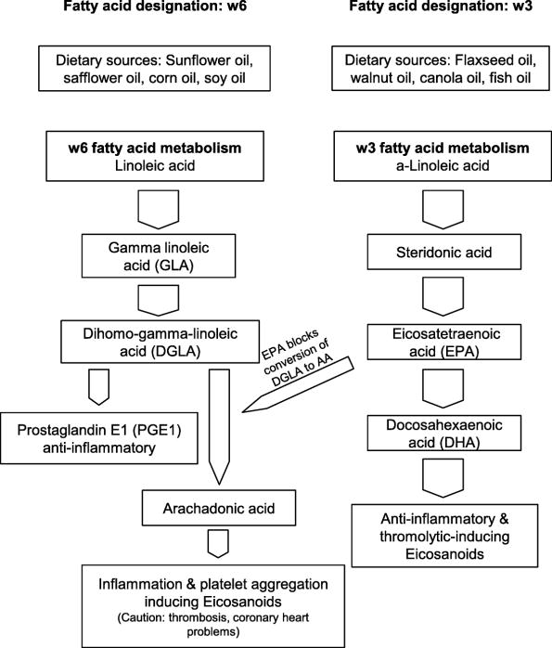
Omegas and Dry Eye: More Knowledge, More Questions. Hom, Milton; Asbell, Penny; Barry, Brendan Optometry & Vision Science. 92(9):948-956, September 2015. DOI: 10.1097/OPX.0000000000000655
3
Slide credit Nathan Schramm, OD, CNS, FSLS
Notes:
Optom Vis Sci. 2015 Sep;92(9):948-56. doi: 10.1097/OPX.0000000000000655.
Omegas and Dry Eye: More Knowledge, More Questions. Hom MM¹, Asbell P, Barry B.
The omega-3 (ω3) and omega-6 (ω6) essential fatty acid knowledge base has been exploding. In the last 5 years, at least 12 clinical trials on ω3 and ω6 supplementation and dry eye disease (DED) were published in the peer-reviewed literature (2010 to 2015), about double the amount published in the 5 years prior. Although there is increasing scientific evidence that supports the potential use of ω3 and ω6 supplementation for DED, there are limited randomized controlled trials to properly inform evidence-based medicine. DED is one of the most common eye conditions that patients seek care for and cannot be disregarded as a trivial condition. The roles of ω3 and ω6 polyunsaturated fatty acids (PUFAs) in the treatment of DED are still not completely understood. There are distinct and sometimes opposite effects of ω3 and ω6 PUFAs, both of which are essential and cannot be synthesized de novo in the body. These fatty acids must be obtained from the diet, which varies widely by region, even within the United States. Omega-3 PUFAs have anti-inflammatory effects; a proper ratio of ω6:ω3 in the diet must be established. Objectively correlating changes in dry eye syndrome with blood levels of ω3 PUFAs has not been done in a large-scale multisite study. Just as Wilder's law of initial value states that "the direction of response of a body function to any agent depends to a large degree on the initial level of that function," the baseline status needs to be taken into account. There is also no consensus on the dose, composition, length of treatment, and so on with ω3 or ω6 PUFAs. Increased quality evidence on the usefulness of over-the-counter supplements is needed to enable eye care providers to confidently outline specific treatment recommendations for using ω3 PUFAs in DED.

Slide 13
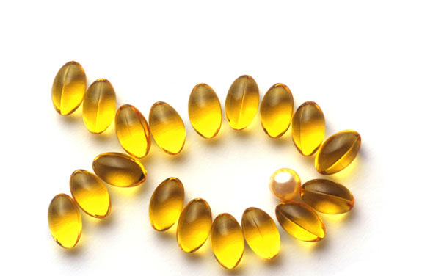
Omega-3 fatty acids and dry eye disease
Omega-3 fatty acids glossary of terms
Alpha-linolenic acid (ALA) - omega-3
Linoleic acid (LA) - omega-6
Docosahexaenoic acid (DHA)
Eicosapentaenoic acid (EPA)
Arachidonic acid (AA)
Gamma-linolenic acid (GLA)
Dihomo-gamma-linolenic acid (DGLA)

Slide 14
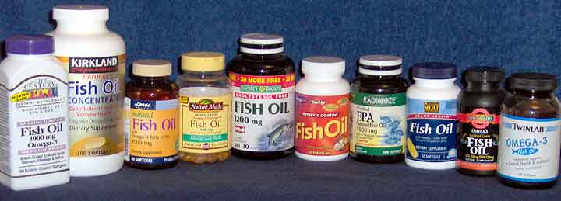
DHA and EPA
DHA and EPA are formed when fish eat algae and are found in the triglyceride form ^{1,2}
A triglyceride consists of a three-carbon glycerol “backbone” with each carbon linked to a fatty acid molecule.
Each triglyceride molecule contains three fatty acids.
In normally produced fish oil – 20% to 30% of the fatty acids are EPA and DHA
Highly concentrated oils – 60% to 85% EPA and DHA
Check the label for the actual EPA/DHA concentrations in a formula
1. Visioli F, Risé P, Barassi MC, et al. Dietary intake of fish vs. formulations leads to higher plasma concentrations of n-3 fatty acids. Lipids. 2003 Apr;38(4):415-8.
2. Dyerberg J, Madsen P, Møller JM, et al. Bioavailability of marine n-3 fatty acid formulations. Prostaglandins Leukot Essent Fatty Acids. 2010 Sep;83(3):137-41.

Slide 15
Anti-inflammatory Fatty Acids
Delta-4 Desaturase
Omega-3
18:2w3
Alpha linolenic (ALA)
18:4w3
SDA
20:4w3
ETA
20:5w3
EPA
20:6w3DHA
There’s a lot going on on this chart …
So let’s look at things one at a time.
(Parent)
Series 3 (“good”)
Prostaglandins, LTB5, Resolvin E1
Essential
Fatty Acids
Delta-6
desaturase
Elongase
Delta-5
Desaturase
COX
Series 2 (“bad”)
Prostaglandins
(Parent)
Omega-6
18:2w6 Linoleic Acid (LA)
18:3w6GLA
20:3w6DGLA
20:4w6
Arachidonic Acid
Series 1 (“good”)
Prostaglandins
Rate-Limiting
Rate-Limiting
2016, Zac Denning, ScienceBased Health, zdenning@sbh.com
Notes:
This slide depicts the Omega 3 family and the Omega 6 family

Slide 16
Anti-inflammatory Fatty Acids
Delta-4 Desaturase
ALA & LA:
Most abundant omega 3/6s in diet. Both must convert to other omegas to effect inflammation, but are inefficiently / inconsistently converted (due to rate-limiting enzyme), reducing their effectiveness
(example: only 10-20% of ALA converted)
Omega-3
18:2w3
Alpha linolenic (ALA)
18:2w3
Alpha linolenic (ALA)
18:4w3
SDA
20:4w3
ETA
20:5w3
EPA
20:6w3DHA
(Parent)
Series 3 (“good”)
Prostaglandins, LTB5, Resolvin E1
Essential
Fatty Acids
Delta-6
desaturase
Delta-6
desaturase
Elongase
Delta-5
Desaturase
COX
Series 2 (“bad”)
Prostaglandins
(Parent)
Omega-6
18:2w6 Linoleic Acid (LA)
20:3w6DGLA
20:4w6
Arachidonic Acid
18:2w6 Linoleic Acid (LA)
18:3w6GLA
Series 1 (“good”)
Prostaglandins
Series 1 (“good”)
Prostaglandins
LA conversion under hormonal / metabolic control. Factors inhibiting conversion include: age, alcohol, zinc/B6/Mg deficiency, trans-fats, high cholesterol, rheumatoid arthritis, and more …
Rate-Limiting
2016, Zac Denning, ScienceBased Health, zdenning@sbh.com
Notes:
Alpha-linolenic acid (ALA) – Omega 3 Linoleic acid (LA) – Omega-6
Most abundant omega 3/6s in diet (seed oil/salad dressing)
Must convert to other omegas to effect inflammation
Inefficiently / inconsistently converted (due to rate-limiting enzyme)
Only 10-20% of ALA converted
Thus less effective
Once metabolized, ALA become prostaglandins E3
LA becomes prostaglandins E2
The progressive enzyme action is affected by many factors.
Example, the delta-6 desaturase enzyme action on both omega molecules is reduced by aging, alcohol, nutrient deficiencies, trans fat, and elevated cholesterol.
Thus affecting the efficiency of the metabolism of these molecules

Slide 17
Anti-inflammatory Fatty Acids
Delta-4 Desaturase
EPA & GLA
are the powerhouses of the omegas – they are effective precursors of anti-inflammatory compounds
(DHA is also precursor to a protectin, NPD1 – though no dry eye role for NPD1 is established)
Omega-3
18:2w3
Alpha linolenic (ALA)
18:4w3
SDA
20:4w3
ETA
20:5w3
EPA
20:5w3
EPA
20:6w3DHA
(Parent)
Series 3 (“good”)
Prostaglandins, LTB5, Resolvin E1
Series 3 (“good”)
Prostaglandins, LTB5, Resolvin E1
Essential
Fatty Acids
Delta-6
desaturase
Elongase
Delta-5
Desaturase
COX
Series 2 (“bad”)
Prostaglandins
(Parent)
20:3w6DGLA
Omega-6
18:2w6 Linoleic Acid (LA)
18:3w6GLA
20:3w6DGLA
20:4w6
Arachidonic Acid
18:3w6GLA
Series 1 (“good”)
Prostaglandins
Series 1 (“good”)
Prostaglandins
Series 1 (“good”)
Prostaglandins
Rate-Limiting
2016, Zac Denning, ScienceBased Health, zdenning@sbh.com
Notes:
EPA is precursor to PGE3, leukotriene B5 (LTB5), plus resolvin E1
DHA is precursor to neuroprotection D1

Slide 18
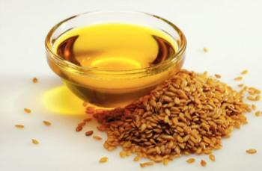
Anti-inflammatory Fatty Acids
Delta-4 Desaturase
Flaxseed oil provides … mostly ALA (plus small amount of LA)
Both inefficiently used
Omega-3
18:2w3
Alpha linolenic (ALA)
18:2w3
Alpha linolenic (ALA)
18:4w3
SDA
20:4w3
ETA
20:5w3
EPA
20:6w3DHA
(Parent)
Series 3 (“good”)
Prostaglandins, LTB5, Resolvin E1
Essential
Fatty Acids
Delta-6
desaturase
Elongase
Delta-5
Desaturase
COX
Series 2 (“bad”)
Prostaglandins
(Parent)
Omega-6
18:2w6 Linoleic Acid (LA)
20:3w6DGLA
20:4w6
Arachidonic Acid
18:2w6 Linoleic Acid (LA)
18:3w6GLA
Series 1 (“good”)
Prostaglandins
Series 1 (“good”)
Prostaglandins
Rate-Limiting
2016, Zac Denning, ScienceBased Health, zdenning@sbh.com

Slide 19
Anti-inflammatory Fatty Acids
Delta-4 Desaturase
Fish oil provides EPA and DHA
Efficiently used, good health benefits overall
Omega-3
18:2w3
Alpha linolenic (ALA)
18:4w3
SDA
20:4w3
ETA
20:5w3
EPA
20:6w3DHA
20:5w3
EPA
20:6w3DHA
(Parent)
Series 3 (“good”)
Prostaglandins, LTB5, Resolvin E1
Essential
Fatty Acids
Delta-6
desaturase
Elongase
Delta-5
Desaturase
COX
Series 2 (“bad”)
Prostaglandins
(Parent)
Omega-6
18:2w6 Linoleic Acid (LA)
18:3w6GLA
20:3w6DGLA
20:4w6
Arachidonic Acid
Series 1 (“good”)
Prostaglandins
Series 1 (“good”)
Prostaglandins
Rate-Limiting
2016, Zac Denning, ScienceBased Health, zdenning@sbh.com

Slide 20
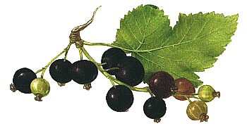
Anti-inflammatory Fatty Acids
Delta-4 Desaturase
Black currant seed oil provides GLA (plus ALA & LA). GLA efficiently reduces inflammation through a unique pathway – and with dry eye specific effects. GLA is not obtainable through diet, fish or flax.
Omega-3
18:2w3
Alpha linolenic (ALA)
18:2w3
Alpha linolenic (ALA)
18:4w3
SDA
20:4w3
ETA
20:5w3
EPA
20:6w3DHA
(Parent)
Series 3 (“good”)
Prostaglandins, LTB5, Resolvin E1
Essential
Fatty Acids
Delta-6
desaturase
Elongase
Delta-5
Desaturase
COX
Series 2 (“bad”)
Prostaglandins
(Parent)
Omega-6
18:2w6 Linoleic Acid (LA)
18:3w6GLA
20:3w6DGLA
20:4w6
Arachidonic Acid
18:2w6 Linoleic Acid (LA)
18:3w6GLA
Series 1 (“good”)
Prostaglandins
Series 1 (“good”)
Prostaglandins
Rate-Limiting
2016, Zac Denning, ScienceBased Health, zdenning@sbh.com
Notes:
GLA has a unique pathway
blackcurrent seed oil

Slide 21
GLA Targeted Action for Dry Eye: lacrimal production
GLA is precursor of an anti-inflammatory prostaglandin, PGE1
PGE1 found in tears, lacrimal gland & conjunctiva (1,2)
GLA
DGLA
PGE1
Viau, Sabrina, et al. Graefe's Arch Clin Exp Ophthalmol 247.8 (2009): 1039-1050.
Aragona, Pasquale, et al. Invest Ophthalm Vis Sci 46.12 (2005): 4474.
2016, Zac Denning, ScienceBased Health, zdenning@sbh.com

Slide 22
Gamma-linolenic acid (GLA)
GLA improves markers of inflammation / inflammatory mediators in dry eye
GLA may reduce inflammation in other diseases
Rheumatoid arthritis, IBD, dermatitis and diabetic retinopathy
Possibly by acting on T-cells to modulate the immune response
Suggests anti-inflammatory Potency:
2,000-3,000 mg omega-3s usually required to have significant effect
In contrast 235 mg of GLA significantly reduced 2 different inflammatory markers in the a clinical trial (n=38)
©2016, Zac Denning, ScienceBased Health, zdenning@sbh.com
Notes:
GLA improves markers of inflammation and inflammatory mediators in dry eye

Slide 23
GLA
GLA, unaccompanied by fish oil, has been found to alleviate dry eye symptoms
Increase tear production and improve CL discomfort in CL associated dry eye¹
Reduce ocular surface inflammation in Sjögren’s syndrome²
GLA with eyelid hygiene, decrease eyelid margin inflammation and improve symptoms in mgd more than either treatment alone³
Post-menopausal women⁴
Mild-moderate DED ⁵
Kokke KH et al. Oral omega-6 fatty acid treatment in contact lens associated dry eye. Cont Lens Anter Eye. 31:141–46, 2008.
Aragona P et al. Systemic omega-3 essential fatty acid treatment and PGE1 tear content in Sjogren's syndrome patients. Invest Ophthalmol Vis Sci. 46:4474–79, 2005.
Pinna A et al. Effect of oral linoleic and gamma-linolenic acid on meibomian gland dysfunction.
Sheppard JD, Pflugfelder SC, et al. Cornea 32 :1297-1304, 2013.
(Brignole-Baudouin et al. Acta Ophthalmologica 89:e591-7, 2007.)

Slide 24
GLA
Studies show GLA (alone, or with modest amounts of EPA and DHA) improves dry eye signs and/or symptoms
EPA is added to GLA-supplemented diets to
Prevent accumulation of arachidonic acid
Decrease levels of pro-inflammatory prostaglandin E2 produced from arachidonic acid

Slide 25
Omega-3 and Omega-6 Ratio
Omega-3 leads to an anti-inflammatory prostaglandin
Sounds good?
We also need pro-inflammatory prostaglandins to fight off infections, diseases and a whole host of conditions.
Ideal ratio of omega-6 to omega-3 is about 4/1
Standard American diet ratio closer to 25 to 1
Thus, the pro-inflammatory pathway is pushed to the chronic inflammatory state
Miljanović B, Trivedi KA, Dana MR, et al. Relation between dietary n-3 and n-6 fatty acids and clinically diagnosed dry eye syndrome in women. Am J Clin Nutr. 2005 Oct;82(4):887-93.
Enos RT, Velázquez KT, McClellan JL, et al. Reducing the dietary omega-6:omega-3 utilizing α-linolenic acid; not a sufficient therapy for attenuating high-fat-diet-induced obesity development nor related detrimental metabolic and adipose tissue inflammatory outcomes. PLoS One. 2014 Apr 14;9(4):e94897.
Notes:
the ideal ratio of omega 3 to omega 6 is about 4/1

Slide 26
Omega-3 and Omega-6 Ratio
With Omega-3 balance, the omega-3 molecules of DHA and EPA will block the conversion to AA
Allow omega-6 molecules GLA and DGLA to convert to a mucus-specific anti-inflammatory prostaglandin E1
Thus, reducing inflammation in all mucous membranes in the body
Reduces inflammation in the tear film
Image TFOS DEWS II

Slide 27
Ethyl Ester (EE) vs Trigylceride (TG)
EE must convert in the liver (produces ethanol)¹
EE reduces bioavailability and often results in:
GI distress,
“fish burps,” and other GI symptoms. ²
Blood thinning (often from Vitamin E)
1. Saghir M, Werner J, et al Rapid in vivo hydrolysis of fatty acid ethyl esters, toxic nonoxidative ethanol metabolites.
Am J Physiol. 1997 Jul;273(1 Pt 1):G184-90.
2. Alexander LJ.Is there a difference between re-esterified triglyceride and ethyl ester fish oil? Advanced Ocular Care.
January/February 2011;2(1):20-21.
Slide credit Nathan Schramm, OD, CNS, FSLS.

Slide 28
EE converted to TG in lab
re-esterified Triglyceride (rTG)
when alcohol is removed, and oil is converted back to more natural triglyceride form.
rTG
2x better absorption than EE^{1,2}
Beckermann B, Beneke M, Seitz I. Comparative bioavailability of eicosapentaenoic acid and docosahexaenoic acid from triglycerides, free fatty acids and ethyl esters in volunteers. Arzneimittelforschung. 1990 Jun;40(6):700-4. PMID: 2144420
Visioli F, Rise P, Barassi MC, et al, Dietary intake of fish vs. formulations leads to higher plasma concentrations of n-3 fatty acids. Lipids. 2003 Apr;38(4):415-8. PMID: 12848287
Slide credit Nathan Schramm, OD, CNS, FSLS

Slide 29
Too much Omega-3
Not good!
Fish oil is a blood thinner
Ingesting excessive amounts could lead to easy bruising and other blood-thinning effects
Better to reduce the amount of omega-6 fatty acids while moderately increasing the omega-3 fats in our diet

Slide 30
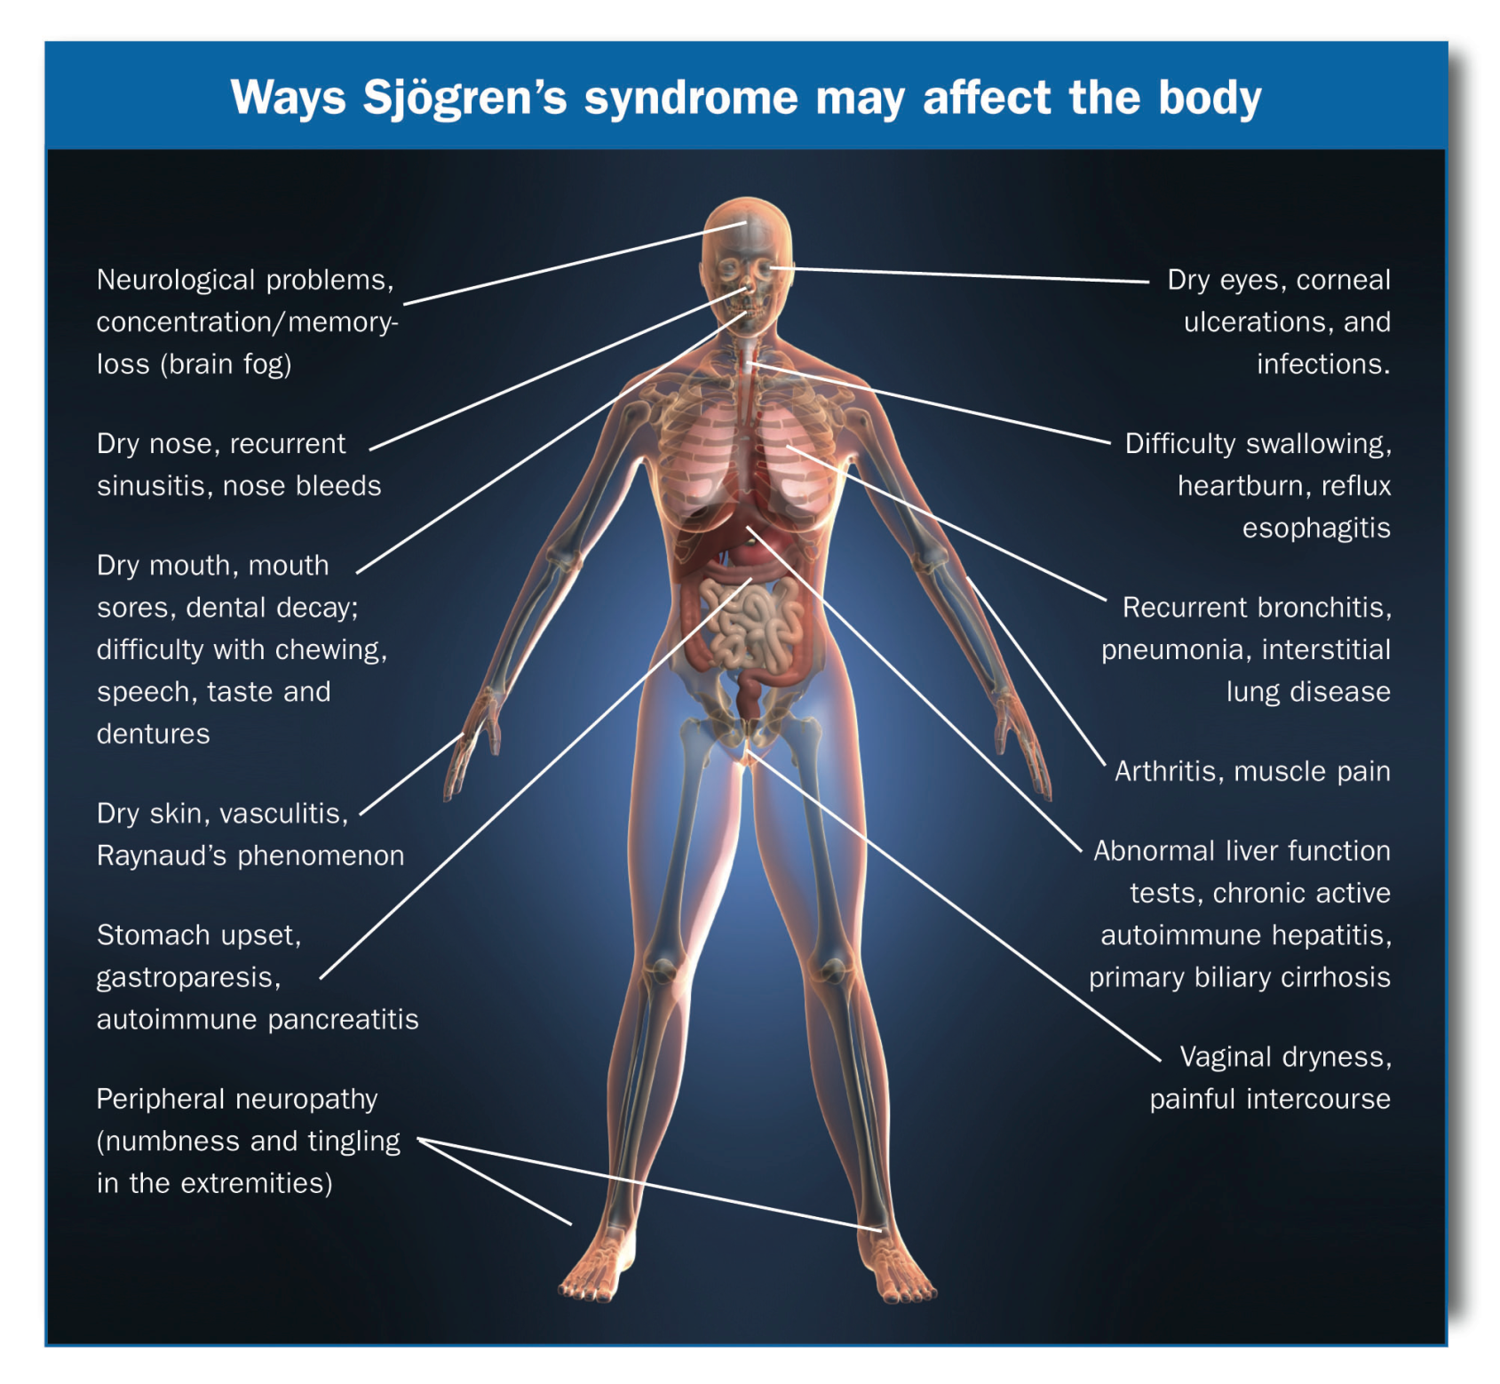
Notes:
Sjogren’s syndrome (SS) is a rheumatic autoimmune disease that is characterized by lymphocytic infiltration of the lacrimal and salivary glands, resulting in the hallmark symptoms of dry eye and dry mouth.
The classification criteria for SS has changed rapidly since 2002.
Takes 3 years to diagnose SS.
44 fold increase in lymphoma (usually non-Hodgkin’s B-cell lymphoma) compared with age and sex matched control
Affect up ot 5% of SS patients at any time during the disease course
The illustration on this slide depicts the major areas of the body that may be affected by Sjogren’s Syndrome.¹
http://www.sjogrens.org/home/about-sjogrens-syndrome/symptoms
The majority of Sjögren’s patients will have ocular and oral symptoms, however, it is important to recognize the clinical manifestation of the disease varies from patient to patient.
Refs:
1. http://www.sjogrens.org/home/about-sjogrens-syndrome/symptoms

Slide 31
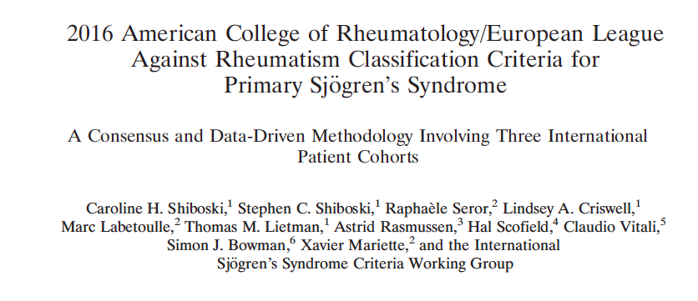
ACR, EULAR classification criteria for Sjögren’s syndrome
anti-Sjögren’-syndrome-related antigen A (anti-SSA/Ro) antibody positivity
focal lymphocytic sialadenitis with a focus score of at least 1 foci per 4 mm²
abnormal ocular staining score of at least 5 or a van Bijsterveld score of at least 4
Schimer’s test result of no greater than 5 mm per 5 minutes
an unstimulated salivary flow rate of no greater than 0.1 mL per minute
Notes:
Van Bijsterveld described a scoring system (rose Bengal) that divides the ocular surface into three zones: nasal bulbar conjunctiva, temporal bulbar conjunctiva, and cornea. Each zone is evaluated on a scale of 0 to 3, with 0 indicating no staining and 3 indicating confluent staining; the maximum possible score with this system is 9 (van Bijsterveld 1969).

Slide 32
ACR, EULAR classification criteria for Sjögren’s syndrome
anti-SSA/Ro and sialadenitis items
Weight of three
Remaining three items
Weight of one

Slide 33
Sjögren's Syndrome
Primary Sjögren’s syndrome
Any 4 of the 6 criteria
Must include either item IV (Histopathology) or VI (Autoantibodies)
Or any 3 of the 4 objective criteria (III, IV, V, VI)
Notes:
According to the European-American consensus group reported in 2002 in the Annals of Rheumatic Diseases, there are two forms of Sjögren's syndrome. Primary Sjögren’s syndrome includes aqueous-deficient dry eye, dry mouth with the presence of autoantibodies, reduced salivary secretion and a positive focus score on minor salivary gland biopsy. Secondary Sjögren’s syndrome involve all of the characteristics of primary Sjögren's syndrome. In addition, autoimmune connective tissue disease, most commonly rheumatoid arthritis is included. Nine out of ten patients with Sjögren’s are women.
Vitali C, Bombardieri S, Jonsson R, et al. Classification criteria for Sjo¨gren’s syndrome: a revised version of the European criteria proposed by the American-European consensus group. Ann Rheum Dis. 2002;61:55458.6.

Slide 34
Sjögren's Syndrome
Secondary Sjögren’s syndrome
All characteristics of Primary Sjögren's syndrome
+ another well-defined major connective tissue disease
The presence of one symptom (I or II)
And 2 of the 3 objective criteria (III, IV and V)
With autoimmune connective tissue disease
Most commonly rheumatoid arthritis
Nine out of ten patients with Sjögren’s are women
Notes:
According to the European-American consensus group reported in 2002 in the Annals of Rheumatic Diseases, there are two forms of Sjögren's syndrome. Primary Sjögren’s syndrome includes aqueous-deficient dry eye, dry mouth with the presence of autoantibodies, reduced salivary secretion and a positive focus score on minor salivary gland biopsy. Secondary Sjögren’s syndrome involve all of the characteristics of primary Sjögren's syndrome. In addition, autoimmune connective tissue disease, most commonly rheumatoid arthritis is included. Nine out of ten patients with Sjögren’s are women.
Vitali C, Bombardieri S, Jonsson R, et al. Classification criteria for Sjo¨gren’s syndrome: a revised version of the European criteria proposed by the American-European consensus group. Ann Rheum Dis. 2002;61:55458.6.

Slide 35
Sjögren's Syndrome
In both Primary and Secondary Sjögren’s syndrome
Lacrimal and salivary gland function and anatomy are altered by the immune cell infiltrate
Primary Sjögren’s
Pathogenesis involves complex interaction between genes and the environment
Recent large-scale Genome-Wide Association Study (GWAS)
Goal – Define genetic factors of KCS and focal lymphocytic sialoadenitis
Study of 3,334 Sjögren’s patients
Outcome – ocular and oral manifestations of Sjögren’s influenced by both shared and trait-specific genetic factors
★ Non-Hodgkin lymphoma occurs in 5-10% of primary Sjögren’s patients
Notes:
According to the European-American consensus group reported in 2002 in the Annals of Rheumatic Diseases, there are two forms of Sjögren's syndrome. Primary Sjögren’s syndrome includes aqueous-deficient dry eye, dry mouth with the presence of autoantibodies, reduced salivary secretion and a positive focus score on minor salivary gland biopsy. Secondary Sjögren’s syndrome involve all of the characteristics of primary Sjögren's syndrome. In addition, autoimmune connective tissue disease, most commonly rheumatoid arthritis is included. Nine out of ten patients with Sjögren’s are women.
Vitali C, Bombardieri S, Jonsson R, et al. Classification criteria for Sjo¨gren’s syndrome: a revised version of the European criteria proposed by the American-European consensus group. Ann Rheum Dis. 2002;61:55458.6.

Slide 36
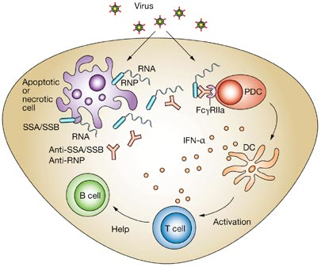
Sjögren's Syndrome
Traditional testing
Autoantibodies as diagnostic markers
Anti-Ro / SSA
70% positive in Sjögren’s patients
Anti – La / SSB
40% positive in Sjögren’s patients
Anti-nuclear antibodies (ANA)
70% positive in Sjögren’s patients
Rheumatoid Factor (RH)
Positive in many rheumatic diseases
Performed for the diagnosis of rheumatoid arthritis (RA)
Positive 60-70% of patients with Sjögren’s
Notes:
Traditional testing includes autoantibodies as diagnostic markers. Anti-Ro / SSA is positive in 70% of Sjögren’s patients. Anti – La / SSB is positive in 40% of Sjögren’s patients. Anti-nuclear antibodies (ANA) is positive in 70% of Sjögren’s patients. Rheumatoid Factor (RH) is positive in many rheumatic diseases and is performed for the diagnosis of rheumatoid arthritis (RA). It is positive in 60-70% of patients with Sjögren’s.
L. Shen, et al., Novel autoantibodies in Sjogren's syndrome, Clin. Immunol. (2012).

Slide 37
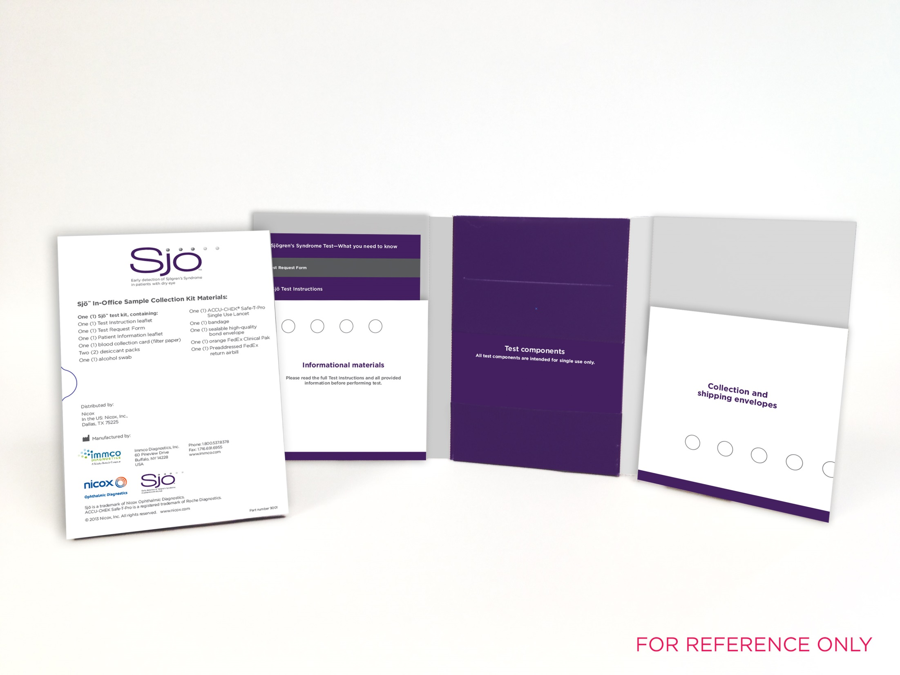
Sjögren's Syndrome
New studies - additional autoantibodies in Sjögren's Syndrome to
Salivary gland protein 1 (SP-1)
Carbonic anhydrase 6 (CA6)
Parotid secretory protein (PSP)
Occurred earlier in the course of the disease
Antibodies found in 45% of patients meeting the criteria for Sjögren's Syndrome who lacked antibodies to Ro or La
SP-1, CA6 and PSP
Useful markers to identify patients with Sjögren's Syndrome at early stages of the disease
Useful markers to identify those that lack antibodies to either Ro or La
Notes:
New studies propose additional autoantibodies in Sjögren's Syndrome to salivary gland protein 1 (SP-1), carbonic anhydrase 6 (CA6), and parotid secretory protein (PSP). Autoantibodies are present in two animal models for Sjögren's Syndrome. These occurred earlier in the course of the disease. Patients with Sjögren's Syndrome also produced antibodies to SP-1, CA6 and PSP. Antibodies were found in 45% of patients meeting the criteria for Sjögren's Syndrome who lacked antibodies to Ro or La. Specifically, SP-1, CA6 and PSP are useful markers to identify patients with Sjögren's Syndrome at early stages of the disease. These are useful markers to identify those that lack antibodies to either Ro or La.
L. Shen, et al., Novel autoantibodies in Sjogren's syndrome, Clin. Immunol. (2012).

Slide 38
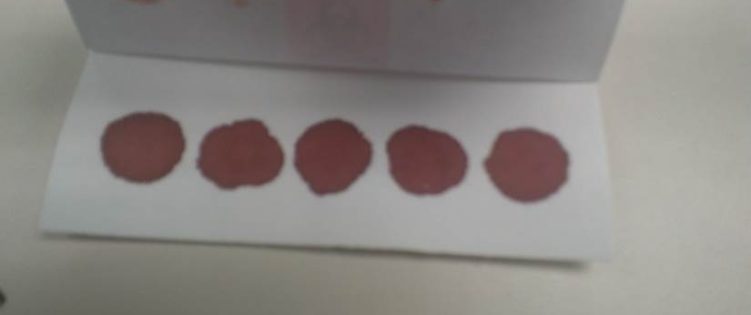
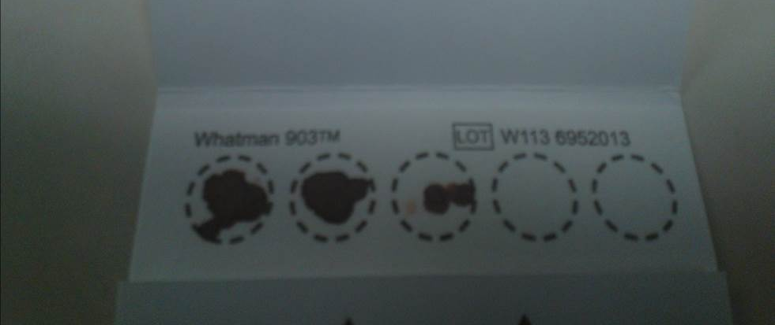
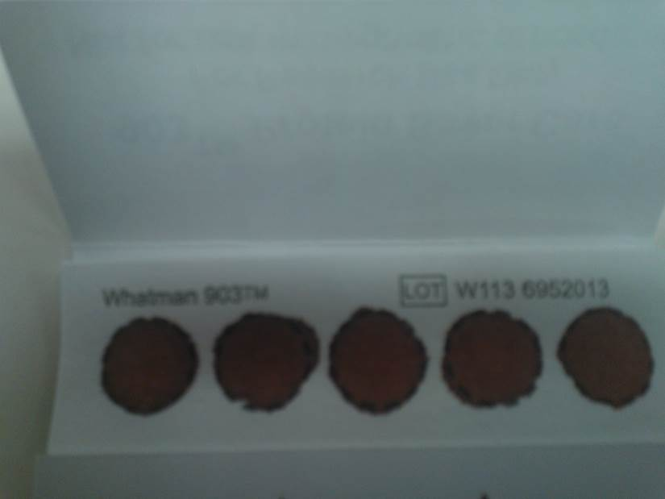
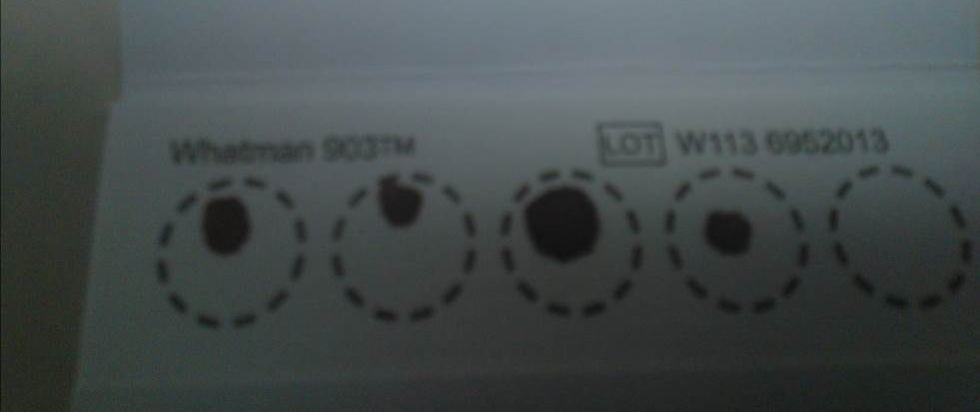
Sjö testing
Test done at local lab
Finger prick
Obtain a blood sample
Apply sample to the collection card
Send card to be analyzed
Notes:
The test is simple to perform. First, a finger prick is done to obtain a blood sample. Next, the sample is applied to a collection card. Finally, the card is analyzed. On the left are examples of excellent samples. On the right are examples of poor samples.

Slide 39
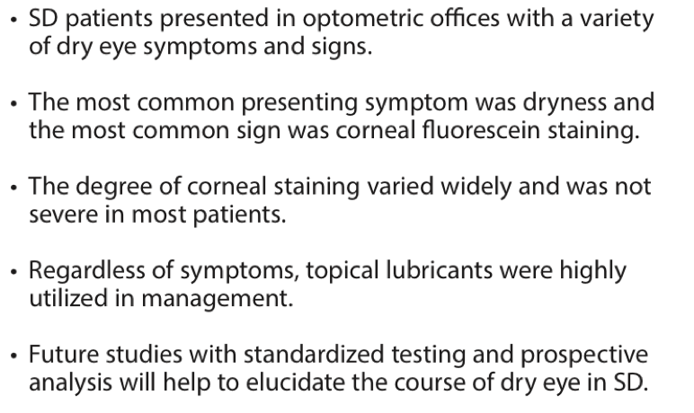
Notes:
Multi-center, cross-sectional, retrospective chart review
Describe signs and symptoms of DED in optometric practices

Slide 40
Notes:
No significant correlation between grade of corneal staining worst eye and patient age
No significant correlation between grade of corneal straining worst eye and years since diagnosis

Slide 41
Kathryn, 58 year old Caucasian Female
Eyes hurt, ache, feel sandy, feel swollen
Needs to blink to see better
Hard to read small print
No eyedrops used
Medical history significant for Sjögren’s disease
Referred by rheumatology for evaluation
Corrected VA
OD 20/20
OS 20/20

Slide 42
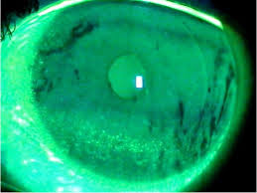
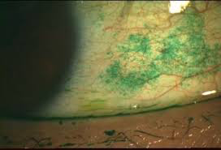
Kathryn Examination
1+ ptosis OU
OD 2+ nasal, 1+ temp NaF stain, 1+ nasal and temporal LG
OS 2+ nasal, 1+ temp NaF stain, 3+ nasal, 1+ temporal LG stain
OD trace inferior PEK
OS 1+ inferior PEK
Reduced tear meniscus OU
TBUT OD 3 seconds OS 4 seconds
Map dot fingerprint dystrophy OU
Normal intraocular pressures and retinal exam OU
Notes:
Picutures not of actual patient, demonstrate staining

Slide 43
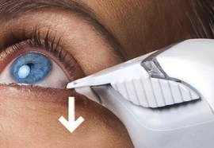
Kathryn Examination
Normal color vision OU
Normal Amsler grid OU
Normal OCT of macula OU
Normal 10-2 visual field OU
Tear Lab OD 318, OS 299
Normal intraocular pressures
Normal dilated examination OU

Slide 44
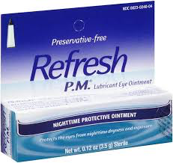
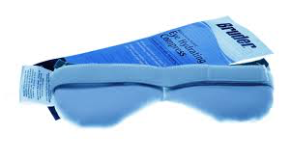
Kathryn Treatment
Monitor ptosis – not interested in surgical correction at this time
Eyelid hygiene including warm compresses
Cyclosporine 0.05% bid OU
Non-preserved Optive and Oasis artificial tears as needed
Lubricant ointment at night
Frequent breaks on the computer
HydroEye Omega 3 fatty acids
Monitor cataracts yearly

Slide 45
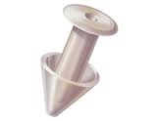
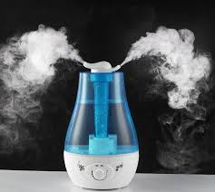
Kathryn
With time, added punctal plugs
Moisture goggles at night
Humidifier at night and near desk at work
Eyes much more comfortable
No dryness, no pain, no ache
Resolved sandy and swollen sensation
Vision improved

Slide 46
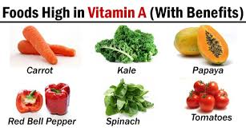
Vitamin A
Vital for corneal and conjunctival epithelial cell health
Necessary for the immune system to function
Needed for goblet cell and lacrimal gland production of a variety of mucins for the base layer of the tear film
Sources of Vitamin A
Red, orange, yellow, and dark green leafy vegetables
Odaka A, Toshida H, Ohta T, et al. Efficacy of retinol palmitate eye drops for dry eye in rabbits with lacrimal gland resection. Clin Ophthalmol. 2012;6:1585-93.
Ubels JL, Dennis MH, Rigatti BW, et al. Nuclear retinoic acid receptors in the lacrimal gland. Curr Eye Res. 1995 Nov;14(11):1055-62.
Ubels JL, MacRae SM. Vitamin A is present as retinol in the tears of humans and rabbits. Curr Eye Res. 1984 Jun;3(6):815-22.

Slide 47
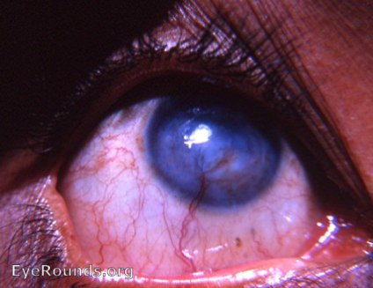
Vitamin A Deficiency
Begin as dry eyes
Progress to becoming the leading cause of preventable childhood blindness
Vitamin A deficiency almost never seen in the developed world
Reports of intentional vitamin A deficiency
A report from the 1960s
A man deliberately ate a vitamin A-deficient diet
Lived off of bread and lime juice for five years
His eyes developed corneal vascularization and ulceration of the cornea

Slide 48
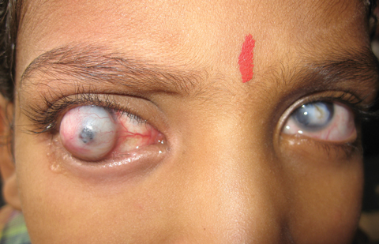
Vitamin A Deficiency
Report of a woman in a cult
Lived off of brown rice and herbal tea
Her eyes literally melted and collapsed
Report of autistic children
Refused to eat anything but French fries or exclusively bacon, blueberry muffins, and Kool-Aid
Became vitamin A deficient
Report from the Bronx
Child refused to eat vegetables
Ate only potato chips, puffed rice cereal with non-fortified soymilk, and juice drinks
Became vitamin A deficient
OD staphyloma OS leukoma
Ocular sequelae of vitamin A deficiency. Sunil Karande, Sujit Jagtap and Richard T Le Mesurier Med J Aust 2008; 188 (5): 308. || doi: 10.5694/j.1326-5377.2008.tb01628.x
Notes:
His right eye had a staphyloma and his left eye a leukoma
Ocular sequelae of vitamin A deficiency
Sunil Karande, Sujit Jagtap and Richard T Le Mesurier
Med J Aust 2008; 188 (5): 308. || doi: 10.5694/j.1326-5377.2008.tb01628.x Published online: 3 March 2008
A staphyloma is an abnormal protrusion of the uveal tissue through a weak point in the eyeball. The protrusion is generally black in colour, due to the inner layers of the eye. It occurs due to weakening of outer layer of eye (cornea or sclera) by an inflammatory or degenerative condition.
Leukoma
White opacity in the cornea of the eye.

Slide 49
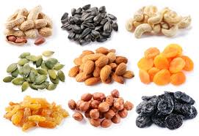
Vitamin B6
One of the nutrient co-factors required to push the metabolic pathway conversion of GLA to DGLA.^{1,2}
Required for the neuronal blink response.³
Sources of Vitamin B6
Nuts, bananas, and beans
1. Horrobin DF. Essential fatty acid and prostaglandin metabolism in Sjögren’s syndrome, systemic sclerosis and rheumatoid arthritis. Scand J Rheumatol Suppl. 1986;61:242-5.
2. Bordoni A, Hrelia S, Lorenzini A, et al. Dual influence of aging and vitamin B6 deficiency on delta-6-desaturation of essential fatty acids in rat liver microsomes. Prostaglandins Leukot Essent Fatty Acids. 1998 Jun;58(6):417-20.
3. Berman BD, Horovitz SG, Morel B, Hallett M. Neural correlates of blink suppression and the buildup of a natural bodily urge. Neuroimage. 2012 Jan 16;59(2):1441-50.

Slide 50
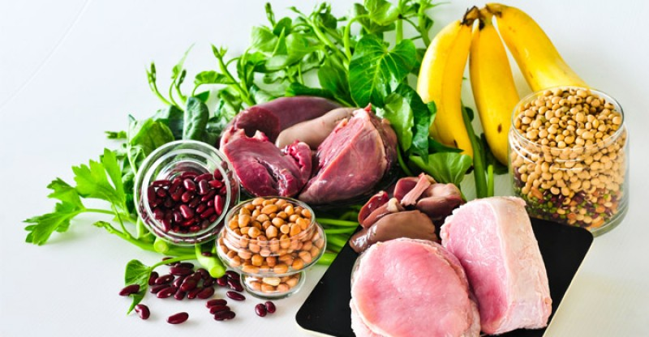
Vitamin B 12
Also called cobalamin
Water-soluble vitamin
Involved in the metabolism of every cell of the human body
Cofactor in DNA synthesis, and in fatty acid and amino acid metabolism
Sources
Fish, meat, poultry, eggs, milk
Clams, sardines, tuna
Yamada K (2013). "Chapter 9. Cobalt: Its Role in Health and Disease". In Sigel A, Sigel H, Sigel RK. Interrelations between Essential Metal Ions and Human Diseases. Metal Ions in Life Sciences.
13. Springer. pp. 295–320. doi:10.1007/978-94-007-7500-8_9. ISBN 978-94-007-7499-5. PMID 24470095.

Slide 51
Vitamin B12 deficiency and neuropathic ocular pain (NOP)
Study of vitamin B12 deficiency on NOP and symptoms in patients with DED
90 patients with severe DED without using ATs
Group 1 (n =45)
Severe DED and vitamin B12 deficiency
Received parenteral vitamin B12 supplement + topical treatment (ATs + cyclosporine)
Group 2 (n =45)
Severe DED and normal serum vitamin B12 level
Received only topical treatment (ATs + cyclosporine)
Ozen S, Ozer MA, Akdemir MO. Vitamin B12 deficiency evaluation and treatment in severe dry eye disease with neuropathic ocular pain.
Graefes Arch Clin Exp Ophthalmol. 2017 Mar 15. doi: 10.1007/s00417-017-3632-y. [Epub ahead of print]
Notes:
parenteral = IV

Slide 52
Vitamin B12 deficiency and neuropathic ocular pain
OSDI score
3rd OSDI question score (have you experienced painful or sore eyes during last week?)
TBUT
Schirmer’s
Improved after 12 weeks (p < 0.001 for each group)
Group 1 mean vitamin B12 level at enrollment was 144.24 ±43.36 pg/ml
Group 2 mean vitamin B12 level at enrollment was 417.53 ±87.22 pg/ml
Group 1 reached 450 ±60.563 pg/ml after 12 weeks of treatment
Ozen S, Ozer MA, Akdemir MO. Vitamin B12 deficiency evaluation and treatment in severe dry eye disease with neuropathic ocular pain.
Graefes Arch Clin Exp Ophthalmol. 2017 Mar 15. doi: 10.1007/s00417-017-3632-y. [Epub ahead of print]

Slide 53
Vitamin B12 deficiency and neuropathic ocular pain
The decrease in the OSDI questionnaire score (-30.80 ±5.24) and 3rd OSDI question score (-2.82 ±0.53) were remarkable in group 1
Findings indicate that vitamin B12 deficiency is related with NOP
★ Consider measuring the serum vitamin B12 level in patients with severe DED presenting with resistant ocular pain despite taking topical treatment
Ozen S, Ozer MA, Akdemir MO. Vitamin B12 deficiency evaluation and treatment in severe dry eye disease with neuropathic ocular pain.
Graefes Arch Clin Exp Ophthalmol. 2017 Mar 15. doi: 10.1007/s00417-017-3632-y. [Epub ahead of print]

Slide 54
Vitamin C
Vitamin C as ascorbyl palmitate (fat-soluble form) modulates PGE1 synthesis
This vitamin C form enhances the production of IgE concentrates in tears, the first line of basophil and mast cell defense against invading pathogens and allergens that frequently cause dry eye symptoms
Sources of Vitamin C
Citrus
Horrobin DF, Campbell A. Sjögren’s syndrome and the sicca syndrome: the role of prostaglandin E1 deficiency. Treatment with essential fatty acids and vitamin C.
Med Hypotheses. 1980 Mar;6(3):225-32.

Slide 55
Vitamin D
Improves tear hyperosmolarity ^{1,2}
Should be included in all formulations that include vitamin A due to an increased risk of fractures in older patients taking large amounts of supplemental vitamin A
However, up to 50% of the world's population may not get enough sun, and 40% of US residents are deficient in vitamin D ^{3,4}
Sources of Vitamin D
Salmon, herring, sardines, canned tuna, oysters, shrimp, egg yolks, mushrooms
1. Bosetti M, Sabbatini M, Calarco A, et al. Effect of retinoic acid and vitamin D3 on osteoblast differentiation and activity in aging. J Bone Miner Metab. 2016 Jan;34(1):65-78.
2. Kizilgul M, Kan S, Ozcelik O, et al. Vitamin D replacement improves tear osmolarity in patients with vitamin D deficiency. Semin Ophthalmol. 2018;33(5):589-594.
3. Haq A, Svobodová, Imran S, et al. Vitamin D deficiency: A single centre analysis of patients from 136 countries. J Steroid Biochem Mol Biol. 2016 Nov;164:209-213. doi: 10.1016/j.jsbmb.2016.02.007. Epub 2016 Feb 11.
4. Forrest KY, Stuhldreher WL. Prevalence and correlates of vitamin D deficiency in US adults. Nutr Res. 2011 Jan;31(1):48-54. doi: 10.1016/j.nutres.2010.12.001.
Notes:
rmat: Abstract
Send to
Int J Reprod Biomed (Yazd). 2019 Nov 7;17(10):685-708. doi: 10.18502/ijrm.v17i10.5284. eCollection 2019 Oct.
The prevalence of hypovitaminosis D and its risk factors in pregnant women and their newborns in the Middle East: A systematic review.
Hajizadeh S¹, Rankin Shary J¹, Gayle Reed S¹, Lynn Wagner C¹.
Author information
1Department of Pediatrics, Medical University of South Carolina, Charleston, SC.
Abstract
BACKGROUND:
Pregnant women and newborns are at risk for vitamin D deficiency (VDD). Also, poor health outcomes for pregnant women with VDD are reported in the published literature.
OBJECTIVE:
Systematic review was to estimate the prevalence of hypovitaminosis D and the associated risk factors for hypovitaminosis D in Middle Eastern pregnant women and their newborns.
RESULTS:
The prevalence of circulating 25-hydroxyvitamin D (25(OH)D) < 50 nmol/L as a marker of vitamin D status in pregnant women and their newborns was between 24.5-98% and 22-100%, respectively. The prevalence of 25(OH) D < 25 nmol/L in pregnant women and their newborns was over a wide range between 16.7-80% and 22-82%, respectively. Predictors for low maternal and neonatal 25(OH)D concentrations included decreased vitamin D synthesis due to reduced exposure to sunlight and decreased nutritional intake of vitamin D. A predictor of low neonatal 25(OH)D concentrations included maternal vitamin D status and the correlation between vitamin D concentrations in maternal and cord blood.
CONCLUSION:
The high prevalence of VDD in the pregnant women of the Middle East underscores the necessity of implementing national prevention and intervention strategies. A clear policy for clinicians and healthcare workers is needed for screening and maintaining sufficient vitamin D status during pregnancy.

Slide 56
Vitamin E
Helps prevent or slow lipid oxidation
Recommend to include in all fatty acid-based formulations including any formulation that includes flaxseed oil or fish oil
Sources of Vitamin E
Cooking oils, nuts, sunflower seeds, almonds, hazelnuts, abalone, pine nuts, salmon, peanuts, avocado, raw peppers, mango
Jiang Q, Elson-Schwab I, Courtemanche C, Ames BN. gamma-tocopherol and its major metabolite, in contrast to alpha-tocopherol, inhibit
cyclooxygenase activity in macrophages and epithelial cells. Proc Natl Acad Sci U S A. 2000 Oct 10;97(21):11494-9.

Slide 57
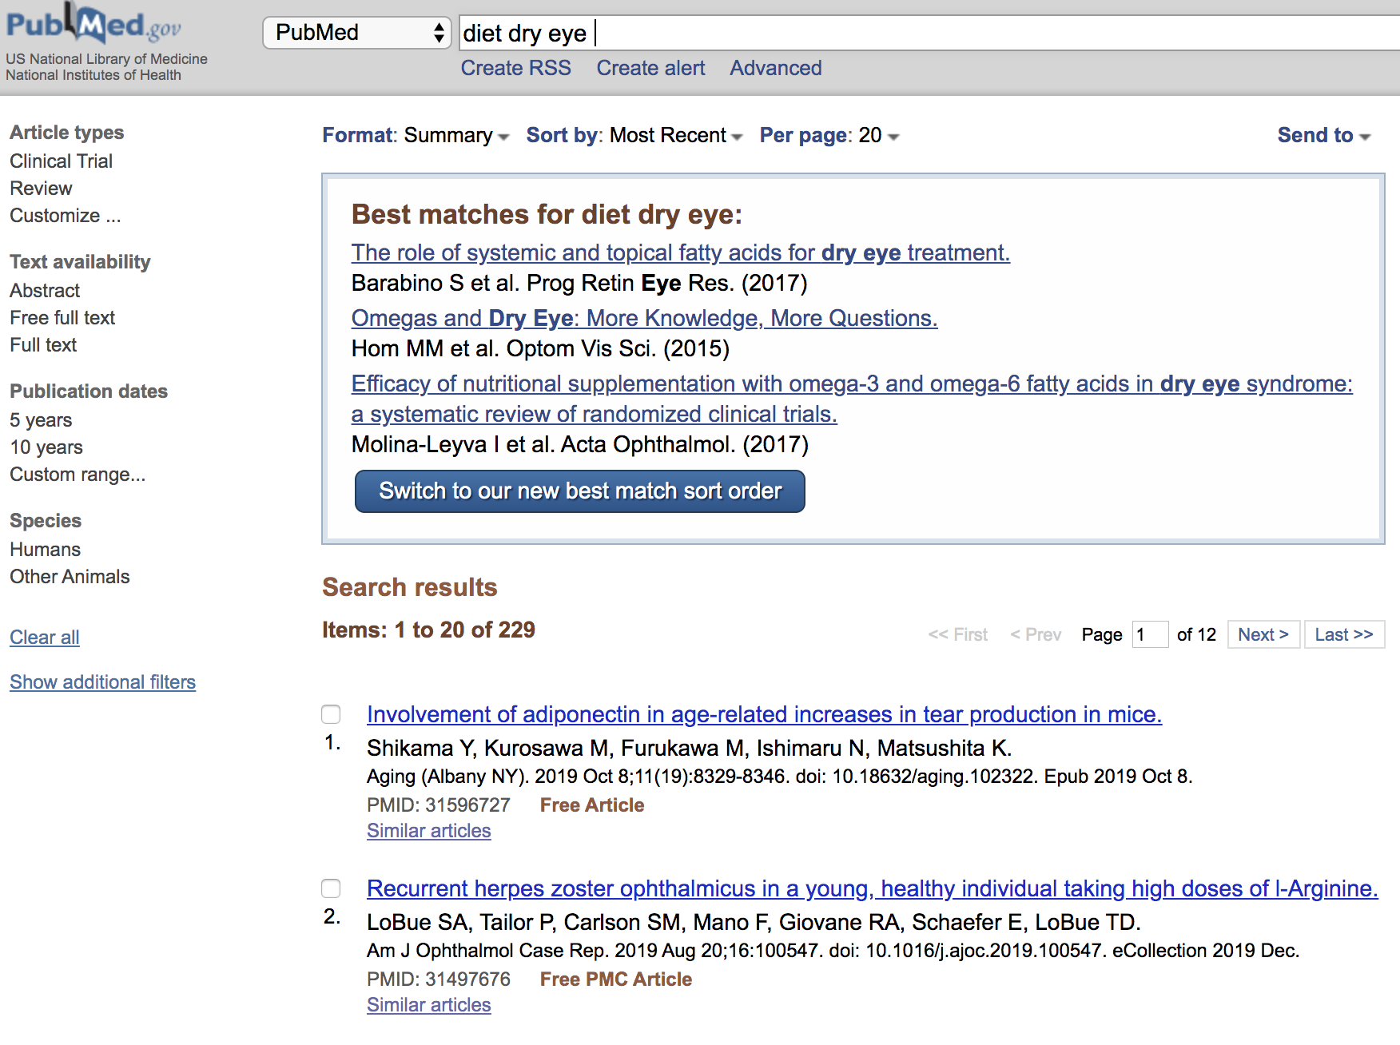
Which diet is best for dry eye?
Plant based diet
Paleo diet
Vegan
Gluten free
Whole 30
Notes:
229 studies
paleo on L
vegan on R

Slide 58
The Dry Eye Diet
Lower protein, total fat, and cholesterol intake
And
Increase complex carbohydrates
Increase vitamin A content (red, orange, yellow, and dark green leafy vegetables)
Increase zinc and folate intake (whole grains, beans, raw vegetables, especially spinach)
Ensure sufficient vitamin B6 and potassium intake (by eating nuts, bananas, and beans)
Ensure sufficient vitamin C intake (by eating citrus)
Eliminate alcohol and caffeine
Reduce sugar and salt intake
Consume six to eight glasses of water per day
Notes:
reduce total fat and cholesterol intake
drink 6-8 glasses of water per day

Slide 59
Study to evaluate the effects of a 2-month lifestyle intervention for DED in office workers.
Prospective interventional RCT
41 middle-aged Japanese office workers (22 men, 19 women, 39.2 ± 8.0 years) with DED
Two groups
Intervention group (n = 22)
Diet modification, increase physical activity, positive thinking
Control group (n = 19)

Slide 60
Primary outcome
Change in DED diagnoses
Secondary outcome
Change in disease parameters - dry eye symptoms (Dry Eye-Related Quality of Life Score), corneal and conjunctival staining scores, TBUT, and Schirmer test results.
2-month lifestyle intervention
Improved dry eye disease
Considerable decrease in subjective symptoms
★ Lifestyle intervention may be a promising management option for DED
Notes:
A total of 36 participants (intervention group, 17; control group, 19) completed the study. The number of definite dry eye disease diagnoses decreased from four to none (p =.05), and the dry eye symptom score showed a significant decrease in the intervention group (p =.03). In contrast, the corneal and conjunctival staining scores, tear break-up time, and Schirmer test results did not differ significantly between groups.

Slide 61
Tumeric and Dry Eye
Curcumin properties
anti-oxidant, anti-inflammatory, anti-angiogenic and wound-healing
anti-tumor (breast, prostate, lung, pancreas, ovary, bladder, cervix, head and neck, brain, kidney and skin)
Curcumin can help prevent corneal neovascularization
Curcumin blocks various growth factors and cytokines which can lead to nv
Curcumin helps wound healing on the cornea
Curcumin inhibits inflammatory cytokines which can then decrease the feedback loop which causes dry eye disease

Slide 62
No more coffee?

Slide 63
The effect of caffeine on tear secretion
Caffeine is the most widely consumed psychoactive substance
Conflicting effects on tear film dynamics
Orally ingested caffeine on tear secretion
Examiner-masked, placebo-controlled, crossover experimental study
Effect of caffeine intake on tear secretion
Osei KA, Ovenseri-Ogbomo G, Kyei, et al. The effect of caffeine on tear secretion. Optom Vis Sci. 2014 Feb;91(2):171-7. doi: 10.1097/OPX.0000000000000129.

Slide 64
The effect of caffeine on tear secretion
41 healthy volunteers
Aged 20 to 26 years (mean, 23.0 ± 2.1 years)
Randomly assigned into two groups, A and B
Two different treatments in two sessions
Subjects in group A – visit 1
5.0 mg/kg body weight of caffeine dissolved in 200 mL of water
Subjects in group B – visit 1
200 mL of water
Visit 2 – order of treatment was reversed
Osei KA, Ovenseri-Ogbomo G, Kyei, et al. The effect of caffeine on tear secretion. Optom Vis Sci. 2014 Feb;91(2):171-7. doi: 10.1097/OPX.0000000000000129.

Slide 65
The effect of caffeine on tear secretion
Schirmer 1 scores
Measured repeatedly at 45, 90, 135, and 180 minutes after treatment
Baseline Schirmer 1 scores compared with posttreatment scores
Schirmer 1 scores increased after caffeine intake.
Statistically significant at 45 and 90 minutes (p < 0.05) after caffeine intake.
No influence of gender in caffeine's effect on tear secretion (F = 0.994, p = 0.399)
★ Orally ingested caffeine appears to stimulate tear secretion in healthy non-dry eye subjects.
Osei KA, Ovenseri-Ogbomo G, Kyei, et al. The effect of caffeine on tear secretion. Optom Vis Sci. 2014 Feb;91(2):171-7. doi: 10.1097/OPX.0000000000000129.

Slide 66
Drink water!
Mild dehydration makes dry eye problems worse.
Especially during hot, dry and windy weather
Drink more water to reduce the symptoms of dry eye syndrome

Slide 67
Microbiome and Ocular Health
Microbiome and human health.¹
Gut microbiota is significant in health and disease.³⁻⁶
An average human body harbors as many microbial species as human cells.²
Many studies have linked microbiome to cancer, obesity, asthma, artherosclerosis, and diabetes.
1. Peterson CT, Sharma V, Elmen L, Peterson SN. Immune homeostasis, dysbiosis and therapeutic modulation of the gut microbiota. Clin Exp Immunol. 2015;179:363–77.
2. Sender R, Fuchs S, Milo R. Are we really vastly outnumbered? Revisiting the ratio of bacterial to host cells in humans. Cell. 2016;164:337–40.
3. Viaud S, Daillere R, Boneca IG, et al. Gut microbiome and anticancer immune response: really hot Sh*t! Cell Death Differ. 2015;22:199–214.
4. Ohtani N. Microbiome and cancer. Sem Immunopathol. 2015;37:65–72.
5. Sanz Y, Olivares M, Moya-Perez A, Agostoni C. Understanding the role of gut microbiome in metabolic disease risk. Pediatr Res. 2015;77:236–44.
6. SanMiguel A, Grice EA. Interactions between host factors and the skin microbiome. Cell Mol Life Sci. 2015;72:1499–515.
Notes:
Nature 2014
Human Microbiome Project
2 year study
genetic sequence of bacteria harvested from more than 240 individuals
identified more than 5 million genes that could play an important role in strategies for improving health.

Slide 68
“What are the characteristics of the healthy ocular microbiota and how do they change during disease?”
Healthy conjunctiva, lid margins, and tears
Fewer microbial species than other mucosal sites like oral mucosal surfaces
Most common species from conjunctival surfaces in humans
Coagulase Negative Staphylococcus sp (CNS sp), including Staphylococcus epidermidis
Isolated from
20–80% of conjunctival swabs
30–100% of lid margin swabs
Less frequently present microbial species
Propionibacterium sp(P. acnes), Corynebacterium sp, S. aureus, Streptococcus sp, Micrococcus sp, Baccilus sp, and Lactobacillus sp
Campos MS, Campos e Silva Lde Q, Rehder JR, et al. Anaerobic flora of the conjunctival sac in patients with AIDS and with anophthalmia compared with normal eyes. Acta Ophthalmol. 1994;72:241–5. Elander TR, Goldberg MA, Salinger CL, et al. Microbial changes in the ocular environment with contact lens wear. CLAO J. 1992;18:53–5.
Graham JE, Moore JE, Jiru X, et al. Ocular pathogen or commensal: a PCR-based study of surface bacterial flora in normal and dry eyes. Invest Ophthalmol Vis Sci. 2007;48:5616–23.
Willcox MD. Characterization of the normal microbiota of the ocular surface. Exp Eye Res. 2013;117:99–105.
Hsu HY, Lind JT, Tseng L, Miller D. Ocular flora and their antibiotic resistance patterns in the midwest: a prospective study of patients undergoing cataract surgery. Am J Ophthalmol. 2013;155:36–44 e2.
Ozkan J, Zhu H, Gabriel M, et al. Effect of prophylactic antibiotic drops on ocular microbiota and physiology during silicone hydrogel lens wear. OptomVis Sci. 2012;89:326–35.
Notes:
microbial presence changes with sex and aging. The majority of studies conducted did not evaluate sex or age-specific differences.

Slide 69
Proteomic analysis of tear fluid in DED
Showed specific alterations in the protein signature
Several downregulated proteins had bactericidal activities
Lactotransferrin
Lysozyme
Polymeric immunoglobulin receptor
Lacritin
Is there a connection between the ocular commensal microbiota and the state of the ocular surface barrier?
Only few studies to date
Karnati R, Laurie DE, Laurie GW. Lacritin and the tear proteome as natural replacement therapy for dry eye. Exp Eye Res. 2013;117:39–52.

Slide 70
Association between ocular microbiota and OSD
More extensive bacterial loads in patients with Sjogren Syndrome than healthy controls.¹
Increased bacterial presence of CNS species in addition to other common commensals such as Corynebacterium and Propionibacterium in non-autoimmune dry eye disease.²
The expanding applicability of deep sequencing approaches will provide insights to whether alterations of ocular surface microbiota correlate with the development of DED.³
1. Albietz JM, Lenton LM. Effect of antibacterial honey on the ocular flora in tear deficiency and meibomian gland disease. Cornea. 2006;25:1012–9.
2. Graham JE, Moore JE, Jiru X, et al. Ocular pathogen or commensal: a PCR-based study of surface bacterial flora in normal and dry eyes. Invest Ophthalmol Vis Sci. 2007;48:5616–23.
3. Narayanan S, Redfern RL, Miller WL, et al. Dry eye disease and microbial keratitis: is there a connection? Ocul Surf. 2013;11:75–92.

Slide 71
Ask about diet when evaluating DED
Discuss supplementation
Review caffeine and water intake
The eyes will thank you
Thank you for your time and attention!

