Slide 1

The Latest Online Tools and Resources from the IRIS Center
2015 OSEP Virtual Project Directors’ Conference
The IRIS Center is funded through a cooperative agreement U.S. Department of Education, Office of Special Education Programs (OSEP) Grant #H325E120002. The contents of this presentation do not necessarily represent the policy of the U.S. Department of Education, and you should not assume endorsement by the Federal Government. Project Officers, Sarah Allen and Tracie Dickson.

Slide 2
What is IRIS?
A national center, funded by the U.S. Department of Education’s Office of Special Education Programs
A resource for personnel preparation and development
A Website that provides collections of free instructional materials and resources about evidence-based practices for all students, particularly those with disabilities ages birth to 21
A technical assistance (TA) provider offering training and dissemination activities for college faculty, professional development providers, and independent learners

Slide 3
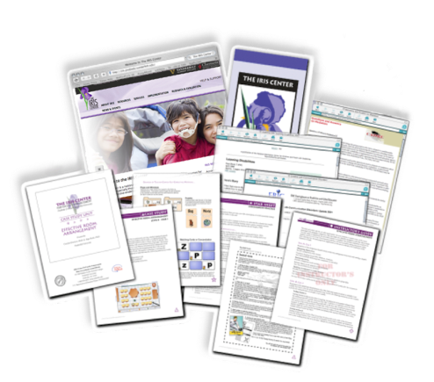
What Does IRIS Provide?
An Array of Resources for Adult Learning:
  Modules
  Case Studies
  Activities
  Information Briefs
  Interviews (Podcasts)
  Glossary
  Video Vignettes
  Annotations of EBPs (New!)
  Book Tool (New!)
Notes:
3

Slide 4
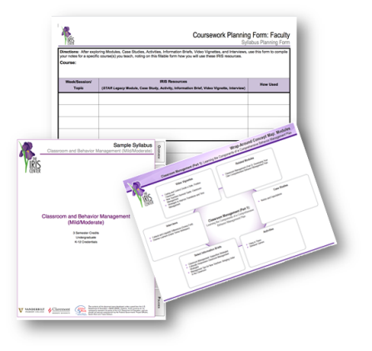
What Does IRIS Provide?
Resources to Support College Instruction and PD Activities:
  Alignment to Standards
  Wrap-Around Concept Maps
  Sample College Syllabi
  Coursework Planning Forms
  Sample Curriculum Matrices
Notes:
4

Slide 5

Resources About Working with Children
Age Group/Grades
  Ages 0-2
  Ages 3-5
  Elementary
  Middle
  High
  Ages 18-21

Slide 6

IRIS’ Four Rs of Research
The IRIS Center’s resources are:
  Grounded in research theory
  Translate research to practice
  Are data-driven and informed by research
  Are proven effective by research
How People Learn Theory

Slide 7
IRIS Resource Topics
Accommodations
Assessment
Assistive Technology
Behavior and Classroom Management
Collaboration
Content Instruction
Differentiated Instruction
Disability
Diversity
Early Intervention / Early Childhood
Learning Strategies
Mathematics
Reading, Literacy, Language Arts
Related Services
RTI
School Improvement / Leadership
Transition

Slide 8
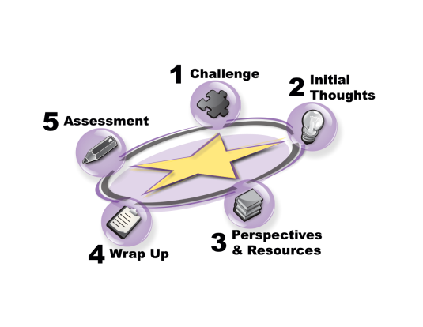
IRIS Modules
How People Learn Theory
STAR Legacy Cycle

Slide 9
Newest Modules
Evidence-Based Practices (Part 1): Identifying and Selecting a Practice or Program
Evidence-Based Practices (Part 2): Implementing a Practice or Program with Fidelity
Evidence-Based Practices (Part 3): Evaluating Learner Outcomes and Fidelity
Early Childhood Behavior Management: Developing and Teaching Rules

Slide 10
IRIS Modules: Content Format
Information is presented in a variety of formats:
  Text
  Tables
  Expert Interviews
  Videos
  Interactive Activities
  Supporting Research
  Links to Other Resources

Slide 11
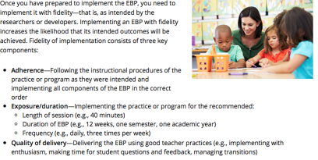
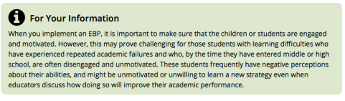
IRIS Modules: Text
From Evidence-Based Practices (Part 2): Page 4

Slide 12
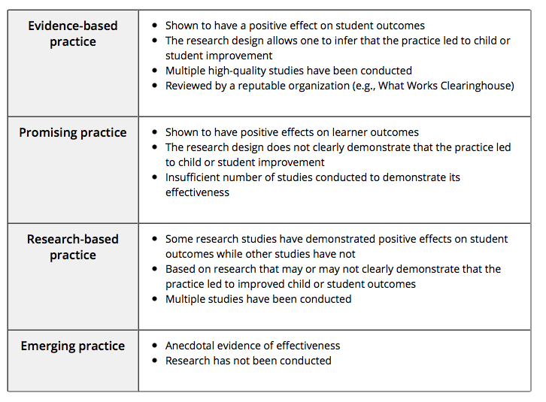
IRIS Modules: Tables
From Evidence-Based Practices (Part 1): Page 1

Slide 13

IRIS Modules: Expert Interviews
From Evidence-Based Practices (Part 1): Page 7

Slide 14
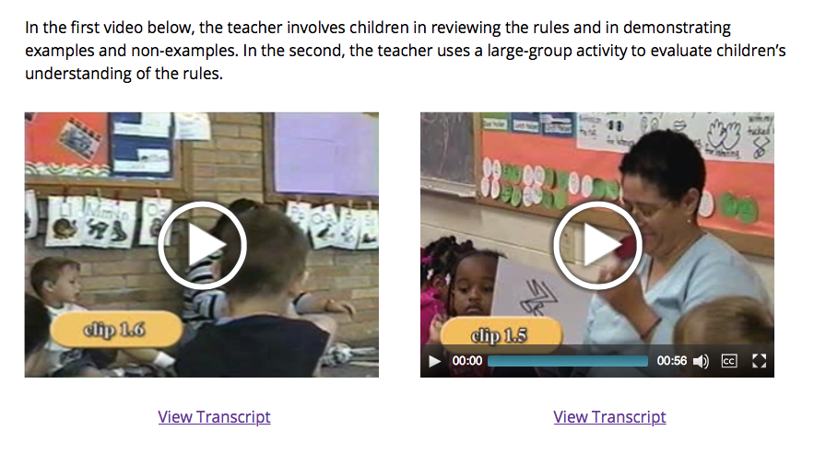
IRIS Modules: Demonstration Videos
From Early Childhood Behavior Management: Page 4

Slide 15
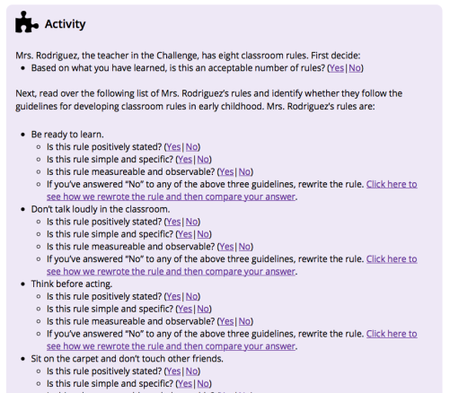
IRIS Modules: Interactive Activities
From Early Childhood Behavior Management: Page 3

Slide 16
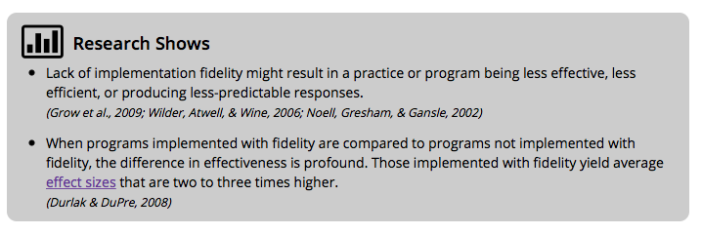
IRIS Modules: Supporting Research
From Evidence-Based Practices (Part 2): Page 1

Slide 17
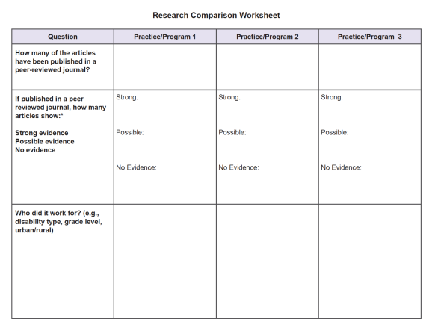
IRIS Modules: Downloadable Resources
From Evidence-Based Practices (Part 1): Page 7

Slide 18
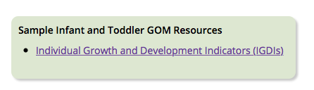
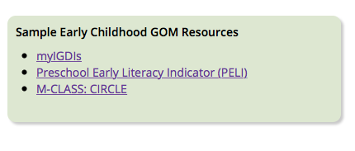
IRIS Modules: Links to Other Resources
From Evidence-Based Practices (Part 3): Page 2

Slide 19
Upcoming Modules
Early Childhood: Setting Up Environments
Early Childhood: Working with Dual-Language Learners
Autism Spectrum Disorders: Characteristics and Diagnoses
Data-based Individualization: Data
Data-based Individualization: Academic Interventions

Slide 20
Contact Us
Resources / Website
IRIS@VU
Phone: (800) 831-6134
Email: iris@vanderbilt.edu
Training / Technical Assistance
IRIS@CGU
Phone: (866) 626-4747
Email: iris@cgu.edu
Website
http://iris.peabody.vanderbilt.edu/ or http://www.iriscenter.com

