Slide 1
Implementing Intensive Intervention to Support Struggling Students
Amy Peterson,
ampeterson@air.org
National Center on Intensive Intervention, www.intensiveintervention.org
This presentation was produced under the U.S. Department of Education, Office of Special Education Programs, Award No. H326Q110005. Celia Rosenquist serves as the project officer. The views expressed herein do not necessarily represent the positions or polices of the U.S. Department of Education. No official endorsement by the U.S. Department of Education of any product, commodity, service or enterprise mentioned in this website is intended or should be inferred.

Slide 2
Abstract
Schools in nearly all states are planning, developing, or implementing some form of a multitiered system of support to improve student outcomes (Berkeley, Bender, Peaster, & Saunders, 2009).
These supports are not universally successful; approximately three to five percent of the general K–12 school population requires intensive academic or behavioral interventions (e.g., Al Otaiba & Fuchs, 2006; National Center on Intensive Intervention, 2013; Wanzek & Vaughn, 2010).
The National Center on Intensive Intervention’s (NCII) approach to intensive intervention is data-based individualization (DBI).
The poster will share information about DBI, provides a case example of a student receiving support through the DBI process within one of our technical assistance sites, and describes lessons learned from our technical assistance work to date.

Slide 3
The Challenge
Recent and historical data indicate that students with disabilities:
Perform below peers on measures of academic achievement (e.g., NCES, 2013),
Dropout of high school at higher rates (Aud et al., 2012), and
Are more likely than peers to be arrested (Sanford et al., 2011).
NAEP Reading, Percentage of Fourth-Grade Students at or Above “Proficient” (1998–2013)
Students w/ no identified disability
Students w/ disabilities
Source: National Center on Education Statistics (2013). NAEP Data Explorer. Retrieved from http://nces.ed.gov/nationsreportcard/naepdata/).
Notes:
Eleven percent of fourth-graders with disabilities performed at or above the “Proficient” level on the NAEP in 2013, compared to 38 percent of their non-disabled peers. This proficiency rate is down from 13 percent in 2009 (p < .05). Continuing a decade-long trend, recent NAEP results show that only 7% of eighth-grade students with Individualized Education Programs (IEPs) were proficient in math, and only 6% were proficient in reading (NAEP Data Explorer, 2013). With scores unchanged from 2011, NAEP data highlight a discrepancy of 31 percentage points between IEP students and total student performance (The Special Ed Connection, November 12, 2013). Whether measured by grade level proficiency, grade-point average, or credits earned, students with disabilities consistently fall behind their classmates (Blackorby et al., 2007; Council for Exceptional Children, 2013;Newman et al., 2011a; USED, 2012b; Wagner et al., 2006).
In general, students with disabilities have a much higher dropout rate (26.2%, compared to a 7% status dropout rate for all students in 2010). Students in the Emotional Disturbance category had the highest dropout rate of all disability categories (44.9%), followed by Learning Disabilities (25.1%).
Twenty-three percent of young adults with disabilities have been arrested at least once, almost twice the rate for youth in the general population (12 percent; p < .001). Rates for arrest and parole are highest among students identified as having Emotional Disturbance (49.4 percent). (Sanford et al., 2011)

Slide 4
NCII’s Approach to Intensive Intervention
Data-Based Individualization (DBI) is a research-based process for individualizing and intensifying interventions through the systematic use of assessment data, validated interventions, and research-based adaption strategies.
DBI is not a single intervention program/strategy or one-time fix, but an ongoing process.
DBI uses data to determine when and how to provide more intensive intervention.
DBI can be used to support
Students with disabilities who are not making adequate progress
Students who present with very low academic achievement and/or high-intensity or high-frequency behavior problems
Students nonresponsive to secondary intervention delivered with fidelity
Notes:
DBI has its origins in data-based program modification/experimental teaching were first developed at the University of Minnesota (Deno & Mirkin, 1977) and expanded upon by others (Capizzi & Fuchs, 2005; Fuchs, Deno, & Mirkin, 1984; Fuchs, Fuchs, & Hamlett, 1989). The DBI process rests on the following assumptions:
Validated programs are not universally effective programs. 3-5% of students need more help (Fuchs et al., 2008; NCII, 2013).
Students with intensive needs often require 10-30 times more practice than peers to learn new information (Gersten et al., 2008).
SWDs requiring special education need specially designed instruction to progress toward standards.
A data-driven, systematized approach can help educators develop programs likely to yield success for students with intensive needs.
DBI is a distinctively different and more intensive approach to intervention, compared to primary prevention’s (Tier 1’s) core program and secondary prevention’s (Tier 2’s) validated, supplementary programs (NCII, 2013).
In a longstanding program of field-based randomized control trials, DBI has demonstrated improved reading, math, and spelling outcomes, compared to business-as-usual special education practice (e.g., Fuchs et al., 1989).

Slide 5
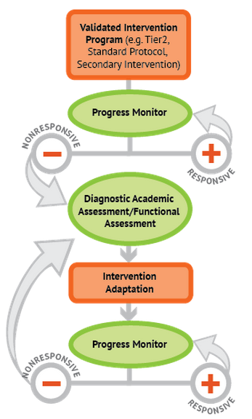
The DBI Process: Key Components
Start with a strong, validated, evidence-based secondary intervention program.
Gather student progress monitoring data frequently and identify whether they are responding at sufficient rate.
Use diagnostic assessment or functional assessments, if nonresponsive, to identify skill deficits and the nature of change that is needed.
Adapt the intervention to meet student needs using multiple data sources.
Continue monitoring progress, with adaptations occurring as needed to ensure adequate progress
Notes:
Secondary intervention program, delivered with greater intensity
Progress monitoring
Diagnostic assessment
Adaptation
Continued progress monitoring, with adaptations occurring as needed to ensure adequate progress

Slide 6
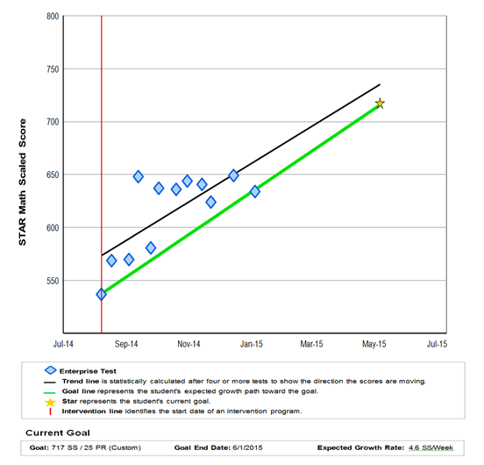
DBI In Action: Reviewing Progress Monitoring Data
The team representing special education teacher, special education director, math interventionist, PD Coordinator, & NCII Coaches met to discuss progress
The team used note-taking template (e.g., http://www.intensiveintervention.org/tools-support-intensive-intervention-data-meetings) to facilitate conversation, review data, and make individual student plan
The analysis suggests:
Student seemed to be plateauing.
“Gets” academic content but struggles with fluency.
Identified potential self-regulation challenges and triggers based on conflict with teacher in previous period.

Slide 7
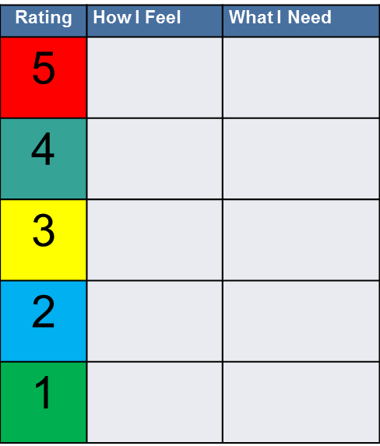
DBI In Action: Developing an Individualized Plan
Team brainstormed potential intensification strategies.
Plan:
Modify antecedents (change homeroom or move fluency work to later in period) to prevent “triggering” student.
Teach emotional awareness and self-regulation explicitly using the Incredible Five-Point Scale.
Team identified a date for next meeting and continue to monitor progress.
Incredible Five Point Scale

Slide 8
What is Needed to Implement DBI? Key Lessons from our TA Work
Staff must be committed, including administrators, special educators, and interventionists.
Student Information Planning Meetings are data driven, there is a designated time to meet, and meetings are structured to facilitate discussion and decision making.
A valid, reliable progress monitoring tool is used that allows data to be graphed and collected on regular and frequent intervals.
Student plans include accurate student data, measurable goals for the intervention, and a timeline for executing and revisiting the intervention plan.
Students with disabilities have access to intensive intervention.
Notes:
NCII provides technical assistance to districts within four states, Missouri, Michigan, Minnesota, and Rhode Island. While areas that we always believed were important, our TA work has solidified our belief that these are essential elements for effective DBI implementation. Althougth we believe these are key tenants, there is some flexibility with how schools and districts implement these practices. For example, the Center does not prescribe a certain tool for progress monitoring, but highlights the importance of the tool being evidence-based.

Slide 9
Conclusion
Results-driven accountability brings a new focus to improving outcomes for students with disabilities. DBI provides a vehicle for states to address their state-identified measurable results (SiMRs) when standard approaches do not work.
http://www.intensiveintervention.org/video-resource/why-intensive-intervention-important
Notes:
OSEP’s vision for Results Driven Accountability is “All components of an accountability system will be aligned in a manner that best support States in improving results for infants, toddlers, children and youth with disabilities, and their families.” The shift in focus from compliance to both compliance and outcomes, highlights a focus of moving outcomes forward for students with disabilities. In the first phase of this work, states are working to identify a state identified measureable result (SiMR) that will be the focus of their improvement work. As states select SiMRs and identify plans to improve outcomes, intensive intervention and DBI provides a valuable process for improving the outcomes for students, particularly those that have the most severe and persistent academic and behavior needs.

Slide 10
References & Related Citations
Al Otaiba, S., & Fuchs, D. (2006). Who are the young children for whom best practices in reading are ineffective? An experimental and longitudinal study. Journal of Learning Disabilities, 39(5), 414–431.
Aud, S., Hussar, W., Johnson, F., Kena, G., Roth, E., Manning, E., et al. (2012). The condition of education 2012 (NCES 2012-045). Washington, DC: National Center for Education Statistics, Institute of Education Sciences, U.S. Department of Education. Retrieved from http://nces.ed.gov/pubs2012/2012045.pdf
Berkeley, S., Bender, W. N., Peaster, L. G., & Saunders, L. (2009). Implementation of response to intervention: A snapshot of progress. Journal of Learning Disabilities, 42(1), 85–95.
Capizzi, A. M., & Fuchs, L. S. (2005). Effects of curriculum-based measurement with and without diagnostic feedback on teacher planning. Remedial and Special Education, 26(3), 159–174.
Deno, S. L., & Mirkin, P. K. (1977). Data-based program modification: A manual. Minneapolis, MN: Leadership Training Institute for Special Education.
Fuchs, L. S., Deno, S. L., & Mirkin, P. K. (1984). The effects of curriculum-based measurement evaluation on pedagogy, student achievement, and student awareness of learning. American Educational Research Journal, 21(2), 449–460.
Fuchs, L. S., Fuchs, D., & Hamlett, C. L. (1989). Effects of instrumental use of curriculum-based measurement to enhance instructional programs. Remedial and Special Education, 10, 43–52.
Fuchs, L. S., Fuchs, D., Powell, S. R., Seethaler, P. M., Cirino, P. T., & Fletcher, J. M. (2008). Intensive intervention for students with mathematics disabilities: Seven principles of effective practice. Learning Disability Quarterly, 31, 79–92.
Gersten, R., Compton, D., Connor, C. M., Dimino, J., Santoro, L., Linan-Thompson, S., & Tilly, W. D. (2008). Assisting students struggling with reading: Response to intervention and multi-tier intervention for reading in the primary grades. A practice guide (NCEE 2009-4045). Washington, DC: U.S. Department of Education, Institute of Education Sciences, National Center for Education Evaluation and Regional Assistance. Retrieved from http://ies.ed.gov/ncee/wwc/PracticeGuide.aspx?sid=3
National Center for Education Statistics. (2013). The nation's report card, a first look: 2013 mathematics and reading. Washington, DC: Institute for Education Sciences. Retrieved from http://nces.ed.gov/pubsearch/pubsinfo.asp?pubid=2014451
National Center on Intensive Intervention. (2013). Data-based individualization: A framework for intensive intervention. Washington, DC: U.S. Department of Education, Office of Special Education. Retrieved from http://www.intensiveintervention.org/resource/data-based-individualization-framework-intensive-intervention
Sanford, C., Newman, L., Wagner, M., Cameto, R., Knokey, A. -M., & Shaver, D. (2011). The post-high school outcomes of young adults with disabilities up to 6 years after high school: Key findings from the National Longitudinal Transition Study-2 (NLTS2) (NCSER 2011-3004). Menlo Park, CA: SRI International. Retrieved from http://ies.ed.gov/ncser/pubs/20113004/pdf/20113004.pdf
Wanzek, J., & Vaughn, S. (2010). Tier 3 interventions for students with significant reading problems. Theory Into Practice, 49(4), 305–315.

