Slide 1
MySQL Architecture Options
Which architecture is right for you?

Slide 2
Who am I?
Charleste King
Lead MySQL DBA at Datavail
Over 15 years experience
Datavail Corporation is a database services company that provides database expertise within a flexible delivery model. We specialize in Oracle, Oracle E-Business, SQL Server, MySQL, MongoDB and DB2. Our flexible onsite/offsite, onshore/offshore service delivery options ensure that you receive our remote DBA expertise in a way that suits your business needs.

Slide 3
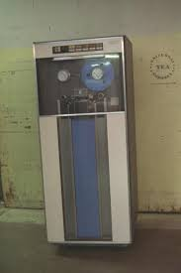
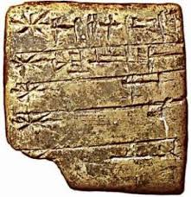
WHAT IS A DATABASE?
A database is a collection of information that is organized in such a way that it can be easily accessed, managed, and updated.

Slide 4
GOALS OF A DATABASE
Data is safely stored
We can retrieve our data
Systematic/repeatable functionality
It’s as fast as possible

Slide 5
Data is safely stored
Data is protected
Data does not become corrupt
Data is not changed without instruction

Slide 6
We can retrieve our data
We can find our data
We can cross reference our data
Data will retain its integrity

Slide 7
Systematic/repeatable functionality
We have a way to systematically store and find our data
Instructions to alter our data are done in a repeatable, structured way

Slide 8
It’s as fast as possible
Long term storage (safe archival)
Short term storage (fast retrieval)
Standard term storage

Slide 9
STORAGE
Where is the data kept?
Methods
Formats

Slide 10
STORAGE ENGINES
MySQL methods and formats of storage
Transactional
Can be rolled back on failure of the larger group transaction
Non-transactional
Data is altered as the statements roll

Slide 11
HOW DATA’S BEEN STORED
Lists/Linked Lists
Flat files
Spreadsheets
Hierarchical databases
Relational databases

Slide 12
MODERN DATA STORAGE CONCERNS
Storage Size
Memory
Indexes
Redundancy

Slide 13
STORAGE TYPES
MyISAM
InnoDB
XtraDB
Memory
NDB
CSV

Slide 14
MYISAM
Non-transactional
Atomic
Fast retrieval
Caveats

Slide 15
INNODB
Transactional
ACID compliant
Row-level locking
Multi-version concurrency control
Caveats

Slide 16
CSV
Text file
Comma Separated Values
Always available
Easily used by software

Slide 17
MEMORY
Data is stored in memory
Very fast
Data not retained on restart

Slide 18
NDB
Exclusively used with MySQL Cluster
Stored in data nodes
Data nodes managed by NDB Administrative node

Slide 19
STORAGE ENGINE COMPARISONS
Storage Engine | Innodb | NDB | MyISAM
Max Storage Limit | 48TB | 3TB | Disk and filesize limited
Transaction Types | All | READ_COMMITTED | Atomic
Foreign Keys | Yes | 7.3+ | Ignored
MVCC | Yes | No | No
Data compression | Yes | No | No
Scalability | Application-level sharding | Yes | Application-level sharding
ACID Compliant | Yes | Yes | No
Parallel Writes | No | Yes | No

Slide 20
CLUSTER SOLUTIONS
MySQL Cluster
Galera Cluster

Slide 21
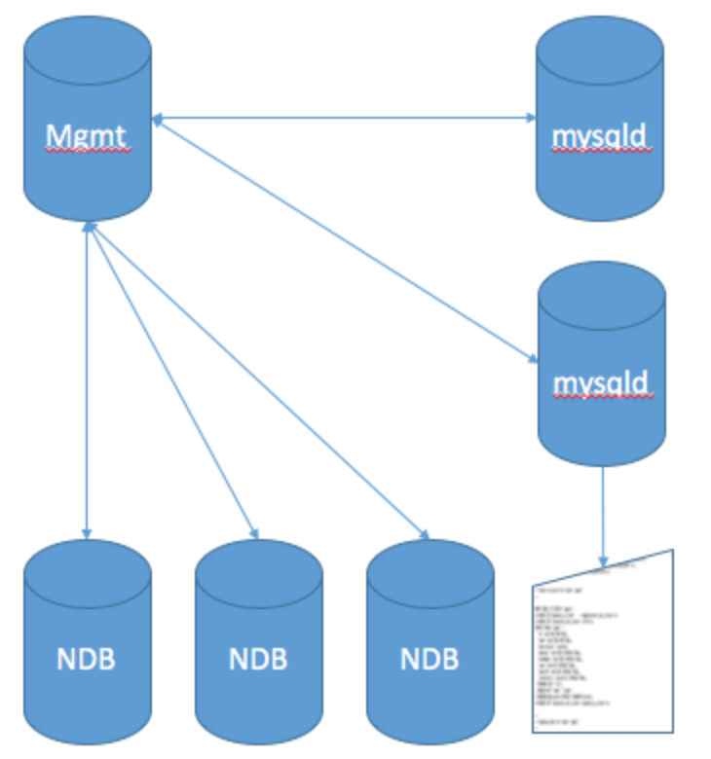
MYSQL CLUSTER
Synchronous replication
highly scalable
real-time
ACID-compliant transactional database
99.999% availability
distributed, multi-master architecture with no single point of failure
scales horizontally
SQL and NoSQL interfaces
NDB Storage Engine

Slide 22
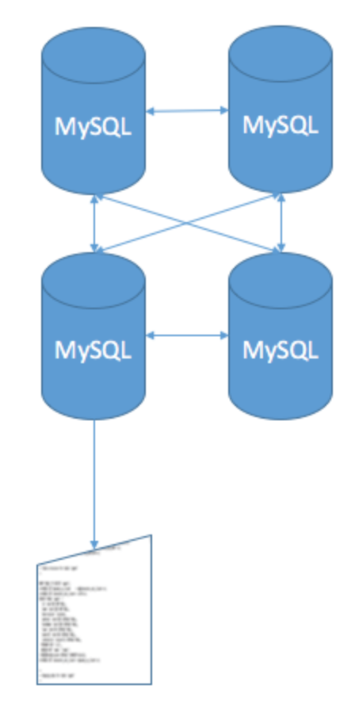
GALERA CLUSTER
Synchronous replication
Active-active multi-master topology
Read and write to any cluster node
Automatic membership control, failed nodes drop from the cluster
Automatic node joining
True parallel replication, on row level
Direct client connections, native MySQL look & feel
InnoDB or XtraDB Storage Engines

Slide 23
REPLICATION SOLUTIONS
Master/Slave
Master/Master
Master/Multi-Slave
Ring Replication

Slide 24
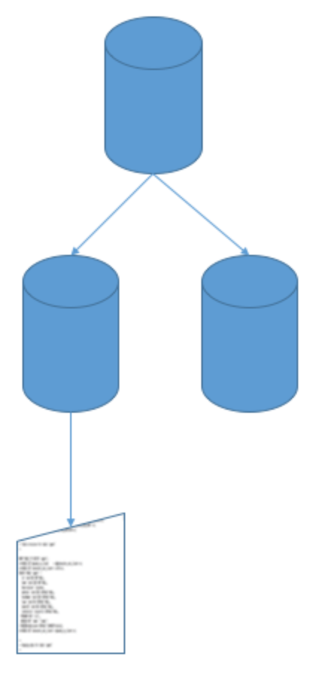
MASTER/SLAVE
Readability of the slave without impacting the master
Backups can be taken without impacting master
Downtime can be averted when the slave is taken offline for maintenance, and easily resynched
Asynchronous
No automatic failover on Master failure
Downtime and possible data loss if Master fails

Slide 25
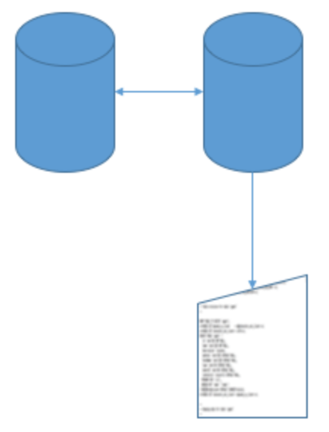
MASTER/MASTER
Writes are distributed
Both servers ready for failover – automatic on the MySQL side
Reads can be distributed
Asynchronous
Alternating auto increments
More complex than Master/Slave to deploy

Slide 26
PERFORMANCE ENHANCEMENTS
READ/WRITE SPLITS
REPORTING/BACKUP SPLITS
IOPS
MEMORY

Slide 27
READ/WRITE SPLITS
Even with a cluster, you can stand up a read-only slave to split load of reads and writes. This works particularly well with a Master/Slave or Master/Master architecture.

Slide 28
REPORTING/BACKUP SPLITS
It is recommended to move reporting and backups off of the primary instance of MySQL. Reports and backups can tie up resources for a long time. And with MyISAM and backups, the tables are fully locked. To keep your data free, it’s best to use a slave.

Slide 29
IOPS
The kind of disk you’re writing to is very important. Even in cloud services, there are marked differences with the use of non-provisioned IOPS vs the standard implementation. The faster your seek/write time to disk, the better performance you will have. SSD is the current best technology for speed.

Slide 30
Speed
MySQL Cluster 7.4: 200M QPS (NoSQL) and 2.5M QPS (SQL)
MySQL 5.6: 250k average for InnoDB.
Galera: ~80k transactions per second

Slide 31
MEMORY
Having enough RAM is of utmost importance with any database. Storage of keys, indexes, and even data can greatly improve performance. If you’re using InnoDB, throw any access memory after tuning to the buffer pool. For MyISAM, make sure your key buffer is sufficient for your indexes and keys. Always ensure you do not vastly over allocate memory to avoid swap. This can be very problematic with hyperthreading as well.

Slide 32
HIGH AVAILABILITY
FAILOVER
DATA REDUNDANCY

Slide 33
FAILOVER
Stand Alone
Master/Slave
Master/Master
MySQL Cluster
Galera Cluster

Slide 34
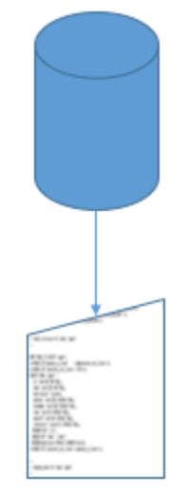
Stand Alone
Full consistent backup required
Binary logs for point-in-time recovery
Restoration takes time
Hardware availability required
High probability of data loss if no binary log

Slide 35
Master/Slave
Hot standby
No immediate restore required
Possible data loss if slave not in sync with master
Slave needs to be promoted
IP change, application connection change, or load balancer needed

Slide 36
Master/Master
Hot standby
No immediate restore required
No promotion needed
IP change, application connection change, or load balancer needed

Slide 37
MySQL Cluster
Automatic internally
Replicants: manual failover
The nature of MySQL Cluster means that with a management node, multiple data nodes, and multiple API nodes, there is still a single point of failure.

Slide 38
Galera Cluster
Automatic internally
Replicants: manual failover
If the application is going to a particular IP in lieu of a pool, then floating IP or manual failover required.

Slide 39
DATA REDUNDANCY
Stand Alone
Master/Slave
Master/Master
MySQL Cluster
Galera Cluster

Slide 40
Stand Alone
No data redundancy
Dependence on backups and binary logs
High probability of data loss in a failure

Slide 41
Master/Slave
Slave is a hot replica of the master
Possibility of data loss with slave lag
Binary log corruption can cause data drift
Improper binary logging and the use of triggers can cause data drift

Slide 42
Master/Master
Slave is a hot replica of the master
Possibility of data loss with slave lag
Binary log corruption can cause data drift
Improper binary logging and the use of triggers can cause data drift

Slide 43
MySQL Cluster
Mirrored data
individual data nodes can fail with aborted transactions
Transactional applications are expected to handle transaction failure
Data loss has occurred while adding nodes

Slide 44
Galera Cluster
In general, Galera cluster works by not considering a transaction complete until it’s members agree.
Large transactions are not advised.
Problems can occur with SST mode.

Slide 45
SO, WHAT’S BEST?
What are your business requirements?
Easiest
Master/Slave and variations
Safest
Galera Cluster
Fastest Performance
Depends
Don’t. Just, Don’t
Stand Alone

