Slide 1
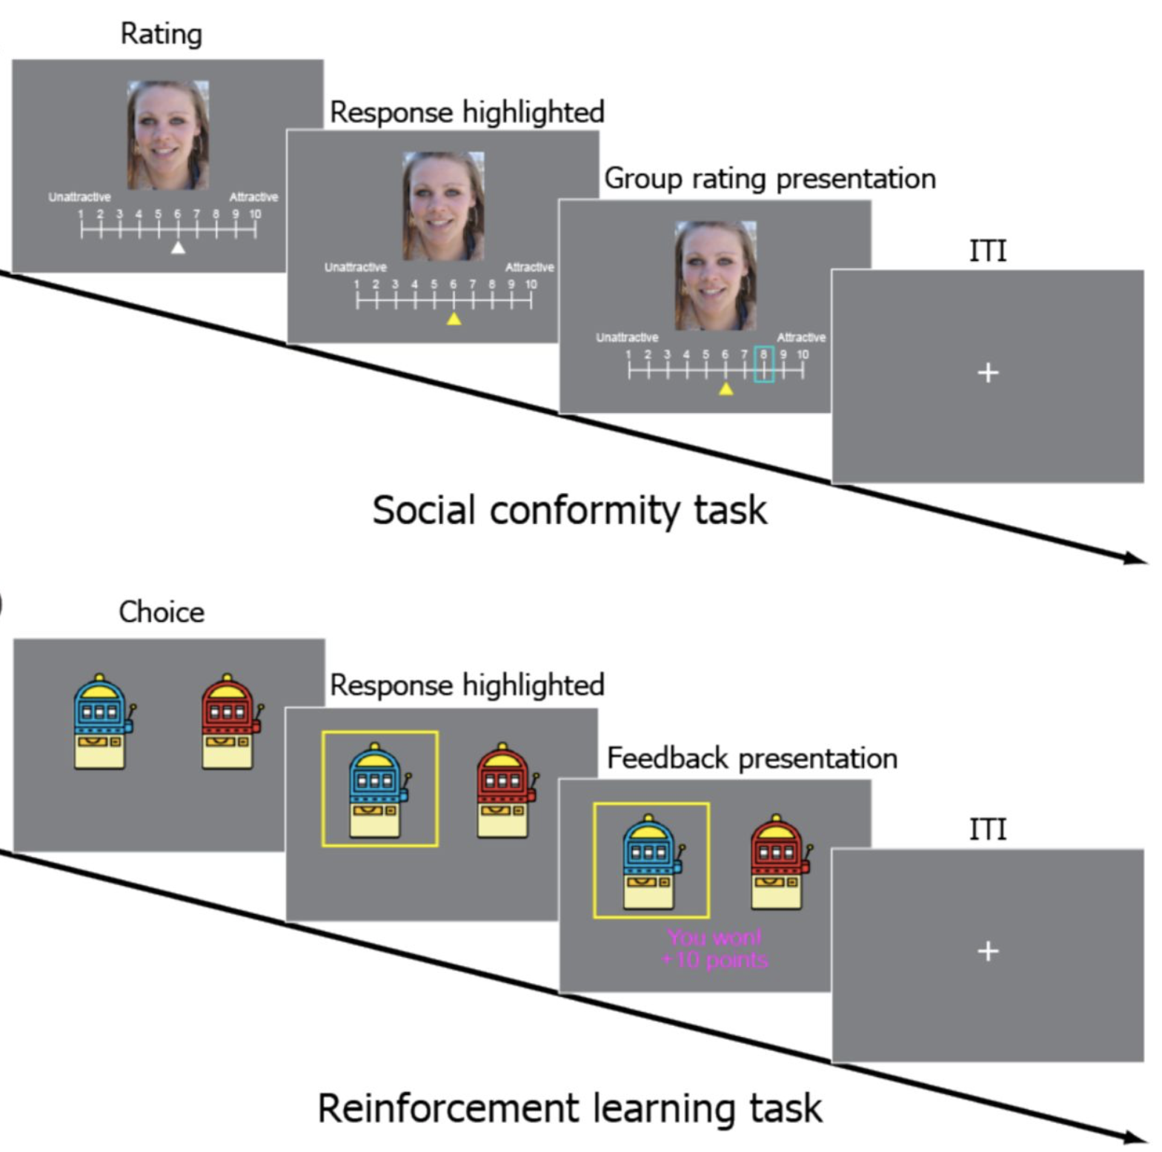
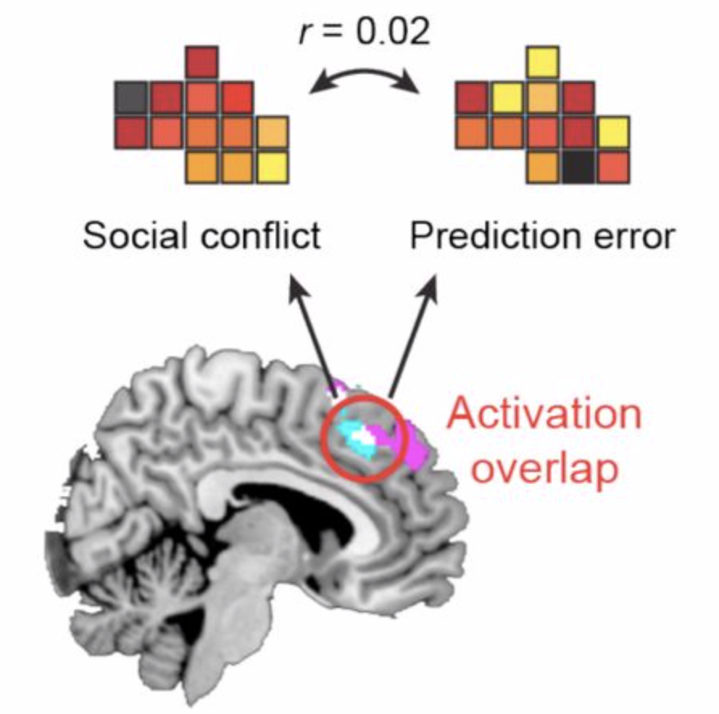
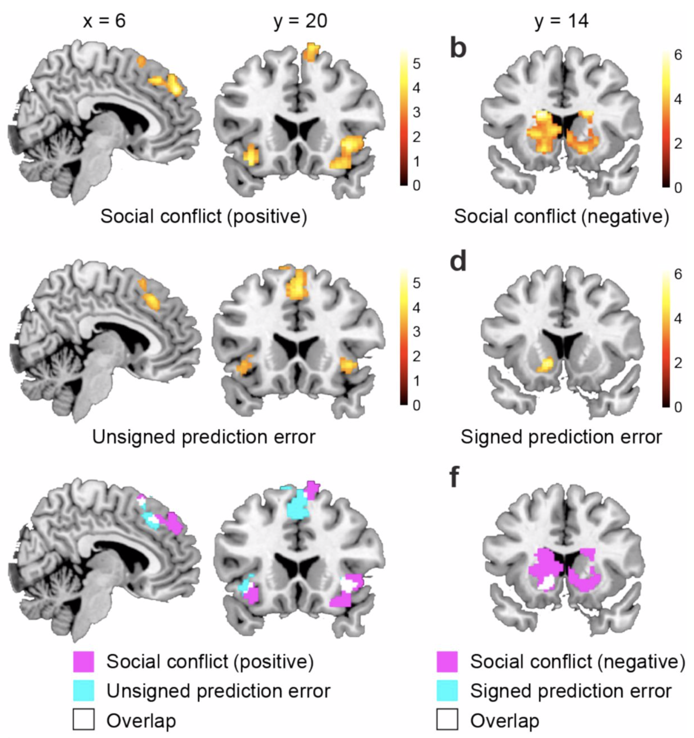
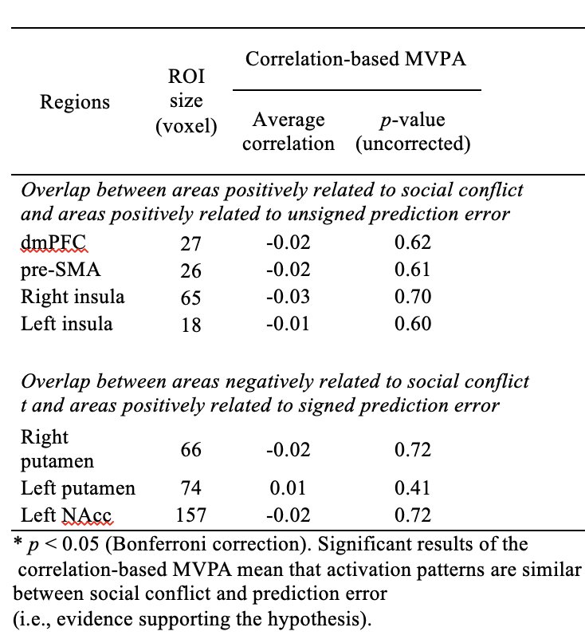
Testing the reinforcement learning hypothesis of social conformity
Marie Levorsen, Ayahito Ito, Shinsuke Suzuki & Keise Izuma
Introduction
Task:
Social influence affects everyday life decisions, it is important to understand how and why that is
Previous neuroimaging studies have found that the posterior medial frontal cortex (pMFC), anterior insula and ventral striatum are involved in both social conformity and reinforcement learning
Klucharev et al., (2009) suggest a common neural mechanism for social conformity and reinforcement learning signalled by a reward prediction error
The two processes have never been directly compared; no previous study has examined these two processes within the same participants
Activation overlaps based on univariate fMRI analysis cannot be considered strong evidence of a common neural mechanism (Woo et al., 2014)
Correlation-based MVPA:
Aim
Results
To test the reinforcement learning hypothesis of social conformity by having the same sample of participants perform both a social conformity task and reinforcement learning tasks whilst in an fMRI scanner
Use multi-voxel pattern analysis (MVPA) to more directly test this hypothesis
Univariate results:
Method
Participants: Twenty-five neurological healthy, British females (mean age = 22.1 years)
Stimuli: 100 digital colour photographs of Caucasian females (the images were taken from the set used in the study by Klucharev et al., 2009).
Procedure:
fMRI scan session: reinforcement learning task and social conformity task
Behavioural testing session: unexpected second social conformity task, without group rating (the difference between the ratings in the first and second conformity task was used to measure the behavioural conformity effect)
Correlation-based MVPA:
Conclusion
No clear evidence of a common neural mechanism for social conformity and reinforcment learning

