Slide 1
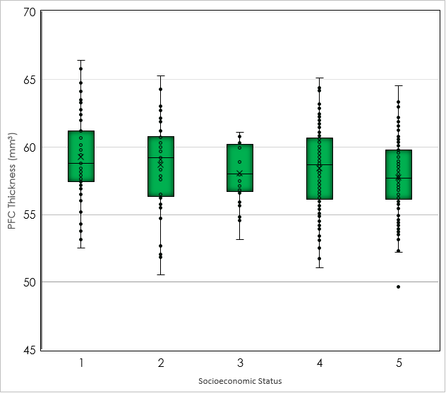
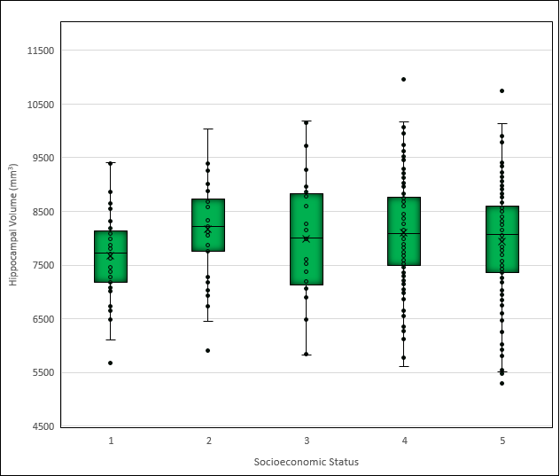
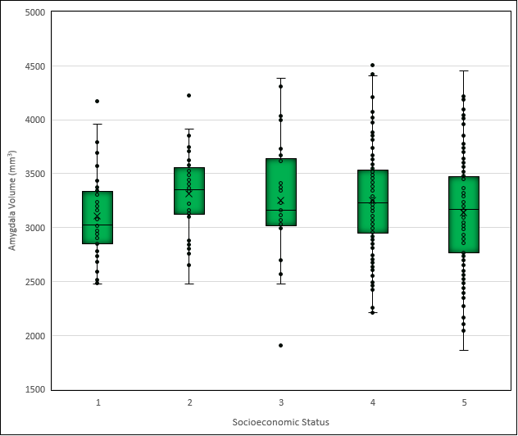
Low Socioeconomic Status as a Proxy for Stress in the Brain
Ashley Mensing, Kristin Maurer, Nikita Das, Eleana Varangis, Yaakov Stern
Introduction
Low SES is associated with higher rates of instability greater likelihood of exposure to social aggression (Dohrenwend & Dohrenwend 1974), and increased likelihood of living in areas characterized by higher rates of mortality and crime (Haan, Kaplan, & Syme 1989).
The socioecological factors that characterize low SES backgrounds may contribute to a higher level of “background stress” and consequently greater exposure to glucocorticoids.
Increased exposure to glucocorticoids has shown a negative effect on hippocampal function, neuronal damage and reduced neurogenesis (McLean 2012, Lupien & McEwen 1997)
Differences in cognitive functioning observed among classes may be attributable to greater exposure to high levels of glucocorticoids throughout the life course and the resulting impact on brain structure.
If true, we might expect to see differences among SES groups in regions of the brain known to be particularly vulnerable to stress.
In this study we evaluate three key regions associated with the stress pathway, the hippocampus, amygdala, and prefrontal cortex and their relationship to socioeconomic status.
Results
Results (cont.)
In the multivariate general linear model, we detected a significant group-level difference between SES and all BM used
Hippocampal volume: F=4.036, p=.000,
Amygdala volume: F=3.814, p=.005,
PFC thickness: F=4.035, p=.003.
Age was a significant covariate within the model, associated with all three brain measures
Gender was significantly associated with hippocampal and amygdala volume but not with PFC thickness.
Education showed a significant relationship with amygdala volume (F=5.8, P=.02) and PFC thickness (F=5.8, p=.02) but not with hippocampal volume.
There was a significant interaction effect between SES and age on amygdala volume (F=2.5, p=.04) and also between SES and gender on the same measure (F=2.9, p=.02).
Univariate one-way ANOVA for SES and BM showed a significant difference between group means for the lower SES group and the upper SES group (Figure 3) for PFC thickness. Greater mean thickness was observed in the lower SES group.
Group differences for amygdala and hippocampal volume did not meet the significance threshold. Box plots showing the results of the ANOVAs are provided to the right.
Summary and Conclusion
SES groups varied significantly in terms of race, ethnicity, and age
SES did not show a clear linear association with any of the three brain measures studied
Individuals in the lower-middle and upper-middle distribution of SES scores showed greater volume and thickness in key regions
Individuals from the lowest SES category exhibit greater PFC thickness than those from the highest SES category
This study raises further questions about the experiences of those in the highest SES category. While not a direct refutation of the stress pathway as a means of explaining disparities in health and cognitive outcomes it suggests that the question as framed may be an oversimplification of complex social phenomena.
Future research may be better served by using direct measures of perceived stress as a mediator between SES and brain measures.
Figure 1. shows mean differences in amygdala volume by SES category. While the multivariate model controlling for age, gender, ethnicity, and race demonstrated significant group differences in amygdala volume, follow-up testing using a univariate one-way ANOVA failed to detect any significant mean differences among the groups.
Figure 2. demonstrates SES group means for hippocampal volume. As with the results displayed in Figure 1, the means represented here did not vary significantly in the one-way univariate ANOVA.
Figure 3. shows the results of the follow-up univariate one-way ANOVA testing for PFC thickness by SES category. Unlike with amygdala and hippocampal volume, we were able to detect significant differences in the mean thickness between the lowest and highest SES groups. However, our findings run contrary to what was expected in that it appears that of the two the greatest PFC thickness belongs to the lowest SES group in direct contradiction to our hypothesis.
Table 1: Subject Demographics
Socioeconomic Status | Low | Lower-Middle | Middle | Upper-Middle | Upper | Total
N(%) | 51 (12.1) | 48 (11.3) | 28 (6.9) | 164 (38.8) | 131 (31.0) | 422
Mean Age (SD) | 46.5 (18.6) | 47.6 (17.8) | 53.9 (15.8) | 53.0 (16.5) | 60.3 (12.8) | 54.5(16.8)1
% Female (SD) | 64.7 | 37.5 | 53.6 | 54.9 | 56.4 | 54.5
%Hispanic (SD) | 19.6 | 0 | 26.6 | 7.3 | 7.6 | 9.32
*
Methods
422 subjects were recruited from a larger study on aging and cognition
T1-weight MPRAGE scan was collected and reconstructed using FreeSurfer (v5.1.2). The following measures were used: total cortical thickness in the prefrontal region as a sum of bilateral pars opercularis, pars orbitalis, pars triangularis, frontal pole, rostral and caudal middle frontal, superior frontal, lateral and medial orbitofrontal, and precentral gyri. Thickness was extracted using standard parcellation.
Total hippocampal volume (sum of left and right, mm³), and total amygdala volume (sum of left and right, mm³) were extracted using standard segmentation.
Subjects self-reported education and occupation which was used to construct a Hollingshead SES score.
Multivariate general linear model was constructed with Hollingshead SES score as the independent variable and age, sex, education, race, ethnicity, and supratentorial volume factored as covariates. Hippocampal volume, amygdala volume, and PFC thickness were all entered as dependent variables and tested simultaneously.
Where significant differences were detected, a one-way univariate ANOVA was performed and post-hoc testing using Tukey’s test was conducted.
References
Dohrenwend, B. S. (1973). Social status and stressful life events. Journal of Personality and Social Psychology, 28(2), 225–235. https://doi.org/10.1037/h0035718
Kaplan G. A. (1998). Socioeconomic considerations in the health of urban areas. Journal of urban health : bulletin of the New York Academy of Medicine, 75(2), 228–235. https://doi.org/10.1007/BF02345090
Lupien, S. J., & McEwen, B. S. (1997). The acute effects of corticosteroids on cognition: Integration of animal and human model studies. Brain Research Reviews, 24(1), 1-27.
http://dx.doi.org/10.1016/S0165-0173(97)00004-0
McLean, J. et al. (2012). Early life socioeconomic status, chronic physiological stress and hippocampal N-acetyl aspartate concentrations, Behavioural Brain Research, 235(2), 225-230
https://doi.org/10.1016/j.bbr.2012.08.013.
Acknowledgements
This work was supported by NIH/NIA R01 AG026158 and NIH/NIA R01 AG038465.

