Slide 1
Notes:
Welcome to our session on Learning Reimagined. We are excited to share with you our thoughts on the future of learning at NIGP, some of the work we are currently doing, and hear from you on where you think we should be focusing our efforts.
But before we get too far a long, some brief introductions into our team of presenters.

Slide 2
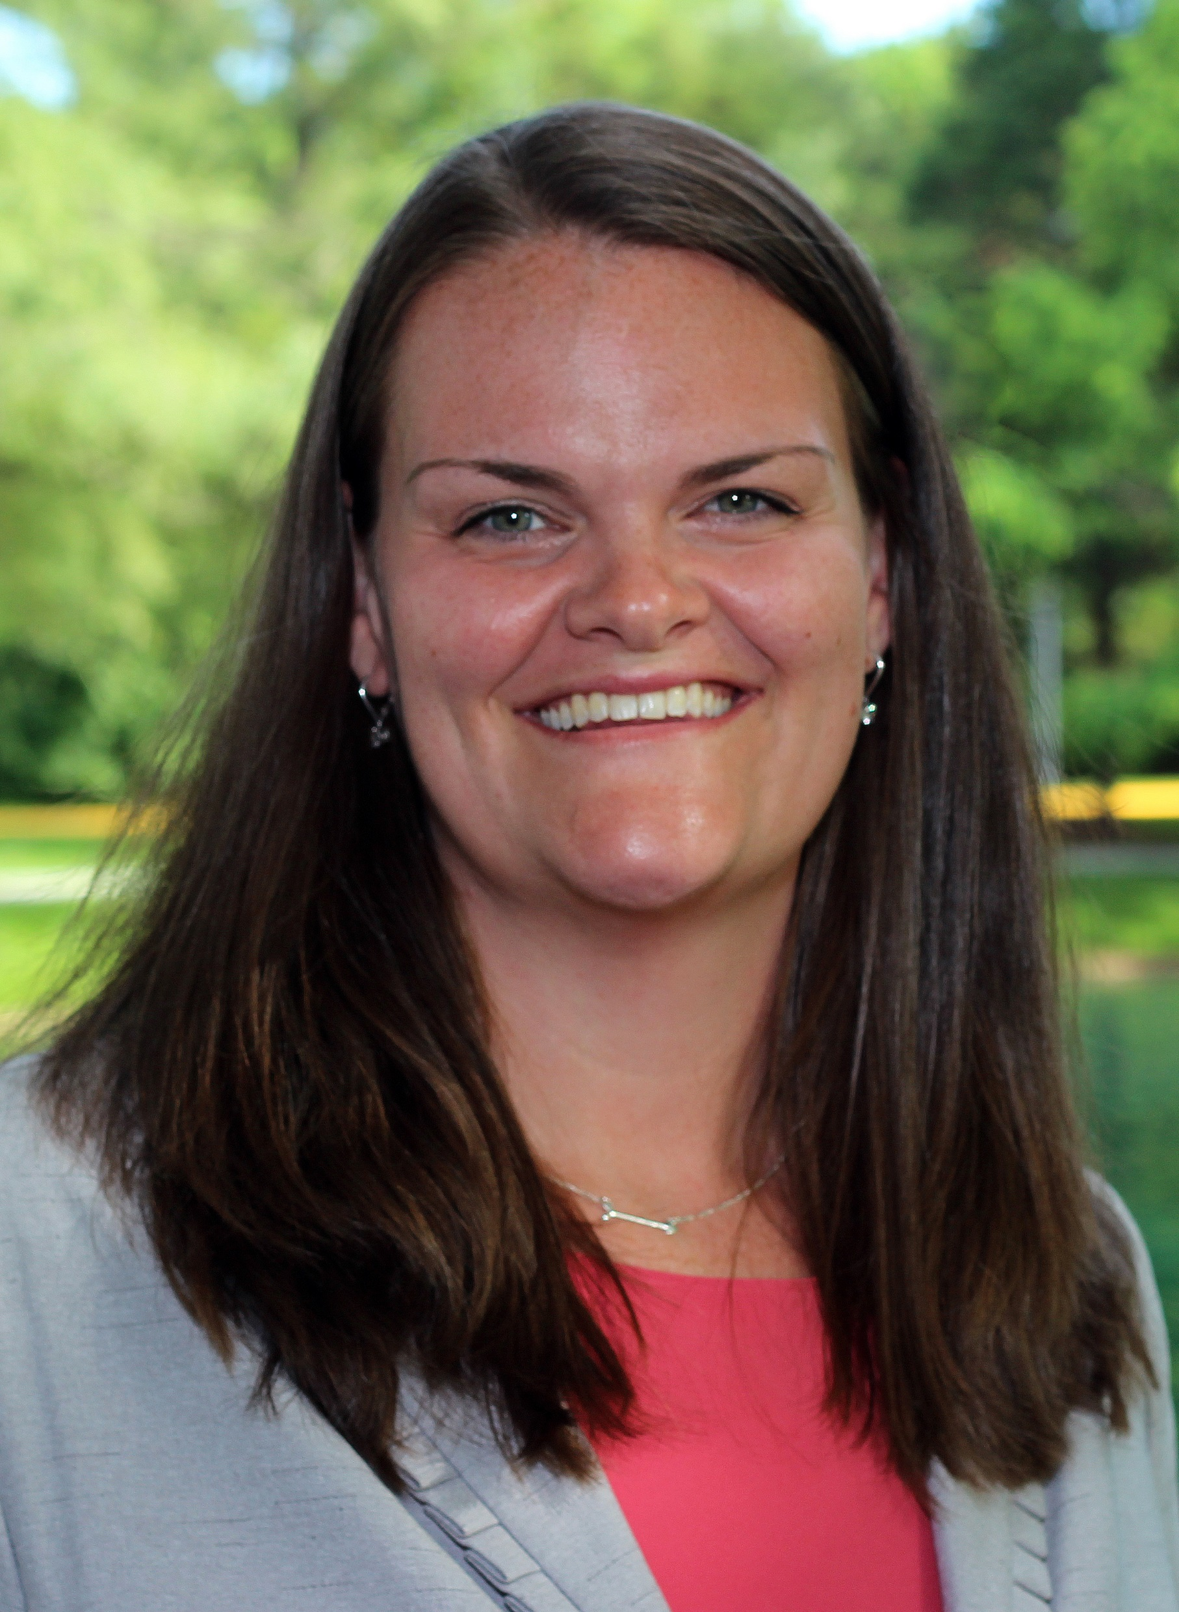
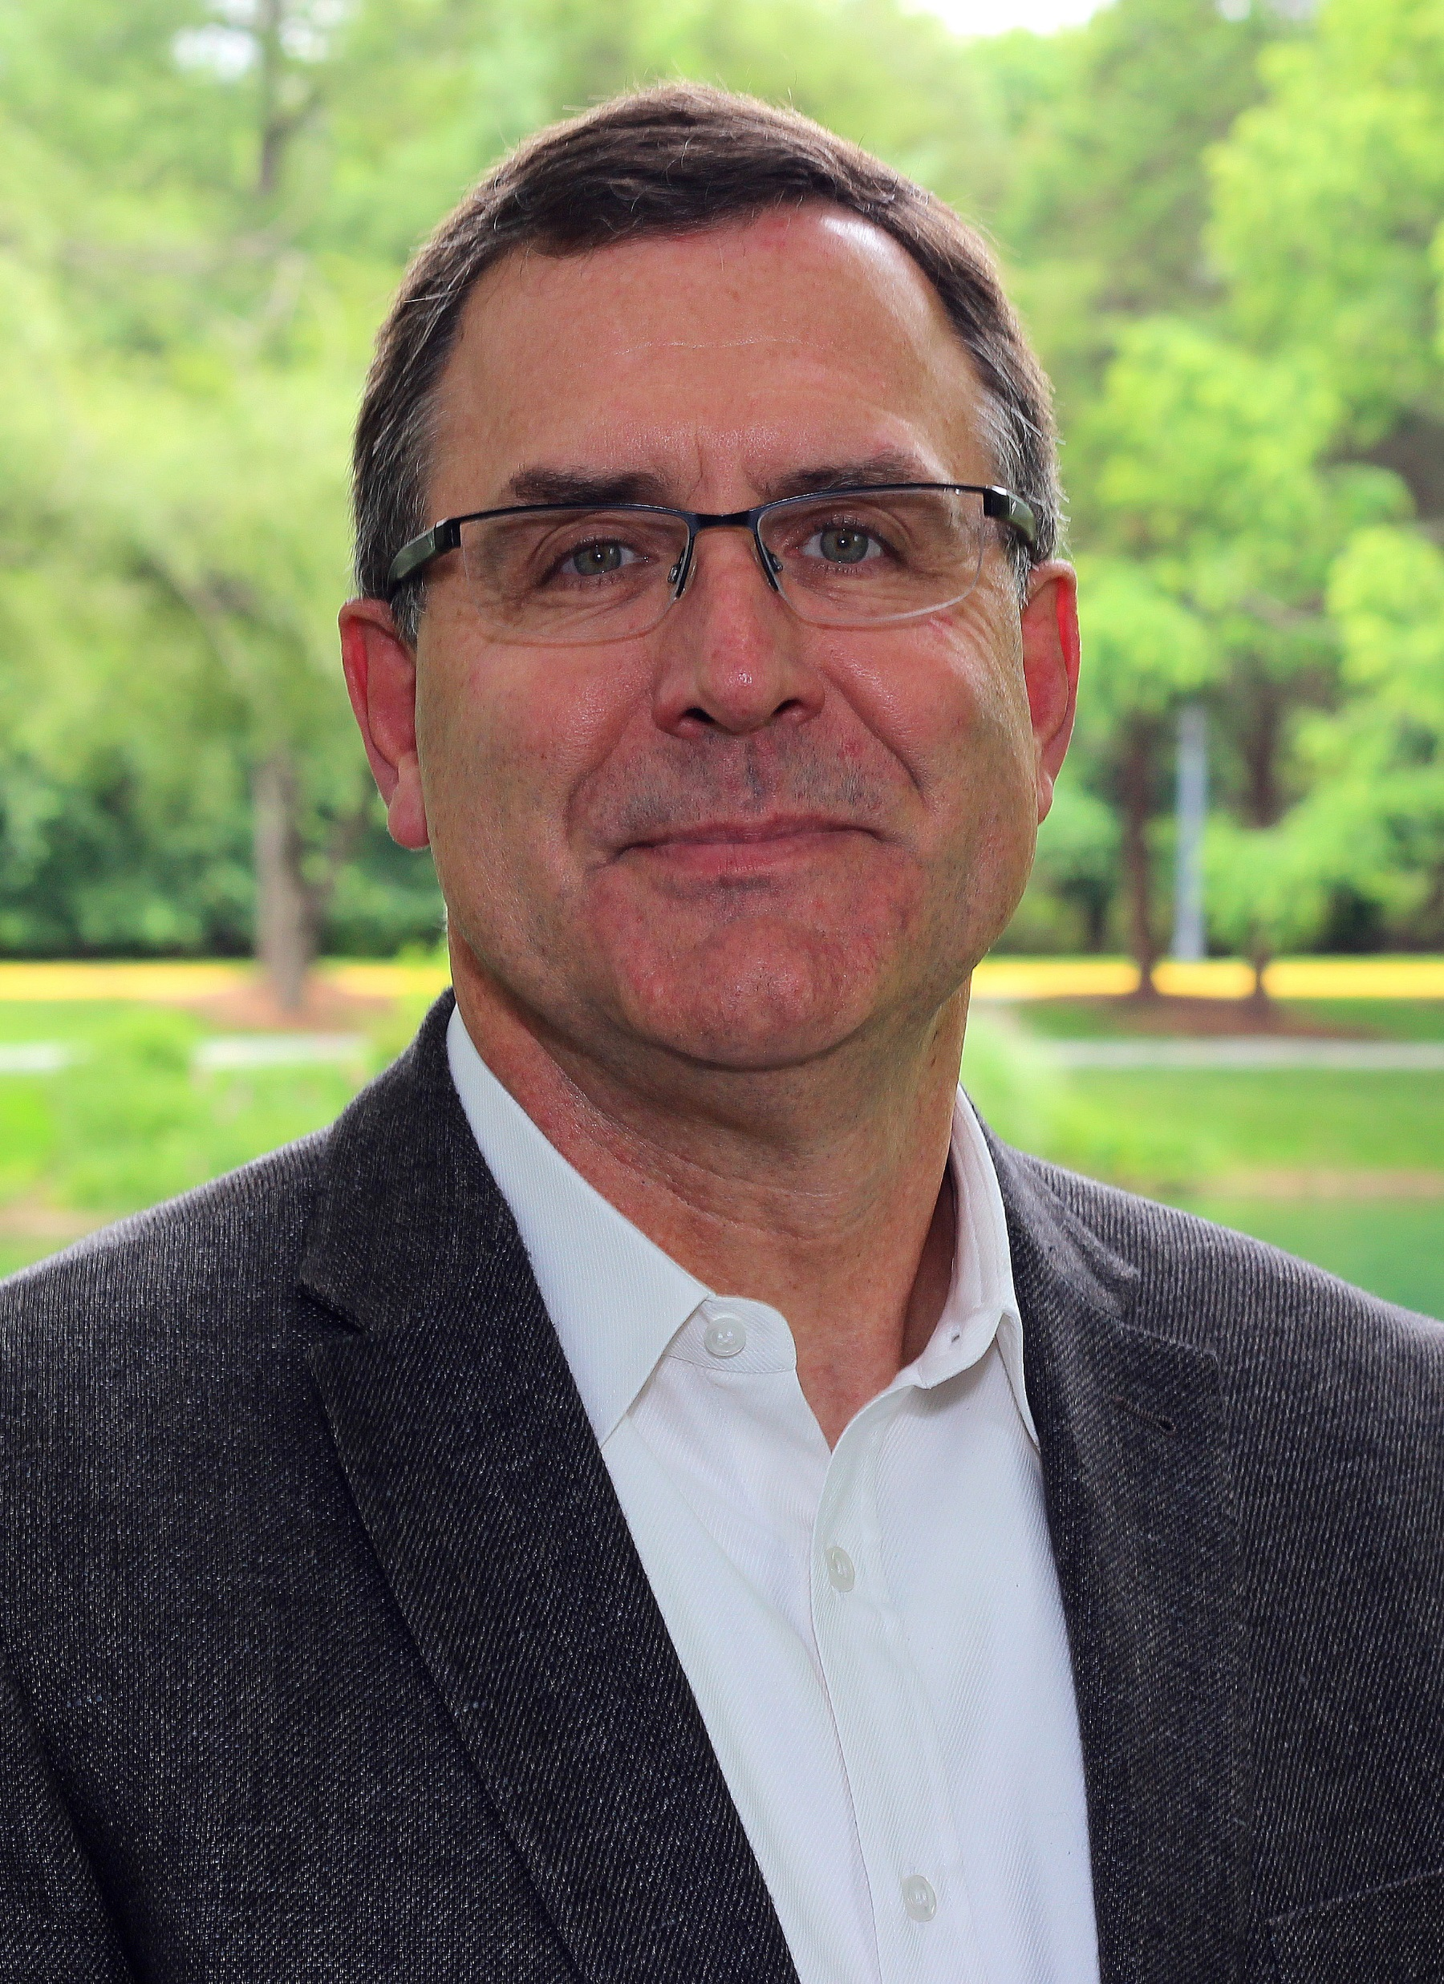
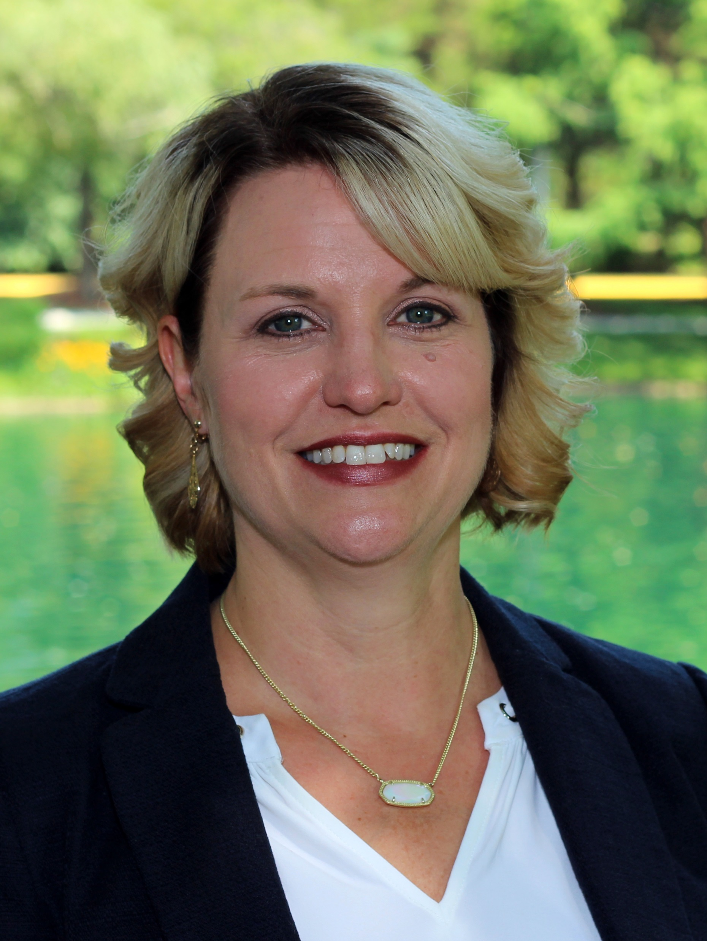
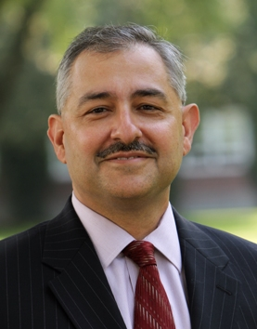
Welcome
Laura Shelters, M. Ed.
Todd Slater, Ph. D.
Carrie Rawn, CEM, CMP
William Clements, Ph. D.
Notes:
Todd to lead, each individual introduce themselves. Todd set the stage for the experience then pass to Laura.
Todd to Carrie to Bill to Laura
4-5 min

Slide 3
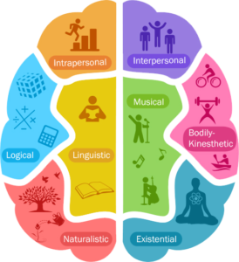
What’s your learning style?
Notes:
Laura to lead this effort.
3 min
Walk to a spot in the room, and say “come over here if you are a visual learner, meaning you like the use of images an color to help you learn.” After 15-30 seconds, I will walk to another area of the room (leaving those standing where they were) and say “come over here if you learn by working with others as much as possible, making you a social learner.” Continue this for all seven styles of learning…

Slide 4
What did that teach us?
People are complex!
Creates a challenge for educators
Notes:
Laura lead then pass to Todd.
2min

Slide 5
Designing for Today’s Learner
Notes:
Todd lead - 4min
As we saw from that brief exercise, there are many different ways in which people like to learn. On top of that today’s learners face new challenges and have different expectations on how they access their learning.
As you all probably experience on a daily basis, we are all over subscribed and bomb barded with information. It is often a struggle to filter out the messages that are coming in and we are being asked to do more with less.
This all impacts are ability to learn as it cuts into our ability to focus and the time we have to set aside for learning. However, with the shelf life of knowledge getting shorter, in many cases less than 5 years, we need to stay current. So how do we do that effectively.
First, we want to address the needs of today. Here are some of the key ones we are focused on.
By doing so, we are building a more flexible experience for you. One that is centered around your needs and directed by you, highly contextualized and applicable to your work, multiple ways in which to learn and access your content, while providing the needed guidance so you can access materials quickly.

Slide 6
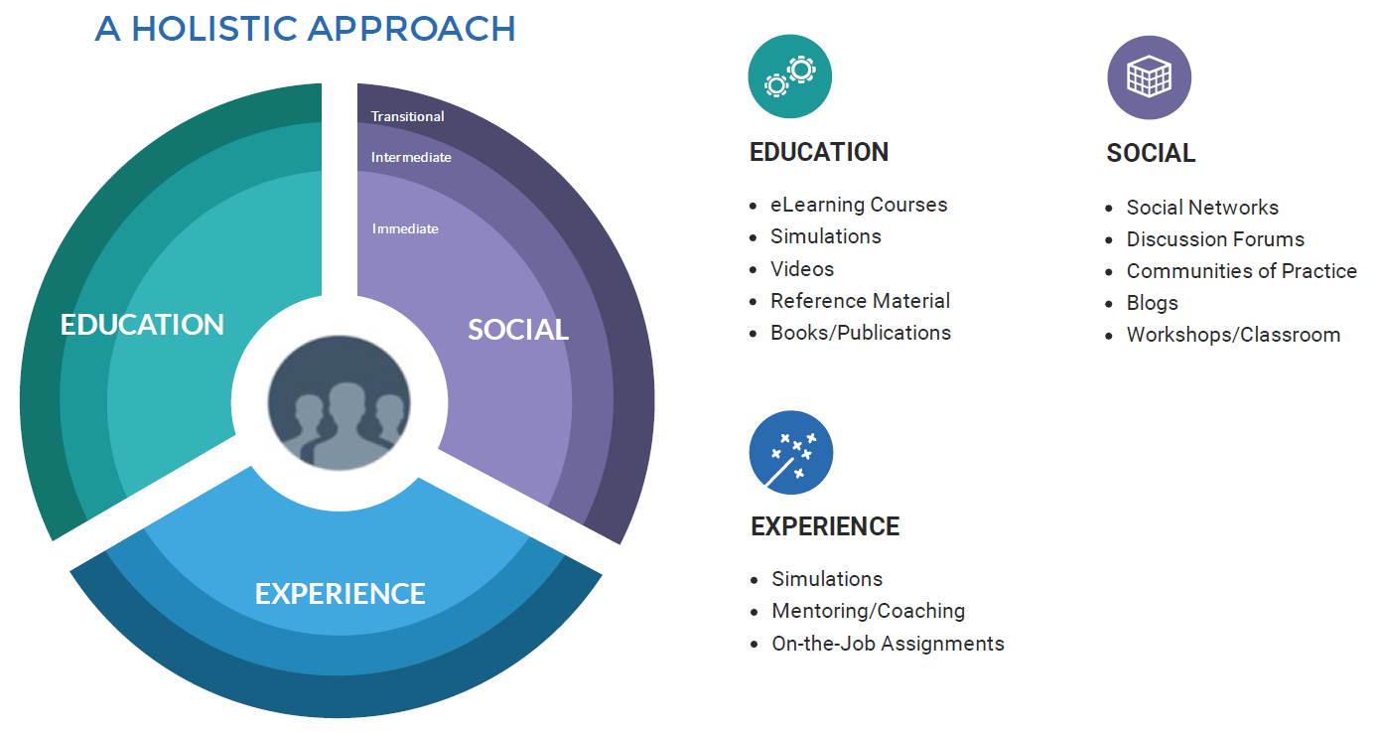
A Holistic Approach
Notes:
Todd lead - 4min
What we are trying to do is create a more holistic learning experience. Moving away from a focus on simply taking a course, to one that continues on long after a course has ended, through access to additional learning.
We are bringing together 3 important elements: education, or more formal learning, social and the ability to interact with peers, and experiential, where you can apply your knowledge.
As you can see, a number of different elements will become available in which to gain the knowledge you are looking for. Finally, we are creating content for all phases of your career. From immediate, that you need to perform today, intermediate – focused on improving on the job you have today, and transitional – helping you move to the next level.

Slide 7
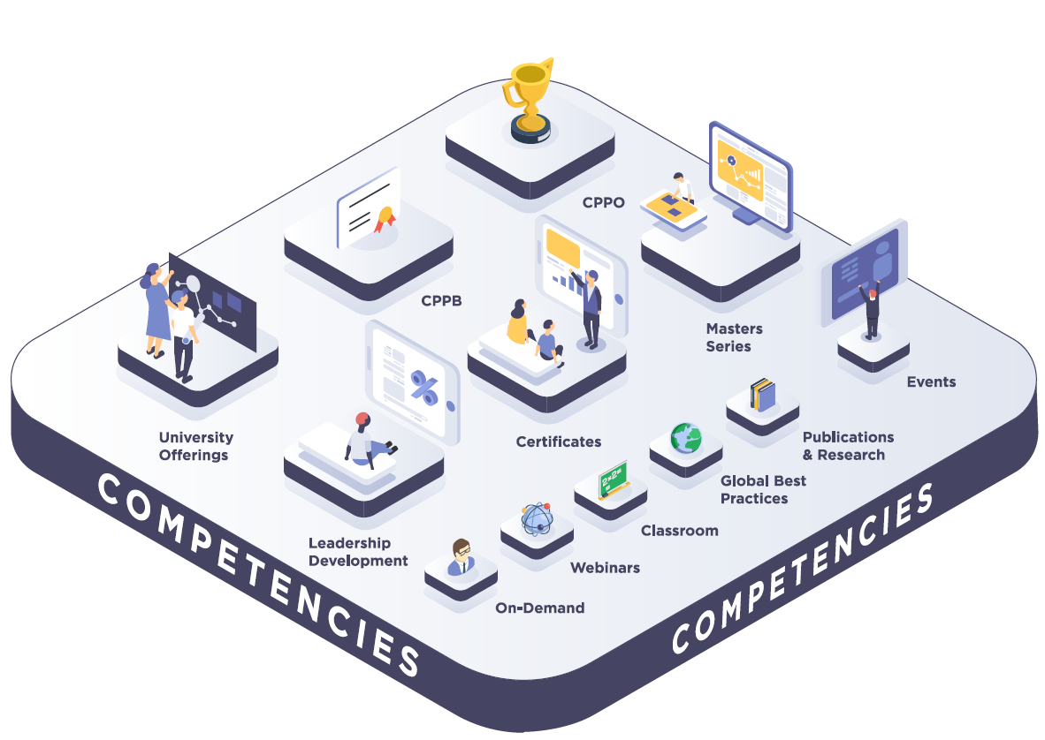
Our Portfolio
Notes:
Todd lead - 4min
So, what does out portfolio look like today and in the coming year? This illustrates the comprehensive view we are working towards. What you see is that competencies form the foundation on which we are building our content.
We have a strong foundation in place currently, however, we are adding a number of new offerings, while going back and updated much of our existing content and delivery methods.

Slide 8
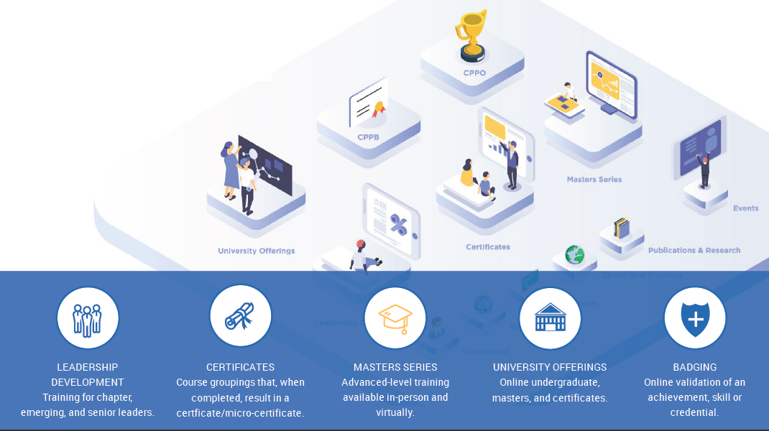
Growing Member Value
Notes:
Todd lead then pass to Carrie. 4min
These are some of the new areas that we are working on.
I would like to now pass it over to Carrie as she takes a closer look at one of our new offerings, virtual conferencing.

Slide 9
Coming to a screen near you in Fall 2018!
Access NIGP content without extra travel costs
Aiming to offer three per year on varying topics
Notes:
Carrie lead then intro Bill, Norwich as a strategic partner.
5min

Slide 10
NIGP Program Scheduling
Scheduling of NIGP classes
Notes:
Carrie lead.
5 min

Slide 11
NIGP Higher Ed Connection
Notes:
Bill lead
2min

Slide 12
Professional Development Challenge
An Impenetrable Wall
Training Organizations vs Higher Education
Past models don’t serve the profession or students
Notes:
Bill lead
2min
An Impenetrable Wall
Training Organizations vs Higher Education
Past models don’t serve the profession or students

Slide 13
Multiple Pathways to Lifelong Learning
Notes:
Bill lead
2min

Slide 14
Mid-career Professional: Learning Challenges
Work and professional responsibilities
Multiple competing priorities
Training Requirements
Educational Desires
Notes:
Bill lead
2min

Slide 15
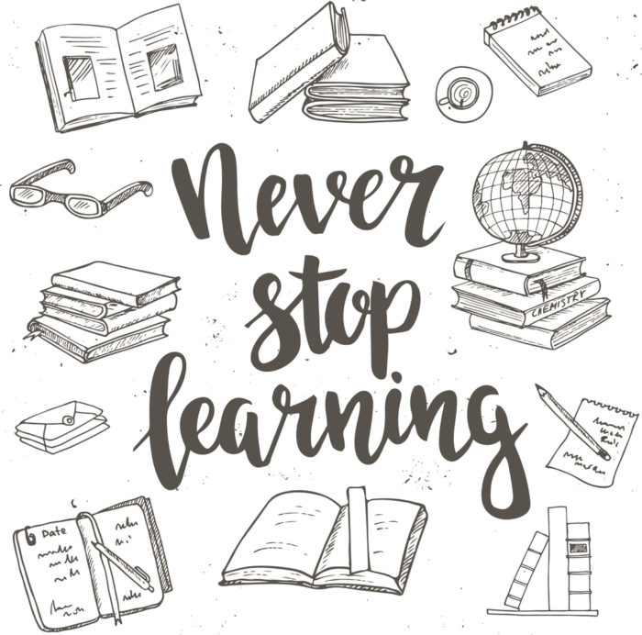
Credit for Worthy Learning Opportunities
Excellent learning opportunities already out there
NIGP is a leader in quality professional training resources
Academic review of training to apply credit
Competencies, not time
Notes:
Bill lead
2min

Slide 16
Academic Credit for NIGP Education
Undergraduate Credit
Norwich review of NIGP training and BOK
CPPB & CPPO
12 undergraduate credits
Master’s / Graduate Credit
Master of Public Administration
Public Procurement Concentration
6 graduate level credits
Notes:
Bill lead then pass to Laura.
2min

Slide 17
Learning Reimagined- An NIGP Case Study: Developing & Managing RFPs
3 day classroom course or 8 week Instructor led course
What we heard: Too much time out of office, too much money to travel, too much time required to check in online each week, but we need the content!
New Design Methodology followed, we segmented content based on how it is used in the field.
The result? Four OnDemand Modules available to take at your convenience.
Notes:
Laura lead.
3min

Slide 18
Notes:
Laura lead.
2min

Slide 19
Aligning Content
Notes:
Laura lead.
2min

Slide 20
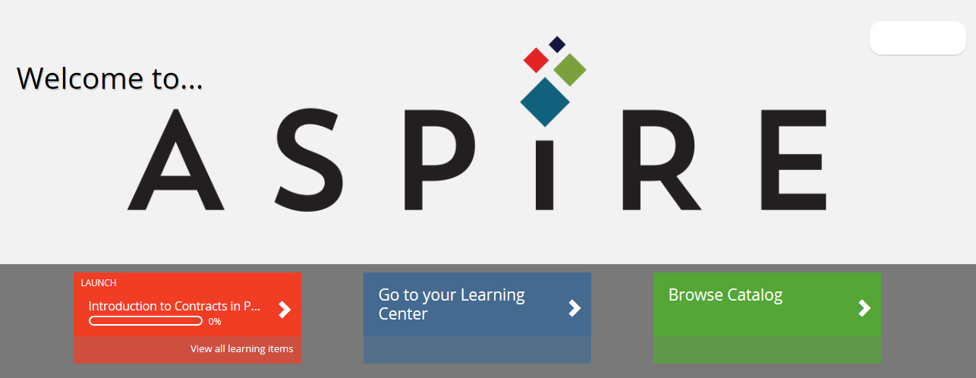
Create Your Learning Journey
Notes:
Laura lead.
3min

Slide 21
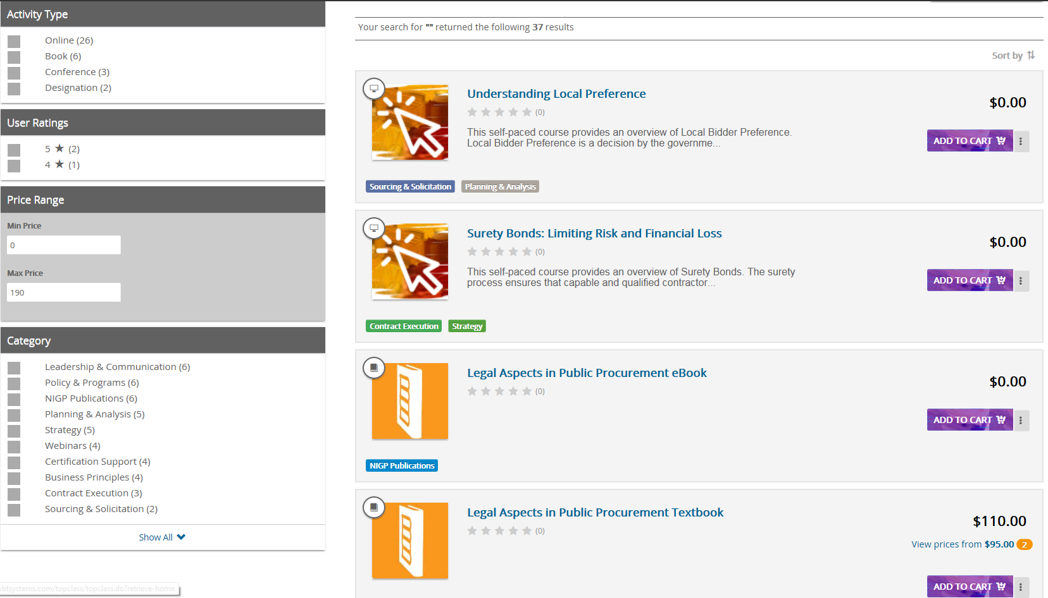
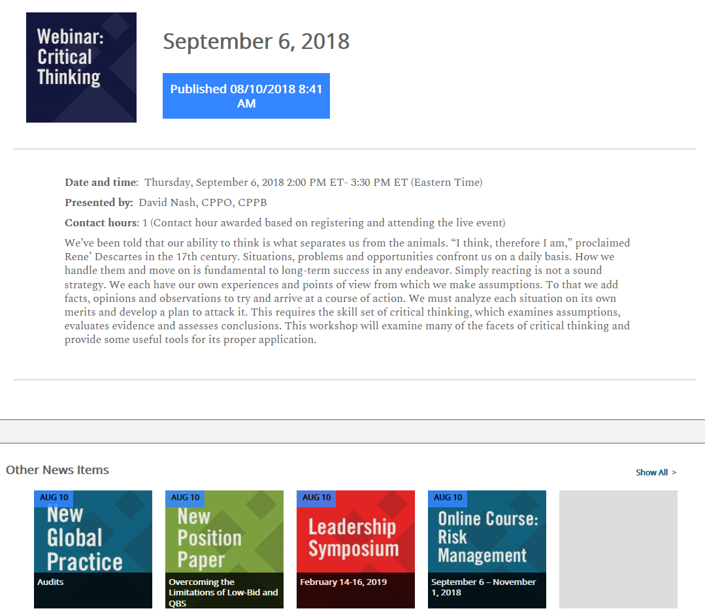
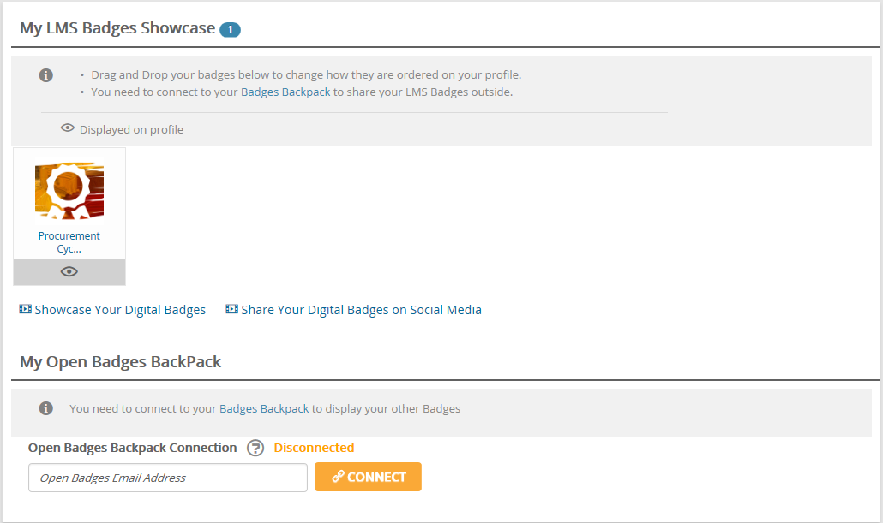
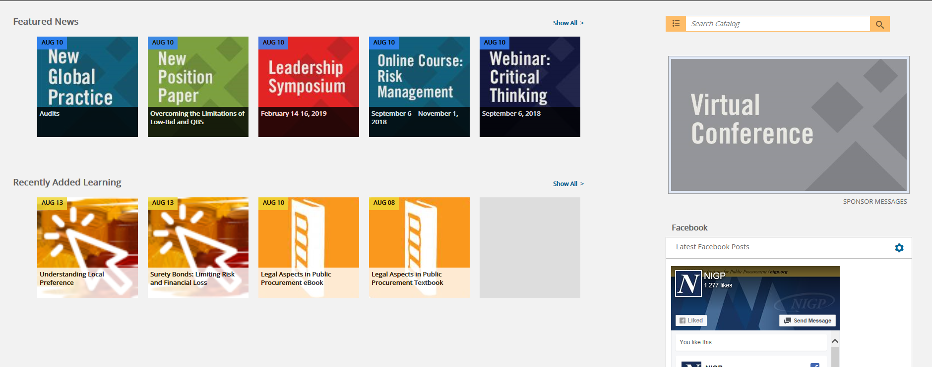
Notes:
LMS screen shots

Slide 22
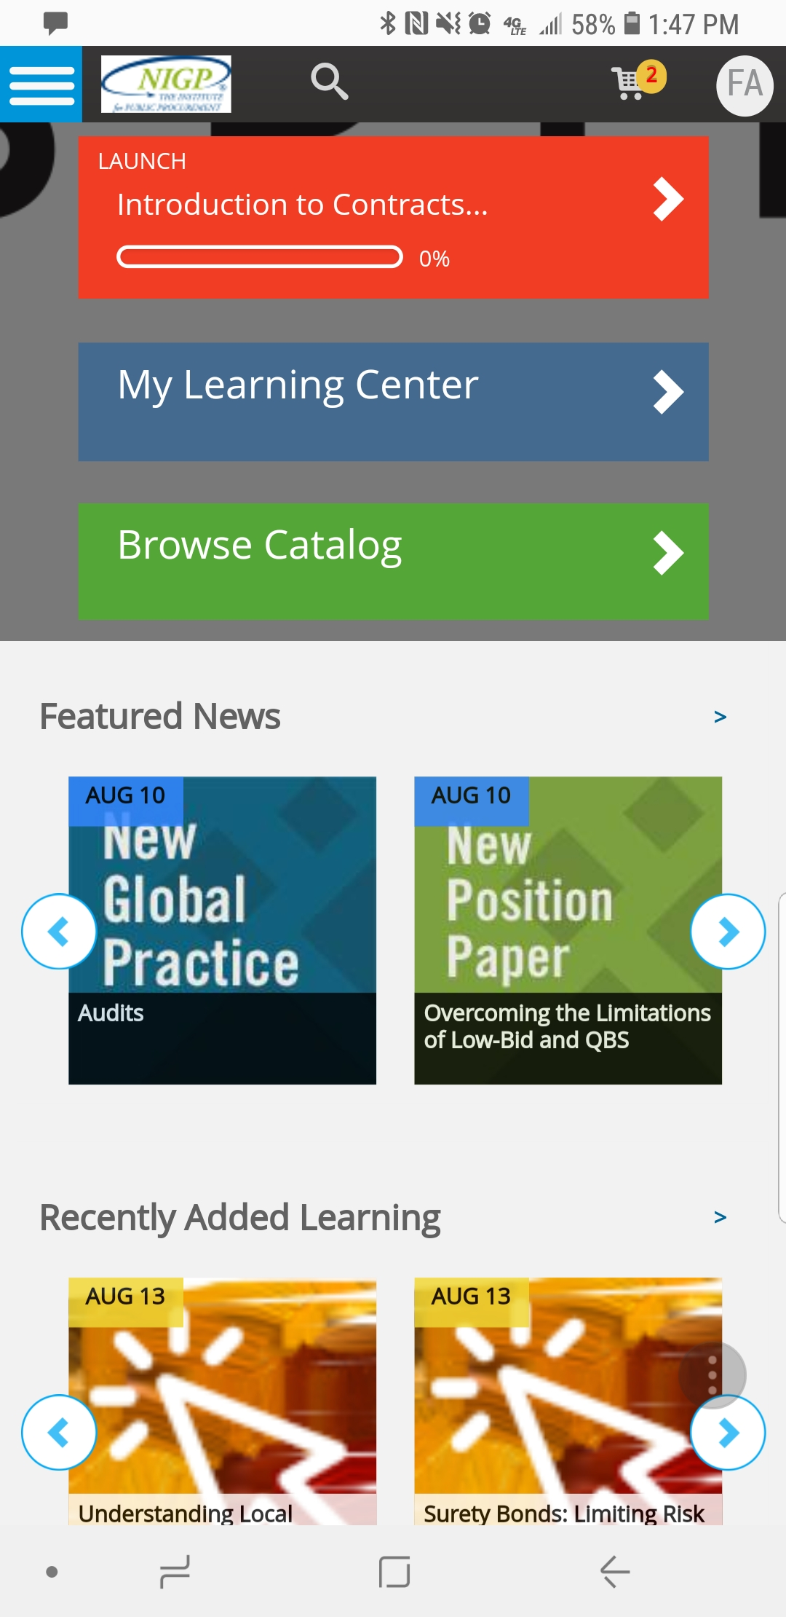
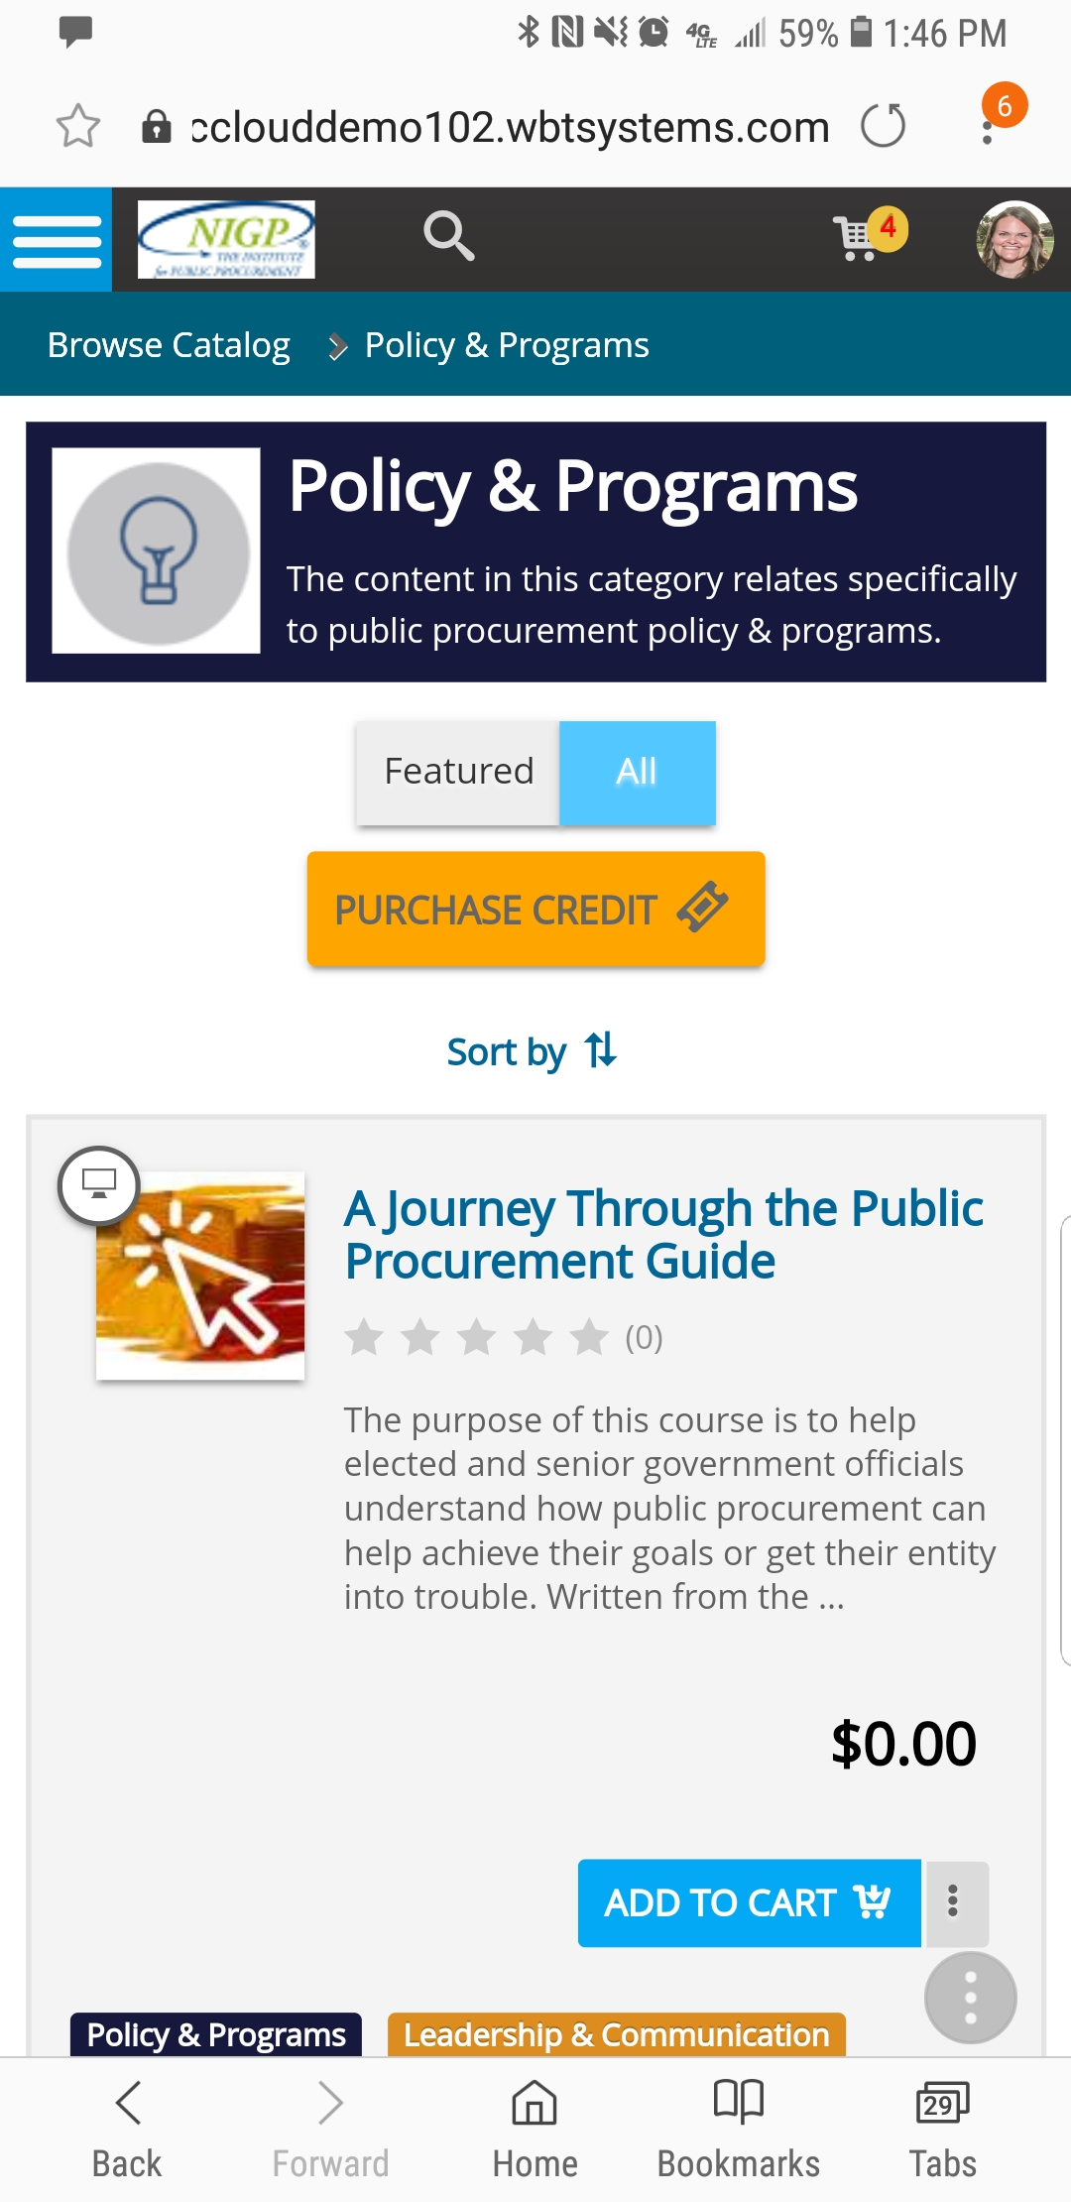
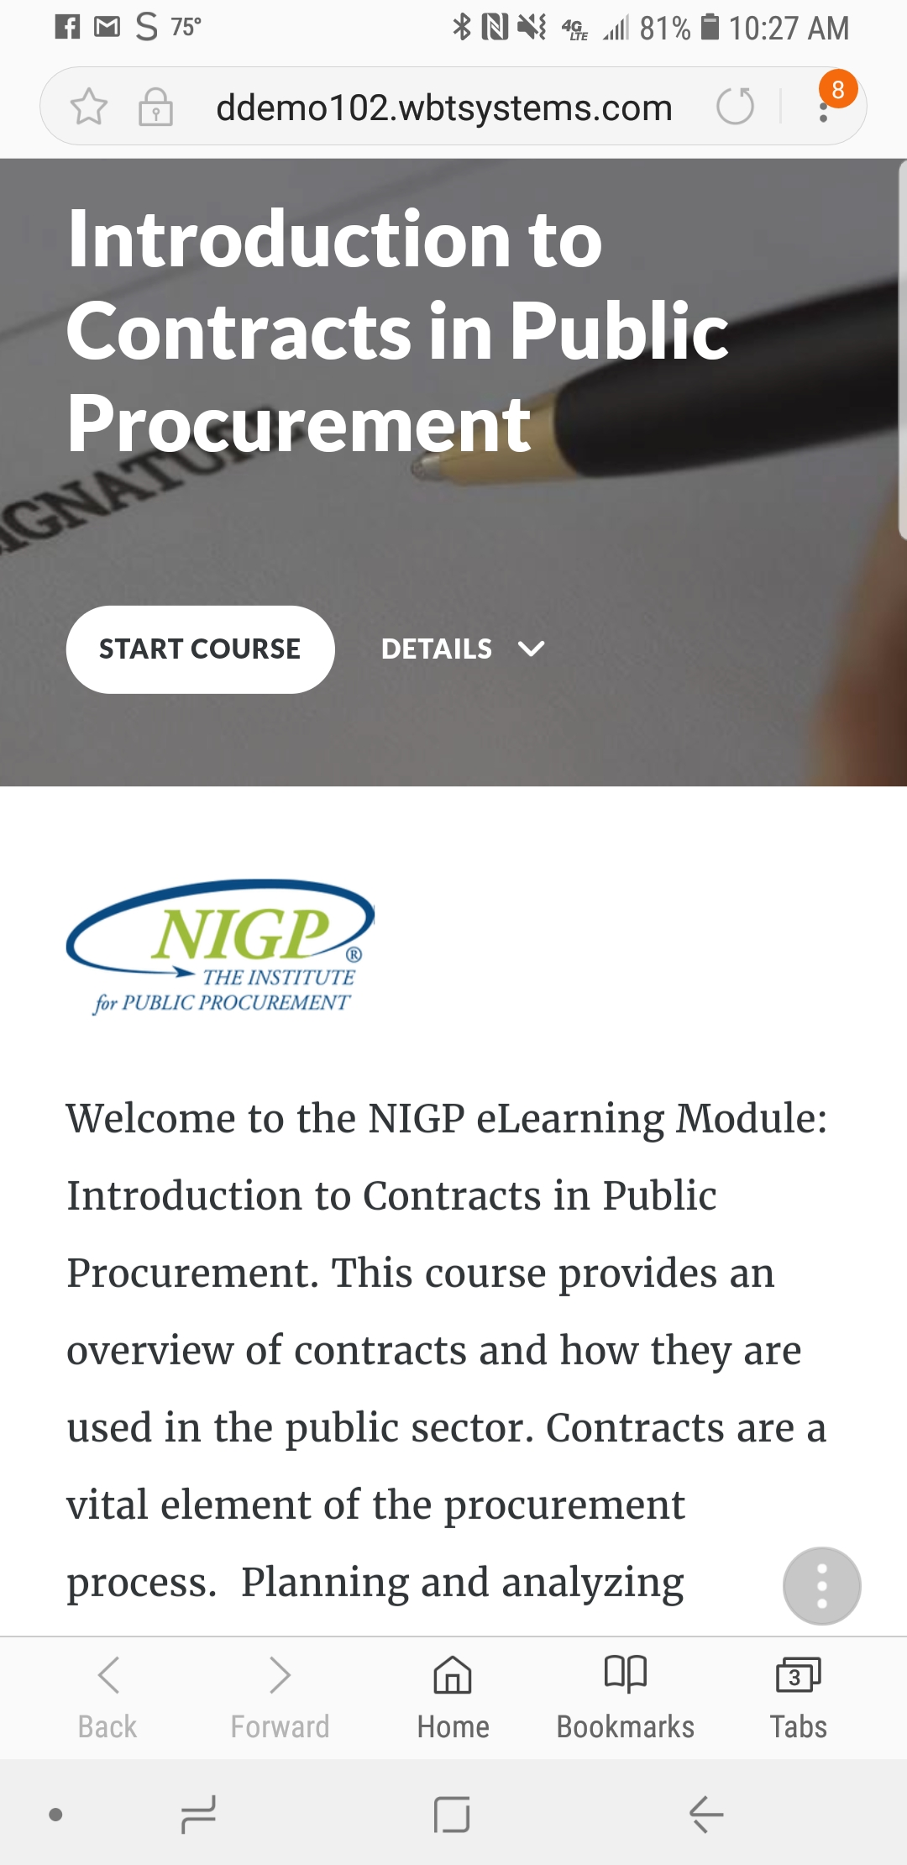
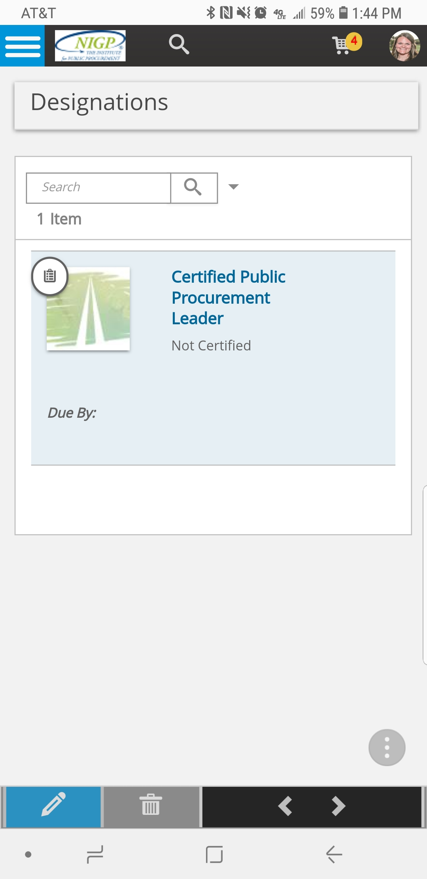
NIGP is Going Mobile!
Notes:
Laura lead then pass to Carrie.
5 min.

Slide 23
Let’s Brainstorm!
Notes:
Laura lead and intro the first question.
15 min

Slide 24
Notes:
Laura lead. Poll Title: What area would you like to see more content being developed for? https://www.polleverywhere.com/multiple_choice_polls/q4oo7kjkdJtV6MF

Slide 25
Notes:
Carrie lead. Poll Title: How much time per week do you have to spend on professional development? https://www.polleverywhere.com/multiple_choice_polls/SWo2MQtLky8uZoc

Slide 26
Notes:
Laura lead. Poll Title: What challenges do you face when it comes reaching professional development goals? https://www.polleverywhere.com/multiple_choice_polls/wJrdVFtUGQa3trs

Slide 27
Notes:
Laura lead. Poll Title: Rank the products below based on your interest level. https://www.polleverywhere.com/ranking_polls/FwZnN4JAqcl41Tr

Slide 28
Notes:
Todd lead. Poll Title: What are your learning goals for the next year? https://www.polleverywhere.com/free_text_polls/jZirP2fYC3nmZFU

Slide 29
Contact us with suggestions on new topics or new programs you would like to see NIGP offer:
Lshelters@nigp.org
Tslater@nigp.org
Crawn@nigp.org
bclements@Norwich.edu
Contact Bill for more information on the Norwich programs:
Notes:
Todd to wrap up. SAVE PRESENTATION RESPONSES.

