Slide 1
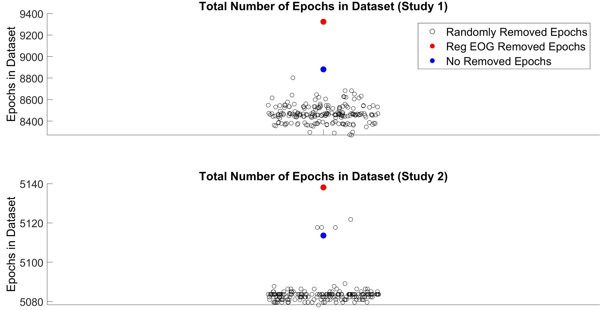
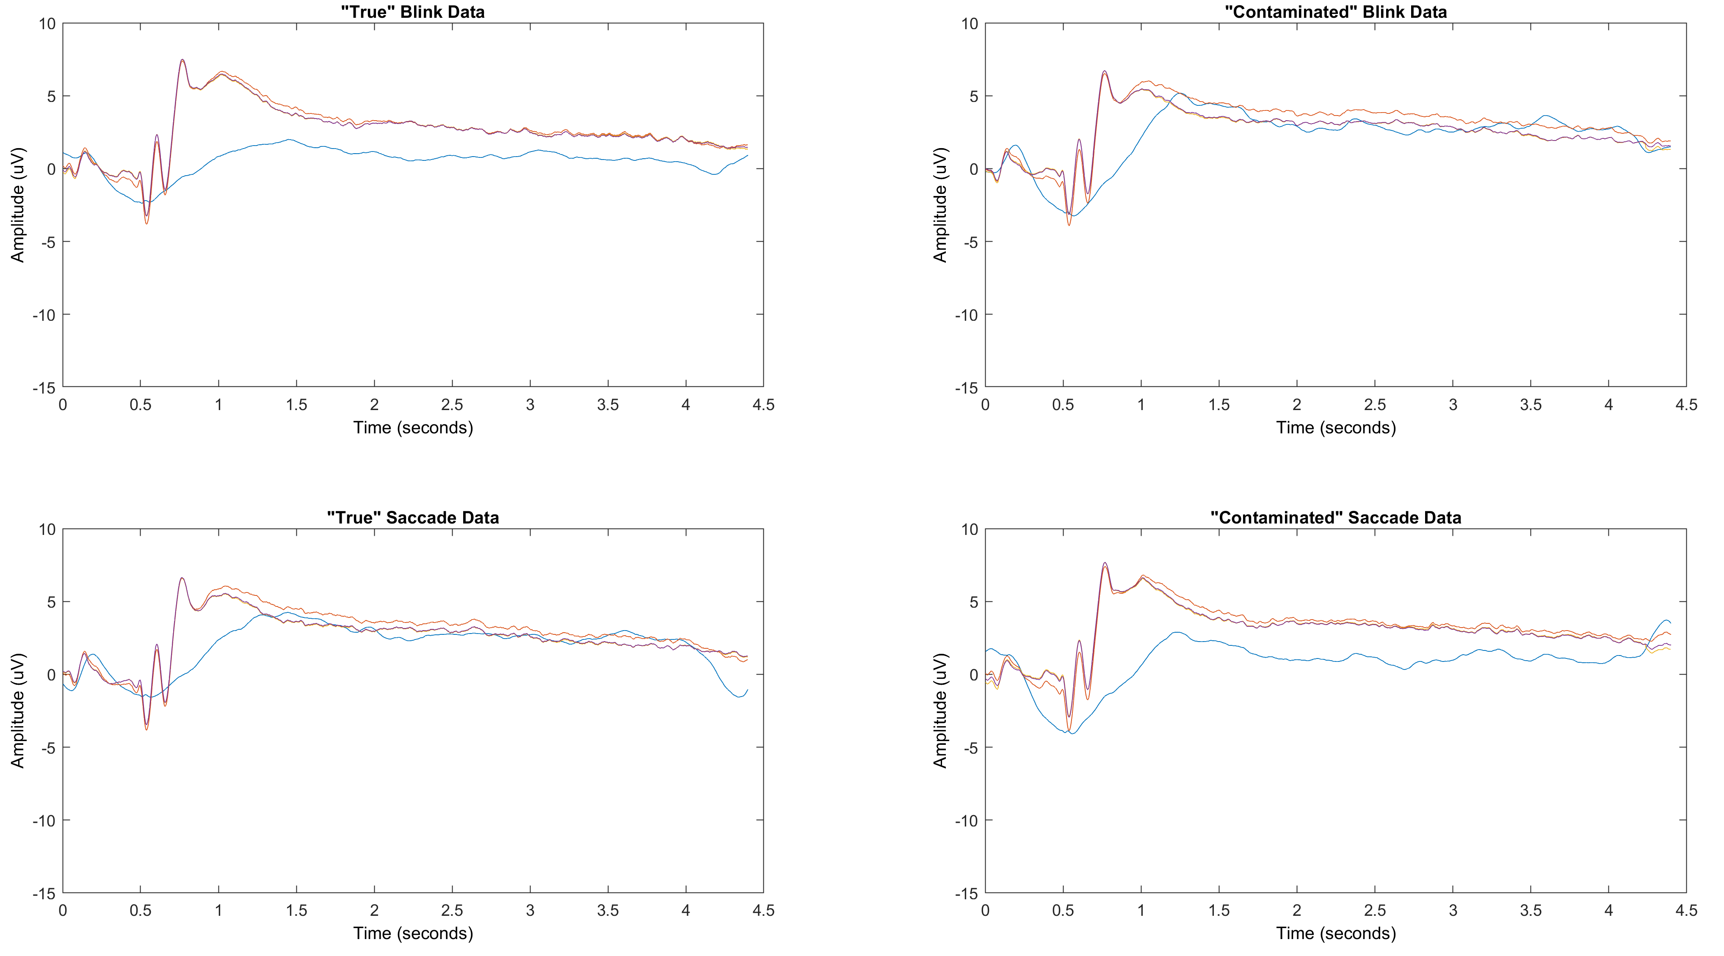
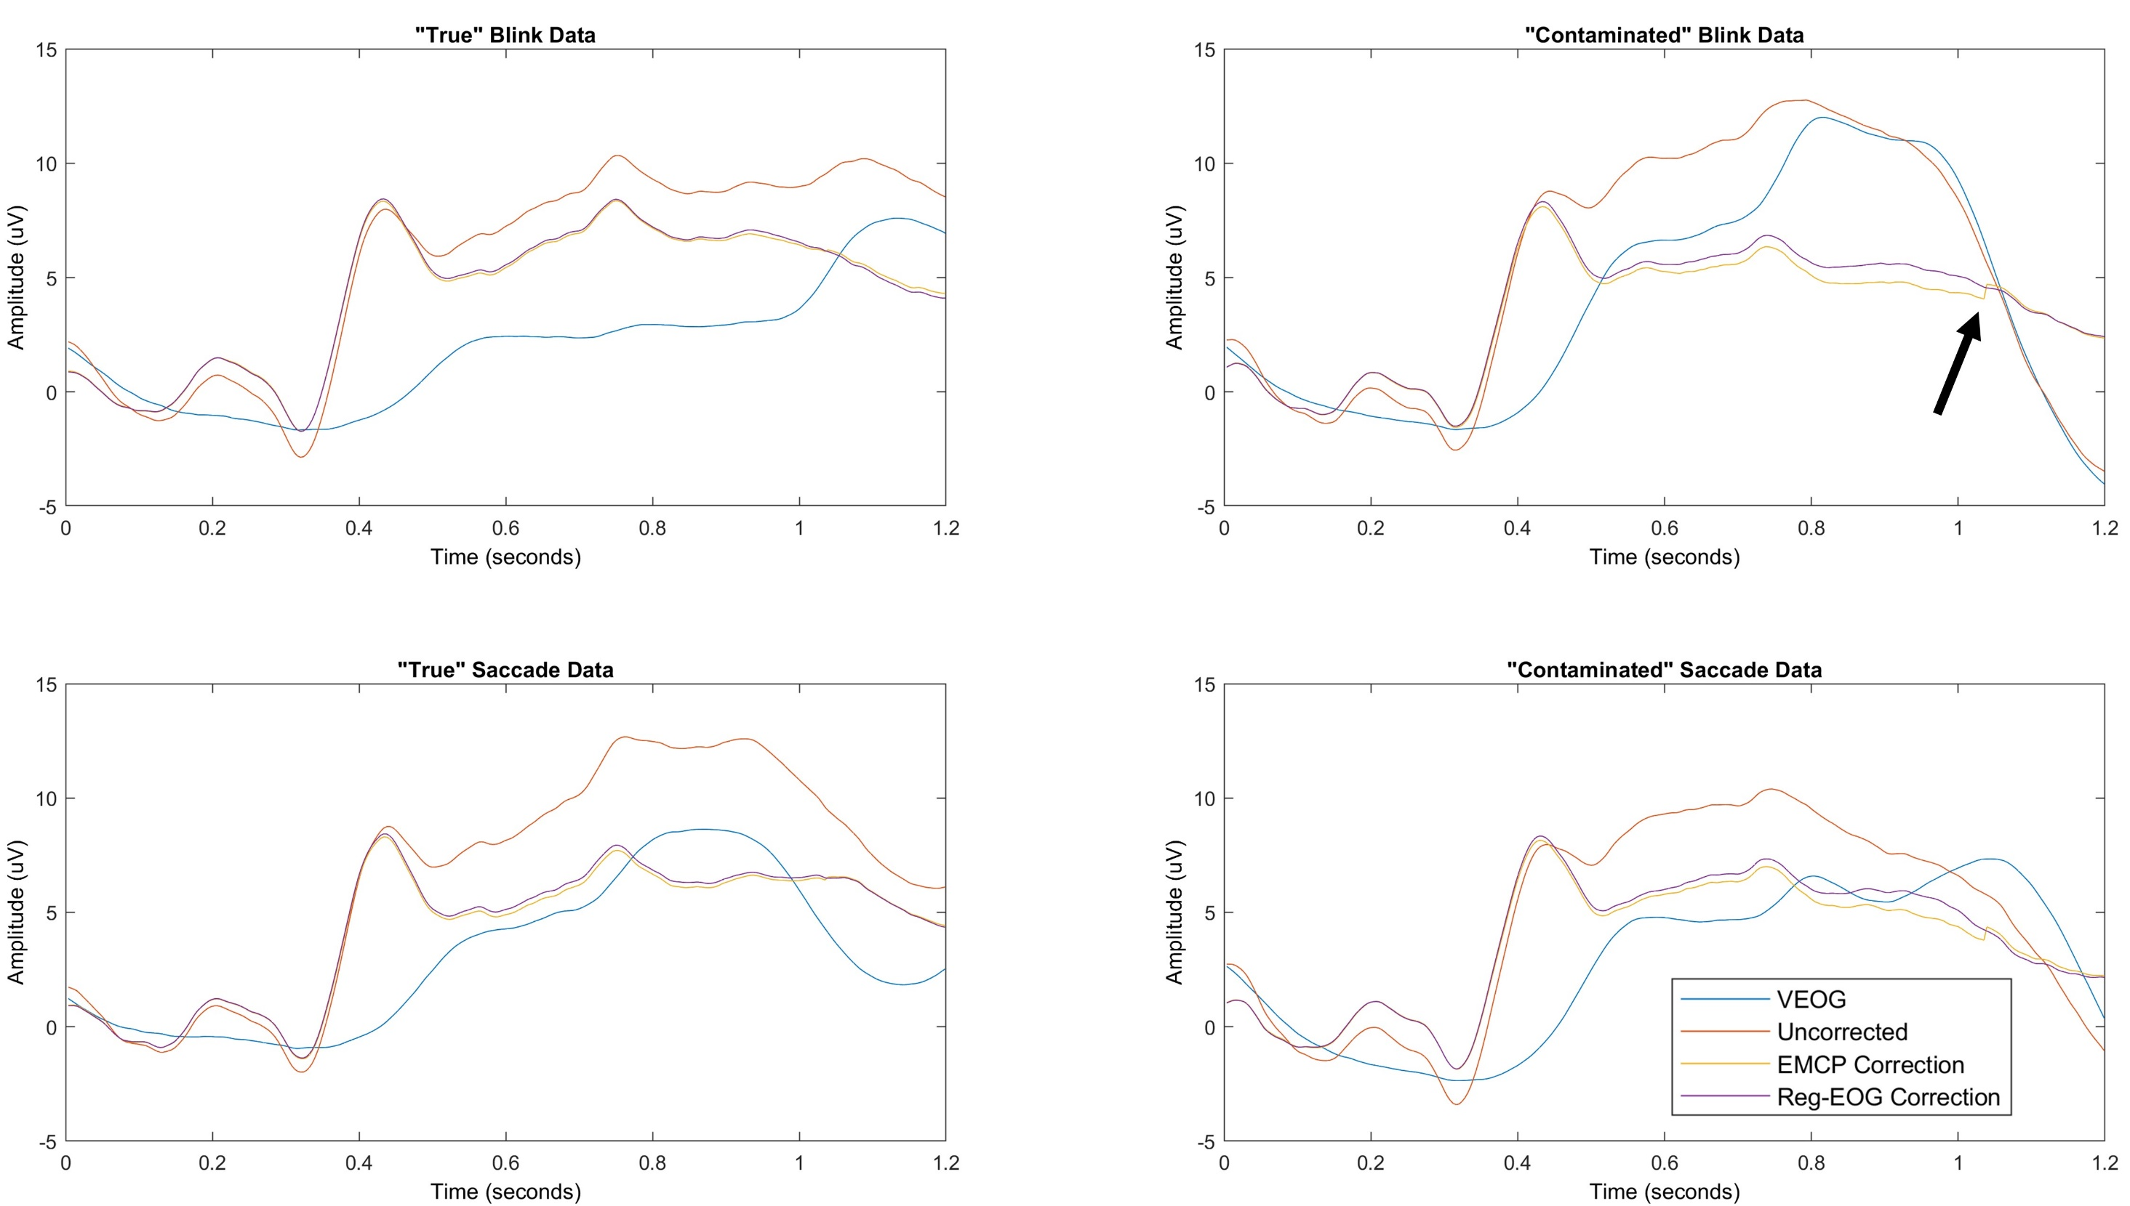
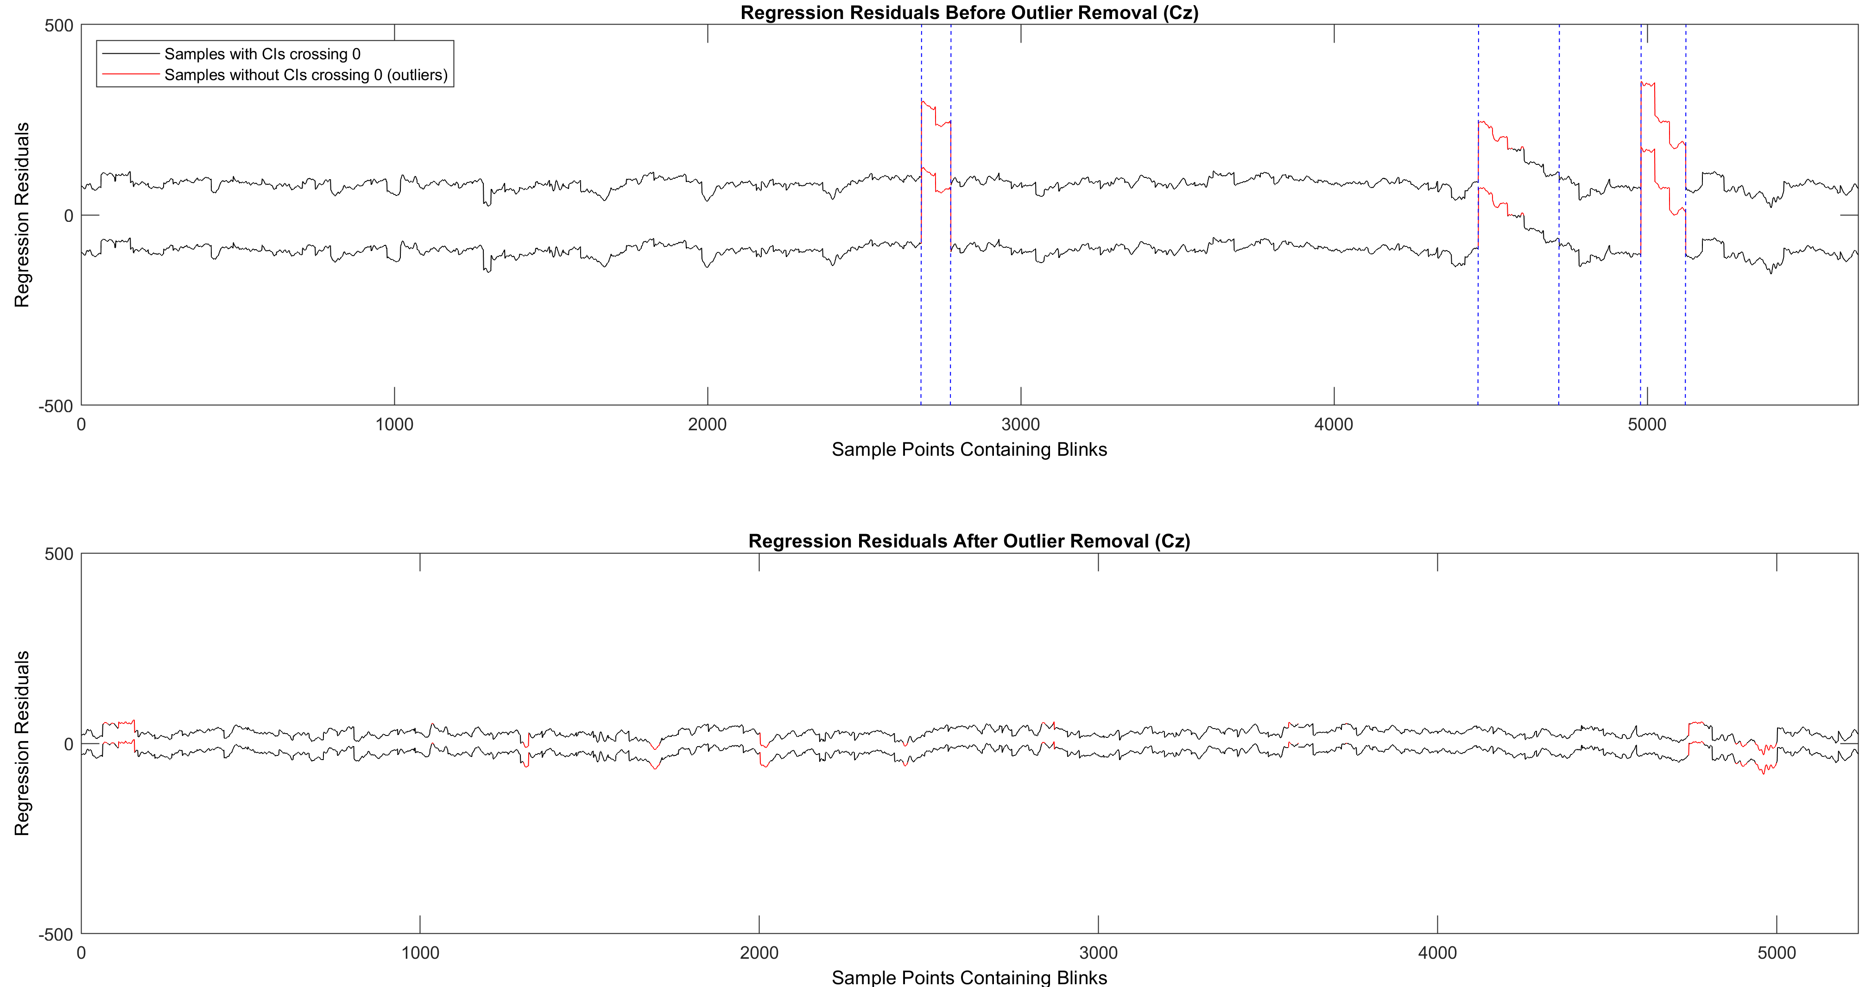
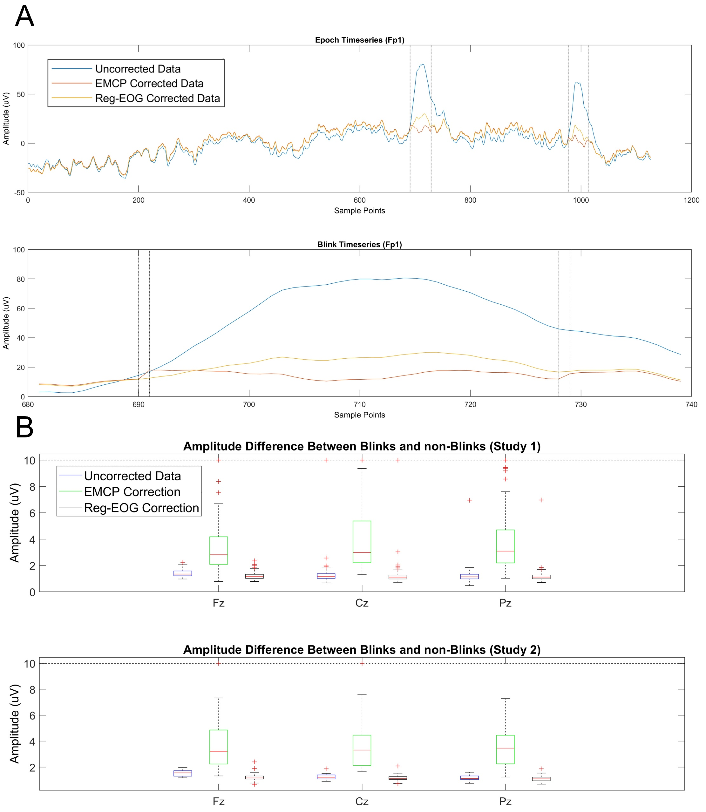
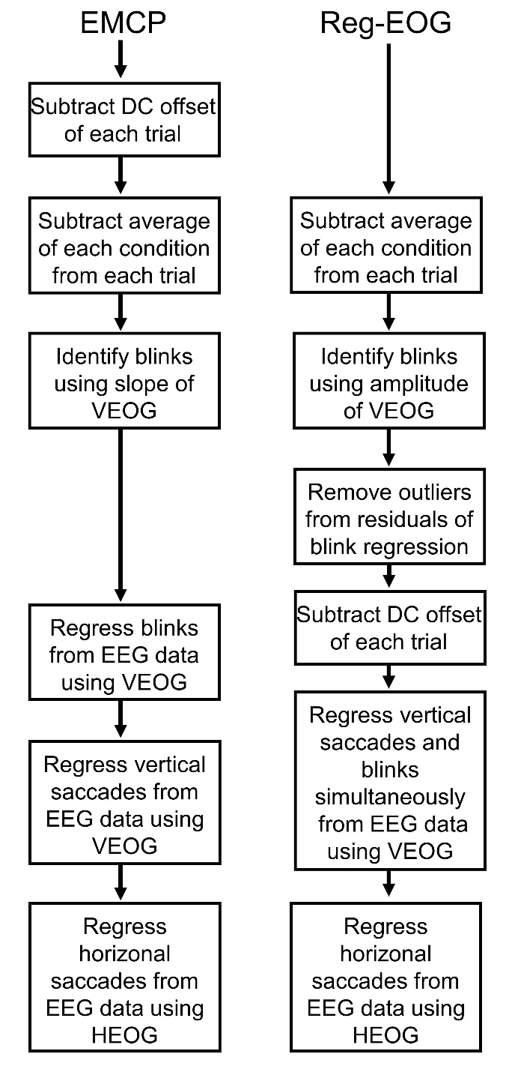
An Automated Method For Correcting Ocular Artifacts In EEG
B89
Brian Kraus
Department of Psychology - Northwestern University
btkraus@u.northwestern.edu
30 Second Summary
1. The Reg-EOG method for removing conserves more data and participants
3. Both corrections perform similarly in each study
Existing automatic eye correction methods are both sensitive to artifacts in the EEG and can distort the recorded data during correction
Here, a method is proposed that is much less sensitive to artifacts in the EEG and that provides visibly less distortion of the data than similar methods
This method provides a similar correction to other ocular correction methods and conserves more data for analysis
The method proposed here is ideal as an automated method for removing ocular artifacts in EEG data
Study 1
Study 2
Methods
1. Two datasets were used for analysis. Study 1 (Kraus & Kitayama, 2019) included 114 participants who viewed unpleasant and neutral IAPS pictures. Participants were instructed to attend to their emotional response in one condition and instructed to suppress it in another condition. In Study 2 (Kamikubo et al., 2018), participants were presented with a scenario which was about either you or another person, followed by a sentence presented word by word. ERPs were time-locked to the presentation of the last word, which was either positive or negative.
Amount of good epochs in each dataset after applying EMCP when removing epochs identified by the Reg-EOG method, no epochs, or randomly removing epochs
2. Calculating multiple correction coefficients in the same EOG channel distorts the data
Conclusions
Reg-EOG method automatically excludes bad data and improves quality of ocular correction
Provides equivalent correction to existing methods without distorting EEG data
The Reg-EOG method is suitable as an automated method of performing ocular correction on EEG data
A. Amplitude of blink onsets and offsets for a full epoch (top) and one blink (below)
B. Amplitude difference of blink offsets for uncorrected data, Reg-EOG, and EMCP corrections in both studies
2. The proposed correction method (Reg-EOG) removes outlier data via the Cis of the residuals of a blink correction (above)
3. In addition, the Reg-EOG method calculates one correction coefficient for the VEOG correction instead of two (left)
4. The efficacy of the Reg-EOG correction was evaluated in both datasets and tested against the correction outlined by Gratton et al. (EMCP; 1983)
References
1. Kraus & Kitayama, 2019. Interdependent Self-Construal Predicts Emotion Suppression in Asian Americans: An Electro- Cortical Investigation. Biological Psychology.
2. Kamikubo et al., 2018. Cultural Perspectives on Self-Other Biases: An ERP investigation among Taiwanese. Presented at the Japanese Psychogical Association Conference.
3. Gratton et al., 1983. A new method for off-line removal of ocular artifact. Electroencephalography and Clinical Neurophysiology.
Acknowledgements
This work was supported by NIH Grant T32NS047987 (BK)

