Slide 1
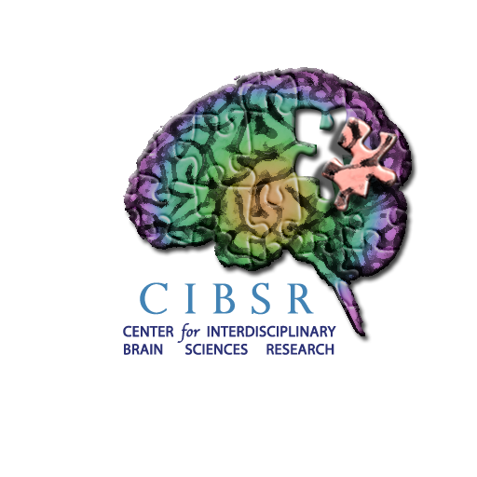

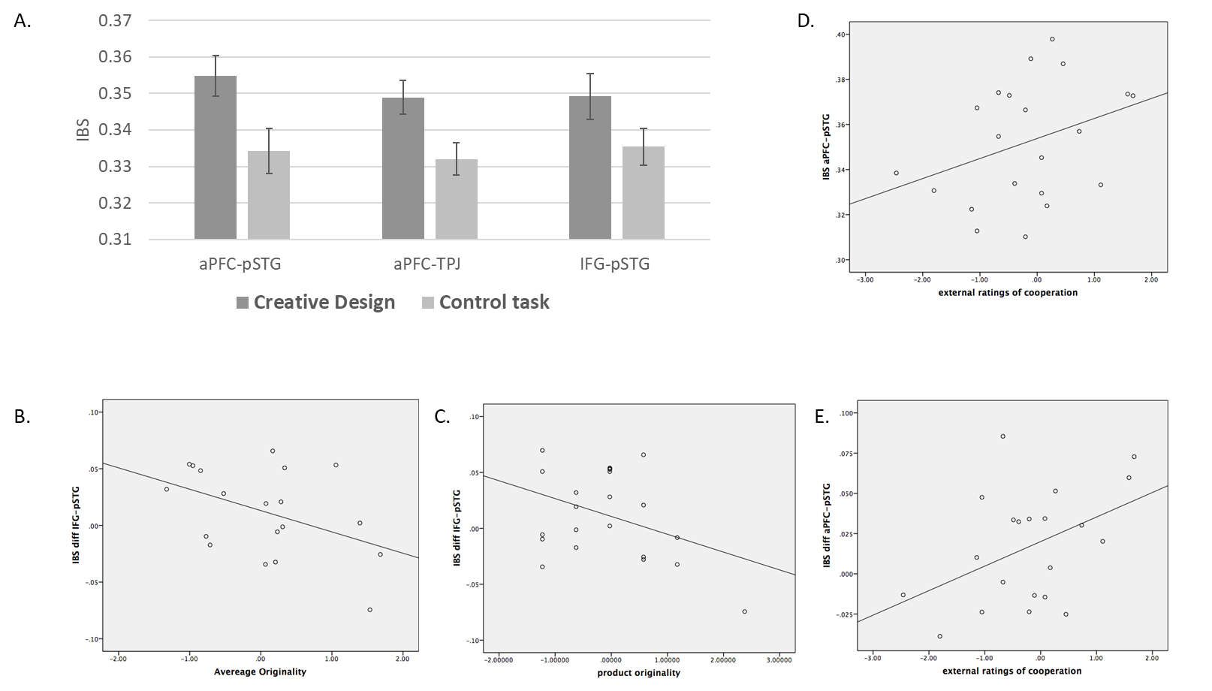
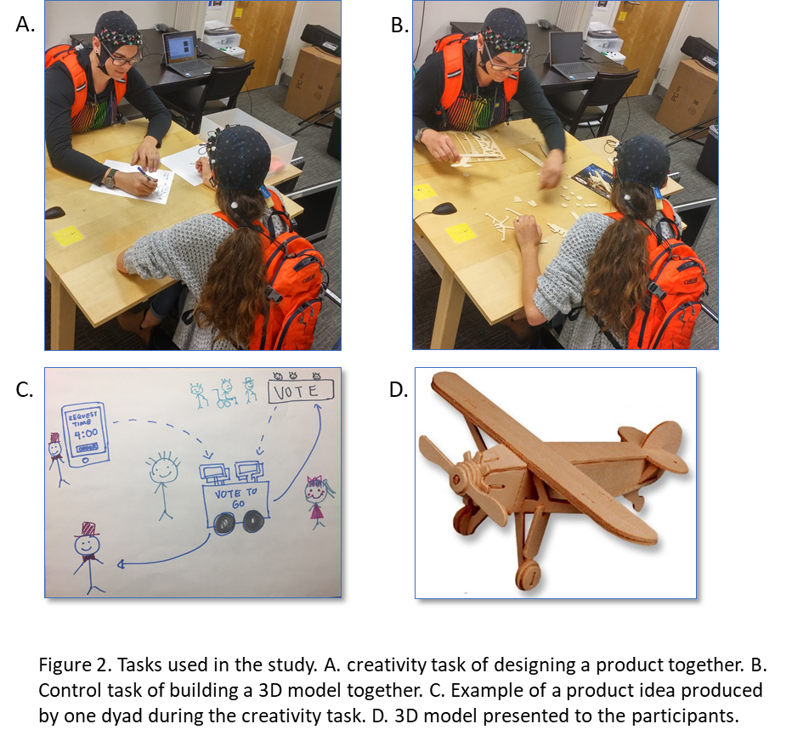
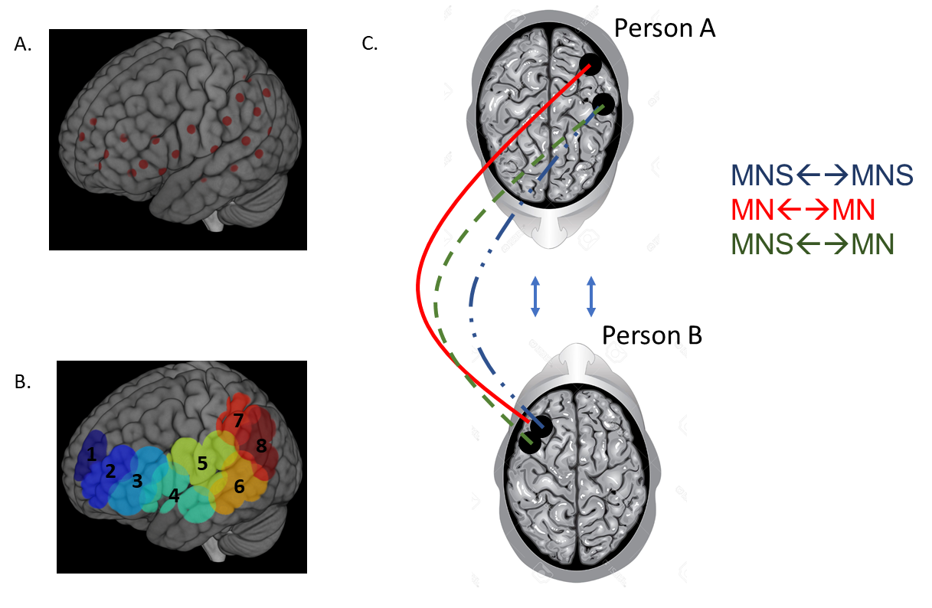
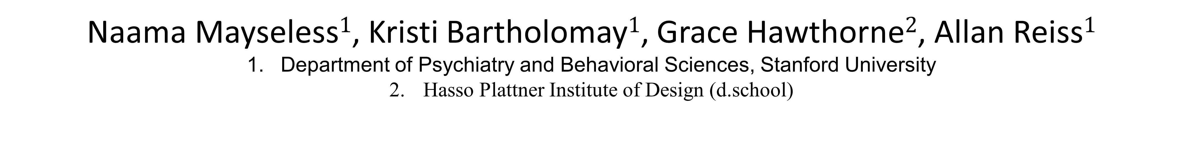
Creative collaboration between team-members is represented in their shared brain activity: A NIRS based hyperscanning study
Naama Mayseless$1$, Kristi Bartholomay$1$, Grace Hawthorne$2$, Allan Reiss$1$
Department of Psychiatry and Behavioral Sciences, Stanford University
Hasso Plattner Institute of Design (d.school)
Introduction
Results
Team collaboration is an essential component of teams looking to achieve innovative ideas.
This study investigated the brain-to-brain synchrony profile that occurs during creative team collaboration.
naturalistic study design that allowed for social face-to-face interaction and free movements using fNIRS
Methods
56 participants (27 females, age: 32.09±6.95) randomly assigned to one of 28 dyad pairs.
two 10-minute tasks while fNIRS was collected Participants then individually completed the Alternate Uses Task (AUT) to assess originality of individual thinking.
Figure 3. IBS Results. (A) Significant results of IBS analysis of the two experimental tasks. (B) Correlation analysis using the difference in IBS between the creative task and the control task between IFG-pSTG and average originality of dyad pair. (C) Correlation analysis using the difference in IBS between the creative design task and the control task between IFG-pSTG and originality of design product. (D) Correlation analysis using IBS of the creative design task between aPFC-pSTG and cooperation index. (E) Correlation analysis using the difference in IBS between the creative task and the control task between aPFC-pSTG and cooperation index.
fNIRS and IBS Analyses
Conclusions
Conclusions
Figure 1. Creativity and control task design. (A) Creativity task designing a product to increase voter turnout. (B) Control task building a 3D model airplane together. (C) Example of a product produced by one dyad in the creativity task. (D) 3D model airplane presented to participants.
IBS between mentalizing systems (aPFC and the temporoparietal gyrus): Increased IBS in the creative task only. These regions are thought to be related to the ability to infer knowledge, beliefs, and emotions (Theory of Mind). Success in the creativity task may require each partner taking the other’s perspective.
IBS between mirror neuron systems (pSTG-IFG): Increased IBS in both creativity and control tasks, suggesting these regions may be related to the demands of cooperation and communication generally, rather than the demands of creativity specifically. The difference in IBS was negatively correlated with average originality of the pair and originality of design product. Since mirror neuron systems are activated on imitation, this may suggest that when cooperation is achieved based on mimicry, overall potential for creativity may be reduced.
IBS between mentalizing and mirror neuron systems (aPFC-pSTG): IBS in these regions was positively correlated with level of cooperation, suggesting that cooperation may rely on one person’s ability of mimicry and their partner’s simultaneous ability to understand their intention.
Data Analysis
fNIRS: fNIRS data was preprocessed and channels were divided into 8 regions of interest in the left frontal, parietal, and temporal regions.
IBS Analysis: Inter-brain Synchrony (IBS) was measured between each ROI of the dyad pairs. Average IBS between the same ROI pairings within a dyad was used in all analyses.
Coding of Cooperation: Level of cooperation was coded independently by two trained raters from the video of both tasks on a 7 point Likert scale.
Coding of Creativity of Designs: Two trained raters raters independently assessed the originality of product ideas on a 5-point Likert scale.
Average Originality: Individual originality scores from the AUT were averaged between each pair to describe average originality of the dyad.
Figure 2. fNIRS setup and IBS analyses. (A) 22 channels covering left frontal, temporal, and parietal regions. (B) Regions of interest from source localization. (C) IBS results show increased IBS between mentalizing systems (MS) and mirror neuron systems (MNS).
ACKNOWLEDGEMENTS: This study was funded by grant ........

