Slide 1
May 20, 2020

Slide 2
Who is AWDis………
Citadel Brands:
Is the exclusive North American partner and distributor of the AWDis – (All We Do Is) stable of leading brands
Established in 2017 and based in Charlotte, NC
One of the fastest growing and most exciting brands in Europe
Will become one of the largest fleece producers in the world.
Long-Term Industry Commitment:
Investing more than $24M in equipment, processes, and facilities in 2019/2020
All of our manufacturing facilities are WRAP Certified
Products are prop 65 compliant

Slide 4
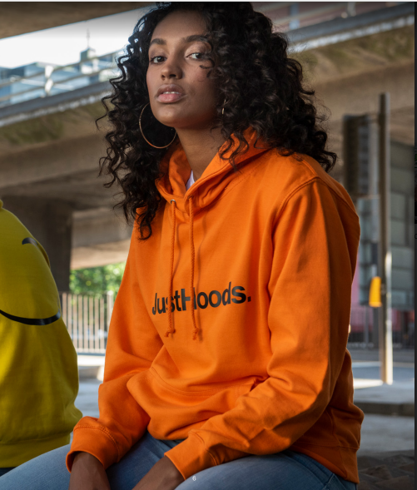
Style: JHA001 – College Hoodie
Fabric: 80% Ring-spun Cotton/20% Polyester
Weight: 8.3oz
Twin Needle Stitching detail
Double Fabric Hood
Kangaroo pouch pocket with hidden openings for phone cord feed
Self-colored drawstrings
Ribbed Cuff and Hem
100% cotton face creates the ideal printing surface
Easy tear-away label ideal for rebranding
Available in 37 colors
Case Quantities: 24 units
Sizes: S – 5XL – 8 Colors all other colors S – 3XL

Slide 5
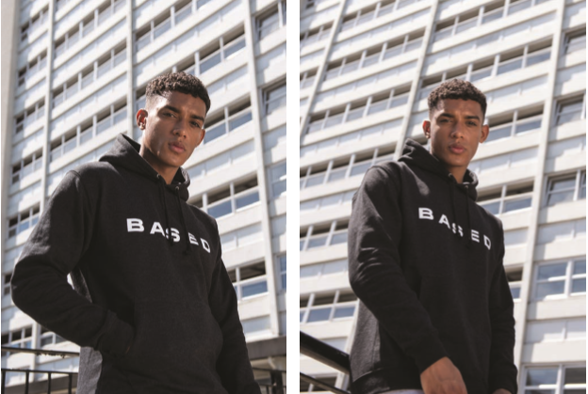
Basic College Hoodie available in 37 Colors

Slide 6
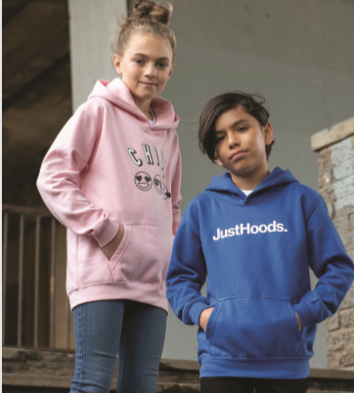
Style: JHY001 – Youth College Hoodie
Fabric: 80% Ring-spun Cotton/20% Polyester
Weight: 8.3oz
Twin Needle Stitching detail
Double Fabric Hood
Kangaroo pouch pocket with hidden openings for phone cord feed
No drawcords to comply with EU regulations
Ribbed Cuff and Hem
100% cotton face creates the ideal printing surface
Easy tear-away labels perfect for rebranding
Available in 8 colors
Case Quantities: 24 units
Sizes: XS – XL

Slide 7
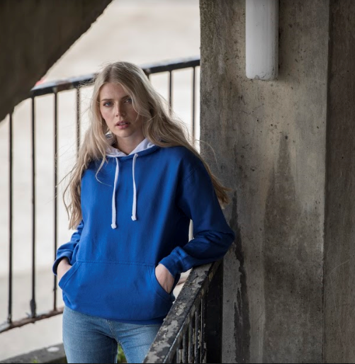
Style: JHA003 – Varsity Contrast Hoodie
Fabric: 80% Ring-spun Cotton/20% Polyester
Weight: 8.3oz
Twin Needle Stitching detail
Double Fabric Hood with contrast inner lining
Kangaroo pouch pocket with hidden openings for phone cord feed
Contrast flat lace drawcords
Ribbed Cuff and Hem
100% cotton face creates the ideal printing surface
Easy tear-away labels perfect for rebranding
Available in 24 colors
Case Quantities: 24 units
Sizes: S – 3XL

Slide 8
Style: JHA009 – Baseball Hoodie
Fabric: 80% Ring-spun Cotton/20% Polyester
Weight: 8.3oz
Twin Needle Stitching detail
Contrast Raglan Sleeves
Contrast Double Fabric Hood
Kangaroo pouch pocket with hidden openings for phone cord feed
Contrast flat lace drawcords
Ribbed Cuff and Hem
Easy tear-away labels prefect for rebranding
Available in 3 colors
Case Quantities: 24 units
Sizes: S – 3XL

Slide 9
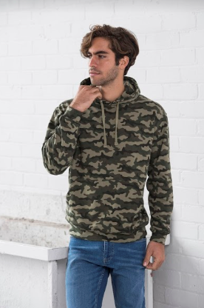
Style: JHA014 – Camo Hoodie
Fabric: 70% Ring-spun Cotton/30% Polyester
Weight: 8.3oz
Twin Needle Stitching detail
Classic all over camouflage print design
Double Fabric Hood
Kangaroo pouch pocket with hidden openings for phone cord feed
Flat lace drawcords
Ribbed Cuff and Hem
Simple tear-away labels perfect for rebranding
Available in 1 color
Case Quantities: 24 units
Sizes: S – 3XL

Slide 10
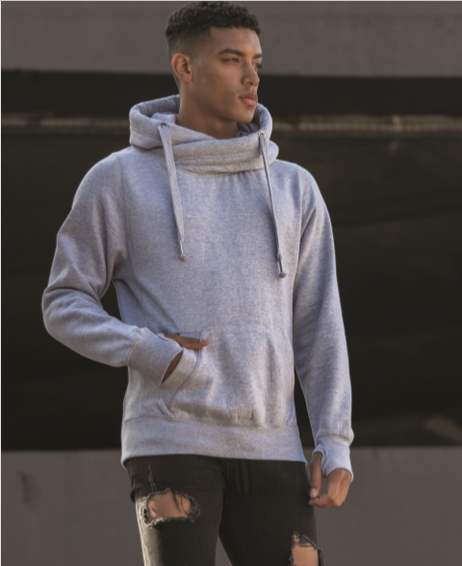
Style: JHA021 – Cross Neck Hoodie
Fabric: 70% Ring-spun Cotton/30% Polyester
Weight: 9.8oz Heavyweight Hoodie
Cross Over Neck detail
Three panel double fabric hood
Thumb holes in the cuffs
Kangaroo pouch pocket with hidden openings for phone cord feed
Flat lace drawcords
Ribbed Cuff and Hem
Easy tear-away labels prefect for rebranding
Available in 3 colors
Case Quantities: 24 units
Sizes: S – 3XL

Slide 11
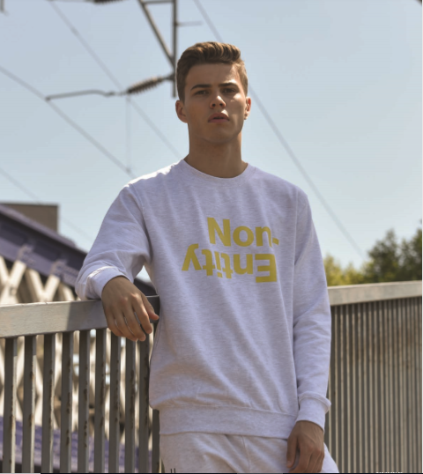
Style: JHA030 – College Sweat
Fabric: 80% Ring-spun Cotton/20% Polyester
Weight: 8.3oz
Twin Needle Stitching detail
Crew Neck Sweat with Stylish fit
Set in Sleeves
Taped Neck
Ribbed collar, cuffs and hem
100% cotton face creates the ideal printing surface
Easy tear-away labels prefect for rebranding
Available in 36 colors
Case Quantities: 36 units
Sizes: S – 5XL – 3 Colors all other colors S – 3XL

Slide 12
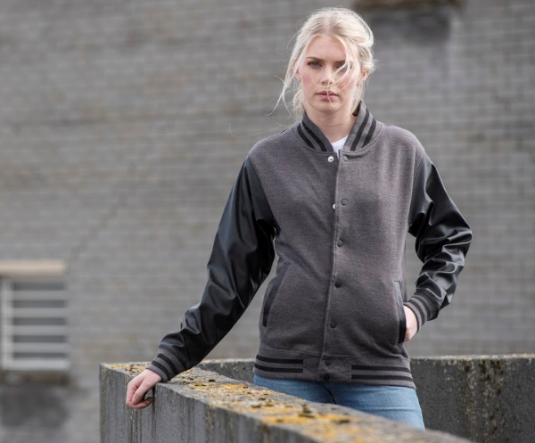
Style: JHA042 – Urban Letterman Jacket
Fabric: 70% Ring-spun Cotton/30% Polyester Body & 100% PU Leather (Sleeves)
Knitted collar, cuffs and waistband with stripe details
Faux leather sleeves
Press – stud closure
Welt pockets with faux leather trim
Hanging loop detail
Taped back neck
Cotton rich face creates the ideal printing surface
Easy tear away labels ideal for rebranding
Available in 2 colors
Case Quantities: 24 units
Sizes: S – 3XL

Slide 13
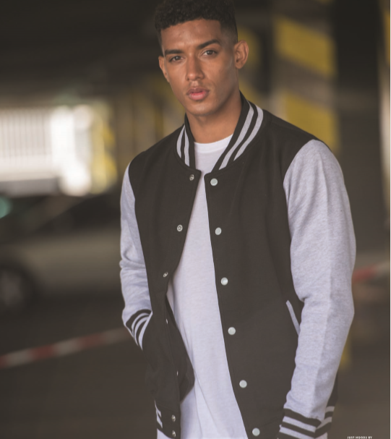
Style: JHA043 – Letterman Jacket
Fabric: 70% Ring-spun Cotton/30% Polyester
Knitted collar, cuffs and waistband with stripe detail
Contrast Sleeves with taped back neck
Press – stud closure
Contrast Studs
Welt contrast pockets
Hanging loop at back neck & Hidden earphone loops
Cotton rich face creates the ideal printing surface
Simple tear away labels ideal for rebranding
Available in 13 colors
Case Quantities: 24 units
Sizes: S – 3XL

Slide 14
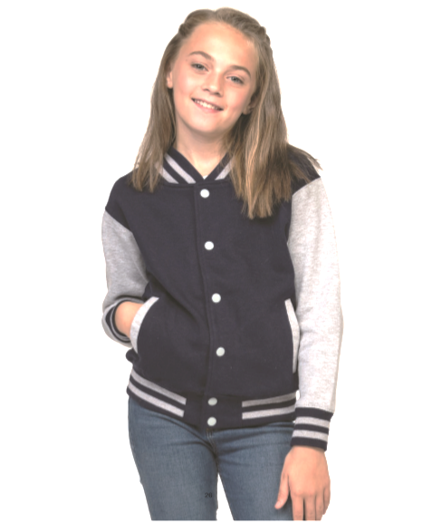
Style: JHY 043 – Youth Letterman Jacket
Fabric: 70% Ring-spun Cotton/30% Polyester
Knitted collar, cuffs and waistband with stripe detail
Contrast Sleeves with taped back neck
Press – stud closure
Contrast Studs
Welt contrast pockets
Hanging loop at back neck & Hidden earphone loops
Cotton rich face creates the ideal printing surface
Easy tear-away labels ideal for rebranding
Available in 5 colors
Case Quantities: 24 units
Sizes: XS – XL

Slide 15
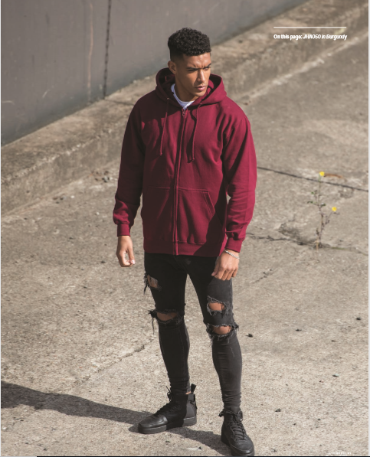
Style: JHA050 – College Zip Hoodie
Fabric: 80% Ring-spun Cotton/20% Polyester
Weight: 8.3oz Full Zip Hoodie
Twin Needle Stitching detail &
Self-fabric covered main Zip
Double Fabric Hood
Right pocket has small hidden openings for phone cord feed with hidden earphone loops
Self-colored drawstrings
Ribbed Cuff and Hem
100% cotton face creates the ideal printing surface
Available in 7 colors
Case Quantities: 24 units
Sizes: S – 3XL

Slide 16
Just Hoods Fleece Product Advantages
Mid-Weight ranging from 8.3oz. to 9.8oz. – Fabrics either 80% Ring-Spun Cotton/20% Polyester or 70% Ring-Spun Cotton/30% Polyester
Our core styles are manufactured using ultra soft, combed ring-spun poly- cotton fabric, providing unbelievable comfort and the ultimate printing surface.
Sell the Just Hoods products with confidence. We only partner with factories that meet our high standards and commitment across human resources, health and safety, environmental practices, legal compliance, security and local laws that’s why all facilities are WRAP certified.
Easy tear away labels which makes them perfect for rebranding
Prop 65 Compliant

Slide 17
New Product Adds for 2020

Slide 18
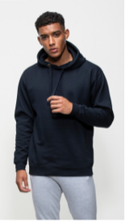
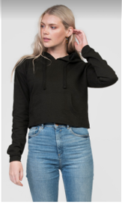
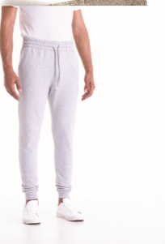
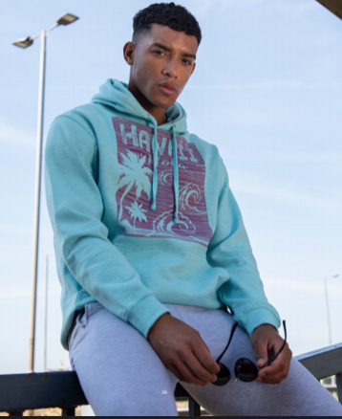
Style: JHA011
Style: JHA016
Style: JHA074
Tapered Track Pant
Style: JHA017
Epic Print Hoodie
Girlie Cropped Hoodie
Surf Hoodie

Slide 19
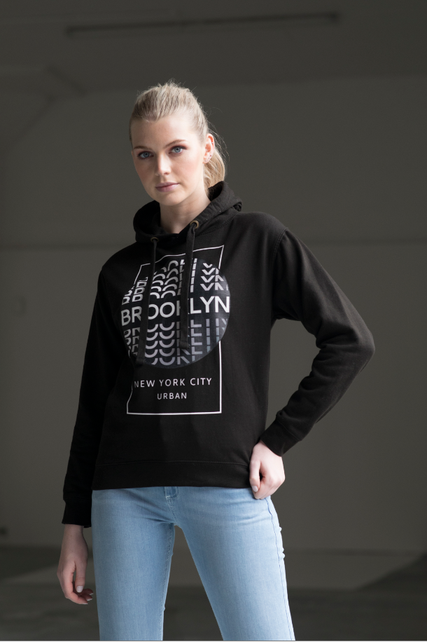
Style: JHA011 – Epic Hoodie
80% Ring-spun Cotton/20% Polyester
8.3oz. Mid-weight fabric
Twin needle stitching detail
Double fabric hood
Self-colored drawcords
Ribbed cuffs and hem
No pocket for maximum print surface area
Soft cotton faced fabric creates ideal printing surface
Simple tear-away label makes it perfect for rebranding
Available in 1 color
Case Quantities: 24 units
Sizes: S – 3XL
New Product for 2020

Slide 20
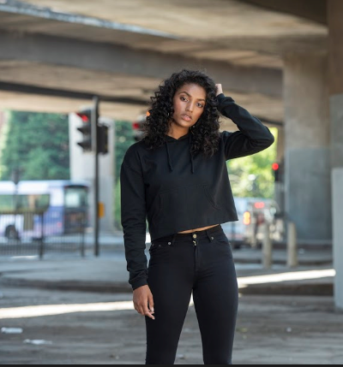
Style: JHA016 – Girlie Cropped Hoodie
80% Ring-spun Cotton/20% Polyester
8.3oz. Mid-weight fabric
Twin needle stitching detail
Cropped cut with drop shoulder design
Raw edge with cover stitching
Relaxed feminine fit
Kangaroo pouch pocket with small hidden openings for ear-phone cord feed
Ribbed cuffs
Easy tear-away label makes it perfect for rebranding
Available in 3 colors
Case Quantities: 24 units
Sizes: XS – XL
New Product for 2020

Slide 21
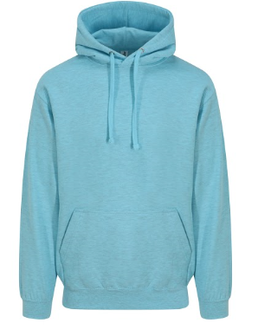
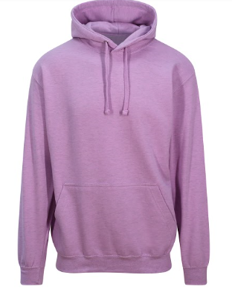
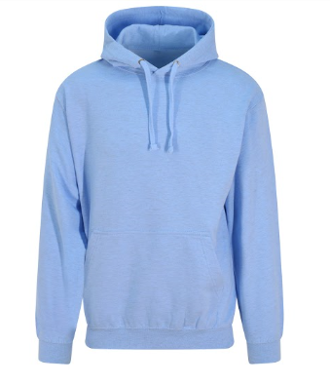
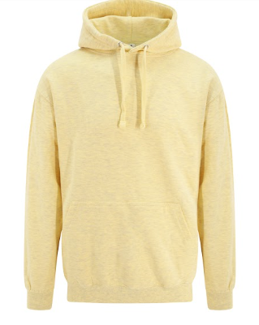
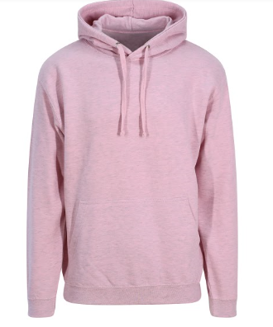
Style: JHA017 – Surf Hoodie
80% Ring-spun Cotton/20% Polyester
8.3oz. Mid-weight fabric
Twin needle stitching detail
Double fabric hood
Self-colored drawcords
Kangaroo pouch pocket with small hidden openings for ear-phone cord feed
Ribbed cuffs and hem
Soft cotton faced fabric creates ideal printing surface
Easy tear-away label makes it perfect for rebranding
Available in 5 colors
Case Quantities: 24 units
Sizes: S – 3XL
Surf Ocean
Surf Purple
New Product for 2020
Surf Blue
Surf Yellow
Surf Pink

Slide 22
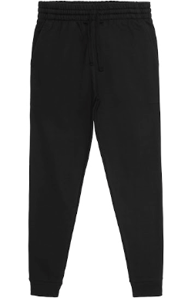
Style: JHA074 – Tapered Track Pant
80% Ring-spun Cotton/20% Polyester
8.3oz. Mid-weight fabric
Twin needle stitching detail
Elasticated waistband
Self-colored drawcords
Front Pockets
Tapered slim fit design
Ribbed cuffs
Soft cotton faced fabric creates the ideal printing surface
Easy tear-away label makes it perfect for rebranding
Available in 2 colors
Case Quantities: 24 units
Sizes: S – 3XL
New Product for 2020

Slide 24
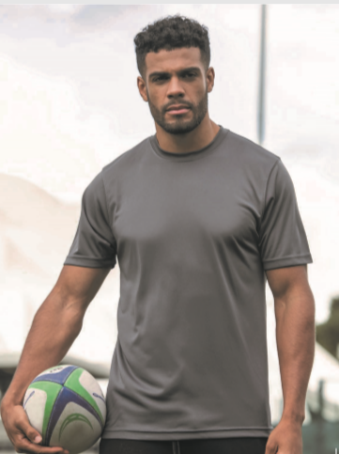
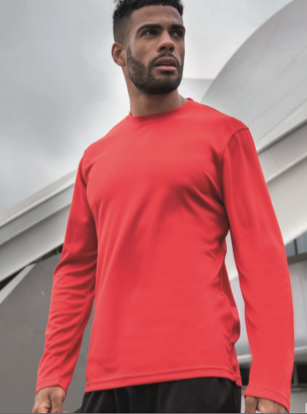
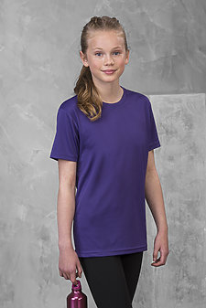
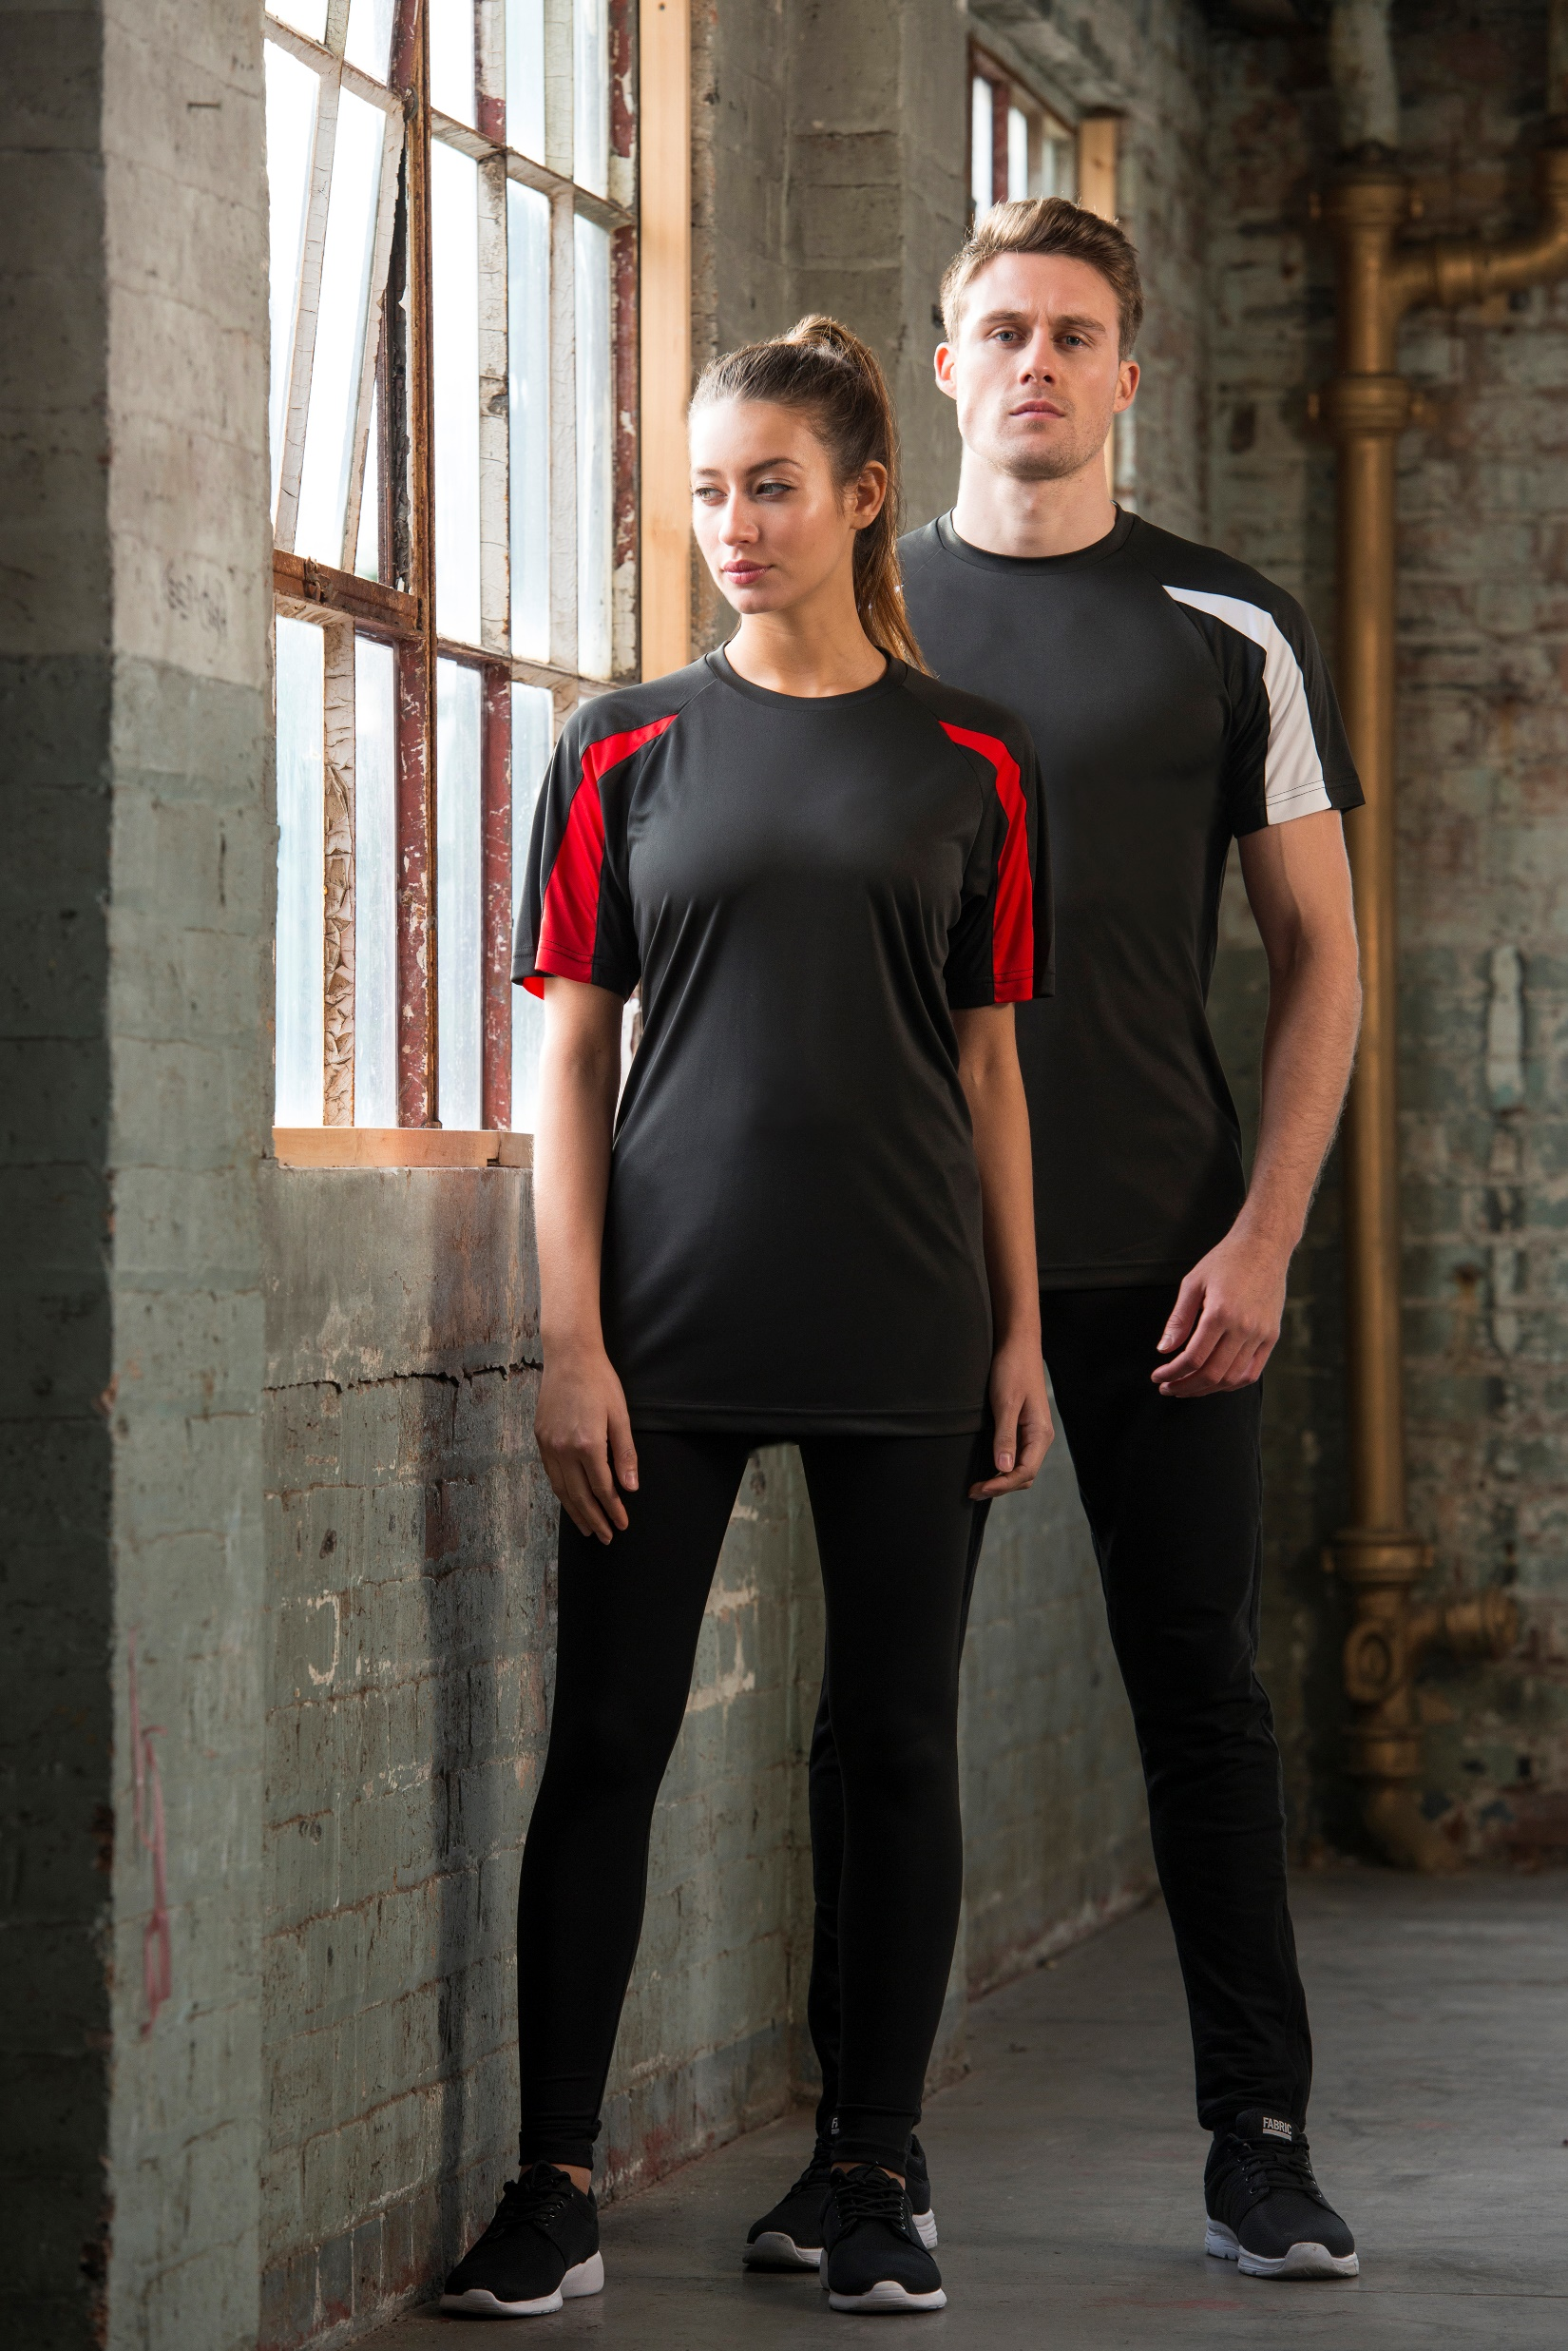

Slide 25
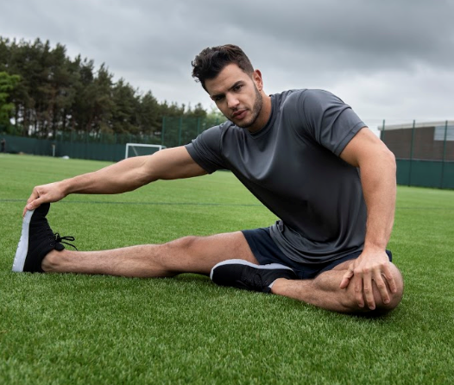
Style: JCA001 – Adult S/S Cool T
Fabric: 100% Polyester
Weight: 4.1oz
Self-fabric taped back neck
Twin needle stitching detail
Inherent stretch fabric properties
Easy tear-away labels for easy rebranding
Relaxed fit
Available in 30 colors
Case Quantities: 72 units
Sizes: S – 5XL – (Arctic White & Jet Black)
Crafted from a lightweight Neoteric Smooth fabric to wick moisture away from the skin to ensure you stay cool and dry

Slide 26
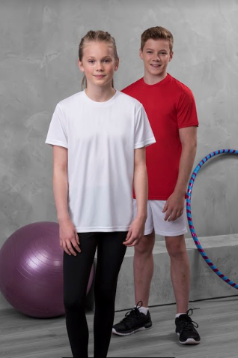
Style: JCY001 – Youth S/S Cool T
Fabric: 100% Polyester
Weight: 4.1oz
Self-fabric taped back neck
Twin needle stitching detail
Inherent stretch fabric properties
Tear away labels for easy rebranding
Relaxed fit
Available in 14 colors
Case Quantities: 72 units
Sizes: XS – XL

Slide 27
Style: JCA002 – Adult L/S Cool T
Fabric: 100% Polyester
Weight: 4.1oz
Self-fabric taped back neck
Twin needle stitching detail
Inherent stretch fabric properties
Tear away labels for easy rebranding
Relaxed fit
Available in 7 colors
Case Quantities: 72 units
Sizes: S – 3XL

Slide 28
Style: JCA005 – Ladies S/S Cool T
New Color Add for 2020
Fabric: 100% Polyester
Weight: 4.1oz
Self-fabric taped back neck
Twin needle stitching detail
Inherent wicking & stretch fabric properties
Tear away labels for easy rebranding
Relaxed fit
Available in 9 colors
Case Quantities: 72 units
Sizes: XS – 2XL
Kelly Green
With a feminine fit and non-restrictive design, this is an essential for you activewear wardrobe

Slide 29
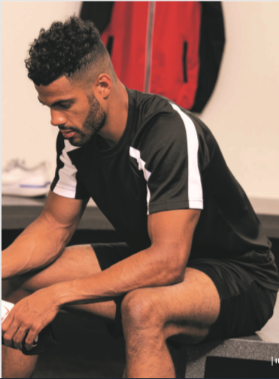
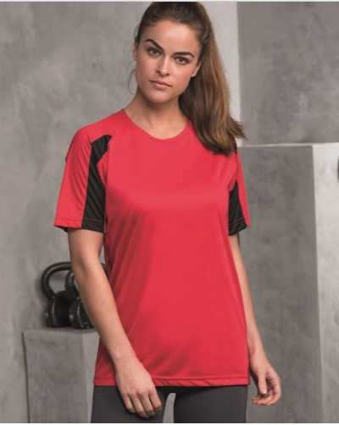
Style: JCA 003 – Contrast S/S Cool T
Fabric: 100% Polyester
Weight: 4.1oz
Self-fabric taped back neck
Twin needle stitching detail
Inherent stretch fabric properties
Tear away labels for easy rebranding
Relaxed fit
Available in 4 colors
Case Quantities: 72 units
Sizes: S – 3XL
This contrast color is a great product for team sports, with raglan sleeves to create a full range of motion.

Slide 30
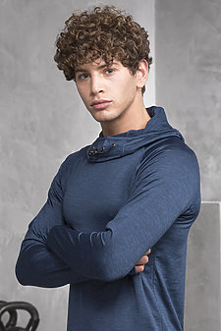
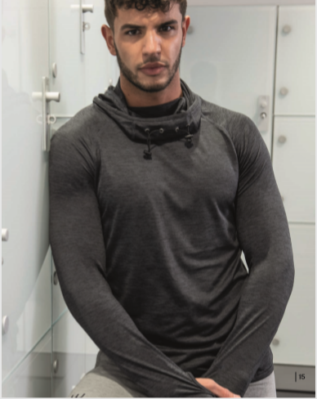
Style: JCA037 – Cool Cowl Neck
Fabric: 92% Polyester/8% Spandex
Weight: 6.2oz
Flat-lock stitching detail
Reflective elements on hood and back neck
Inherent stretch fabric properties
Raglan sleeve design with thumb-hole openings
Easy tear-away labels for easy rebranding
Available in 5 colors
Case Quantities: 24 units
Sizes: S – 3XL
Black Slate
Navy
Royal
Grey
Red

Slide 31
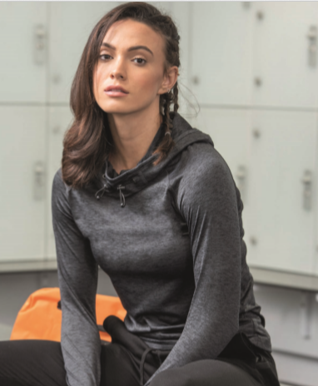
Style: JCA038 – Ladies Cool Cowl Neck
Fabric: 92% Polyester/8% Spandex
Weight: 6.2oz
Flat-lock stitching detail
Reflective elements on hood and back neck
Inherent stretch fabric properties
Raglan sleeve design with thumb-hole openings
Easy tear-away labels for easy rebranding
Available in 5 colors
Case Quantities: 24 units
Sizes: XS – 2XL
Black Slate
Electric Pink
Royal
Grey
Red

Slide 32
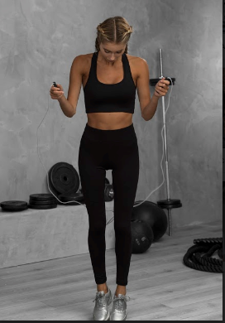
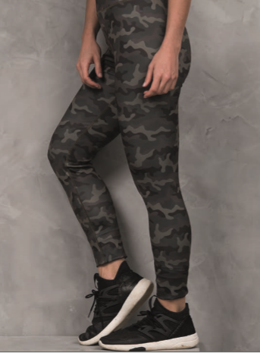
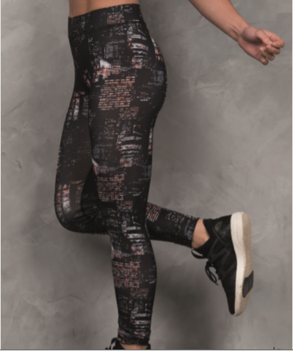
Push your workout to the next level with these ultimate workout leggings

Slide 33
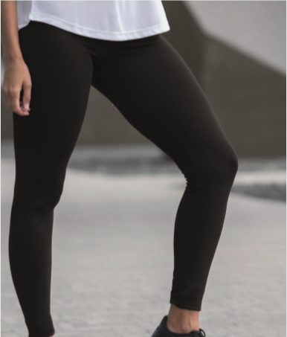
Style: JCA070 – Ladies Workout Leggings
Fabric: 86% Polyester/14% Spandex
Weight: 9.9oz
Flat-lock stitching detail for Comfort
Active Fit
Smooth Finish
Polyester/Spandex blend fabric
Available in 1 color – Jet Black
Case Quantities: 48 units
Sizes: XS – XL

Slide 34
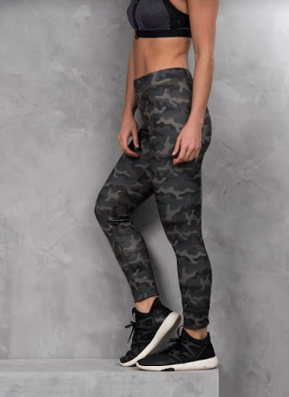
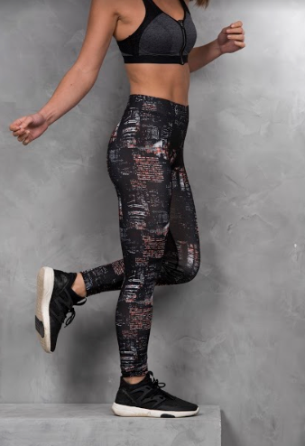
Style: JCA077 – Ladies Printed Leggings
Fabric: 86% Polyester/14% Spandex
Weight: 9.9oz
Elasticated smooth waistband
Flat-lock stitching for Comfort
Flat seams for less irritation
Full length for a sleek finish
Available in 2 colors
Case Quantities: 48 units
Sizes: XS – XL
Fashion Green Camo
City Nights

Slide 35
Just Cool Product Advantages
Just Cool poly product are crafted from a lightweight Smooth Neoteric Fabric – creating a great platform for Screen Printing, Sublimation, or Heat Transfers
Sell the Just Cool products with confidence. We only partner with factories that meet our high standards and commitment across human resources, health and safety, environmental practices, legal compliance, security and local laws that’s why all facilities WRAP certified.
Great opening price point products to target large scale Poly end-users.
Easy tear away labels which makes them perfect for rebranding
Prop 65 Complaint

