Slide 2
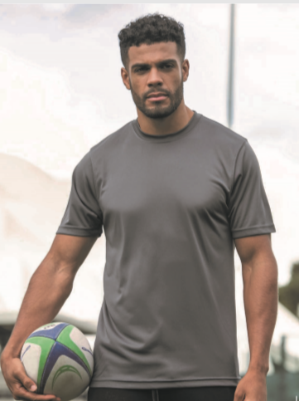
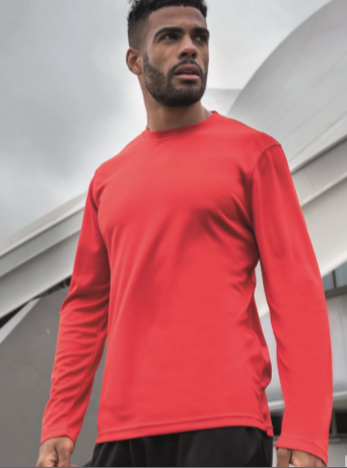
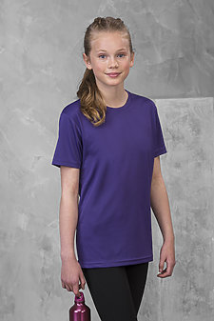
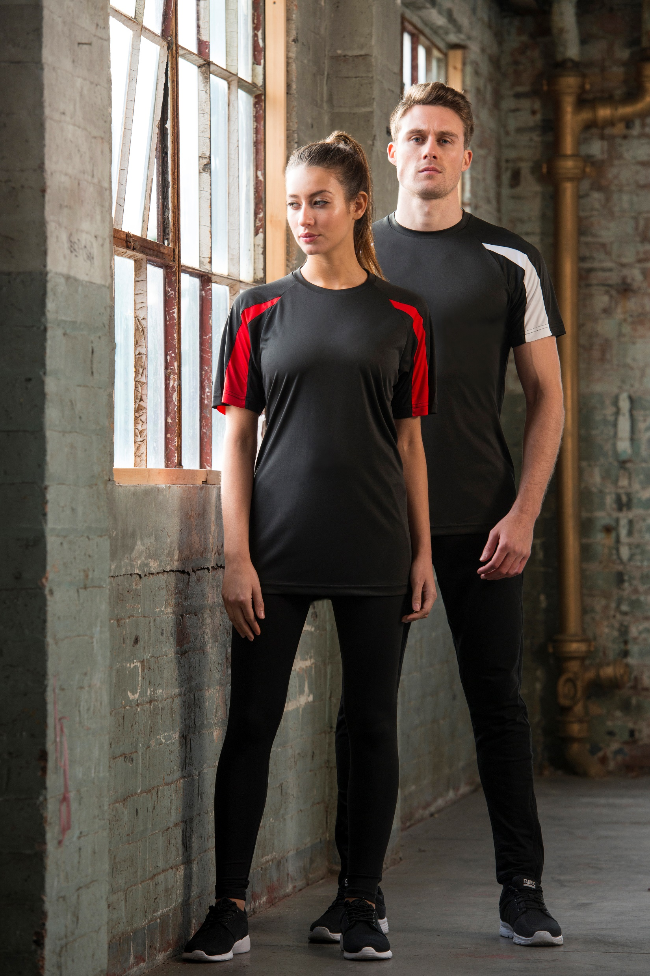

Slide 3
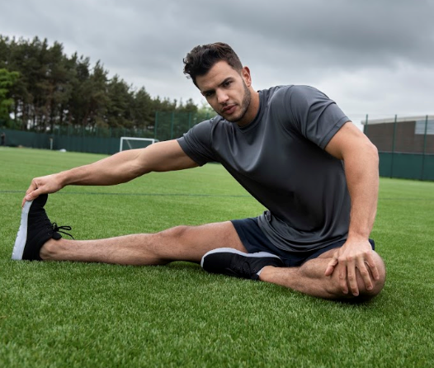
Style: JCA001 – Adult S/S Cool T
Fabric: 100% Polyester
Weight: 4.1oz
Self-fabric taped back neck
Twin needle stitching detail
Inherent stretch fabric properties
Easy tear-away labels for easy rebranding
Relaxed fit
Available in 30 colors
Case Quantities: 72 units
Sizes: S – 5XL – (Arctic White & Jet Black)
Crafted from a lightweight Neoteric Smooth fabric to wick moisture away from the skin to ensure you stay cool and dry

Slide 4
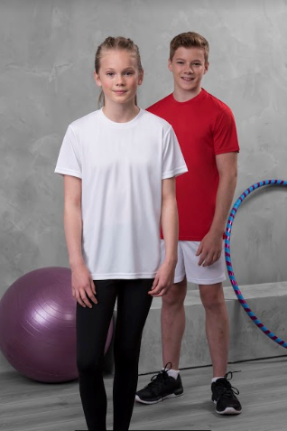
Style: JCY001 – Youth S/S Cool T
Fabric: 100% Polyester
Weight: 4.1oz
Self-fabric taped back neck
Twin needle stitching detail
Inherent stretch fabric properties
Tear away labels for easy rebranding
Relaxed fit
Available in 14 colors
Case Quantities: 72 units
Sizes: XS – XL

Slide 5
Style: JCA002 – Adult L/S Cool T
Fabric: 100% Polyester
Weight: 4.1oz
Self-fabric taped back neck
Twin needle stitching detail
Inherent stretch fabric properties
Tear away labels for easy rebranding
Relaxed fit
Available in 7 colors
Case Quantities: 72 units
Sizes: S – 3XL

Slide 6
Style: JCA005 – Ladies S/S Cool T
New Color Add for 2020
Fabric: 100% Polyester
Weight: 4.1oz
Self-fabric taped back neck
Twin needle stitching detail
Inherent wicking & stretch fabric properties
Tear away labels for easy rebranding
Relaxed fit
Available in 9 colors
Case Quantities: 72 units
Sizes: XS – 2XL
Kelly Green
With a feminine fit and non-restrictive design, this is an essential for you activewear wardrobe

Slide 7
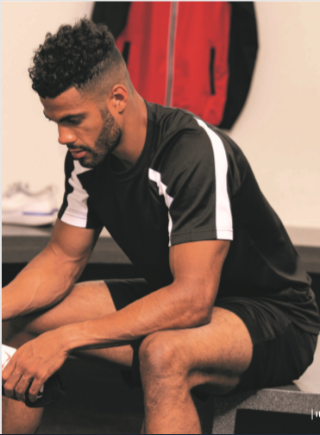
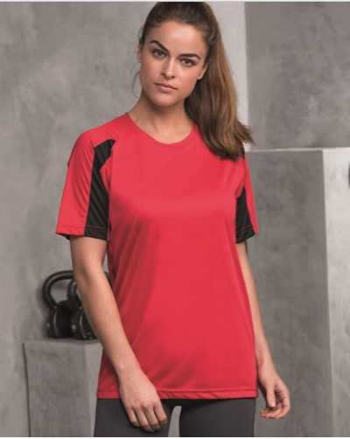
Style: JCA 003 – Contrast S/S Cool T
Fabric: 100% Polyester
Weight: 4.1oz
Self-fabric taped back neck
Twin needle stitching detail
Inherent stretch fabric properties
Tear away labels for easy rebranding
Relaxed fit
Available in 4 colors
Case Quantities: 72 units
Sizes: S – 3XL
This contrast color is a great product for team sports, with raglan sleeves to create a full range of motion.

Slide 8
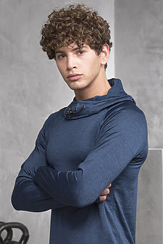
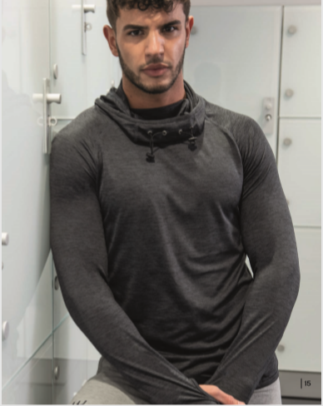
Style: JCA037 – Cool Cowl Neck
Fabric: 92% Polyester/8% Spandex
Weight: 6.2oz
Flat-lock stitching detail
Reflective elements on hood and back neck
Inherent stretch fabric properties
Raglan sleeve design with thumb-hole openings
Easy tear-away labels for easy rebranding
Available in 5 colors
Case Quantities: 24 units
Sizes: S – 3XL
Black Slate
Navy
Royal
Grey
Red

Slide 9
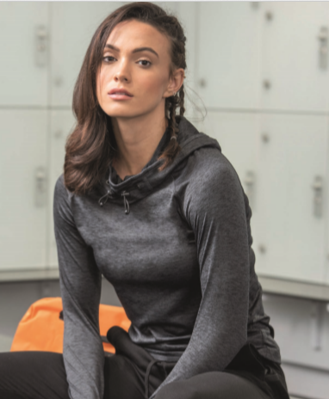
Style: JCA038 – Ladies Cool Cowl Neck
Fabric: 92% Polyester/8% Spandex
Weight: 6.2oz
Flat-lock stitching detail
Reflective elements on hood and back neck
Inherent stretch fabric properties
Raglan sleeve design with thumb-hole openings
Easy tear-away labels for easy rebranding
Available in 5 colors
Case Quantities: 24 units
Sizes: XS – 2XL
Black Slate
Electric Pink
Royal
Grey
Red

Slide 10
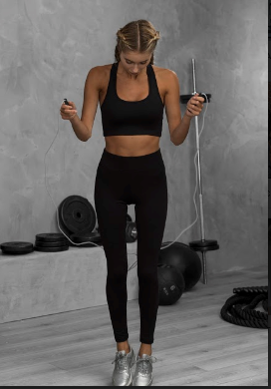
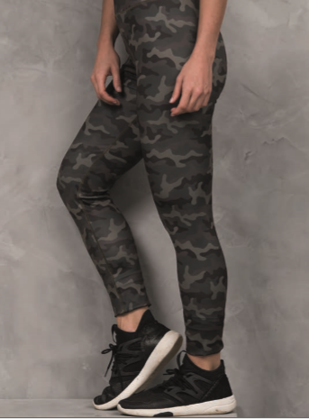
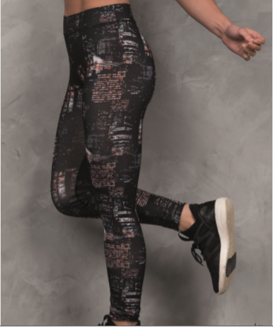
Push your workout to the next level with these ultimate workout leggings

Slide 11
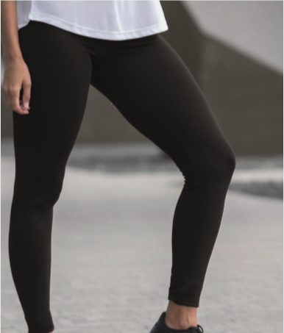
Style: JCA070 – Ladies Workout Leggings
Fabric: 86% Polyester/14% Spandex
Weight: 9.9oz
Flat-lock stitching detail for Comfort
Active Fit
Smooth Finish
Polyester/Spandex blend fabric
Available in 1 color – Jet Black
Case Quantities: 48 units
Sizes: XS – XL

Slide 12
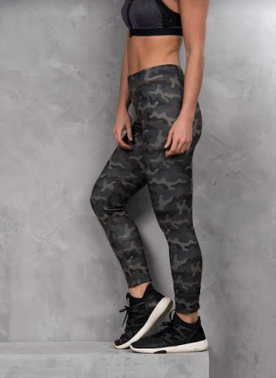
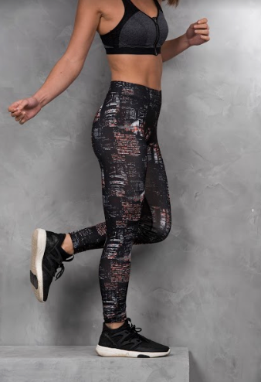
Style: JCA077 – Ladies Printed Leggings
Fabric: 86% Polyester/14% Spandex
Weight: 9.9oz
Elasticated smooth waistband
Flat-lock stitching for Comfort
Flat seams for less irritation
Full length for a sleek finish
Available in 2 colors
Case Quantities: 48 units
Sizes: XS – XL
Fashion Green Camo
City Nights

Slide 13
Just Cool Product Advantages
Just Cool poly product are crafted from a lightweight Smooth Neoteric Fabric – creating a great platform for Screen Printing, Sublimation, or Heat Transfers
Sell the Just Cool products with confidence. We only partner with factories that meet our high standards and commitment across human resources, health and safety, environmental practices, legal compliance, security and local laws that’s why all facilities WRAP certified.
Great opening price point products to target large scale Poly end-users.
Easy tear away labels which makes them perfect for rebranding
Prop 65 Complaint

